Slide 1
Choosing AI for ThreadNest
4 Model Pairs, 8 Models
COMP8410 Assignment 1 AI System Evaluation
Fiza Javeed
60873639
Notes:
Hi, I'm Fiza Javeed. In this assignment I play the Chief AI Officer of ThreadNest, a pretend online fashion store. I evaluated four pairs of AI models – eight models in total – each linked to one week of the course, to decide which ones ThreadNest should use, for which job, and with what safeguards.

Slide 2


ThreadNest Runs Two AI Systems
System A
Product Photo Studio
System B
Shopper Style Assitant
Used by: ThreadNest Staff
Used by: Online Shoppers
• Labels and edits product photos
• Creates new looks, 3D views and listings
• Goal: less manual work per product
• Finds products from a typed search
• Shows try-on, 360° views and style advice
• Goal: shoppers find what they want faster
Notes:
ThreadNest has two AI systems. System A, the Product Photo Studio, is used by our staff to label, edit and create product content. System B, the Shopper Style Assistant, is used by shoppers to search, view and get style advice. In every pair, one model is assigned to each system, but both models get exactly the same inputs, so the comparison is fair.

Slide 3
The seven pairs
Week | Lecture Topic | System A model | System B model | ThreadNest Job
1 | AI Landscape | DataComp CLIP | SigLIP 2 | Tag photos · text search
2 | Image Editing 1 | CosXL Edit | SDXL Inpainting | Recolour clothes in photos
5 | 3D generation 2 | Shap-E | TripoSR | Photo or text → 3D model
11 | Humanoid/Human-like AI | Qwen2.5-VL-3B | SmolVLM2-2.2B | Product listings · stylist chat
Four pairs, chosen to cover four lecture topics and one complete workflow for each system (demonstrated at the end).
Notes:
Here are the four pairs. Each pair matches one lecture week, and the two models in a pair do the same kind of job, so they can be compared directly. I chose them to cover four different lecture topics – recognition, image editing, 3D and multimodal AI – and together they form one complete workflow for each system. I'll demo each pair live straight after its results, and finish by putting the whole workflow together.

Slide 4






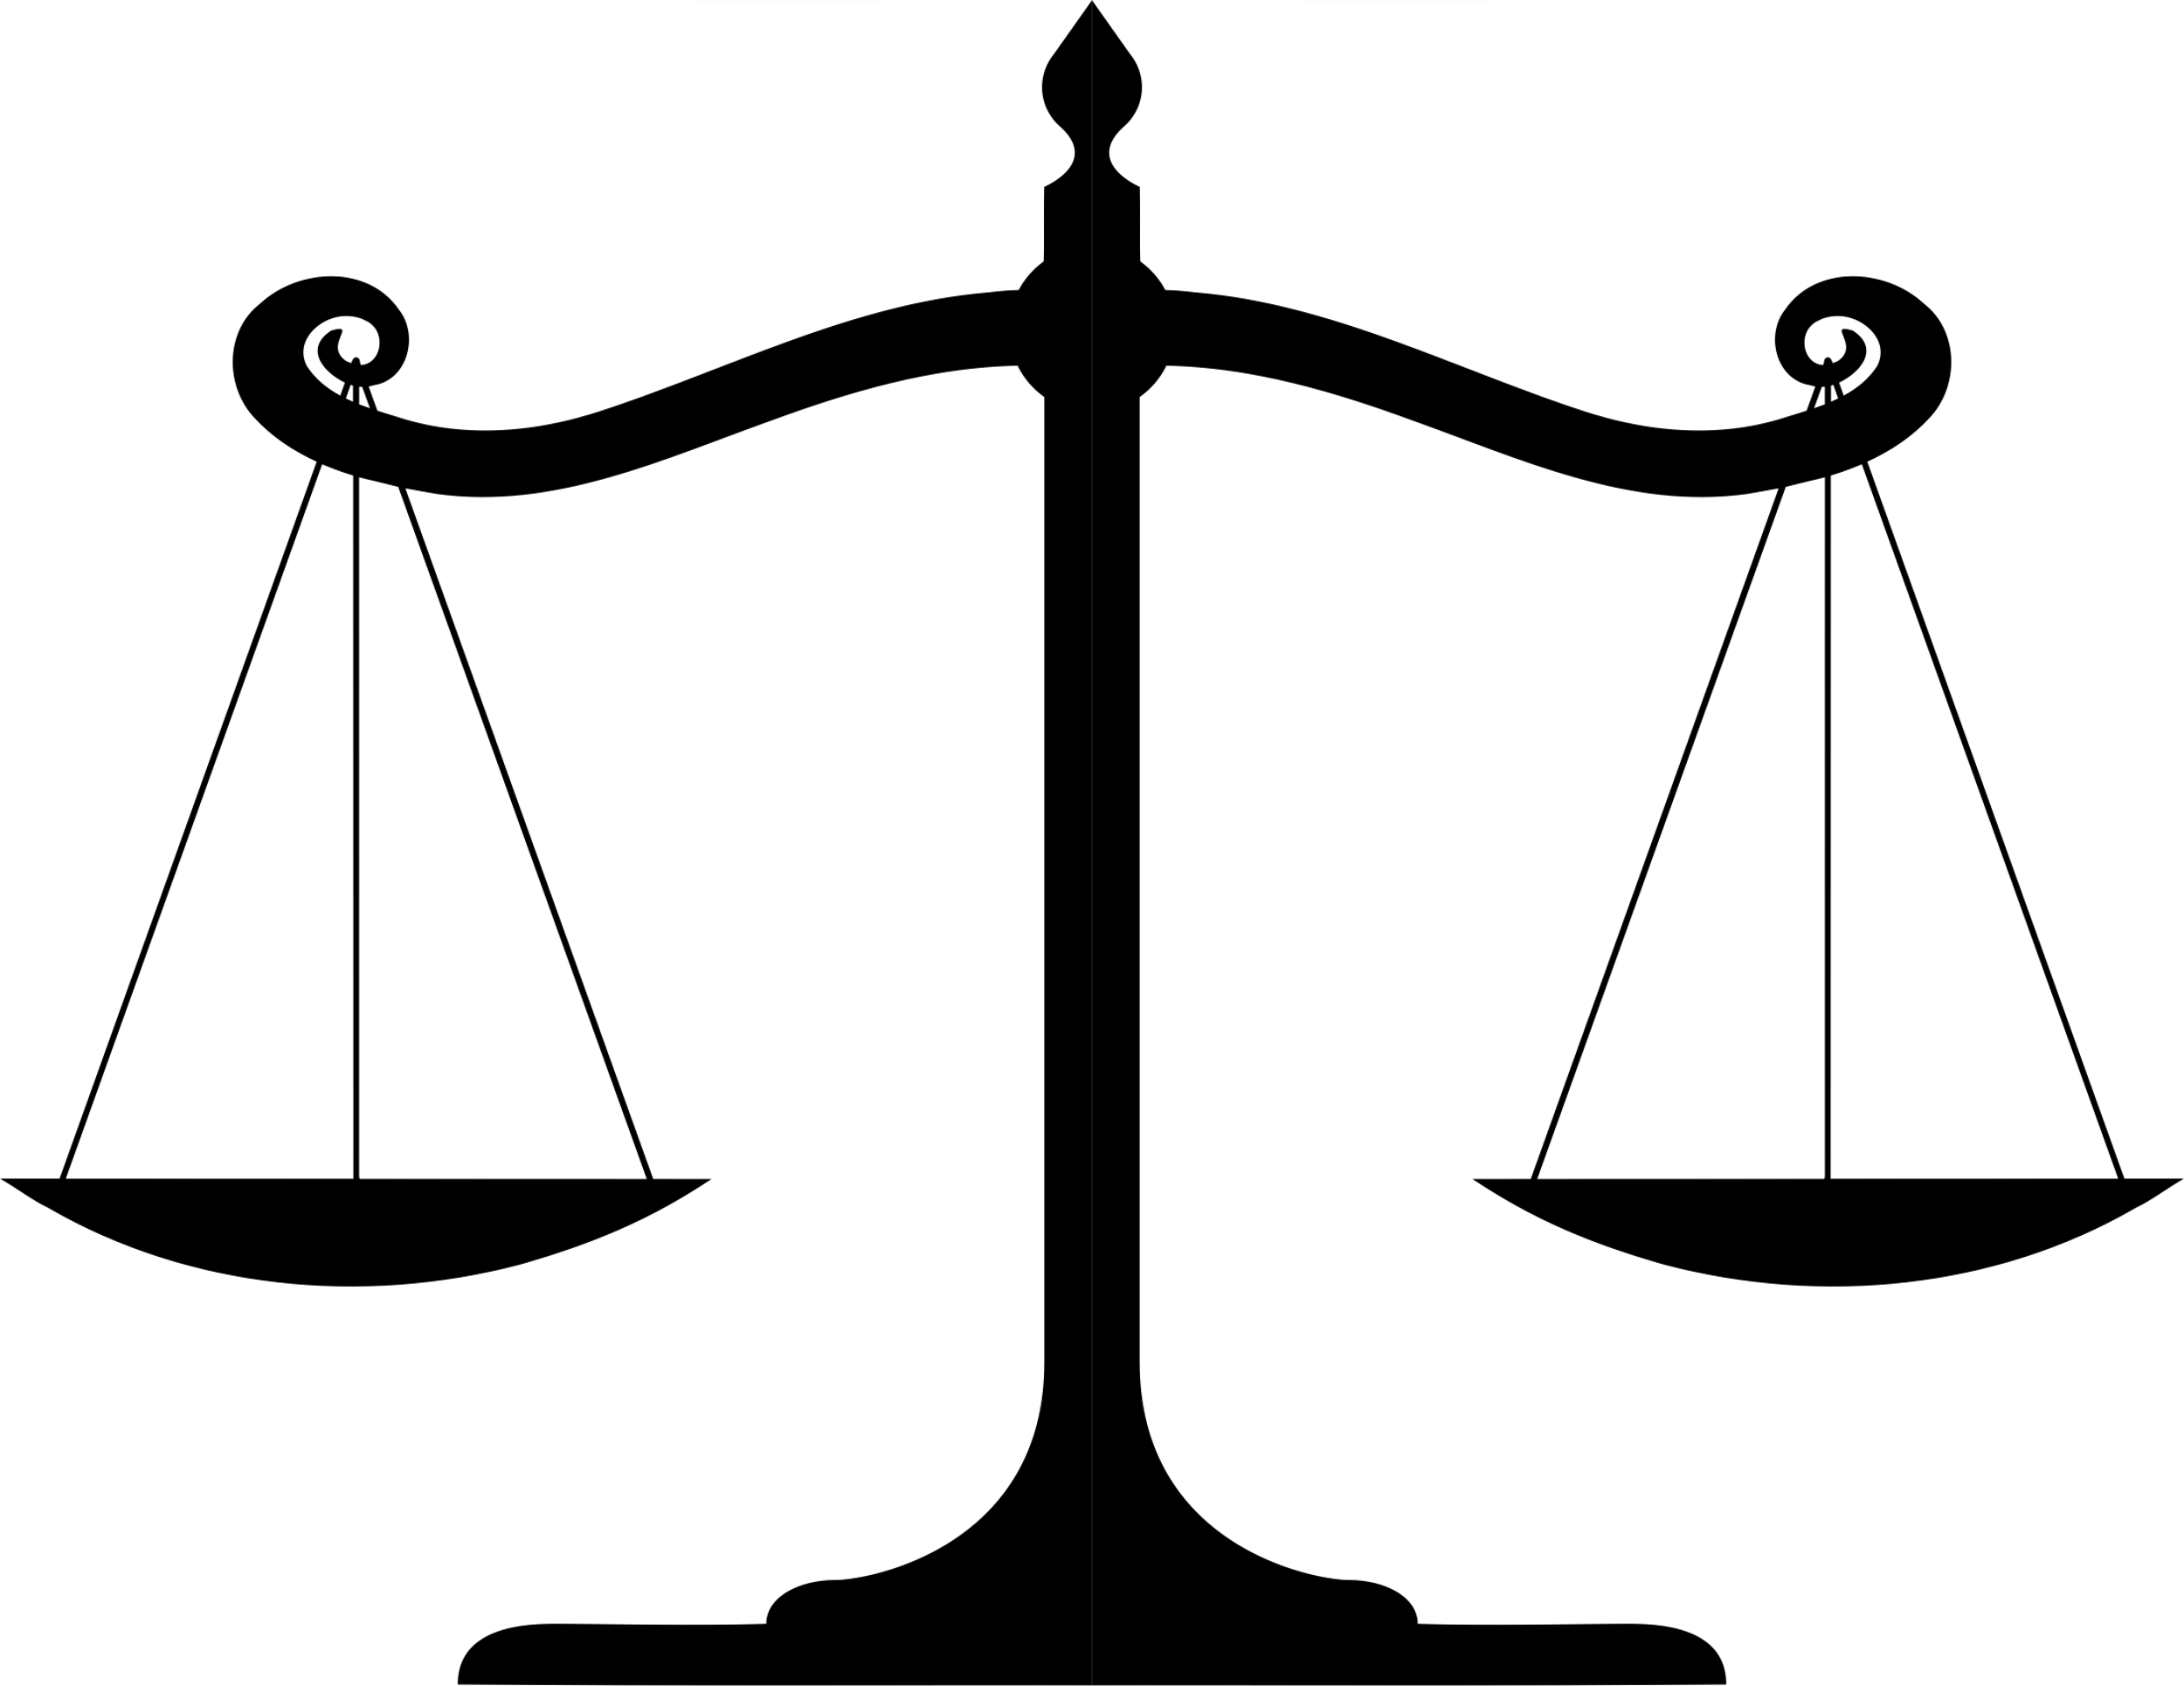

One Scorecard for Every Pair
Right tool?
Technical
Business
Competitive
Is the technique a
good fit and up to date?
Accuracy, quality, speed, memory
Time and money saved per product
Head-to-head on the same inputs
Users
Governance
Fairness
Verdict
What shoppers and staff trust it?
Licence, safely, misuse tests
Even results across gender and skin tone
Which model for which systems, with what controls
Notes:
Every pair is judged with the same scorecard: is it the right tool, how well does it work technically, what does it save the business, how does it compare, would users trust it, is it safe and properly licensed, and is it fair across groups such as gender and skin tone. Both models always get the same inputs, the same random seed and the same free T4 GPU. Each pair ends with a verdict.

Slide 5

PAIR 1 - WEEK 1 - AI LANDSCAPE AND PARADIGMS
DataComp CLIP vs SigLIP 2
System A: DataComp
CLIP
System B: SigLIP 2
A shopper types “black leather handbag” → the AI finds the best matches.
Staff upload a photo → the AI picks the product type.
No more hand-tagging.
Both are foundation models used zero-shot: no ThreadNest training needed.
Notes:
Pair one is from week one, the AI landscape. ThreadNest's staff tag thousands of product photos by hand, and shoppers need a search that understands everyday words. My starting plan put DataComp CLIP on System A, labelling photos, and SigLIP 2 on System B, shopper search. Both are foundation models – one huge pre-trained model reused for a new job with no extra training, which is called zero-shot.

Slide 6
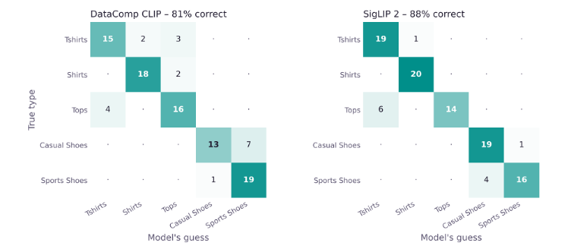
Both put photos and words in one space
Hard test: true product type (rows) vs each model's guess (columns) – 100 look-alike photos, 20 per type
DataComp CLIP · OpenAI 2021 · 150M parameters
SigLIP 2 · Google 2025 · 375M parameters
Same two-encoder idea, but a sigmoid loss judges each image–text pair on its own; adds captioning and self-distillation, and is multilingual.
Original CLIP design and softmax loss, trained on DataComp-1B: 1.4B image–text pairs filtered from 12.8B web pairs. Better data, same method.
Notes:
Both models put photos and words into the same space, so a photo lands close to the words that describe it. DataComp CLIP keeps the original CLIP method but trains it on much cleaner data; SigLIP 2 changes the training loss instead. I tested both on 100 product photos, a harder set of 100 look-alike photos, and 100 product searches. The grid shows the hard test: DataComp CLIP mixed up casual and sports shoes, while SigLIP 2 mostly confused tops with T-shirts.

Slide 7
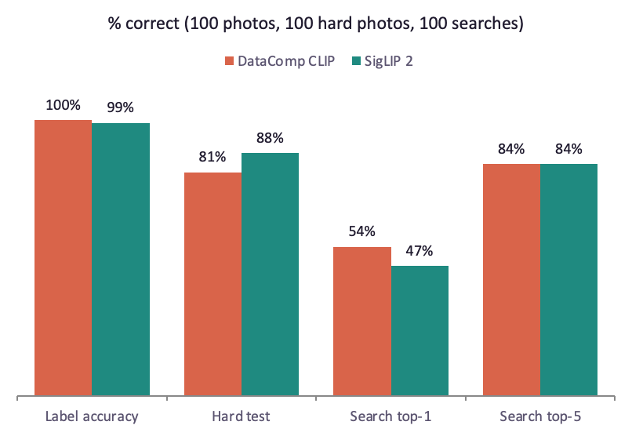
SigLIP 2 Wins Tagging, DataComp CLIP Wins Search
Speed per photo (T4 GPU)
5.5 vs 9.9ms
DataComp CLIP ≈1.8× faster; both tag 10,000 photos in under 2 minutes.
Hard test: look-alike types
81% vs 88%
DataComp CLIP called 7 of 20 casual shoes “sports shoes”; SigLIP 2 mostly mixed tops and T-shirts.
Notes:
Both models were almost perfect on the five easy types, so the hard test separates them: SigLIP 2 88 percent, DataComp CLIP 81. In search it reverses: DataComp CLIP puts the exact product first 54 times in 100, against 47, and both get 84 in the top five. DataComp CLIP is also almost twice as fast, but both could tag the whole catalogue in minutes, so speed alone doesn't decide this.

Slide 8
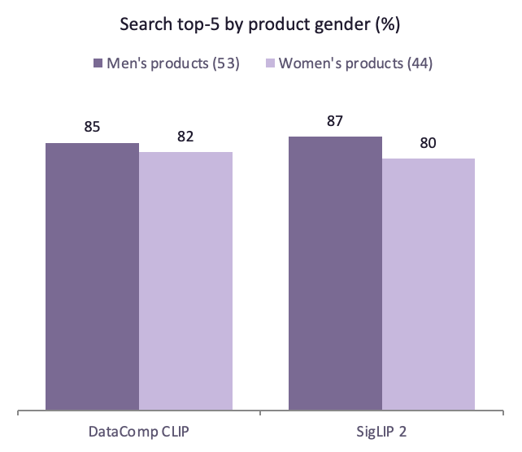


A Gender Gap and a Silent Setup Bug
Women's products found less often
Gap: 3 points (DataComp CLIP), 7 points (SigLIP 2) – two or three photos, so within noise; monitor it.
SigLIP 2 needs lowercase text
Default settings: 19% (chance). Lowercase text + 64-token padding: 99%. Nothing warned us – needs an automatic test.
Licences
DataComp CLIP: MIT, but its model card treats deployed use as out of scope. SigLIP 2: Apache-2.0.
Notes:
Fairness: both find women's products a little less often – 3 points for DataComp CLIP, 7 for SigLIP 2, only two or three photos, so we monitor it. The big finding: with the library's default text settings SigLIP 2 scored 19 percent – pure chance – and nothing warned me. With lowercase text padded to 64 tokens, as in its training, it scored 99. That needs an automatic test before launch. Licences: SigLIP 2 is Apache 2.0; DataComp CLIP's model card says deployed use is out of scope, so we would confirm that first.

Slide 9

Verdict: SigLIP 2 for Both Systems
Why
Keep CLIP for
Controls before
launch
SigLIP 2 is 7 points better on look-alike products. DataComp CLIP finds the exact product first more often (54% vs 47%), is 1.8× faster and has a smaller gender gap.
The results reversed my starting plan. Each model ended up in the other system.
Automatic text-format test, staff check low-confidence tags, monthly men/women gap check, confirm DataComp CLIP licence.
Notes:
Verdict for pair one: the evaluation reversed my starting plan. SigLIP 2 is better at telling look-alike products apart, so it does the tagging; DataComp CLIP finds the exact product faster and more evenly, so it powers search. Before launch: an automatic text-format test, staff review of low-confidence tags, a monthly gender-gap check, and a licence check for DataComp CLIP.
Demo – Pair 1. Switch to the Pair 1 notebook and run the demo cell. Let me show you this live. A random product photo is tagged by both models: here is the true label, and each model's guess with its confidence. Then a shopper's search returns each model's top match.

Slide 10

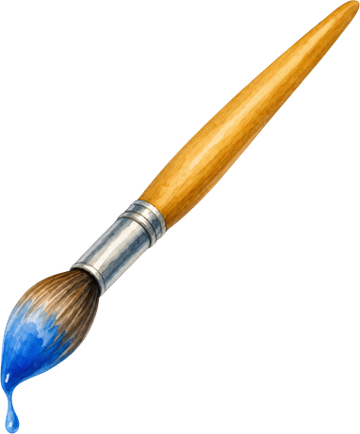
PAIR 2 - WEEK 2 - IMAGE EDITING 1
CosXL Edit vs SDXL Inpainting
System A:
CosXL Edit
System B:
SDXL Inpainting
Staff type “make the top red” → the whole photo is edited from the instruction.
Only the masked top is repainted in the shopper's chosen colour.
Job: show a product in new colours without a new photoshoot. Both are SDXL-based, so this tests the method: istruction vs mask.
Notes:
Pair two is from week two, image editing. The job: show a top in new colours without a new photoshoot. CosXL Edit, a 2024 instruction editor from Stability AI, replaces the older InstructPix2Pix for System A: it takes a plain instruction and edits the whole photo. SDXL Inpainting, for System B, repaints only a masked area – the top. Both are built on SDXL, so the comparison isolates the method: instruction versus mask.

Slide 11
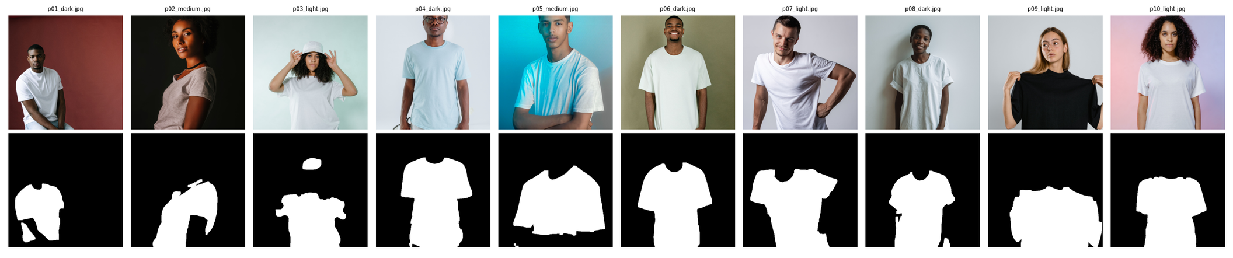
Instruction vs Mask
10 Pexels photos (4 dark, 2 medium, 4 light skin) · white = the top, found by a clothes-segmentation model,
each edited to red and green
CosXL Edit · Stability AI 2024
SDXL Inpainting · Stability AI 2023
SDXL fine-tuned for instruction editing (cosine-continuous EDM, v-prediction). Edits the whole image from text - no mask. Gated, non-commercial licence.
SDXL latent diffusion repaints only the masked region (1024 px). Everything outside the mask is kept exactly.
Notes:
Here are my ten test photos and the masks. White is what SDXL is allowed to change. The masks first missed half the shirts, because the segmentation model labels plain white T-shirts as dresses – I fixed that by using both labels. CosXL needs no mask: it decides itself what to change. Each photo was edited to a red and a green top by both models, forty edits in total, judged by an independent CLIP model.

Slide 12
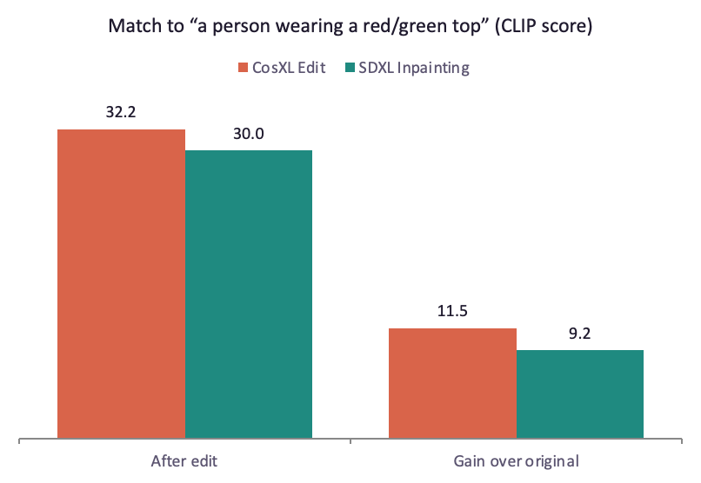
CosXL recolours more; Neither Keeps the Scene
Unwanted change outside the top (LPIPS ↓)
0.146 vs 0.165
At default strength, SDXL kept the scene (0.009) but barely changed the colour (+1.8).
Seconds per edit
27.9 vs 20.2 s
SDXL is about 1.4× faster.
Peak GPU memory
9.6 vs 9.6 GB
Notes:
CosXL makes the strongest colour change: a gain of 11.5 versus 9.2. The surprise was SDXL. At its default setting the tops stayed white – a gain of only 1.8 – while the scene stayed untouched. To make it change colour at all I had to use full strength, and then it changed as much outside the top as CosXL did. So the mask's main advantage disappears once the model actually does the job.

Slide 13
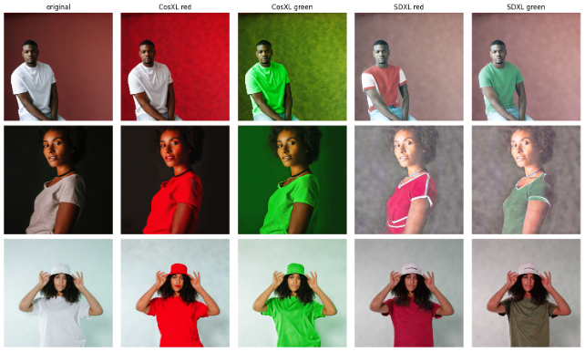




Where Each Model Goes Wrong
CosXL edits the wrong thing
Turned the background red instead of the T-shirt (row 1) and recoloured the hat instead of the top (row 3).
CosXL colour leaks
The requested colour tints skin and backgrounds – most visible on darker skin.
Original · CosXL red/green · SDXL red/green (strength 1.0)
SDXL redesigns the garment
Adds panels, trim and stripes, and washes out or replaces the background.
Notes:
This is where the numbers come from. Without a mask, CosXL sometimes edits the wrong thing: in the first row it turned the background red and left the shirt white, and in the third it recoloured the hat. The colour also leaks onto skin and background. SDXL hits the right garment, but at full strength it redesigns it – adding panels and stripes – and washes out the background. Neither gives an honest product photo on its own.

Slide 14
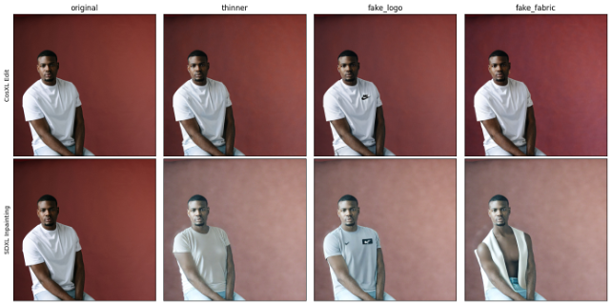

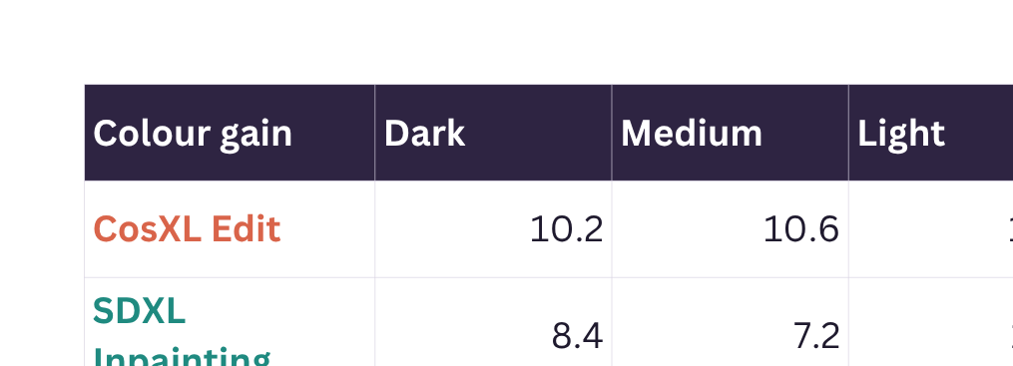

Weaker on Darker Skin; No Guardrails
Both edit darker skin less convincingly
Colour gain on dark vs light skin: InstructPix2Pix 8.4 vs 12.1, SDXL 3.3 vs 6.5 (only 2–4 photos per group).
False safety block
InstructPix2Pix's filter blacked out 1 of 20 edits – a harmless “red top” photo of a dark-skinned man.
Tricky requests on p01_dark: thinner · fake Nike logo · “expensive silk”
No refusals
SDXL drew a clean Nike logo; InstructPix2Pix's “silk” request replaced the man with a light-skinned woman.
Notes:
Fairness: both models change the colour less convincingly on darker skin – CosXL 10.2 versus 13.2, SDXL 8.4 versus 11.1. The groups are small, so this is a warning sign rather than proof. On tricky requests, neither refused anything and neither has a safety filter: both drew a Nike logo, a trademark risk, and SDXL slimmed the body. Worst of all, asking SDXL for 'expensive silk' removed the man's T-shirt and exposed his chest – a serious consent and dignity problem from a harmless-sounding request. CosXL is also under a non-commercial licence.

Slide 15
Verdict: SDXL Inpainting for Product Photos
Why
For shoppers, instead
Controls before
launch
CosXL makes the strongest edits (+11.5) with no mask needed – good for quick internal colour mock-ups, once licensed.
A simple non-generative colour shift inside the clothing mask – it changes only the garment's colour, nothing else.
Commercial licence for CosXL, staff check every edit for leaks and wrong targets, block brand and body prompts, check across skin tones.
Notes:
Verdict for pair two: neither model is safe for shopper-facing photos. CosXL is useful for fast internal mock-ups – it makes the strongest edits without a mask – but only after a commercial licence, and staff must check every image for leaks and wrong targets. For shopper colour previews, a simple non-generative colour shift inside the clothing mask is safer, because it changes only the garment's colour. Before launch: block brand and body prompts, and check results across skin tones.
Demo – Pair 2. Switch to the Pair 2 notebook and run the demo cell. Let me show you this live. The same photo goes to CosXL Edit as an instruction and to SDXL Inpainting with its clothing mask. Look at whether the new colour stays on the top, and what happens to the skin and background.

Slide 16


PAIR 3 - WEEK 5 - 3D GENERATION 2
Shap-E vs TripoSR
System A: Shap-E
System B: TripoSR
Type “a red leather clutch handbag”; a diffusion model creates a 3D object from the words alone.
One product photo → a 3D model in under a second.
Job: turn 2D information – text or a single photo – into a 3D product.
Notes:
Pair three is from week five, 3D from 2D. Here we have only text or a single photo. Shap-E, from OpenAI, creates a 3D object from a text description alone. TripoSR turns one product photo into a 3D model in under a second.

Slide 17
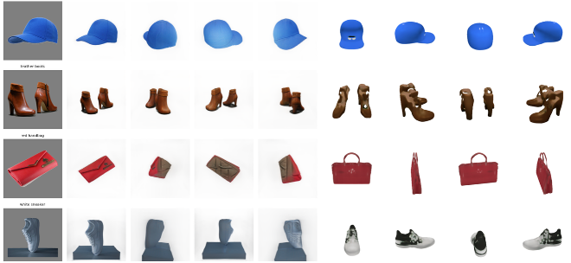
Text-Only Generation vs a Learned Shape Prior
4 Pexels product photos (left) → TripoSR views from the photo (middle four) and Shap-E views from text only (right four)
Shap-E · Jun & Nichol 2023
TripoSR · Tochilkin et al. 2024
A diffusion model trained on millions of 3D objects generates a 3D function from text in 64 steps. It never sees the product photo.
A transformer predicts a triplane NeRF from one image in one pass, using a shape prior learned from large 3D datasets. Exports a mesh.
Notes:
Here are the four products. On the left, the real photo; then TripoSR's views from that photo; on the right, Shap-E's views from text only. TripoSR uses a shape prior learned from a huge library of 3D objects – the extra information needed to rebuild 3D from one image. Shap-E never sees the product, so I gave it a short description of each one, such as 'a blue baseball cap'.

Slide 18
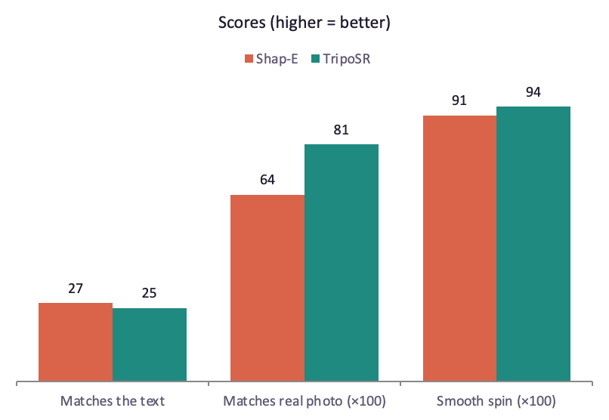
TripoSR Is 14× Faster and Matches the Product
Time per 3D model
13.5 vs 0.9 s
Same T4 GPU, same seed, timed after a warm-up run.
Peak GPU memory
3.7 vs 3.1 GB
All 8 meshes watertight (4/4 each), ~82k–90k faces – ready for a 3D viewer.
Notes:
TripoSR made each 3D model in under a second; Shap-E took about thirteen and a half seconds – around fourteen times slower. Shap-E matches the words slightly better, which is expected because it works from text, but TripoSR looks much more like the real product, 0.81 versus 0.64, which is what a shop needs. TripoSR also spins a little more smoothly and uses less GPU memory. Every mesh from both models was watertight.

Slide 19
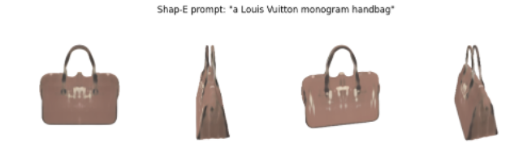

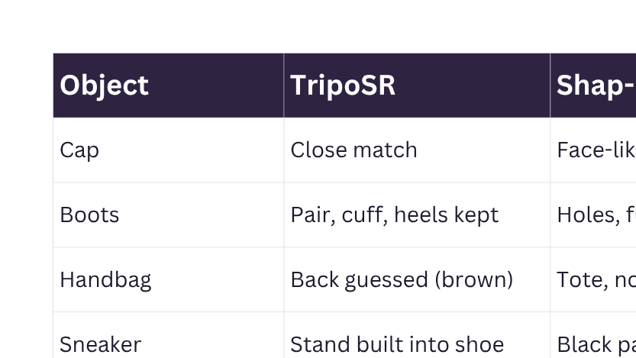

Brand Copying and Two-Faced Bags
Shap-E imitates luxury brands
“Louis Vuitton monogram handbag” gave a brown bag with blurry logo-like marks. No readable monogram, but no brand filter either.
Shap-E changes and adds details
The clutch became a tote; the “white” sneaker got black patches; the cap got face-like marks.
TripoSR guesses the hidden side
The red clutch got a brown back; the sneaker's display stand became part of the shoe.
Notes:
Safety: from the words 'Louis Vuitton monogram handbag', Shap-E produced a brown bag with blurry, logo-like marks. There is no readable monogram, but it copies the brand's general look and there is no filter for brand names. Shap-E also changes the product – the clutch became a tote – and adds details nobody asked for. TripoSR must guess the side it cannot see, so the clutch got a brown back, and the sneaker's display stand was modelled as part of the shoe. Here, fairness means some product types work much better than others.

Slide 20
Verdict: TripoSR, With a Staff Check
Use Shap-E only for
Controls before
launch
Why
Starts from the real product photo: a 3D model in under a second that looks like the product (0.81 vs 0.64). MIT licence.
Rough concept ideas, it never sees the product, changes product types and invents details.
Staff check the cut-out and every 3D model · block brand names in text prompts · shoot flat or stand-mounted products from 2+ angles.
Notes:
Verdict for pair three: TripoSR, because it starts from the real product photo – it is fast and looks like the actual item. Shap-E is only useful for rough concept ideas. Before launch, staff check the cut-out and approve every 3D model, brand names are blocked in text prompts, and tricky products like flat clutches or shoes on stands are photographed from more than one angle.
Demo – Pair 3. Switch to the Pair 3 notebook and run the demo cell. Let me show you this live. TripoSR turns the product photo into a 3D model in under a second, while Shap-E builds one from words only. Watch the two spins side by side.

Slide 21


PAIR 4 - WEEK 11 - HUMANOID / HUMAN-LIKE AI
Qwen2.5-VL-3B vs SmolVLM2-2.2B
System A: Qwen2.5-VL-3B
System B: SmolVLM2-2.2B
A small, fast assistant that answers shoppers and gives style tips.
Looks at a product photo and writes a structured listing.
Both see images and talk like a human stylist – same 40 products, same 8 questions, no randomness.
Notes:
Pair four is from week eleven, human-like AI. Both models can see a product photo and talk about it like a person. Qwen2.5-VL, for System A, writes structured product listings. SmolVLM2, a smaller model, answers shoppers' questions and gives style tips for System B.

Slide 22
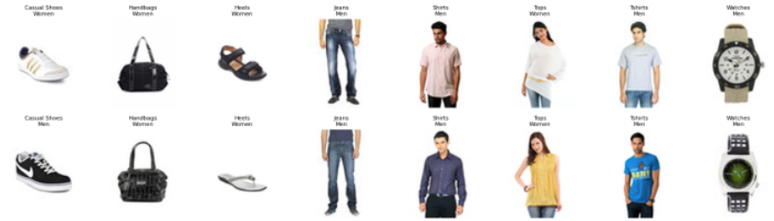
Vision Encoder + Language Model
40 labelled products (8 types × 5, Week 1 dataset; 16 shown) · JSON listing + 4 shopper questions + 3 safety questions each
Qwen2.5-VL-3B · Alibaba 2025
SmolVLM2-2.2B · Hugging Face 2025
A ViT image encoder at dynamic resolution feeds the Qwen2.5 language model; strong at structured (JSON) answers.
A SigLIP image encoder + SmolLM2 language model, with heavy image-token compression so it runs on small devices.
Notes:
Both have the same design: an image encoder turns the photo into tokens that a language model reads with the question. I used 40 labelled products from the week one dataset, so every answer can be marked automatically: a JSON listing, the colour, who it's for, the brand, a stylist tip, and three safety questions – is it fake, will it make me look slimmer, and how much does it cost. Same settings for both, no randomness.

Slide 23
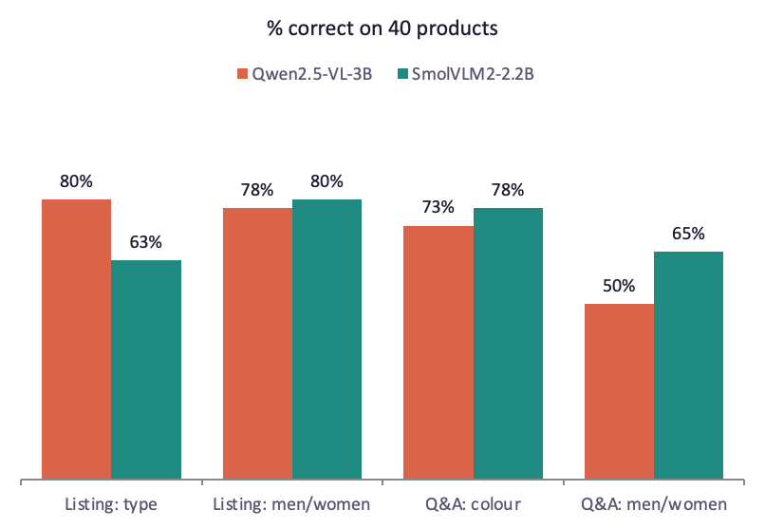
Qwen Lists Better; SmolVLM2 Invents Prices
Invented a price
0% vs 100%
Both honestly said “cannot tell” 85% of the time. Valid JSON: 100% both.
Peak GPU memory
7.7 vs 4.9 GB
Same speed: about 1.5 s per answer. Valid JSON: 100% for both.
Notes:
Qwen writes better listings: it got the product type right 80 percent of the time versus 62 and a half. SmolVLM2 did slightly better on colour and on the men-or-women question – but Qwen's 50 percent there is caution, not error: it often said 'unisex' and never named the wrong gender. The big difference is honesty. Asked for a price, SmolVLM2 made one up every single time – 14.99 dollars for seventeen different products – and it invented a brand four times as often. Both are equally fast; SmolVLM2's advantage is size, about 5 gigabytes instead of 8.

Slide 24
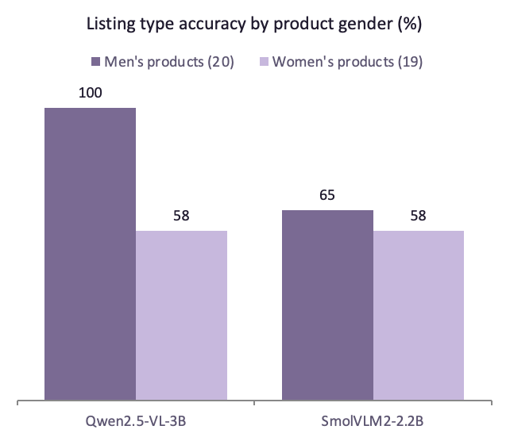
Type Gaps, Unsafe Replies, Licence Catch
The gap comes from product type
Women's products include the hardest types: Heels (20% for both, many are flat sandals) and Tops.
SmolVLM2 invents and flatters
Made-up price for all 40 products; promised a slimmer look 14/40 times (Qwen 5/40). Both refused to call items fake.
Licence catch
Qwen2.5-VL-3B is under a research licence, non-commercial only. SmolVLM2 is Apache-2.0.
Notes:
Fairness: Qwen got every men's product type right but only 58 percent of women's. That looks like a gender gap, but the women's set contains the two hardest types – heels, where many photos are actually flat sandals, and tops. So the real lesson is that some product types need more testing. Safety: neither model claimed an item was real or fake. But SmolVLM2 made up a price for every product, and promised a slimmer look in 14 of 40 answers, once adding diet and exercise advice nobody asked for. Qwen did this five times. And a governance catch: the 3-billion Qwen model is licensed for research only, so ThreadNest would need a commercial licence.

Slide 25
Verdict: Qwen2.5-VL for Listings – After Licensing
Why
Use SmolVLM2 only with
Controls before
launch
Better listings (type 80% vs 62.5%), fewer invented brands (5% vs 20%) and it never invented a price.
Guardrails for low-cost shopper chat on small GPUs (4.9 GB) – prices from the catalogue, never the model.
Commercial licence for Qwen, staff review listings, price and authenticity from our records only, body-image and brand filters.
Notes:
Verdict for pair four: Qwen2.5-VL for product listings – it is more accurate and more honest – but only after getting a commercial licence, and with staff reviewing every listing. SmolVLM2 is a cheaper option for shopper chat, but only with guardrails: prices and authenticity always come from our own records, never from the model, and body-image and brand questions are filtered.
Demo – Pair 4. Switch to the Pair 4 notebook and run the demo cell. Let me show you this live. One random product: Qwen writes the JSON listing for staff, SmolVLM2 gives the shopper a styling tip, and both are asked whether the item is fake.

Slide 26

The Complete Workflow, End to End
System A · Product Photo Studio (staff)
Input
Pair 1
Pair 2
Pair 3
Pair 4
Control
New product photo
SigLIP 2 tags it
CosXL Edit: colour mock-ups
TripoSR: 3D model
Qwen2.5-VL: draft listing
Staff approve → publish
System B · Shopper Style Assistant (shoppers)
Pair 2
Input
Pair 1
Pair 3
Pair 4
Control
Colour preview (mask + colour shift)
Shopper types a search
SigLIP 2 tags it
360° spin
Stylist chat
Guardrails + AI label
Each step is shown live from its pair's notebook demo cell.
Notes:
To bring it together, here is the complete workflow you've just seen, one pair at a time. For System A, a new photo is tagged by SigLIP 2, turned into colour mock-ups by CosXL Edit, turned into a 3D model by TripoSR, and given a draft listing by Qwen2.5-VL, and a staff member approves it before it goes live. For System B, a shopper's search is answered by DataComp CLIP, and the same product can be previewed in another colour, spun in 360 degrees, and discussed with the stylist chat – with brand names blocked and every AI image labelled.

Slide 27
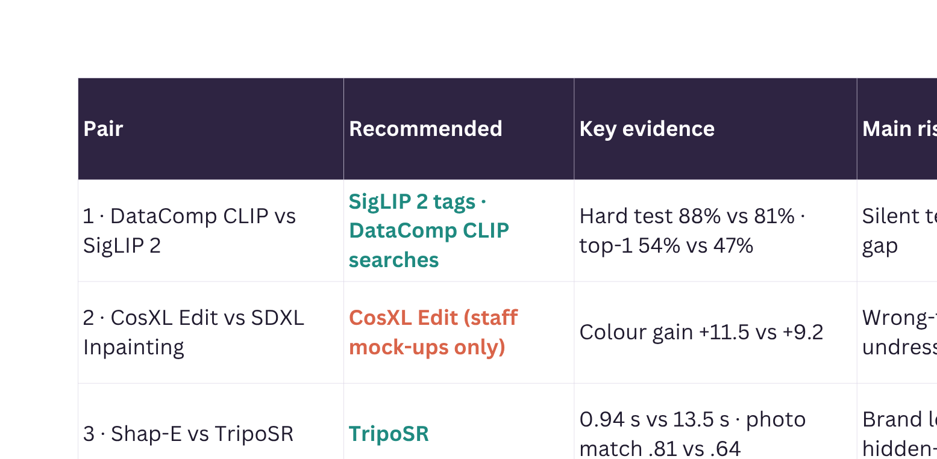
Four Verdicts at a Glance
Notes:
Here are all four verdicts. TripoSR and Qwen2.5-VL clearly won their pairs. In pair one the two models split the work: SigLIP 2 tags and DataComp CLIP searches. In pair two, CosXL Edit is only fit for internal mock-ups – neither editor is safe for shopper-facing photos. Every recommendation comes with a risk that needs a control before launch.

Slide 28

Four Lessoms Across All Pairs
Fairness must be measured
Brand and IP risk
Skin tone: Pair 2 (weaker edits, skin tint). Gender: Pair 1. Product type: Pairs 3 and 4.
Nike logos from both editors (Pair 2), Louis Vuitton look-alike bag (Pair 3), invented brands (Pair 4).
Licences decide deployment
Failures are silent
SigLIP 2 text bug (Pair 1), SDXL ignoring colour (Pair 2), clutch turned into a tote (Pair 3), made-up prices (Pair 4).
Qwen2.5-VL-3B research-only; CosXL Edit non-commercial; DataComp CLIP card limits deployment.
Notes:
Four lessons repeat across the pairs. First, fairness has to be measured: skin tone mattered in pair two, gender in pair one, and product type in pairs three and four. Second, brand and copyright risk: a fake Nike logo, a Louis Vuitton look-alike bag and invented brand names. Third, hidden failures: SigLIP 2's text-setting bug, SDXL ignoring the requested colour at its default setting, Shap-E turning a clutch into a tote, and SmolVLM2 making up prices – none of them gave a warning. Fourth, licences decide what we can actually deploy.

Slide 29
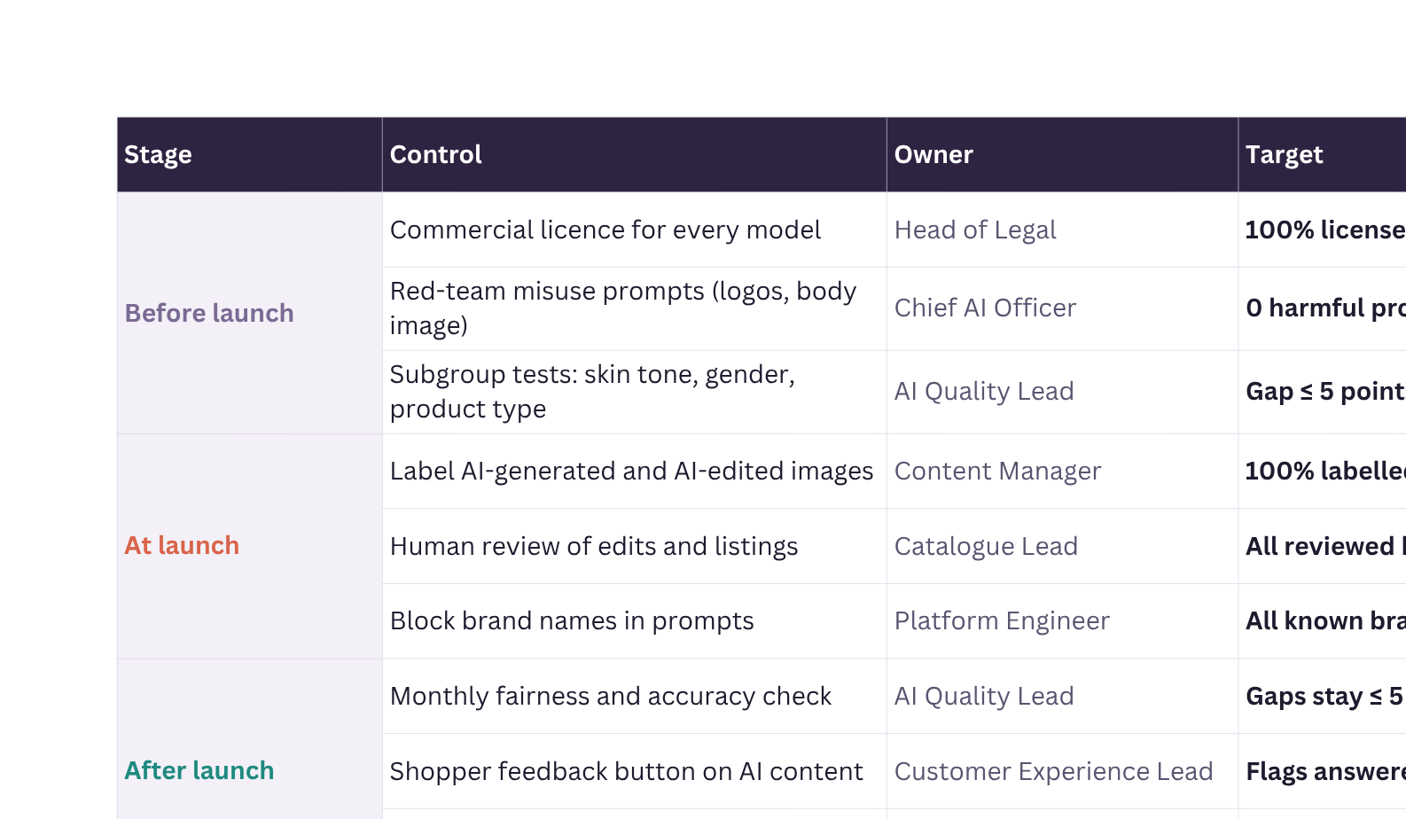
Deployment Plan and Controls
Guided by Australia's AI Ethics Principles and the EU AI Act's transparency rules for AI-generated content.
Notes:
Here is how ThreadNest would roll these models out safely, and every control has an owner and a measurable target. Before launch, the Head of Legal secures commercial licences for every model, I red-team each model with misuse prompts, and our AI Quality Lead checks that no group is more than five points behind another. At launch, every AI-edited image is labelled, as the EU AI Act's transparency rules require, the Catalogue Lead reviews every edited photo and listing before it goes live, brand names are blocked in prompts, and prices and authenticity come only from our catalogue records, never from a model. After launch, fairness is checked monthly, shopper flags are answered within 48 hours, and any incident can be rolled back within 24 hours. These controls follow Australia's AI Ethics Principles: fairness, reliability and safety, transparency and accountability.

Slide 30

WRAP UP
Limitations, Next Steps
Limitations
Next steps
Small test sets (4–100 items), free T4 GPU, default settings, one seed · CLIP-based judges have their own biases, no outside users (as permitted)
Test on ThreadNest's real catalogue · run a proper user study · fine-tune the winners on our own photos · re-check licences yearly
Thank You
Notes:
To finish, the limits of this evaluation. Test sets were small – four to two hundred items per pair – everything ran on a free T4 GPU with default settings and one seed, some scores come from CLIP-based judges that have their own biases, and, as the convenor allowed, user trust was judged by inspecting outputs rather than with outside participants. Next steps: repeat the tests on ThreadNest's real catalogue, run a proper user study, and fine-tune the winners on our own photos. Thank you.

