Slide 1
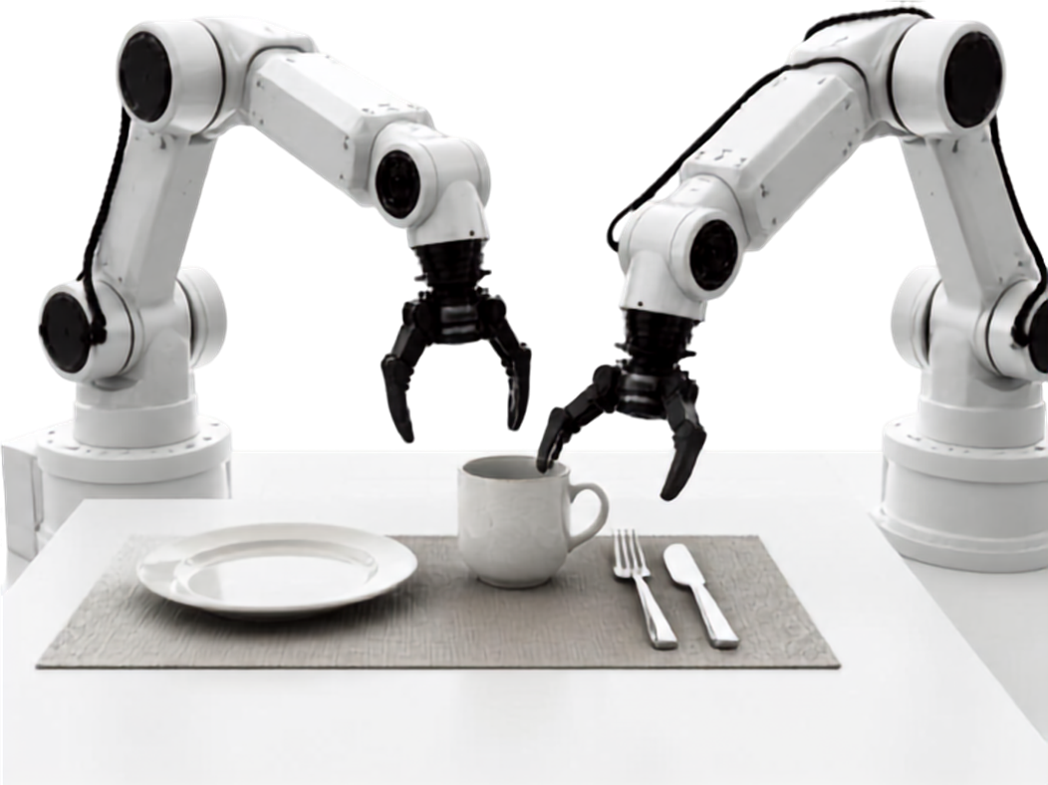
LABLAB AI INFRA SUMMIT
TableGuard-Lite
Safety-Aware Closed-Loop Bimanual VLA for Reliable Table Setting.
Lablab AI Infra Summit
Online Track
Team TableGuard-Lite
Syeda Fizza Rubab
PhD Student
Saira Asghar
AI Engineer
Rana Zain
AI/ML Engineer
MuJoCo • SO-101 • VLA • Intel

Slide 2


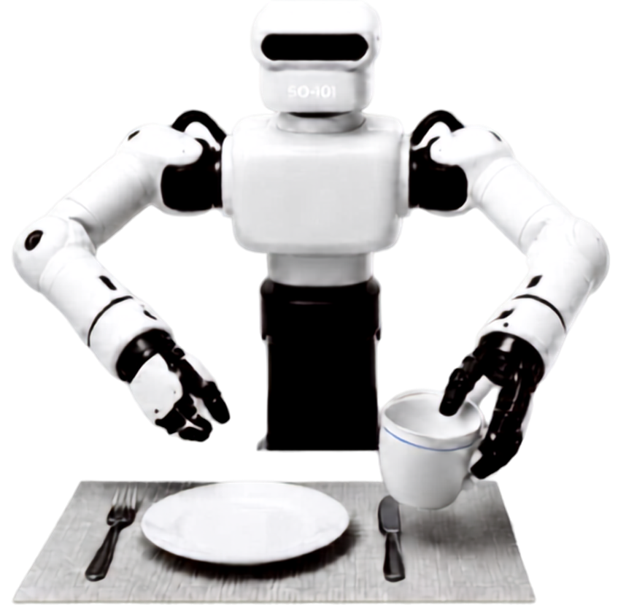










The Problem: Safe, Verifiable, Goal-Preserving Execution
Multi-modal policies can generate table-setting actions, but bimmanual execution remains fragile.
1
Cascading failures
Unsafe recovery can fix a tilted cup while disturbing an aligned plate or fork.
2
Blind execution
Oclusions or stale video frames >10 s can cause the policy to act without reliable perception.
3
Unverifiable decisions
Black-box outputs lack formal runtime states and bounded recovery behavior.
4
Edge latency
Heavy multi-modal models struggle to sustain 20 Hz control (>50 ms) on edge hardware.
The system must preserve completed goals, HOLD when perception is uncertain, bound repairs to <2 attempts, and meet the real-time control budget.

Slide 3
The Solution — TableGuard-Lite
Resilient Dual-Arm Safety Supervision with Real-Time Edge Acceleration
Perceive → Predict → Adapt → Guard → Execute → Replan
Adapter RMSE: 0.5449 → 0.2529 (53.6% reduction)
CORE VALUE PROPOSITION
TableGuard-Lite introduces a deterministic runtime supervisor that eliminates cascading manipulation failures,
enforces safe fail-stops during perceptual glitches, and runs in real-time on Intel edge silicon.
1
Deterministic State Machine
2
100% Goal Preservation Guarantee
CONTINUE / HOLD / REPAIR / STOP
100%
goal integrity
Evaluates sub-goal satisfaction at every 20 Hz control step. Replaces blind heuristic guessing with bounded, mathematical transitions.
Strictly isolates repairs to defective tableware without disturbing settled items. Eliminates cascading collisions and tableware spills.
Stops cascading failures
Protects settled goals
3
Safe HOLD During Perception Glitches
4
Real-Time OpenVINO Edge Pipeline
No Fake Execution
Sub-50ms
edge inference budget
116
TESTS
Automatically executes a safe HOLD when the gripper occludes the camera or frames drop (> 1.0s).
Sub-50ms inference budget on Intel Core Ultra (CPU / Arc GPU / AI Boost NPU). Zero-hardcoded portability backed by 116 automated unit tests.
Handles blind execution
Meets the edge latency budget

Slide 4

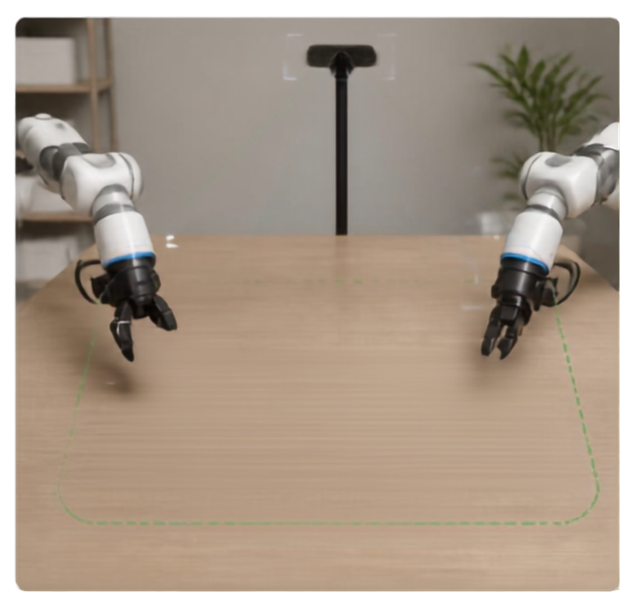
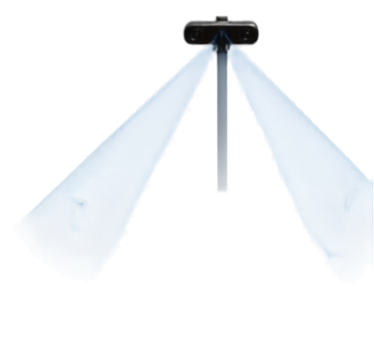





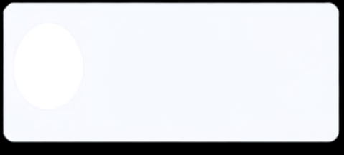
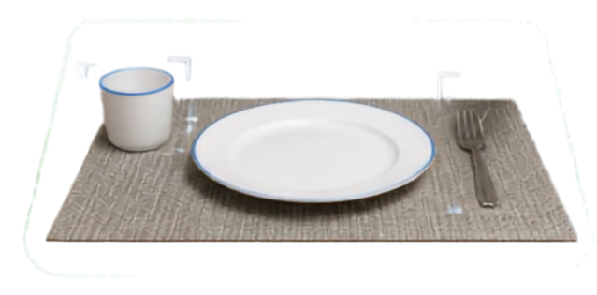








Use Case & Impact
Where it fits
Why it matters
1. Hospitality & service robotics
1. Protects the task goal
Preserves the plate and table state while the robot acts.
Safer table-setting and table-reset assistance in structured dining environments.
2. Robotics research labs
2. Stops unsafe continuation
A runtime supervisor can hold or stop execution when contact, collision, or joint-rate limits are approached.
A verifiable testbed for bimanual vision-language-action policies.
3. Edge AI deployment
3. Makes progress measurable
Real-time inference and safety supervision on Intel hardware without relying on cloud response time.
Learned Action Adapter: refines SmolVLA action chunks before safety supervision.
Separates verified capabilities from limitations and creates a clear path toward reliable end-to-end deployment.
SAFE OPERATING BOUNDARY
From generated actions to accountable execution.

Slide 5









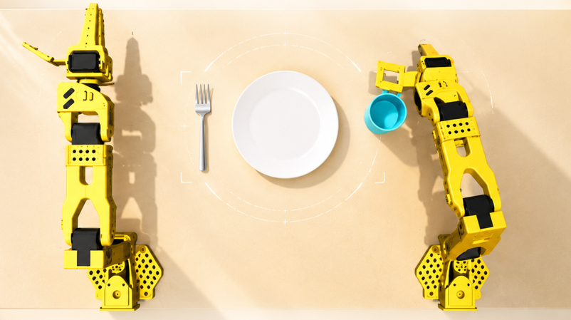




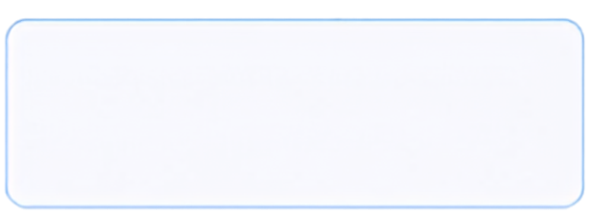
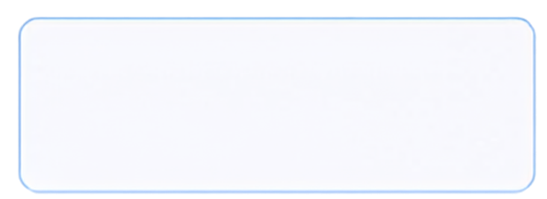


TableGuard-Lite System Architecture
Safety-aware closed-loop VLA architecture for bimanual manipulation
1
Inputs
2
SmolVLA Policy
3
Safety Supervisor
4
Dual SO-101 MuJoCo Execution
Two robot arms in MuJoCo
Natural-Language Instruction
+
3 RGB Cameras + 12-Joint State
20 × 12 Action Chunk
Joint-rate · collision · contact
Learned Action Adapter
Scene-preservation checks
fresh observations
failure states
Closed-Loop Replanning
5
6
Recovery-Oriented Learning
Execute 10 learned steps, then re-observe and replan
Failure states → targeted fine-tuning
Safety-aware closed-loop VLA architecture for bimanual manipulation with runtime supervision and recovery-oriented learning.

Slide 6
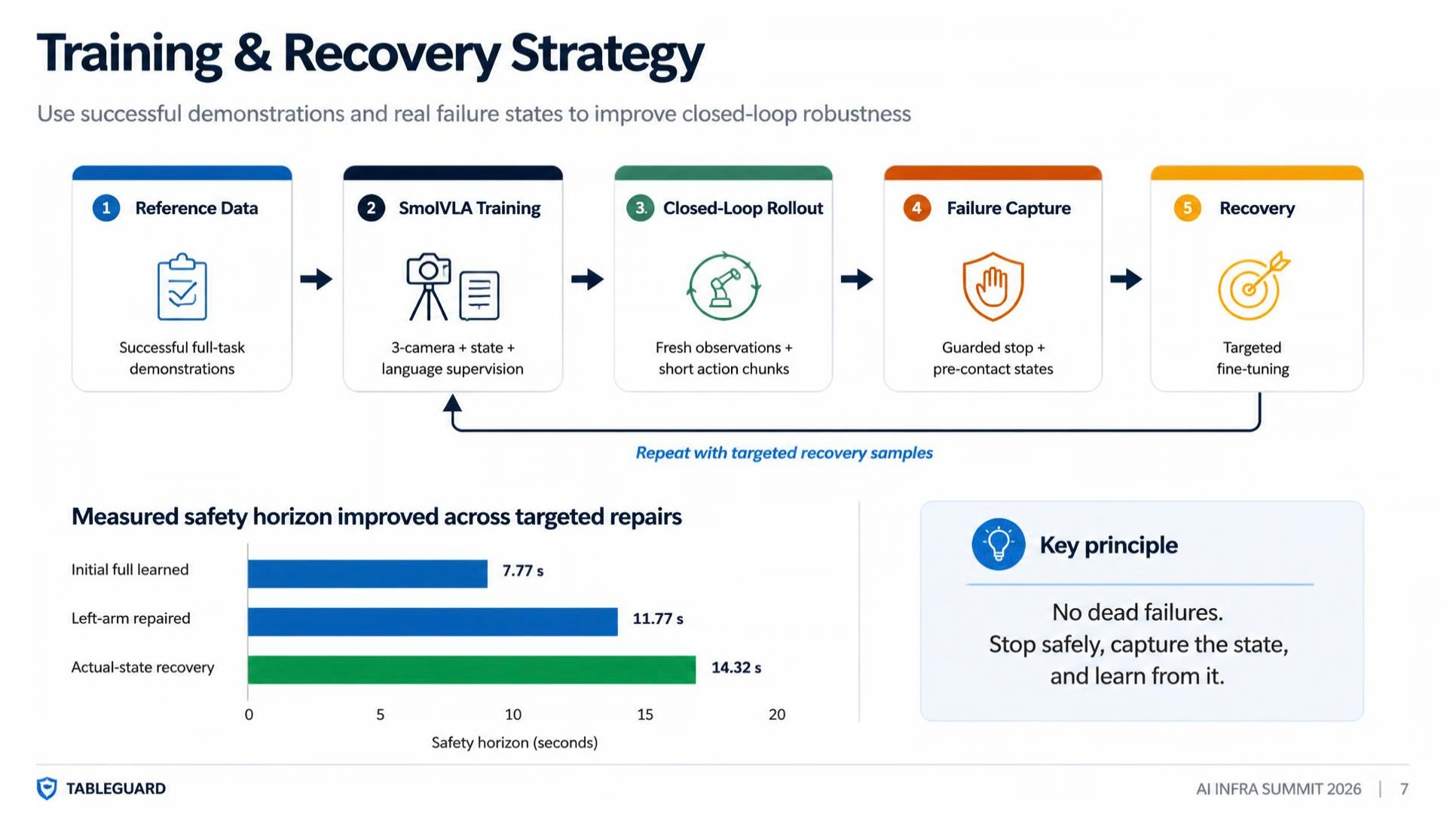

Slide 7
Results & Deployment Evidence
What is verified today — and what is not yet claimed
MuJoCo simulation • guarded execution • no real-robot claim
Full reference task — PASS
VERIFIED
15.07 s
VERIFIED
OpenVINO / Intel — PASS
VERIFIED
Cup right +25 mm, fork left −25 mm, plate preserved.
Safety horizon —
Final FP32 export, standalone IE, Intel CPU inference, numerical parity verified.
Final guard event: development_table / right_camera_box2
task_success = False
7.77 s → 11.77 s → 14.32 s → 15.07 s
Guarded closed-loop execution
GUARDED
Verification checklist
STATUS
✓
3-camera VLA pipeline
VERIFIED
✓
12-joint learned control
VERIFIED
✓
Runtime safety supervisor
VERIFIED
✓
Recovery-oriented training
VERIFIED
VERIFIED
The final learned rollout did not complete the task. Final guard event: development_table / right_camera_box2.
✓
OpenVINO deployment path
—
Full learned end-to-end task
NOT YET
Adapter RMSE ↓53.6% 0.5449 → 0.2529
Claim only what is verified.
≈94% safe-execution improvement • Final learned rollout: 302 policy calls

Slide 8
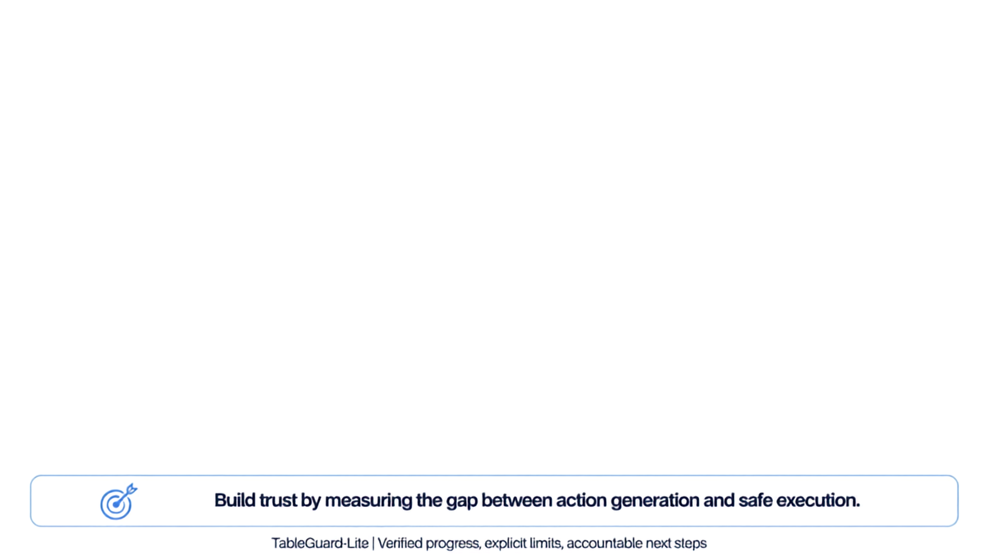



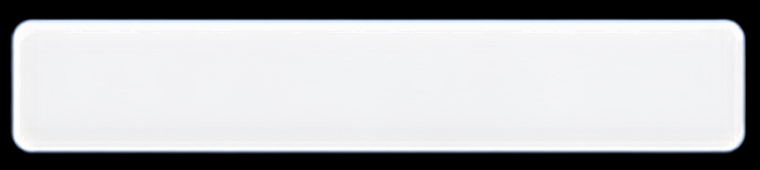





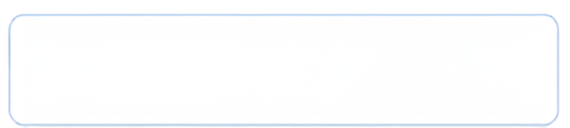











Limitations & Next Steps
HONEST STATUS
Next steps
Current limitations
1
Expand recovery data
Train and validate more recovery-oriented behaviors around contact, collision, and joint-to-edge cases.
1
Full learned end-to-end task — NOT YET
Completion not achieved.
2
Close the end-to-end gap
Improve policy and supervisor coordination until the complete table-setting sequence succeeds reliably under guardrails.
2
Safety intervention remains necessary
The supervisor stopped repeated left-finger/plate contact instead of allowing unsafe continuation.
3
Broaden validation
Test more table layouts, object placements, camera conditions, and repeated trials on real edge hardware.
Validation scope is still bound
3
Current evidence covers verified pipeline components, guarded execution, and deployment-path parity — not full production readiness.
4
Prepare deployment evidence
Report repeatable success, safety-stop frequency, latency, and failure-mode results before making broader claims.
Long-horizon bimanual action drift and geometry-contact risk remain unresolved.

