Slide 1
What is TESS?
Transiting Exoplanet Survey Satellite (TESS)
TESS is a NASA space telescope launched on 18 April 2018 to search for planets outside our Solar System.
Unlike traditional telescopes that take detailed images of planets, TESS continuously monitors the brightness of millions of stars. When a planet passes in front of a star, it blocks a small amount of light, creating a tiny dip in brightness called a transit.
By detecting these repeating dips, astronomers can identify and study exoplanets.
Key Facts
Agency: NASA
Launch Date: 18 April 2018
Mission: Search for transiting exoplanets
Observes: Millions of nearby bright stars
Main Data Product: Light Curves

Slide 2
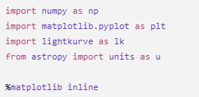
NumPy (np)Performs mathematical calculations and handles data.
Matplotlib (plt)
Creates graphs and visualises data.
Lightkurve (lk)
Downloads and analyses TESS light curves.
Astropy Units (u)
Handles astronomical units such as days, seconds, and distances.

Slide 3
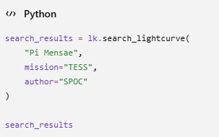
What does this code do?
Searches the TESS archive for observations of Pi Mensae.
Finds available light curve data.
Returns a list of observations.
Code Breakdown
"Pi Mensae" → Target star
mission="TESS" → Search only TESS observations
author="SPOC" → Use NASA's processed light curves
Why is this step important?
Before analysing a star, we must first find its observations in the TESS archive.

Slide 4
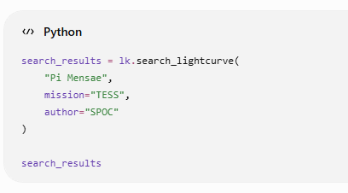
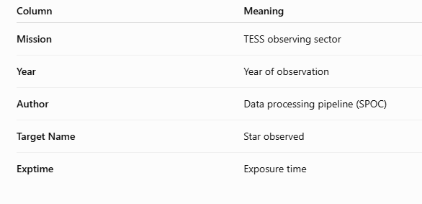
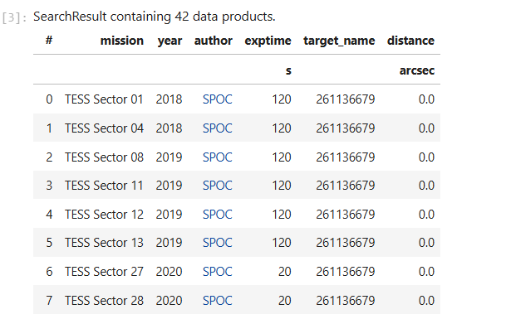
What does this code do?
Searches the NASA TESS archive for Pi Mensae.
Finds all available light curve observations.
Returns a table of available datasets.

Slide 5
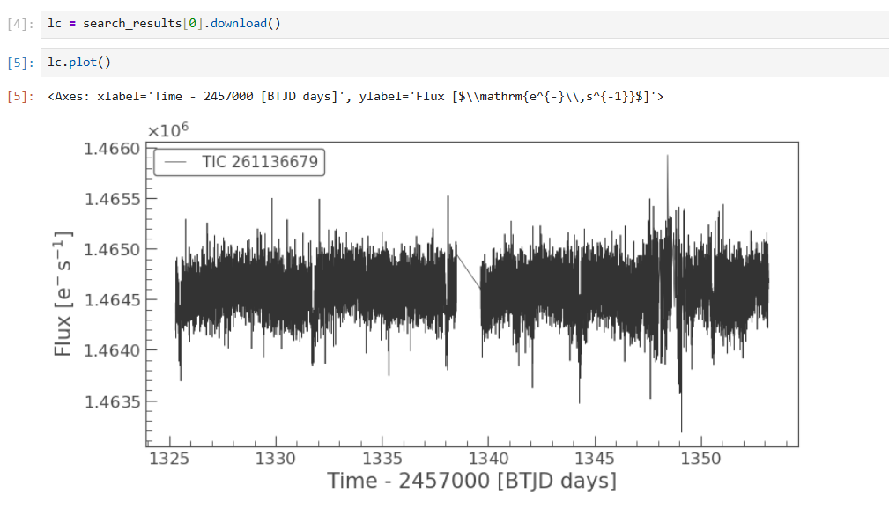
What does this code do?
Downloads the first available TESS observationof Pi Mensae.
Stores the data in the variable lc (light curve).
Plots the star's brightness (flux) versus time.
Understanding the Plot
X-axis: Observation Time (BTJD days)
Y-axis: Stellar Brightness (Flux)
Each point represents one brightness measurement recorded by TESS.
The gap in the middle indicates a period when TESS was not observing the star.
Small fluctuations are normal and may be caused by instrumental noise or natural stellar variability.

Slide 6

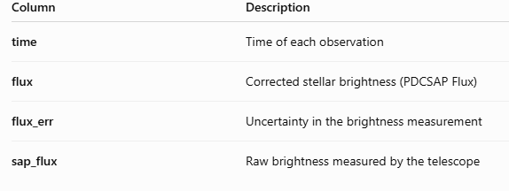
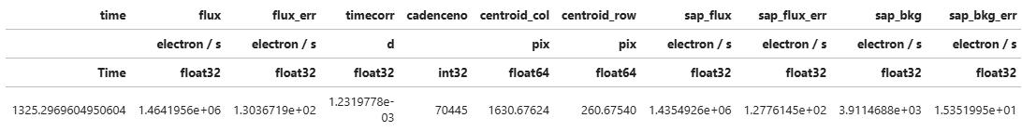
What does this code do?
Selects the PDCSAP Flux from the downloaded light curve.
Uses the corrected brightness measurements provided by the TESS pipeline.
Removes many instrumental effects and systematic trends.
UNDERSTANDING THE OUTPUT
Why use PDCSAP Flux?
Cleaner than the raw SAP Flux
Instrumental noise is reduced
Better for detecting exoplanet transits

Slide 7
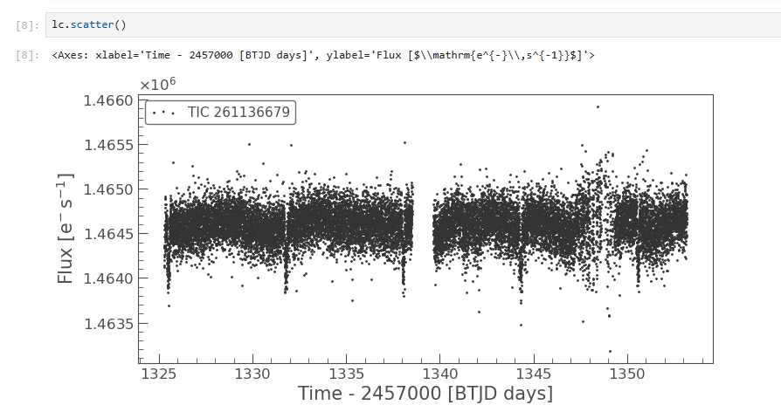
What does this code do?
Plots the light curve as individual data points.
Each dot represents one brightness measurement recorded by TESS.
Helps us examine the distribution of the observations.
Why use a Scatter Plot?
Makes it easier to identify outliers and noisy measurements.
Shows the true distribution of the data.
Useful before cleaning and analysing the light curve.
Understanding the Plot
X-axis: Observation Time (BTJD days)
Y-axis: Stellar Brightness (Flux)
Each dot represents one observation.
The gap in the middle indicates a break in observations.
A few isolated points are outliers caused by noise or measurement errors.

Slide 8
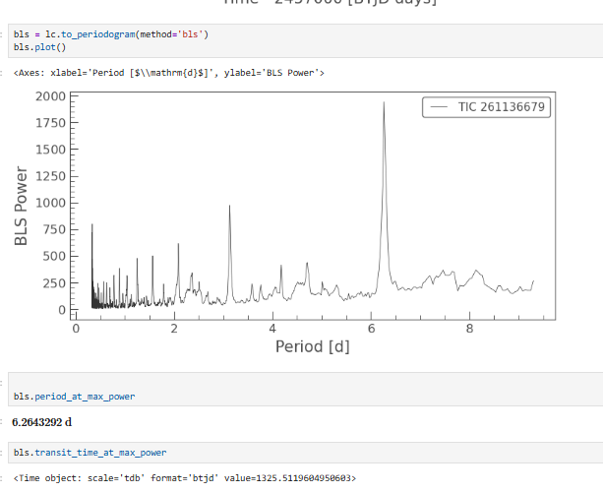
What is BLS?
BLS (Box Least Squares) is an algorithm used to search for repeating transit signals in a light curve.
It tests thousands of possible orbital periods and finds the one that best matches a repeating dip in brightness.
Understanding the Plot
X-axis: Trial orbital period (days)
Y-axis: BLS Power (strength of the transit signal)
Highest peak → Most likely orbital period of the planet
📍 Detected Orbital Period: 6.264 days
📍 Estimated First Transit: BTJD 1325.51
What does this mean?
The strongest peak at 6.264 days suggests that the planet passes in front of its star once every 6.264 days.
This is our first evidence of a repeating transit signal.

Slide 9
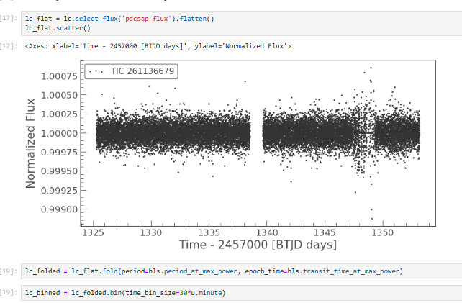
Understanding the Plot
X-axis: Observation Time (BTJD days)
Y-axis: Normalized Flux
The brightness is now centred around 1.0.
Long-term variations have been removed.
Small brightness dips are now easier to detect.
What does this code do?
Selects the PDCSAP Flux (corrected light curve).
Removes long-term trends using flatten().
Displays the normalized light curve.
Why Normalize the Light Curve?
Before searching for planets, we remove slow changes in brightness caused by:
Instrumental effects
Telescope drift
Stellar variability
This makes the transit signal stand out more clearly.

Slide 10
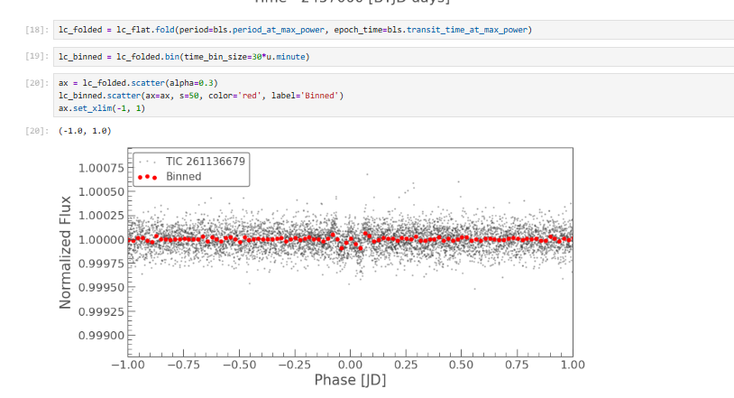
Understanding the Plot
Grey points → Individual observations
Red points → Averaged (binned) measurements
X-axis: Orbital Phase
Y-axis: Normalized Flux
Dip at Phase = 0 → Planet passing in front of the star (Transit)
What does this code do?
Folds the light curve using the detected orbital period.
Aligns all transits on top of each other.
Bins the data to reduce noise.
Highlights the average transit using red points.
Why Fold the Light Curve?
A single transit is often hidden in noisy data.
By folding the light curve using the orbital period, all transits line up, making the transit signal much easier to detect.

Slide 11
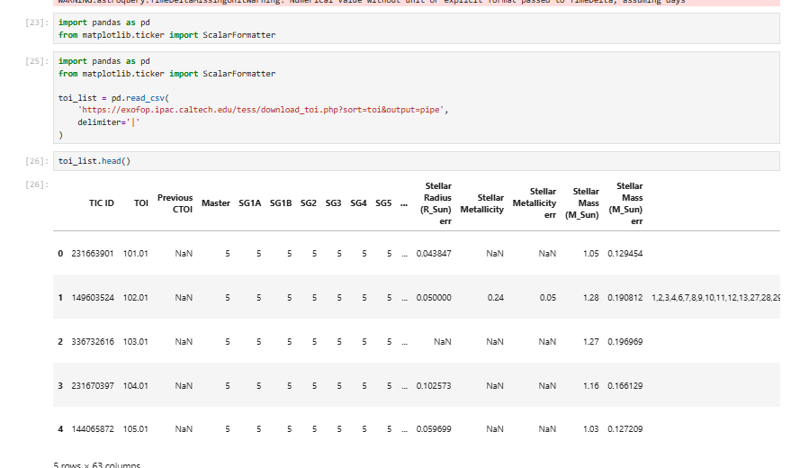
Understanding the Table
TIC ID → Unique identifier for the target star.
TOI → TESS Object of Interest number.
Stellar Radius → Radius of the host star.
Stellar Mass → Mass of the host star.
Additional columns contain information about the star and the detected planet candidate.
What does this code do?
Downloads the latest TESS Objects of Interest (TOI) catalogue.
Loads the catalogue into a Pandas DataFrame.
Displays the first few entries.

Slide 12
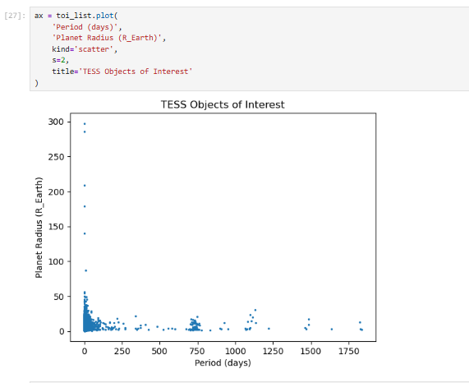
What does this code do?
Creates a scatter plot of all TESS Objects of Interest (TOIs).
Compares each planet candidate by its:
Orbital Period (days)
Planet Radius (Earth radii)
Understanding the Plot
X-axis: Orbital Period (days)
Y-axis: Planet Radius (Earth radii)
Each point represents one exoplanet candidate discovered by TESS.
What can we observe?
Most planets have short orbital periods (less than ~100 days).
Most detected planets are smaller than about 10 Earth radii.
A few planets have very large radii or long orbital periods, making them relatively rare.

