Slide 1
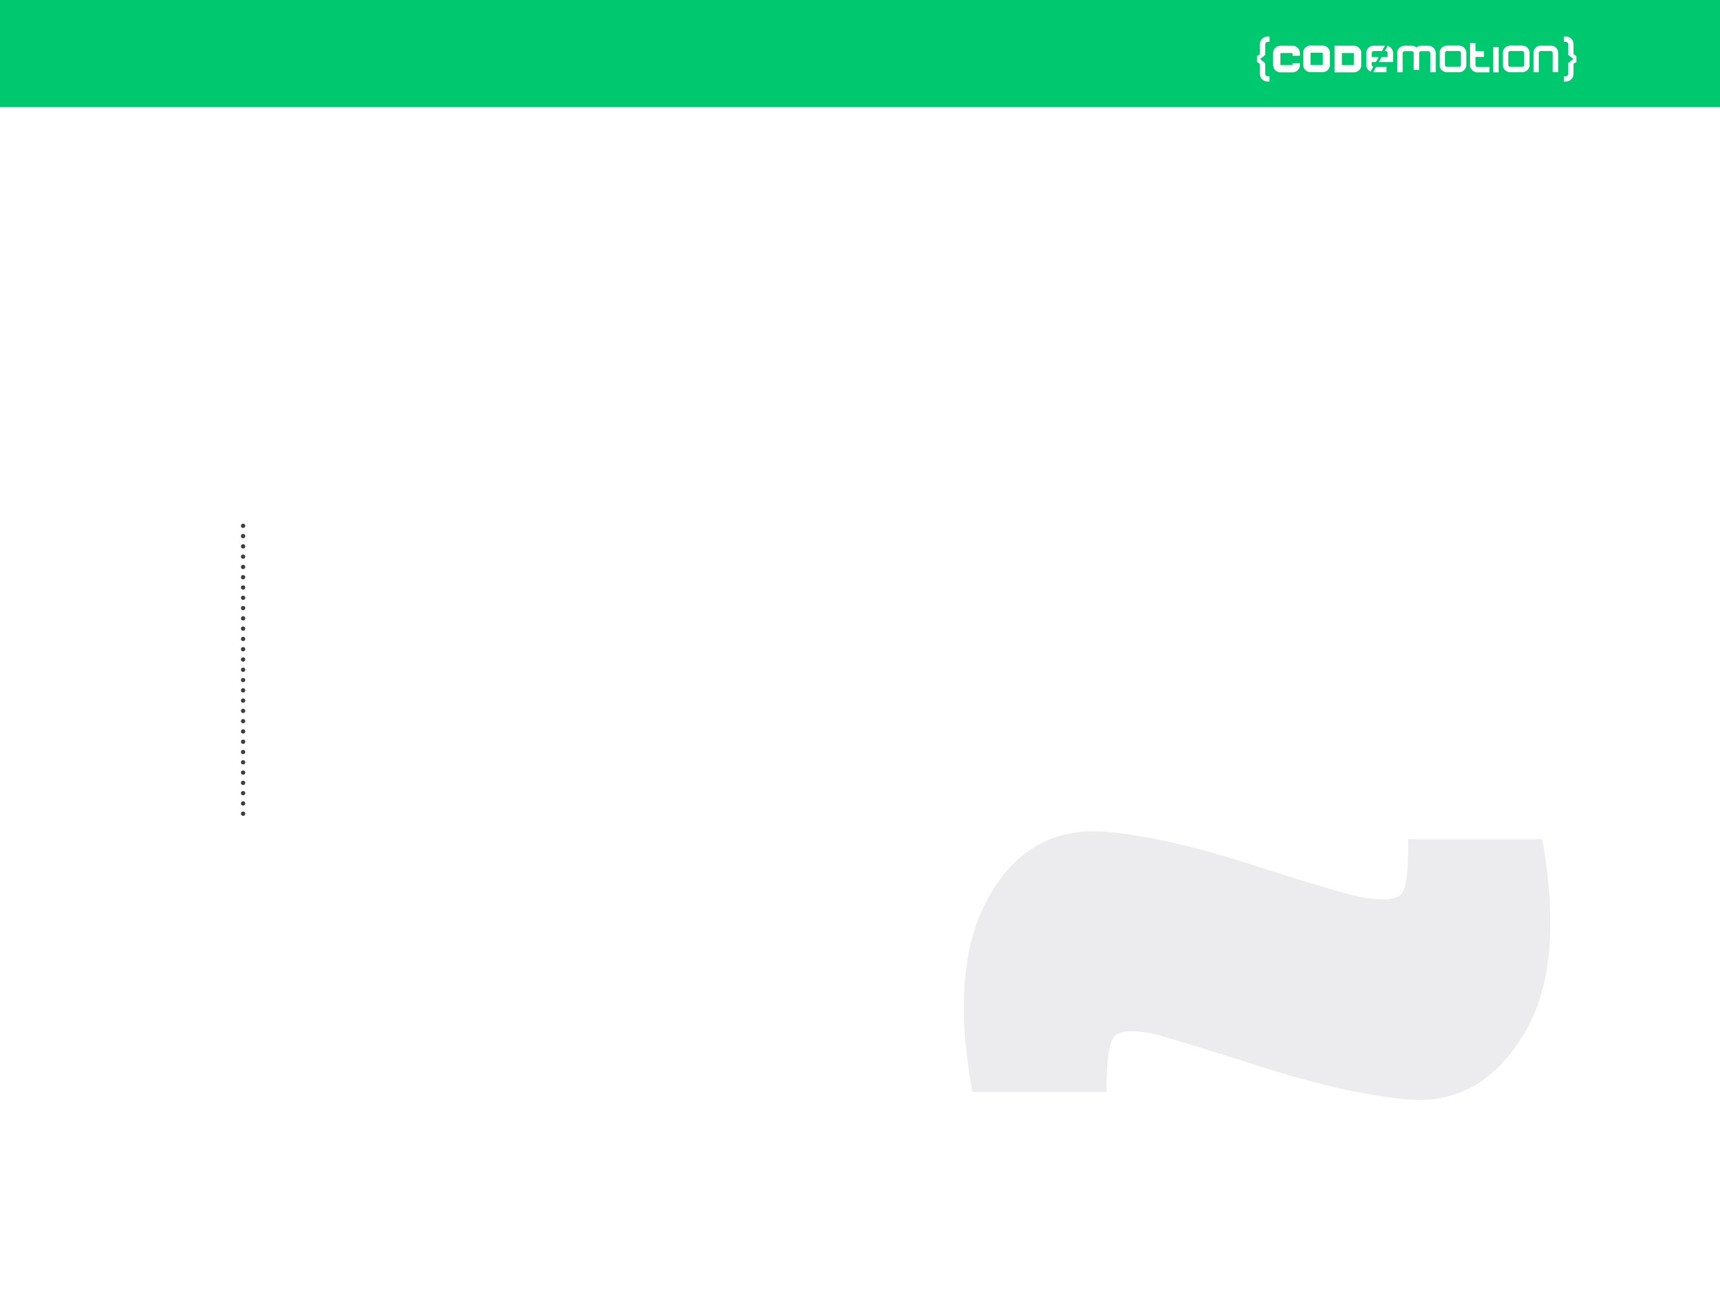



Valerio «Lotti» Riva
Introduction to development of multiplayer HTML5 games (with Socket.io)
valerio.riva@gmail.com
@ValerioRiva
http://it.linkedin.com/in/valerioriva/

Slide 2
Who am I?
Web developer
Game developer @Interactive Project
MyGPTeam, MyGPTeam Turbo, OverVolt: crazy slot cars
http://interactiveproject.com/
Game Jammer
https://www.facebook.com/RomeGameJams
Mentor @CoderDojo Roma
https://coderdojoroma.wordpress.com/

Slide 3
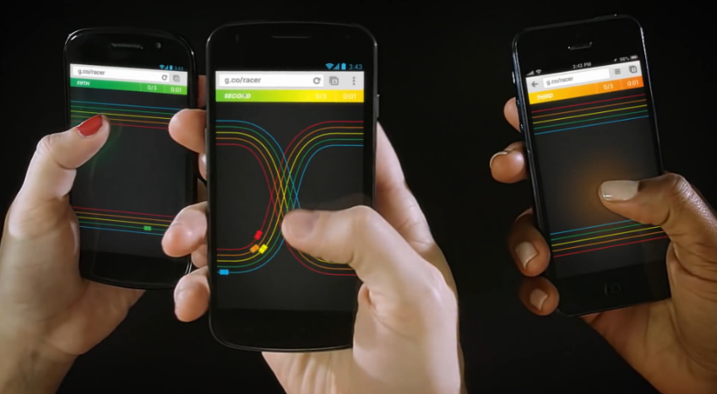
Intro
Multiplayer architectures & technologies
Multiplayer services
Implementation of a simple multiplayer game

Slide 4
Multiplayer games
What is a multiplayer game?
Trivia Time
First multiplayer game?
Biggest (in terms of players) multiplayer game?
Pioneer multiplayer (as we know it) game?

Slide 5
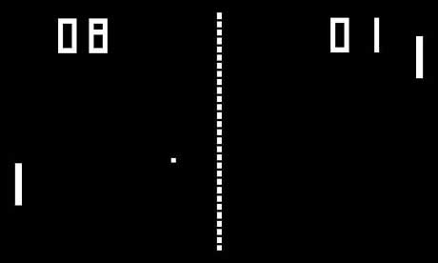
Trivia Time
First multiplayer game
1971!

Slide 6

Trivia Time
Biggest (in terms of players) multiplayer game
About 7.5 million concurrent players!

Slide 7

Trivia Time
Pioneer multiplayer game (as we know it)?
1999: it redefined the multiplayer online gaming experience.

Slide 8
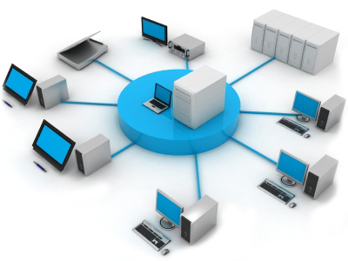
Multiplayer Architectures
Client - Server
Peer 2 Peer
Hybrid (a mix of both)

Slide 9
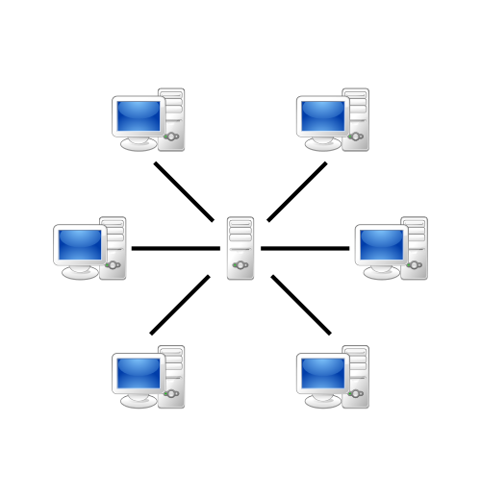
Client - Server Paradigm
Suitable for games that evolve over time
Hard to maintain, high costs
Lineage 2, World of Warcraft

Slide 10
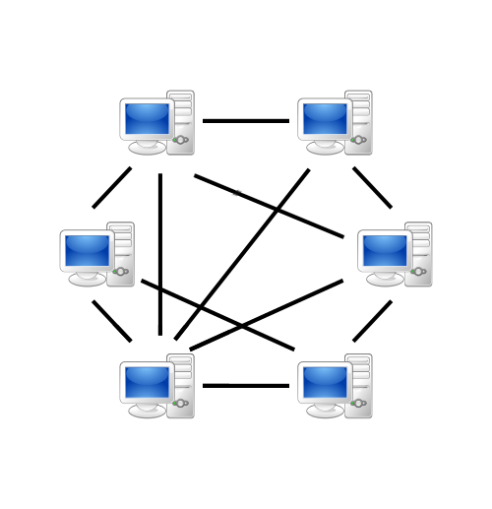
Peer 2 Peer Paradigm
Suitable for games that don’t evolve over time
Easy to maintain, low costs
Is it really used?
Cheating, Modding, Pirates, Business

Slide 11
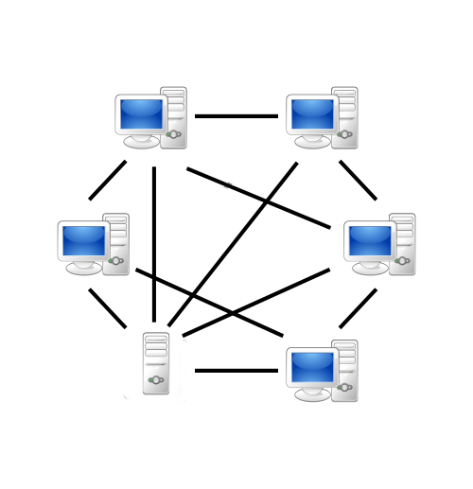
Hybrid Paradigm
Most used!
Client-Server duties: matchmaking, world data, …
P2P duties: assets sharing, voip, …

Slide 12





«Multiplayer as a Service»
Provides you infrastructure and algorithms
Provides SDK for various game engines
Reliability and auto-scaling
Real-time / turn-based multiplayer
Match-making, leaderboards, achievements
Cloud storage (saved games)
Free or paid services

Slide 13
Networking technologies
Web API
Request-Response system
Identified by a url
Permanent connection not required
Suitable on asynchronous games
Socket
Bidirectional communication between softwares
Identified by a protocol, an address and a port
Permanet connection required
Suitable on synchronous games

Slide 14





Networking technologies (2)
Web API
Socket

Slide 15


Socket instead of WebAPI
PRO
Full-duplex communication
Real time!
Can use UDP protocol
CON
A stream of byte
Permanent connection required
Firewall :\
NAT :\

Slide 16
WebSocket
Works as an upgrade of standard HTTP connection
Full-duplex channel over a single TCP connection
WebSocket instead of Socket
PRO
Full-duplex communication
Real time!
Firewall :)
CON
A stream of byte
Permanent connection required
Can’t use UDP protocol

Slide 17

Socket.io
A Javascript library that enhances WebSocket
Easy to use
Event-driven
Falls back to other technologies if WebSocket is not available
Adds broadcasting
Adds support to multiplexing with «namespaces»
Adds support to rooms

Slide 18
Socket.io: Client example
<script src="/socket.io/socket.io.js"></script> <script> var socket = io(); socket.on('pong', function(data) {
//do something with received data
console.log(data); }); socket.emit('ping', { user: "Lotti" }); </script>

Slide 19
Socket.io: Server example
var app = require('express')(); var http = require('http').Server(app); var io = require('socket.io')(http); io.on('connection', function(socket) { //a socket just connected! socket.on('ping', function(data) { //do something with received data console.log(data.user); socket.emit('pong', 'hello!'); }); });

Slide 20
Socket.io instead of WebSocket
Full-duplex communication
Real time!
Firewall :)
Event-driven
Rooms!
Permanent connection required
Can’t use UDP protocol

Slide 21
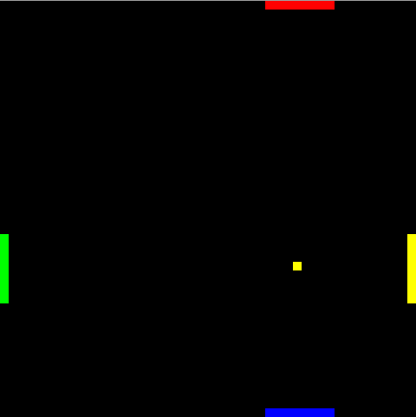
Pong4

Slide 22
Pong4 (2)
A simple real-time multiplayer "Pong" game
Built with
phaser.io (game)
socket.io (networking)
express.io (content delivery)
Runs on node.js
http://pong4.eu-gb.mybluemix.net
https://github.com/Lotti/codemotion2015

Slide 23
Pong4 (3)
Hybrid paradigm
Server
Forwards events and data between clients
Fat client (host): Game manager
Player movements
Checks collisions
Keeps scores
Starts and ends a game
Thin client
Player movements
Can be promoted to host

Slide 24
Pong4 Server: host join event
socket.on('host', function(data, ack) { var room = makeGameId(); socket.join(room, function (err) { if (!err) { clientPlayers[socket.id] = 0; clients[socket.id] = room; hosts[socket.id] = true; ack(room); log('host '+socket.id+' connected'); } else { log(err,'e'); sendError(1, "host: can't join room", socket); } }); });
1
2

Slide 25
Pong4 Server: client join event
socket.on('join', function(data, ack) { var room = data; if (roomExists(room)) { socket.join(room, function (err) { if (!err) { clients[socket.id] = room; var players = socketsInRoom(room); clientPlayers[socket.id] = players.length - 1; ack({ playersCount: players.length }); io.to(room).emit('joined', { playersCount: players.length }); } else { log(err, 'e'); sendError(3, "client: can't join room", socket); } }); } else { sendError(2, "that room doesn't exists", socket); } });
1
2

Slide 26
Pong4 Client: sending data
updateServer: function () {
//... var data = { socketId: socket.id }; if (master) { data['ball'] = true; data['ballX'] = ball.position.x; data['ballY'] = ball.position.y; } else data['ball'] = false;
data['player'] = parseInt(currentPlayer); switch(data['player']) { case 0: case 2: data['paddle'] = paddles[currentPlayer].position.x; break; case 1: case 3: data['paddle'] = paddles[currentPlayer].position.y; break; }
socket.emit('gameUpdate', data); },

Slide 27
Pong4 Server: broadcasting data
socket.on('gameUpdate', function(data) { var room = clients[data.socketId]; delete data.socketId; io.to(room).emit('clientUpdate', data); });

Slide 28
Pong4 Client: receiving data
updateClient: function (data) {
if (!master && data.ball == true) { ball.position.x = data.ballX; ball.position.y = data.ballY; } if (currentPlayer != data.player) { switch(parseInt(data.player)) { case 0: case 2: paddles[data.player].position.x = data.paddle; break; case 1: case 3: paddles[data.player].position.y = data.paddle; break; } } },

Slide 29
References
http://socket.io/
http://phaser.io/
http://pong4.eu-gb.mybluemix.net/
https://github.com/Lotti/codemotion2015/
https://console.ng.bluemix.net/
https://developers.google.com/games/services/
https://www.exitgames.com/en/Realtime
http://www.smartfoxserver.com/
https://developer.apple.com/game-center/
http://appwarp.shephertz.com/

Slide 30
Thank you!
Any Questions?
Leave your feedback on Joind.in!
https://joind.in/event/view/3347
valerio.riva@gmail.com
@ValerioRiva
http://it.linkedin.com/in/valerioriva/

