Slide 1
The Well Behaved Robot
An intro to Neural Networks
Scott Dyer
From: http://en.wikiversity.org/wiki/Learning_and_neural_networks

Slide 2
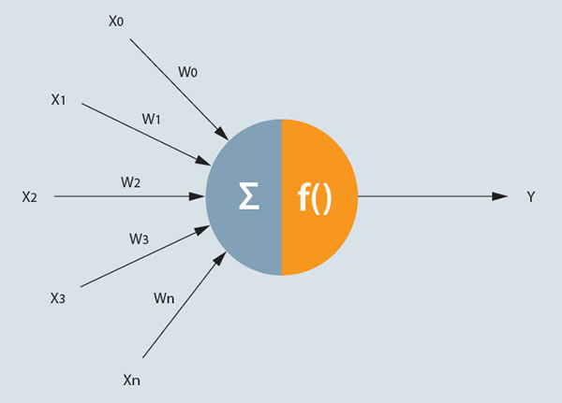
A Neuron
http://www.fico.com/en/Communities/analytic-technologies/Pages/NeuralNetworks.aspx

Slide 3
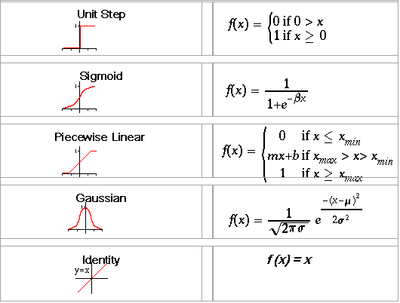
Neuron Activation Functions
http://www.atwebo.com/ann.htm

Slide 4
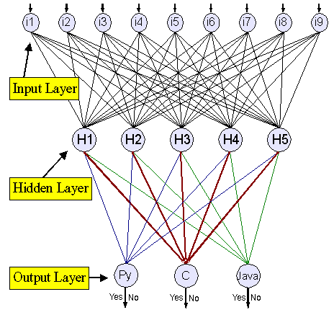
Neural Network
https://www.ibm.com/developerworks/library/l-neural/

Slide 5
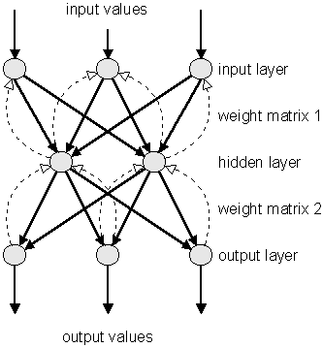
Backpropagation Training
http://www.nnwj.de/backpropagation-net.html

Slide 6
The Well Behaved Robot
The robot guards the door to the pool hall in a haunted mansion.
If a human enters greet them politely (adult or child)
If a child enters the room yell for help (children have damaged the felt in the past)
If a vampire enters the room stab it in the heart (real vampires are dangerous parasites no matter what Twilight would have you think)
If a werewolf enters the room yell for help and RUN AWAY. (Werewolves have a habit of destroying robots and the repairs are costly)

Slide 7
Robots Neural Network
Height In
Greet Out
.
Yell Out
.
.
Stake Out
Run Out
Hairiness In

Slide 8
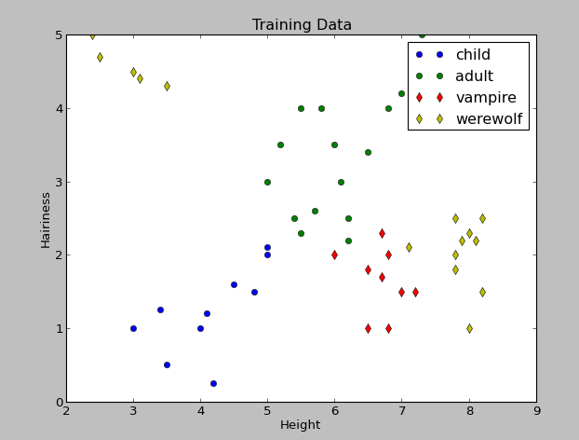
Training Data

Slide 9
Demo

