Slide 1
The Well Behaved Robot
An intro to Neural Networks
Scott Dyer
From: http://en.wikiversity.org/wiki/Learning_and_neural_networks

Slide 2
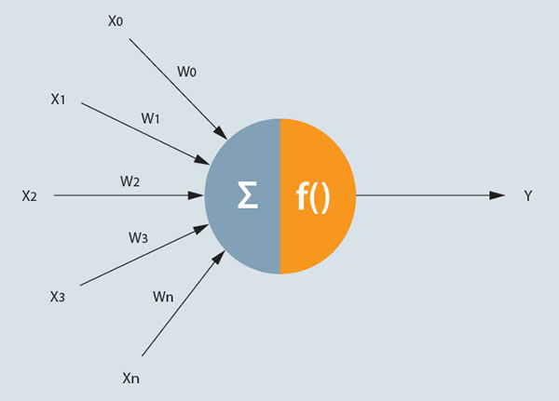
A Neuron
http://www.fico.com/en/Communities/analytic-technologies/Pages/NeuralNetworks.aspx

Slide 3
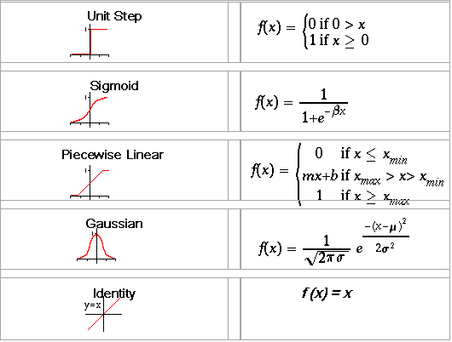
Neuron Activation Functions
http://www.atwebo.com/ann.htm

Slide 4
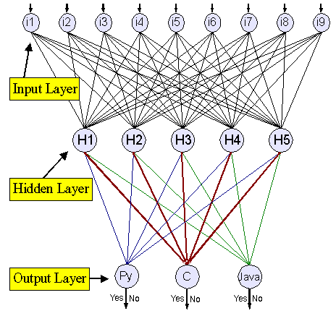
Neural Network
https://www.ibm.com/developerworks/library/l-neural/

Slide 5
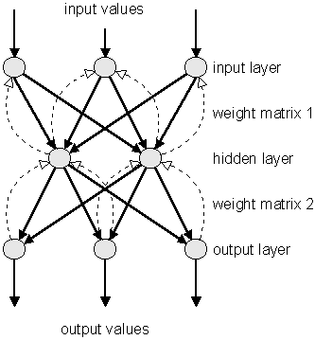
Backpropagation Training
http://www.nnwj.de/backpropagation-net.html

Slide 6
The Well Behaved Robot
The robot guards the door to the pool hall in a haunted mansion.
If a human enters greet them politely (adult or child)
If a child enters the room yell for help (children have damaged the felt in the past)
If a vampire enters the room yell and stab it in the heart (real vampires are dangerous parasites no matter what Twilight would have you think)
If a werewolf enters the room yell for help and RUN AWAY. (Werewolves have a habit of destroying robots and the repairs are costly)

Slide 7
Robots Neural Network
Height In
Greet Out
.
Yell Out
.
.
Stake Out
Run Out
Hairiness In

Slide 8
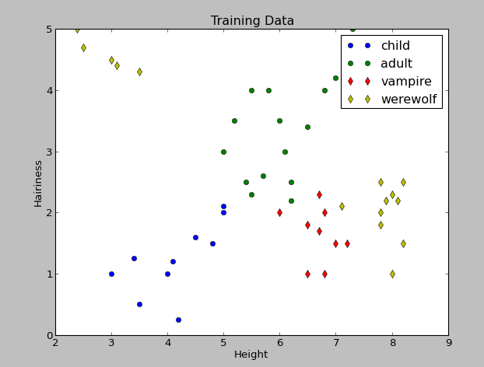
Training Data

Slide 9
Demo

Slide 10
Lessons Learned
Architecture matters
Having 2 hidden layers increased training time
Number of neurons in hidden layer matters
Too few will not converge
Too many takes longer to train
Saving and loading Neural Net is VITAL
Data sets
For Backpropagation Training activation functions must be differentiable

