Slide 1
The Well Behaved Robot
An intro to Neural Networks
Scott Dyer
From: http://en.wikiversity.org/wiki/Learning_and_neural_networks

Slide 2
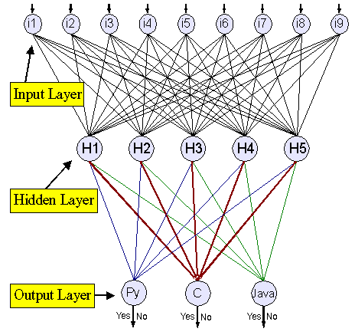
Neural Network
https://www.ibm.com/developerworks/library/l-neural/

Slide 3
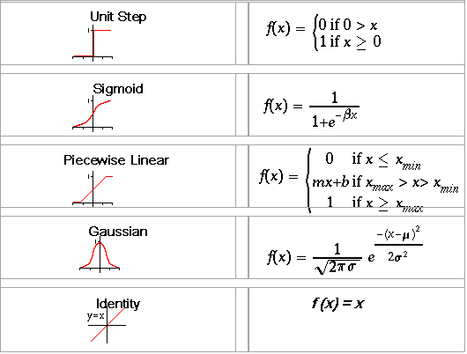
Neuron Activation Functions

Slide 4
The Well Behaved Robot
The robot guards the door to the pool hall in a haunted mansion.
If a human enters greet them politely (adult or child)
If a child enters the room yell for help (children have damaged the felt in the past)
If a vampire enters the room stab it in the heart (real vampires are dangerous parasites no matter what Twilight would have you think)
If a werewolf enters yell for help and run away. (Werewolves have a habit of destroying robots, repairs are costly)

Slide 5
Robots Neural Network
Height In
Greet Out
.
Yell Out
.
.
Stake Out
Run Out
Hairiness In

Slide 6
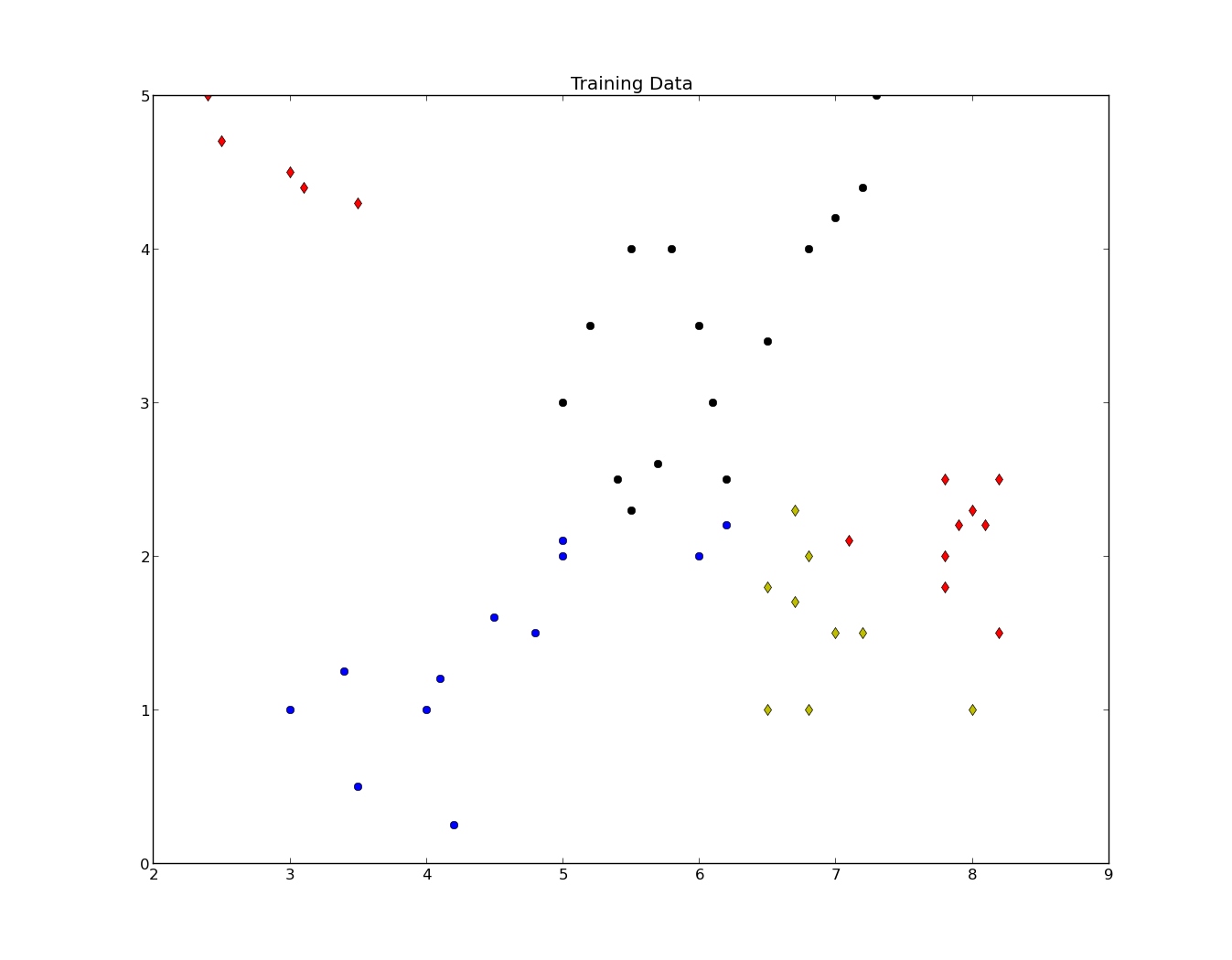

Slide 7
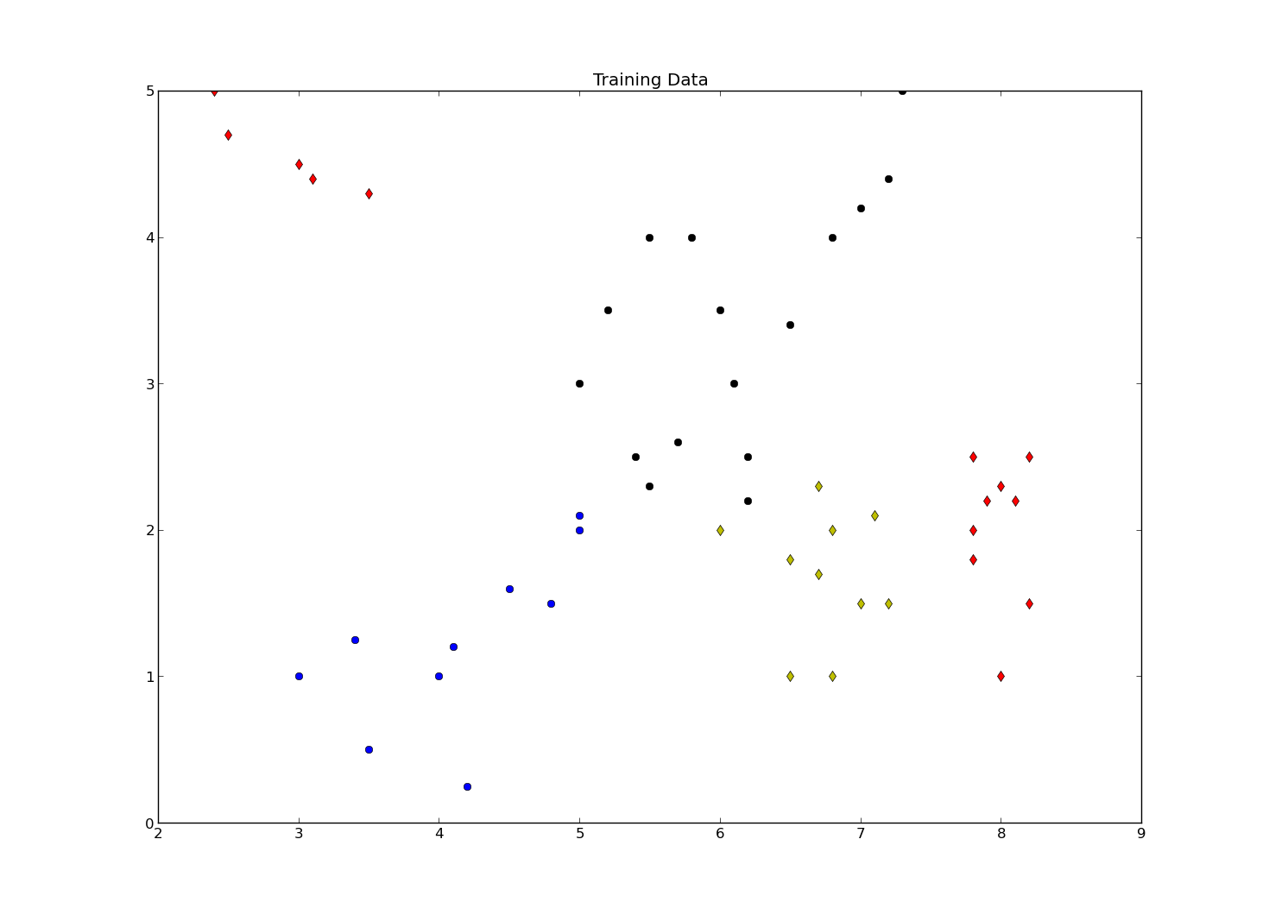

Slide 8
Demo

