Slide 1

#334C50
#1E2527
#567578
#EA9F40
#282D33
#50898D
#EAA446
#262B2F
#5AA4A4
#F2A944
#B89958
#252D31
#6BB0B0
#F7B648
#41555C
#79C5C3
#FBC043
#566465
#81CAC8

Slide 2

#3B3F4A
#091E24
#386066
#0A212A
#3F424C
#215460
#0D252D
#444851
#20636D
#0D2229
#386F7E
#5A5C66
#989FA1
#1F646F
#0E2B37
#5B8B94
#6B6F73
#9EA1A5
#2E707B
#0F363F
#5E97A0
#888D93
#A2A6AA
#D0E0E7
#909598
#CBCED2

Slide 3

#0C1C3C
#5D637B
#A9A7B2
#0C1D3B
#696F85
#B0B2C0
#0C1F3F
#72748A
#CFCACE
#122445
#868999
#D8D3D6
#E5E1E1

Slide 4
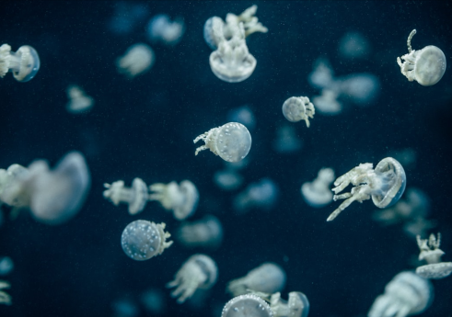
#E3F2EF
#BFD3D1
#A0B6AD
#5D8490
#002D40
#01192B
#02101D
#000610

Slide 5
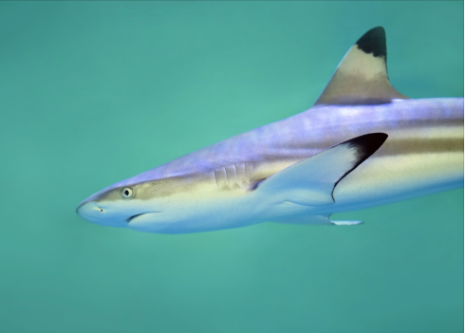
#328080
#D1D9FB
#7D757A
#B9C39D
#5EB9A7
#16272E

