Slide 1

Drag and drop to convert images to WebP format.

Slide 2
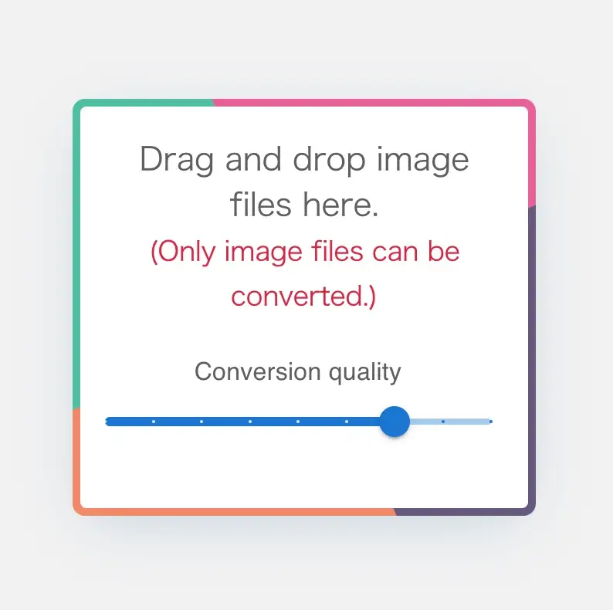
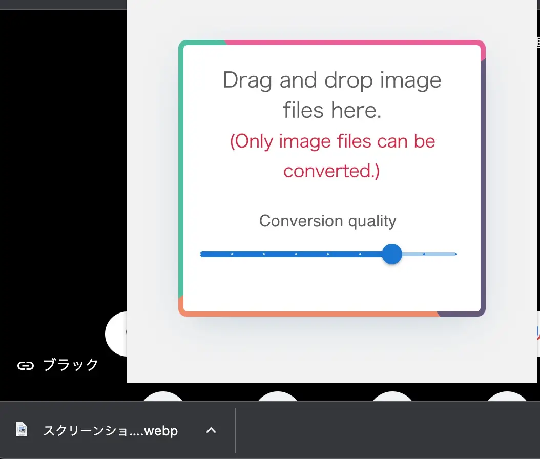
Drag and drop to convert images to WebP format
File will be downloaded automatically.

