Slide 1
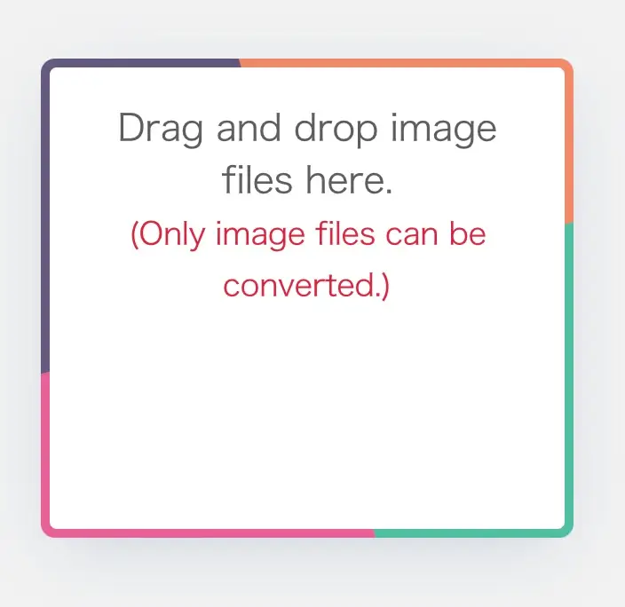
・Convert to WebP format.
・Just drag the image.
・Can compress Size.

