Slide 1
FinSentinel
0.978
Best Macro F1
Financial Sentiment Analysis using LLMs
6
Dori Fu · Rhea Nayar · Fatema Jaynab
Model Tiers
DS-UA 301 · NYU · May 13, 2026
github.com/rn2357-cloud/financial-sentiment-analysis
2,264
FPB Sentences

Slide 2
OVERVIEW
Executive Summary
Problem
Manually tracking financial sentiment across hundreds of headlines is slow, costly, and inconsistent. Existing tools lack calibration for a retail investor's perspective.
Goal
Automatically classify financial headlines as positive, negative, or neutral from a retail investor's perspective, with structured risk metadata (type, severity, horizon).
Approach
5-tier pipeline: Majority baseline/TF-IDF+LogReg → FinBERT zero-shot → FinBERT+LoRA → LLM prompting (zero/few/CoT/RAG+CoT) → ReAct agent + DistilBERT distillation.
Result
FinBERT+LoRA achieves 0.978 macro F1 at 50ms latency and zero API cost — matching GPT-4o-mini few-shot, surpassing TF-IDF by +11 points on macro F1.

Slide 3
BACKGROUND
Motivation & Related Work
Retail investors process hundreds of financial headlines daily.
Financial language is domain-specific — 'profit warning' is not just general negativity.
Directional signals from a retail investor differ from raw sentiment.
Existing tools lack calibration for investor perspective.
Dataset: Financial PhraseBank (FPB AllAgree)
2,264 sentences annotated by 16 finance professionals. Highest-quality subset where all annotators agreed.
Deng et al. (2023)
Reddit Market Sentiment Analysis
Method: LLM in-context learning + CoT on Reddit posts with weak labels. Fine-tuned model generalizes to FiQA.
⚡ Limitation: Only positive/neutral/negative — no multi-dimensional risk tagging.
Vijayan (2023)
Prompt Structured Extraction
Method: ChatGPT / BARD with standard, persona, CoT, and few-shot prompts for structured extraction from travel emails.
⚡ Limitation: General domain (travel), not finance. No investor-perspective calibration.
Our contribution: extends both papers into multi-dimensional financial risk tagging with quantitative benchmarks.

Slide 4
METHOD
5-Tier Pipeline Architecture
Tier 0–1
Tier 2A
Tier 2B
Tier 3
Tier 4–5
Baselines
FinBERT ZS
FinBERT+LoRA ★
LLM Prompting
Agent+Distilled
Majority class
+ TF-IDF+LogReg
Domain-pretrained
BERT (110M params)
PEFT r=8, 3 epochs
0.27% params
Zero/Few/CoT
RAG+CoT (GPT-4o-mini)
ReAct agent
+ DistilBERT student
F1: 0.34 / 0.87
F1: 0.963
F1: 0.978
F1: 0.83–0.98
F1: 0.26 / 0.54
★ Best accuracy-cost-latency balance: FinBERT+LoRA — 0.978 F1 · 50ms · zero API cost · 0.27% params trained

Slide 5
METHOD
Implementation & Experiment Details
Data & Evaluation
Key Hyperparameters
Dataset:
FPB AllAgree (2,264 sentences)
LoRA rank r:
8
Train / Test:
80% train / 20% test, stratified
LoRA alpha:
16 · dropout 0.1
LoRA targets:
Q + V attention layers
LLM eval:
200-sentence stratified sample
Training:
3 epochs · lr 2e-4 · batch 16
Cross-domain:
FiQA-Sentiment (Twitter/Stocktwits)
LLM model:
GPT-4o-mini, temperature=0
Primary metric:
Macro F1 — 61.4% neutral imbalance
Few-shot:
6 examples (2 per class, held-out)
Stats tests:
McNemar + Wilson 95% CIs
RAG:
BM25 (40%) + FAISS (60%), k=3
Distillation:
500 examples · 5 CoT paths · MSE loss
API cost:
Distillation corpus: $0.37 total
Student:
DistilBERT · 5 epochs · 66M params

Slide 6

DEMO
Demo — FinSentinel: Financial Risk Intelligence
Live headlines
[ Add app recording here ]
Fetches real-time Yahoo Finance RSS headlines by ticker (AAPL, MSFT, NVDA, etc.)
Sentiment pipeline
Classifies each headline with zero-shot / few-shot / CoT / RAG+CoT prompting
Daily scores
Aggregates per-headline sentiment into daily scores per ticker (range: −1 to +1)
Price correlation
Fetches actual yfinance returns and computes Pearson + Spearman correlation

Slide 7
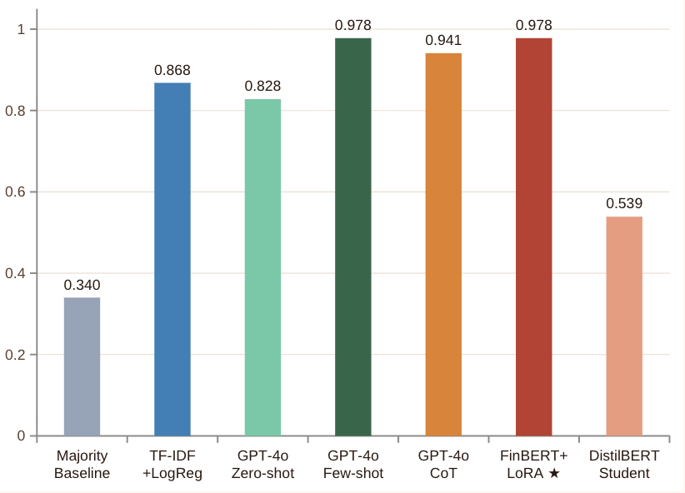
EVALUATION
Results — Model Performance
FinBERT+LoRA ties GPT-4o few-shot (0.978 F1) at zero API cost and 50ms latency
Few-shot beats zero-shot by +15 F1 points (p<0.001, McNemar)
CoT (0.941) underperforms few-shot — adds conservative neutral bias
FiQA cross-domain: accuracy drops to 10% — clean benchmark ≠ real-world

Slide 8
EVALUATION
Results — Error Analysis & Statistical Tests
Dominant Error: Neutral → Positive
Statistical Significance
Zero-shot
6/8 neutral→pos
p < 0.001
p = 0.109
Few-shot
3/5 neutral→pos
Zero-shot → Few-shot
(McNemar, n=200)
Few-shot → CoT
(not significant)
CoT
1/7 neutral→pos
27 / 29
+10.6 pts
Disagreements fixed by
few-shot vs zero-shot
Macro F1 gain over
TF-IDF baseline
Neutral→Pos
Other errors
Root cause: zero-shot sees 'revenue' or 'sales' and infers positive without reading direction. Few-shot calibrates this by teaching investor perspective.

Slide 9
TAKEAWAYS
Conclusion
01
Domain beats scale
02
Few-shot calibration is the biggest lever
FinBERT zero-shot (0.963) outperforms GPT-4o-mini zero-shot (0.828) despite being 70× smaller. Domain pre-training matters more than model size.
6 labeled examples boost macro F1 from 0.828 → 0.978 (p<0.001). They teach the model to judge directional investor signals, not surface words like 'sales'.
03
FinBERT+LoRA is the practical winner
04
Real-world gap remains
Matches GPT-4o-mini few-shot (0.978 F1) at zero API cost, 50ms latency, and 0.27% of params trained. Best accuracy-cost-latency tradeoff.
Strong FPB results (98.5%) collapse on FiQA (10%). Future work: domain adaptation, larger distillation dataset, live sentiment-price RSS dashboard.

Slide 10
BACKUP
Complete Model Benchmark (FPB)
Model | Accuracy | Macro F1 | Latency | API Cost | Note
Majority baseline | 64.5% | 0.340 | — | Free | Lower bound
TF-IDF + LogReg | 90.3% | 0.868 | <1ms | Free | Keyword-based
FinBERT zero-shot | 96.0% | 0.963 | ~80ms | Free | Strong domain model
GPT-4o-mini zero-shot | — | 0.828 | ~1.2s | Paid | Neutral-bias errors
GPT-4o-mini few-shot | 97.5% | 0.978 | ~1.2s | Paid | p<0.001 vs zero-shot
GPT-4o-mini CoT | 93.0% | 0.941 | ~1.5s | Paid | Overcorrects to neutral
RAG + CoT | — | 0.953 | ~2.0s | Paid | Marginal RAG gain
ReAct Agent | — | 0.260 | ~5s+ | Paid | Parsing failures
FinBERT+LoRA ★ | 98.5% | 0.978 | ~50ms | Free | Best overall ✓
DistilBERT student | 78.4% | 0.539 | ~10ms | Free | Neg class recall=0.02
FiQA cross-domain: all models drop sharply (accuracy ~10%). Strong FPB results do not transfer to informal microblog financial text.

