Slide 1
Autistica Charity IT Project

Slide 2
Contents
Aim
Stakeholders
Stakeholder desires
Communication and team structure
Process so far
Resources
Actions
Questions

Slide 3
Project Aim
To produce a platform that will enable the Autistic community to record daily sensory experiences

Slide 4



Stakeholders

Slide 5
Stakeholders
Autistic Community
Everyone Else

Slide 6
Stakeholder desires
Understanding Autism to help our staff be more productive
Showing our customers we are a genuine responsible business
Chance to create a textbook example of how internally we can conduct an open source and Agile style software development project

Slide 7

Stakeholder desires
Conduct research into the Autistic community so they can advise government, public bodies and industry how to better adapt physical spaces
Project to be open to all

Slide 8
Stakeholder desires
Community
Better understanding of Autism and problematic sensory issues
Understanding coping mechanisms
A platform that respects personal data and choices around data sharing

Slide 9
Stakeholder arrangement
Community

Slide 10

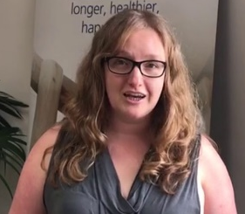

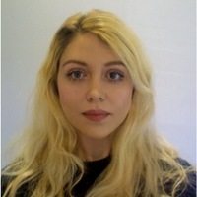

Communication interface
Craig Hall (Responsible business head)
Andrew Harding (Project lead)
Thomas Stanley (Product Owner)
Kirstie Whitaker (Solution Owner)
Georgia Aitkenhead

Slide 11
Fujitsu Org Tree
Craig Hall
( Responsible Business Head)
Andrew Harding (Project Lead)
Robin Dryden (DNS Charity lead & resource manager)
Emilia Driscol
(PM)
Saima Butt
(Agile Coach/BA)
Ellen Devereux
(BA)
Thomas Stanley (PO)
Solution developers
Chris Legg (Designer)

Slide 12
The process
Focus groups were hosted by Autistica to discuss with the Autistic community what they would want from the platform
Transcripts were written up from the focus groups and user stories are being written up from these transcripts
The user stories will be confirmed by the focus groups (to check they are a true representation of the initial opinions)
Feb 10th: A prioritization session to choose which user stories are most important for the initial sprint (MOSCOW) and define
Developers will begin the first sprint based on the prioritisation

Slide 13
Sharepoint
https://emeia.fujitsu.local/emeia/sites/T31/T1857/default.aspx

Slide 14
Github Resources
https://github.com/fjAutisticaCitizenScience/AutisticaCitizenScience
Forked from
https://github.com/alan-turing-institute/AutisticaCitizenScience
Alan Turing prototype demo source
https://github.com/alan-turing-institute/autistica-filemanagement-demo

Slide 15
Demos
Alan Turing Prototype
https://autistica-demo-deployment.herokuapp.com/
Fujitsu Prototype
https://fjautisticaexperiences.herokuapp.com/

Slide 16
Actions
You
Create Github Account
Forward your Github Account name
Investigate Angular (Prototype uses this)
Minimum guaranteed time commitment (So we can effectively plan our sprint planning sessions)
Me
Add you to the Github repository contribution team (Once I have your Github account name)
Inform Andrew Harding/Imogen Kempter and the Alan Turing Institute of your involvement

Slide 17
Questions?

