Slide 1
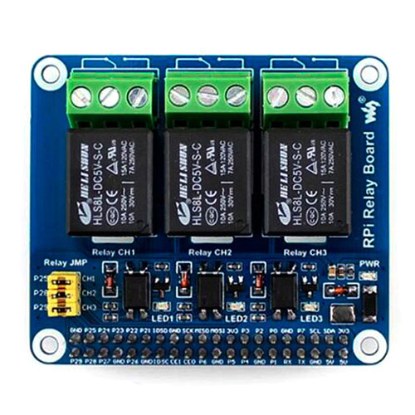
24 V
Uhr/RUT
V
Stop indicator
Varistor

