Slide 1
Why Wind Power Advantages and Drawbacks Must Be Taken Into Account
by: Fernando J Amador

Slide 2
Wind Power for electricity Generation
The control and use of the wind power make for a clean and sustainable form of electricity generation.
It does not produce global warming gases nor toxic pollutants.
The wind is inexhaustible, abundant, and free.
The use of wind power to produce electricity is growing at a fast pace.
For this reason, a thorough analysis of its advantages and drawbacks must be taken into account.
Although it has great potential and benefits, wind power also impacts the environment in ways that have to be observed and which can be mitigated.

Slide 3
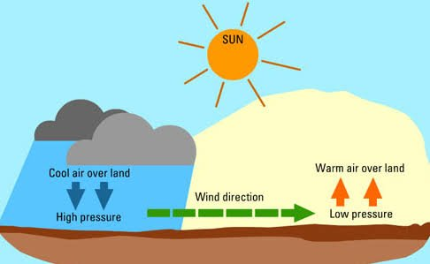
What makes the wind?
Wind is caused by the irregular heating of the atmosphere by the sun, the rotation of the earth, fluctuations in the earth's surface, vegetation, bodies of water, and mountains.

Slide 4
How electricity is generated from wind power
The wind goes through the turbines that change the energy in the wind into mechanical power.
A generator turns this mechanical power into electricity.
The turbine is composed of three blades.
The turbine starts generating electrical power with wind speed of six to nine miles per hour.

Slide 5
Advantages of Wind Power
Wind power can generate electricity in a very efficient way.
Wind power is capable of supplying more than twenty percent of the world’s electricity.
Rural areas are able to revitalize their economies by attracting the wind energy industry.
Wind farm development generates millions in revenue from property tax and land lease payments.
One big advantage of wind energy is that it has a free fuel source.
Wind is free, it does not need to be mined.
Without the need for mining there is less destruction of land.

Slide 6
Cont. Advantages of Wind Power
Another advantage of wind power is that it supports the agriculture since the turbines can be installed in the middle of the cropland without damage to production.
The land in the wind farm can also be used for trails, highways, agriculture and livestock.
Offshore wind farms act as artificial reefs and increase the fish population.
Wind power also maintains lakes and streams clean.
Wind power does not pollute the air unlike coal and nuclear which produce emissions that cause acid rain and greenhouse gases.

Slide 7
Impacts Associated with Wind Power Generation
Aesthetics is a disadvantage of wind power because wind turbines have a visual impact over the landscape. To improve aesthetics they can be arranged in a pattern or painted.
The wind turbines produce foreign noise and vibration to the area. The noise has been reduced considerably by the use of sound-absorbent material and minimizing blade surface imperfections.
Another problem is the shadow flicker that is produced when the rotor blades turn during the day.
Turbine construction might affect plants and animals. The bird collisions are very rare since the rotor blades spin slowly at fifteen times per minute. These impacts are not a threat to species population.

Slide 8
Impact of wind power on the earth surface temperature
Keith and Miller from Harvard University modeled large wind farms and concluded that real life wind power generation would need larger wind farms and more land area to produce the proposed energy targets.
They used a weather forecasting model and then placed turbines over one third of the United States simulating actual electricity demand.
The model showed that this setting would rise by 32.4 degrees Fahrenheit the continental United States average surface temperature.
This warming effect is caused by the turbines mixing the atmosphere above and below.

Slide 9
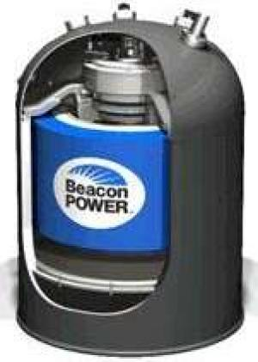
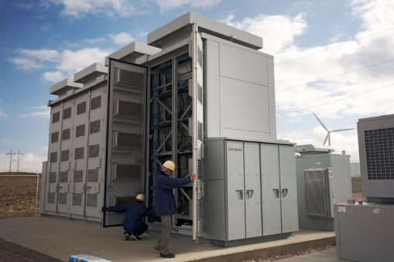
Harnessing Wind Power
One of the challenges of wind power is the intermittent nature of the wind.
Wind farms generate most of the electricity during the night, when the demand is at its lowest point.
The energy generated has to be stored to be used during the day.
Beacon Power has a storage device called a flywheel. An array of flywheels can power two hundred homes for one day.
Another storage device in the making is a massive battery the size of a bus.
Other batteries are being assembled by racking smaller batteries together.

Slide 10
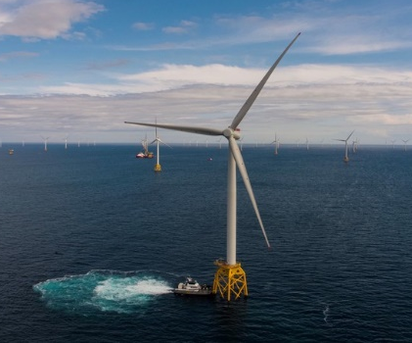
Largest Wind Farms by Capacity
Five of them are operated in the United States mostly in California and Texas.
The biggest wind farm in the world is Jiu Quan Wind Power Base in China.
When finished it will have 7,000 wind turbines.
The fifth biggest windfarm in the world is the Shepherds Flat Wind Farm located in the United States.
The largest offshore in the world is the London Array Offshore Wind Farm in England.

Slide 11
Conclusion
In conclusion, wind power has enormous environmental benefits as it is a form of electricity generation that is sustainable and clean.
It does not produce greenhouse gases and is unlimited.
Wind power supports the agriculture and rural areas economies.
There is no need for mining.
Wind power maintains lakes and streams clean.
Despite its vast potential, there are impacts associated with wind power that should be recognized and mitigated.
Aesthetics, sound and vibration, and shadow flicker and large land areas.
If large wind farms are built, the continental United States average surface temperature would rise by 32.4 degrees Fahrenheit.
Wind power advantages overwhelm its environmental and economic impacts.
These impacts need to be studied and assessed to make a good choice when developing wind farms.

