Slide 1
Car2X Communication
Florian Janßen, Hagen schmidtchen,
paul bergmann, johannes Windelen

Slide 2
Project Goal (hagen)
Allow cars to communicate with each other and with control stations
Exchange diagnostics
Receive situational information and emergency broadcasts
Information gain leads to improved path planning and car control

Slide 3
Main Working Steps so far (hagen)
Reading the documentation and getting into the previous group‘s code
Installation and tutorials for the Altera Quartus software (FPGA)
Learn about the Nios II and multicore implementations on FPGA
Planning the Car2X Protocol and the general hardware setup
Current WIP:
Basic Quartus hardware implementation
Experiments with the wireless converter hardware
Setting up PC as car2x station

Slide 4
Work since midterm (hagen)

Slide 5

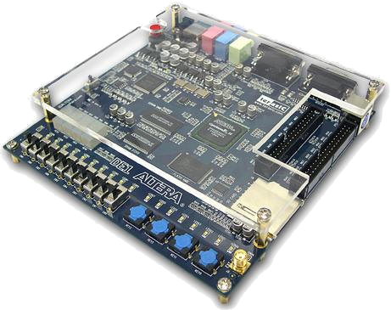
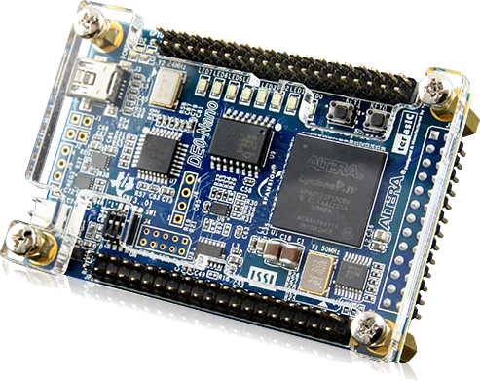
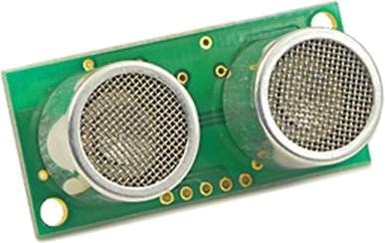
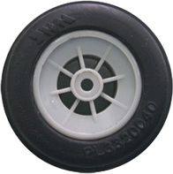
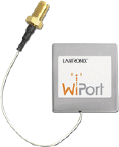
Hardware Setup (on car)
4x
H-Bridge

Slide 6
Hardware Setup (FPGA)
OnChip
Memory
SDRAM
CarControl
Nios Core
Shared
Memory
Communication Nios Core
Ethernet
System
JTAG UART

Slide 7
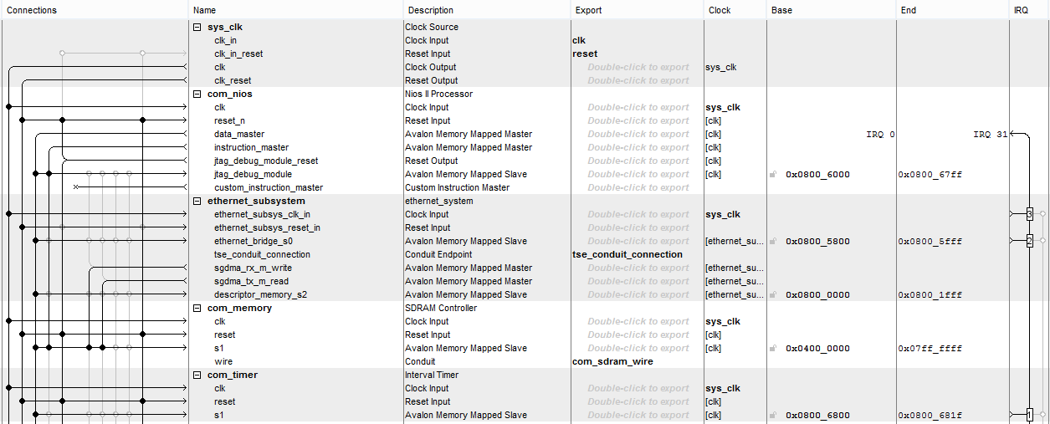
Hardware Setup (FPGA - QSYS)

Slide 8
Hardware Setup (FPGA - Toplevel)
„boring“ verilog code

Slide 9
Hardware Setup (Problems)
Partially bad tutorials (copy paste → “It works”)
Combine different tutorials
No/very few Verilog/VHDL skills
Broken Board
Never sure, where the error comes from (HW, SW, Eclipse, …)!

Slide 10
WiPort configuration (PAUL)
XYZ
ABC
132
New image: shows wiport – board- computer comm.

Slide 11
Communication Flow (PAUL)
Other sensing
Altera FPGA
Telnet CarProtocol
+ C2XExtensions
Motor controllers
Switch
WiPort
Image processing

Slide 12
Communication Core (PAUL)

Slide 13
Car Control Core (JO)

Slide 14
C2X protocol (jo)
Table with current message types, headers ...

Slide 15
GUI (HAGEN)

Slide 16
Further Steps (HAGEN)
Documentation
Get the system running ... Usw

