Slide 1
Car2X Communication
Florian Janßen, Hagen schmidtchen,
paul bergmann, johannes Windelen

Slide 2
Project Goal
allow cars to communicate with each other and with control stations
exchange diagnostics
receive situational information and emergency broadcasts
information gain leads to improved path planning and car control

Slide 3
Main Working Steps so far
Reading the documentation and getting into the previous group‘s code
Installation and tutorials for the Altera Quartus software (FPGA)
Learn about the Nios II and multicore implementations on FPGA
Planning the Car2X Protocol and the general hardware setup
Current WIP:
Basic Quartus hardware implementation
Experiments with the wireless converter hardware
Setting up PC as car2x station

Slide 4
Communication Flow
Other sensing
Altera FPGA
Telnet CarProtocol
+ C2XExtensions
Motor controllers
Switch
memory
Com-Core
ethernet
WiPort
Control-Core
Image processing

Slide 5

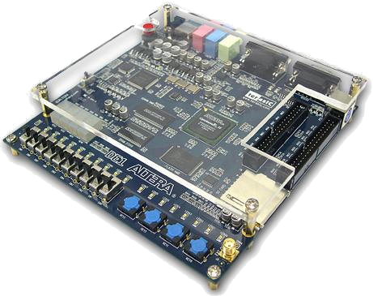
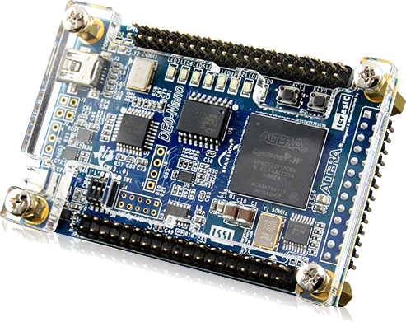
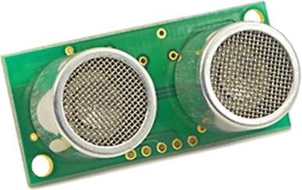
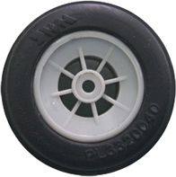
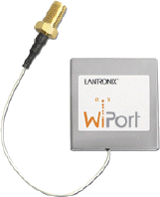
Hardware Setup (on car)
4x
H-Bridge

Slide 6
Hardware Setup (FPGA)
OnChip
Memory
SDRAM
CarControl
Nios Core
Shared
Memory
Communication Nios Core
Ethernet
System
JTAG UART

Slide 7
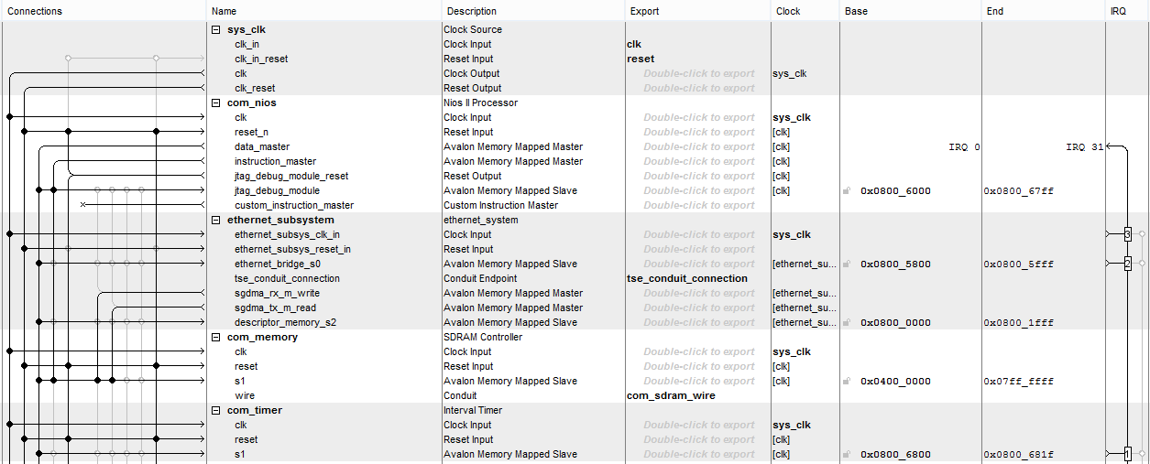
Hardware Setup (FPGA - QSYS)

Slide 8
Hardware Setup (FPGA - Toplevel)
„boring“ verilog code

Slide 9
Hardware Setup (Problems)
Partially bad tutorials (copy paste → “It works”)
Combine different tutorials
No/very few Verilog/VHDL skills
Broken Board
Never sure, where the error comes from (HW, SW, Eclipse, …)!

Slide 10
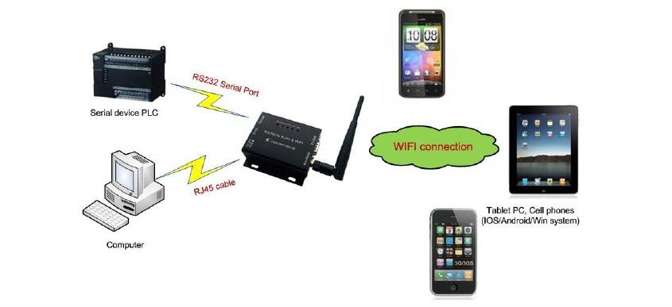
WiPort
Wireless networking server
WiFi antenna, serial and LAN port
TCP/IP communication with external systems (other cars, basestation, etc.)

Slide 11
Car2x Protocol-Structure
Message ID (2Bytes) |  |  | Payload length (1Byte) | Payload
0-2 | 3-7 | 8-15 | 16-23 | 24-x
Type | Subtype | Reserved | Length of payload in Bytes | Message payload

Slide 12
Car2x Protocol-Message Types
“00” InfoMessage (from station or other car)
“00” currentSpeed
“01” steeringInformation
“01” EmergencyInfoMessage
“00” emerencyBreaking
“10” PollingMessage (from Image Processing Unit)
“00” pollInfoMessages
“01” pollOwnSpeedSensorData
“10” pollIRSensorData
“11” ControlMessage (station or Image Processing Unit to Remote-Control the Car)
“00” setMotorControlMessage

Slide 13
Further Steps
Migrate last years code to the new FPGA design
Implement Car2X protocol
Add WiPort communication

