Slide 1
Car2X communication

Slide 2
Zielsetzung/Aufgabenstellung

Slide 3
Main working steps so far
Reading the documentation and getting into the previous group‘s code
Installation and tutorials for the Altera Quartus software (FPGA)
Learn about the Nios II and multicore implementations on FPGA
Planning the Car2X Protocol and the general hardware setup
Current WIP:
Basic Quartus hardware implementation
Experiments with the wireless converter hardware
Setting up PC as car2x station

Slide 4
Kontzept

Slide 5
Hardware Aufbau

Slide 6
Com Fluss

Slide 7
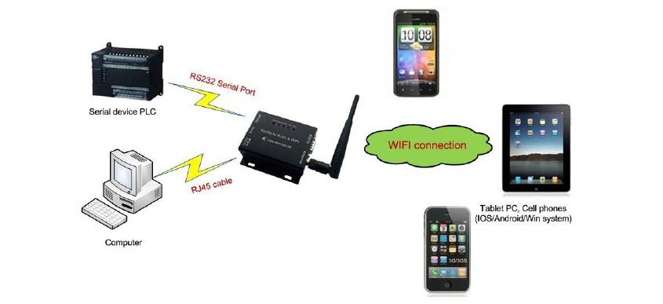
WiPort
Wireless networking server
WiFi antenna, serial and LAN port
TCP/IP communication with external systems (other cars, basestation, etc.)

Slide 8
Hardware Conf FPGA

Slide 9
Car2x Protocol-Structure
Message ID (1-2Bytes) | Payload length (1Byte) | Payload
0 | 1 | 2 | 3 | 4 | 5 | 6 | 7
Type | Type | Subtype | Subtype | Put | Your | Ad | Here!

Slide 10
Car2x Protocol-Message Types
“00” InfoMessage (from station or other car)
“00” currentSpeed
“01” steeringInformation
“01” EmergencyInfoMessage
“00” emerencyBreaking
“10” PollingMessage (from Image Processing Unit)
“00” pollInfoMessages
“01” pollOwnSpeedSensorData
“10” pollIRSensorData
“11” ControlMessage (station or Image Processing Unit to Remote-Control the Car)
“00” setMotorControlMessage

Slide 11
Further steps
Migrate last years code to the new FPGA design
Implement Car2X protocol
Add WiPort communication

