Slide 1
Car2X communication

Slide 2
Zielsetzung/Aufgabenstellung

Slide 3
Main working steps so far
Reading the documentation and getting into the previous group‘s code
Installation and tutorials for the Altera Quartus software (FPGA)
Learn about the Nios II and multicore implementations on FPGA
Planning the Car2X Protocol and the general hardware setup
Current WIP:
Basic Quartus hardware implementation
Experiments with the wireless converter hardware
Setting up PC as car2x station

Slide 4
Concept
Camera System
FPGA
Motor Control & Wheels
Communication Core
Additional Sensing
Car Control Core
Other Car

Slide 5

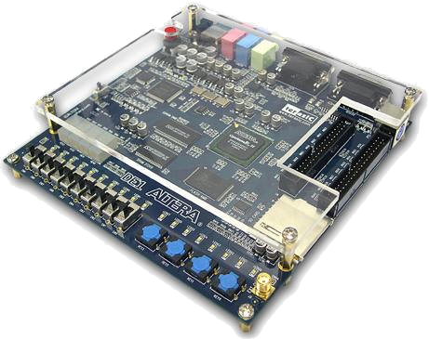
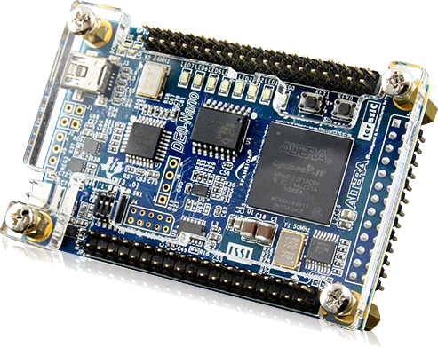
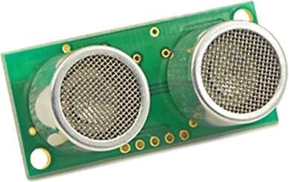
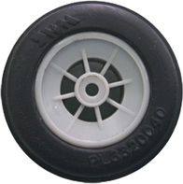
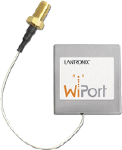
Hardware Setup
4x
H-Bridge

Slide 6
Com Fluss

Slide 7
WiPort

Slide 8
Hardware Conf FPGA

Slide 9
Car2x Protocol-Structure
Message ID (1-2Bytes) | Payload length (1Byte) | Payload
0 | 1 | 2 | 3 | 4 | 5 | 6 | 7
Type | Type | Subtype | Subtype | Put | Your | Ad | Here!

Slide 10
Car2x Protocol-Message Types
“00” InfoMessage (from station or other car)
“00” currentSpeed
“01” steeringInformation
“01” EmergencyInfoMessage
“00” emerencyBreaking
“10” PollingMessage (from Image Processing Unit)
“00” pollInfoMessages
“01” pollOwnSpeedSensorData
“10” pollIRSensorData
“11” ControlMessage (station or Image Processing Unit to Remote-Control the Car)
“00” setMotorControlMessage

Slide 11
Nächste Schritte

