Slide 1
Car2X Communication
Florian Janßen, Hagen schmidtchen,
paul bergmann, johannes Windelen

Slide 2
Project Goal (hagen)
Allow cars to communicate with each other and with control stations
Exchange diagnostics
Receive situational information and emergency broadcasts
Information gain leads to improved path planning and car control

Slide 3
Pre-midterm
Reading the documentation and getting into the previous group‘s code
Installation and tutorials for the Altera Quartus software (FPGA)
Learn about the Nios II and multicore implementations on FPGA
Planning the Car2X Protocol and the general hardware setup
Current WIP:
Basic Quartus hardware implementation
Experiments with the wireless converter hardware
Setting up PC as car2x station

Slide 4

Post-midterm
Hardware (THE BIG ONE)
Ethernet controller
Memory problems
Timing problems
.... problems
We also implemented a lot of software
Telnet server
Message handler
Shared Memory controller
Testing GUI

Slide 5

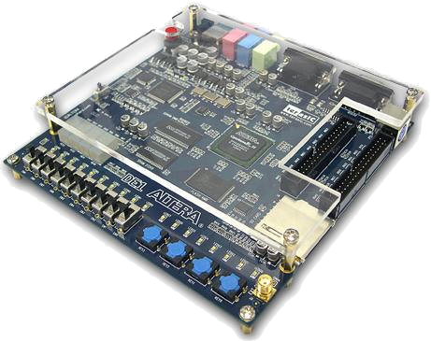
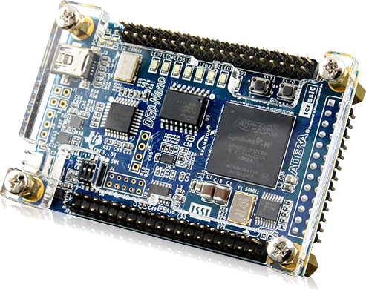
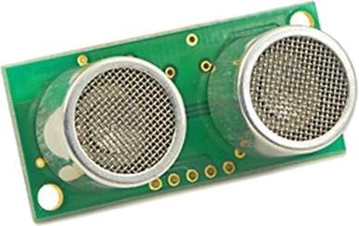
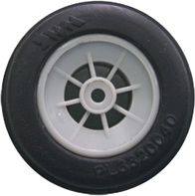
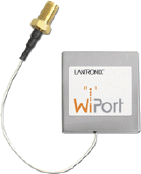
Hardware Setup (on car)
4x
H-Bridge

Slide 6
Hardware Setup (FPGA)
OnChip
Memory
SDRAM
CarControl
Nios Core
Shared
Memory
Communication Nios Core
Ethernet
System
JTAG UART

Slide 7
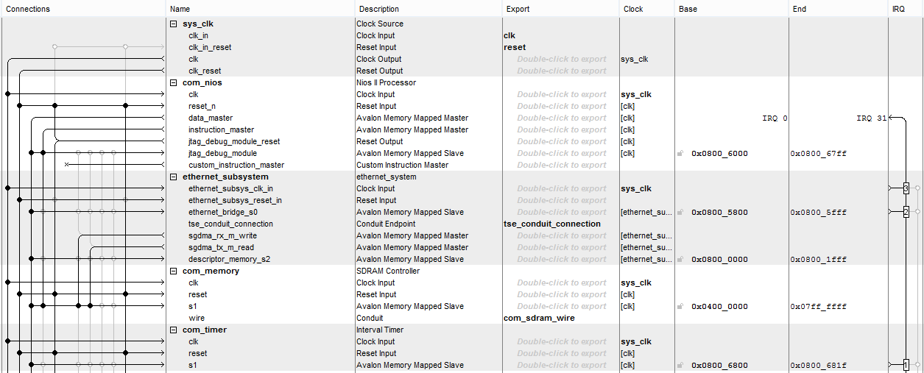
Hardware Setup (FPGA - QSYS)

Slide 8
Hardware Setup (FPGA - Hierarchy)
Toplevel file
IO Pin
Planer
Net
DDIO
Net
PLL
RAM
PLL
QSYS
entity

Slide 9
Hardware Setup (Problems)
Partially bad tutorials (copy paste → “It works”)
Combine different tutorials
No/very few Verilog/VHDL skills
Broken Board
Never sure, where the error comes from (HW, SW, Eclipse, …)!

Slide 10
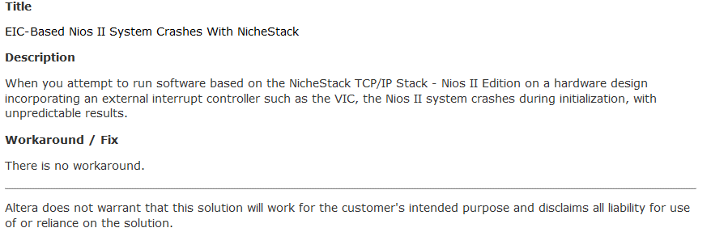
Hardware Setup (Problems)

Slide 11
WiPort configuration (PAUL)
Client
IP
Configuration:
Access point
Client mode
Static IP
Server
Client
Client
IP
WiPort
Ethernet
Client
IP

Slide 12
Communication Flow (PAUL)
Other sensing
Altera FPGA
Telnet CarProtocol
+ C2XExtensions
Motor controllers
Switch
WiPort
Image processing

Slide 13
Communication Core (PAUL)
Runs MicroC OS: Multithreading
3 Threads:
Socket Server (OUR TASK)
Inet Main (OS)
Clock Tick (OS)
TCP server implemented with Nichestack TCP / IP suite
Can accept multiple connections (WiPort, wheels, camera, ...)

Slide 14
Communication Core Workflow (PAUL)
Wheels
C A R P ...
Client
Connections
Telnet
TCP Server
Connection
Buffers
WiPort
Camera
Data
Packet
Shared Memory
Execute Commands
Parser

Slide 15
Memory controller
Comms Core
MemController
Mutex 1
Control Core MemController
Supports multiple shared memory areas
One hardware mutex per area
Instantiate a MemController for each Area
API:
get(idx), getLast(), getAll(), clear(), push()
Mutex 2
Mutex 3
Shared memory
Area 1<CarState> | Area 2<int> | Area 3<float>
CarState content[] | int content[] | float content[]
index | index | index
maxElements | maxElements | maxElements

Slide 16
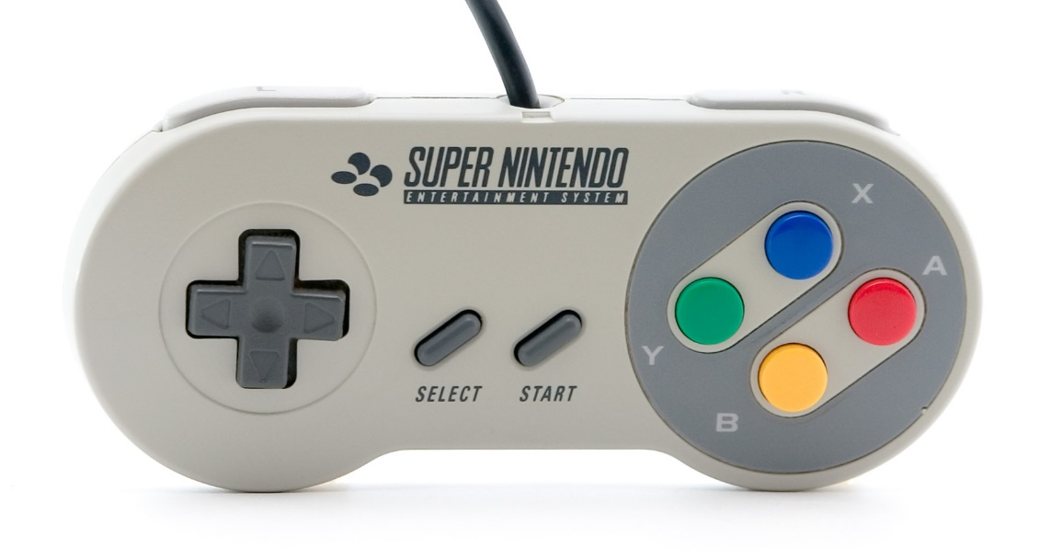
Car Control Core
State machine based on Operating mode: idle, autonomous, remote control, emergency brake
Sets car parameters (max speed)
Calculates the velocities of the individual motors
Modular idea: run image processing, more fancy control code.

Slide 17
C2X protocol: the packets
‘C’ | ‘A’ | ‘R’ | ‘P’
packet counter |  | payload length
type | … | length | …
payload
type | … | length | …
payload
C2X protocol header
Car Message 1
Car Message 2

Slide 18
C2X protocol: what‘s supported
‘C’ | ‘A’ | ‘R’ | ‘P’
packet counter |  | payload length
type | … | length | …
Available message types:
0x30 - State
0x60 - RemoteControl
0x08 - GoalPose
0x01 - EmergencyBrake
0x02 - MotorVelocity
0x03 - MotorMeasurement

Slide 19
C2X protocol: what‘s supported
‘C’ | ‘A’ | ‘R’ | ‘P’
0x0000 |  | 0x0008
0x60 | … | 0x04 | …
0x10 | 0x15 | 0x10 | 0x15
Available message types:
0x30 - State
0x60 - RemoteControl
0x08 - GoalPose
0x01 - EmergencyBrake
0x02 - MotorVelocity
0x03 - MotorMeasurement

Slide 20
GUI (HAGEN)

Slide 21
Further Steps (HAGEN)
Documentation
Get the system running ... Usw

