Slide 1
Car2X Communication
Florian Janßen, Hagen schmidtchen,
paul bergmann, johannes Windelen

Slide 2
Project Goal
allow cars to communicate with each other and with control stations
exchange diagnostics
receive situational information and emergency broadcasts
information gain leads to improved path planning and car control

Slide 3
Main Working Steps so far
Reading the documentation and getting into the previous group‘s code
Installation and tutorials for the Altera Quartus software (FPGA)
Learn about the Nios II and multicore implementations on FPGA
Planning the Car2X Protocol and the general hardware setup
Current WIP:
Basic Quartus hardware implementation
Experiments with the wireless converter hardware
Setting up PC as car2x station

Slide 4

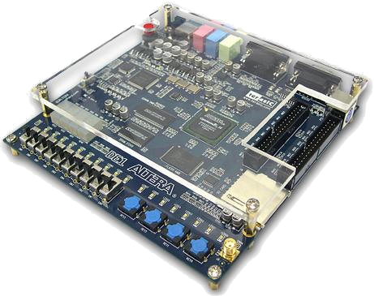
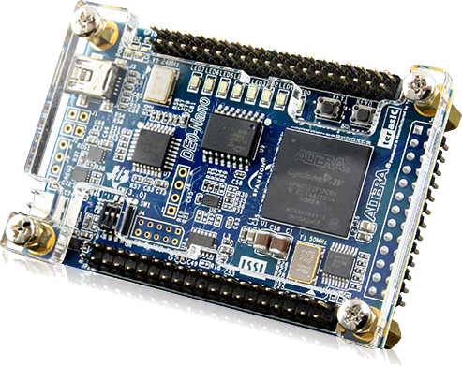
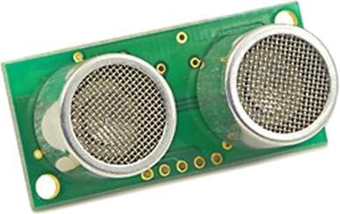
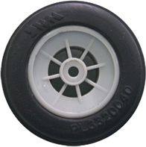
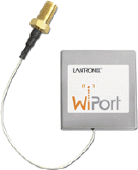
Hardware Setup
4x
H-Bridge

Slide 5
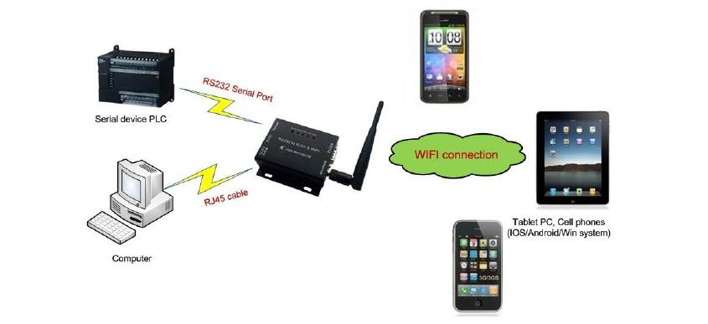
WiPort
Wireless networking server
WiFi antenna, serial and LAN port
TCP/IP communication with external systems (other cars, basestation, etc.)

Slide 6
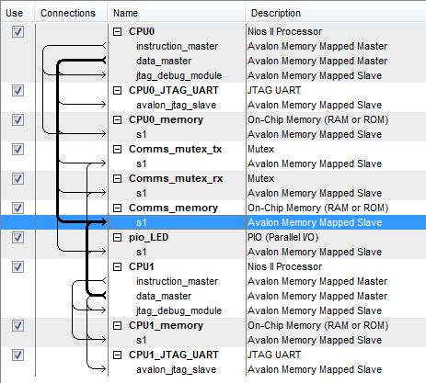
FPGA Configuration
2x NiosII CPUs (each with their own JTAG, data/instruction memory)
1x shared memory for inter-core communication
Hardware mutexes for different shared memory areas
Ethernet controller

Slide 7
Communication Flow
Other sensing
Altera FPGA
Telnet CarProtocol
C2xProtocol
Motor controllers
memory
Core 2
Switch
Core 1
ethernet
WiPort
Core 0
Image processing

Slide 8
Car2x Protocol-Structure
Message ID (2Bytes) |  |  | Payload length (1Byte) | Payload
0-2 | 3-7 | 8-15 | 16-23 | 24-x
Type | Subtype | Reserved | Length of payload in Bytes | Message payload

Slide 9
Car2x Protocol-Message Types
“00” InfoMessage (from station or other car)
“00” currentSpeed
“01” steeringInformation
“01” EmergencyInfoMessage
“00” emerencyBreaking
“10” PollingMessage (from Image Processing Unit)
“00” pollInfoMessages
“01” pollOwnSpeedSensorData
“10” pollIRSensorData
“11” ControlMessage (station or Image Processing Unit to Remote-Control the Car)
“00” setMotorControlMessage

Slide 10
Further Steps
Migrate last years code to the new FPGA design
Implement Car2X protocol
Add WiPort communication

