Slide 1

AFLA BEGINNER GUIDE 2 OF 3
Germline analysis
From reads to a classified variant: QC, filtering, inheritance, ACMG/AMP evidence and the case report
Education and research use only · not for clinical diagnosis or patient management

Slide 2
What happens when you click Run
Every box can be switched on or off in the form
1
2
3
4
5
Clean reads
Align
Call variants
Extra layers
Annotate
fastp removes adapters and poor-quality ends; writes a QC report.
bwa places reads on GRCh38; duplicates marked (capture) or primers clipped (amplicon).
GATK or DeepVariant (GPU). Families are genotyped together.
CNV (CNVkit), runs of homozygosity, structural variants (Manta).
VEP adds genes, HGVS, gnomAD, ClinVar, REVEL, AlphaMissense; AFLA adds ACMG evidence and HPO ranking.
AFLA · education and research only · 2

Slide 3




Setting up a case
Optional fields that make the report much smarter
Sample sheet (families)
HPO terms
CSV with sample, role, sex, family, hpo. Family members are called together, so de novo and compound heterozygous variants can be recognised.
The patient's features as HPO codes, e.g. HP:0001250 (seizure). Genes are ranked by how well their known phenotypes match.
Gene list / panel
Case ID
Genes to focus on, or a PanelApp panel chosen inside the report: a "virtual panel" that avoids incidental findings.
A pseudonym printed on the report. Never use a patient's name.
AFLA · education and research only · 3

Slide 4
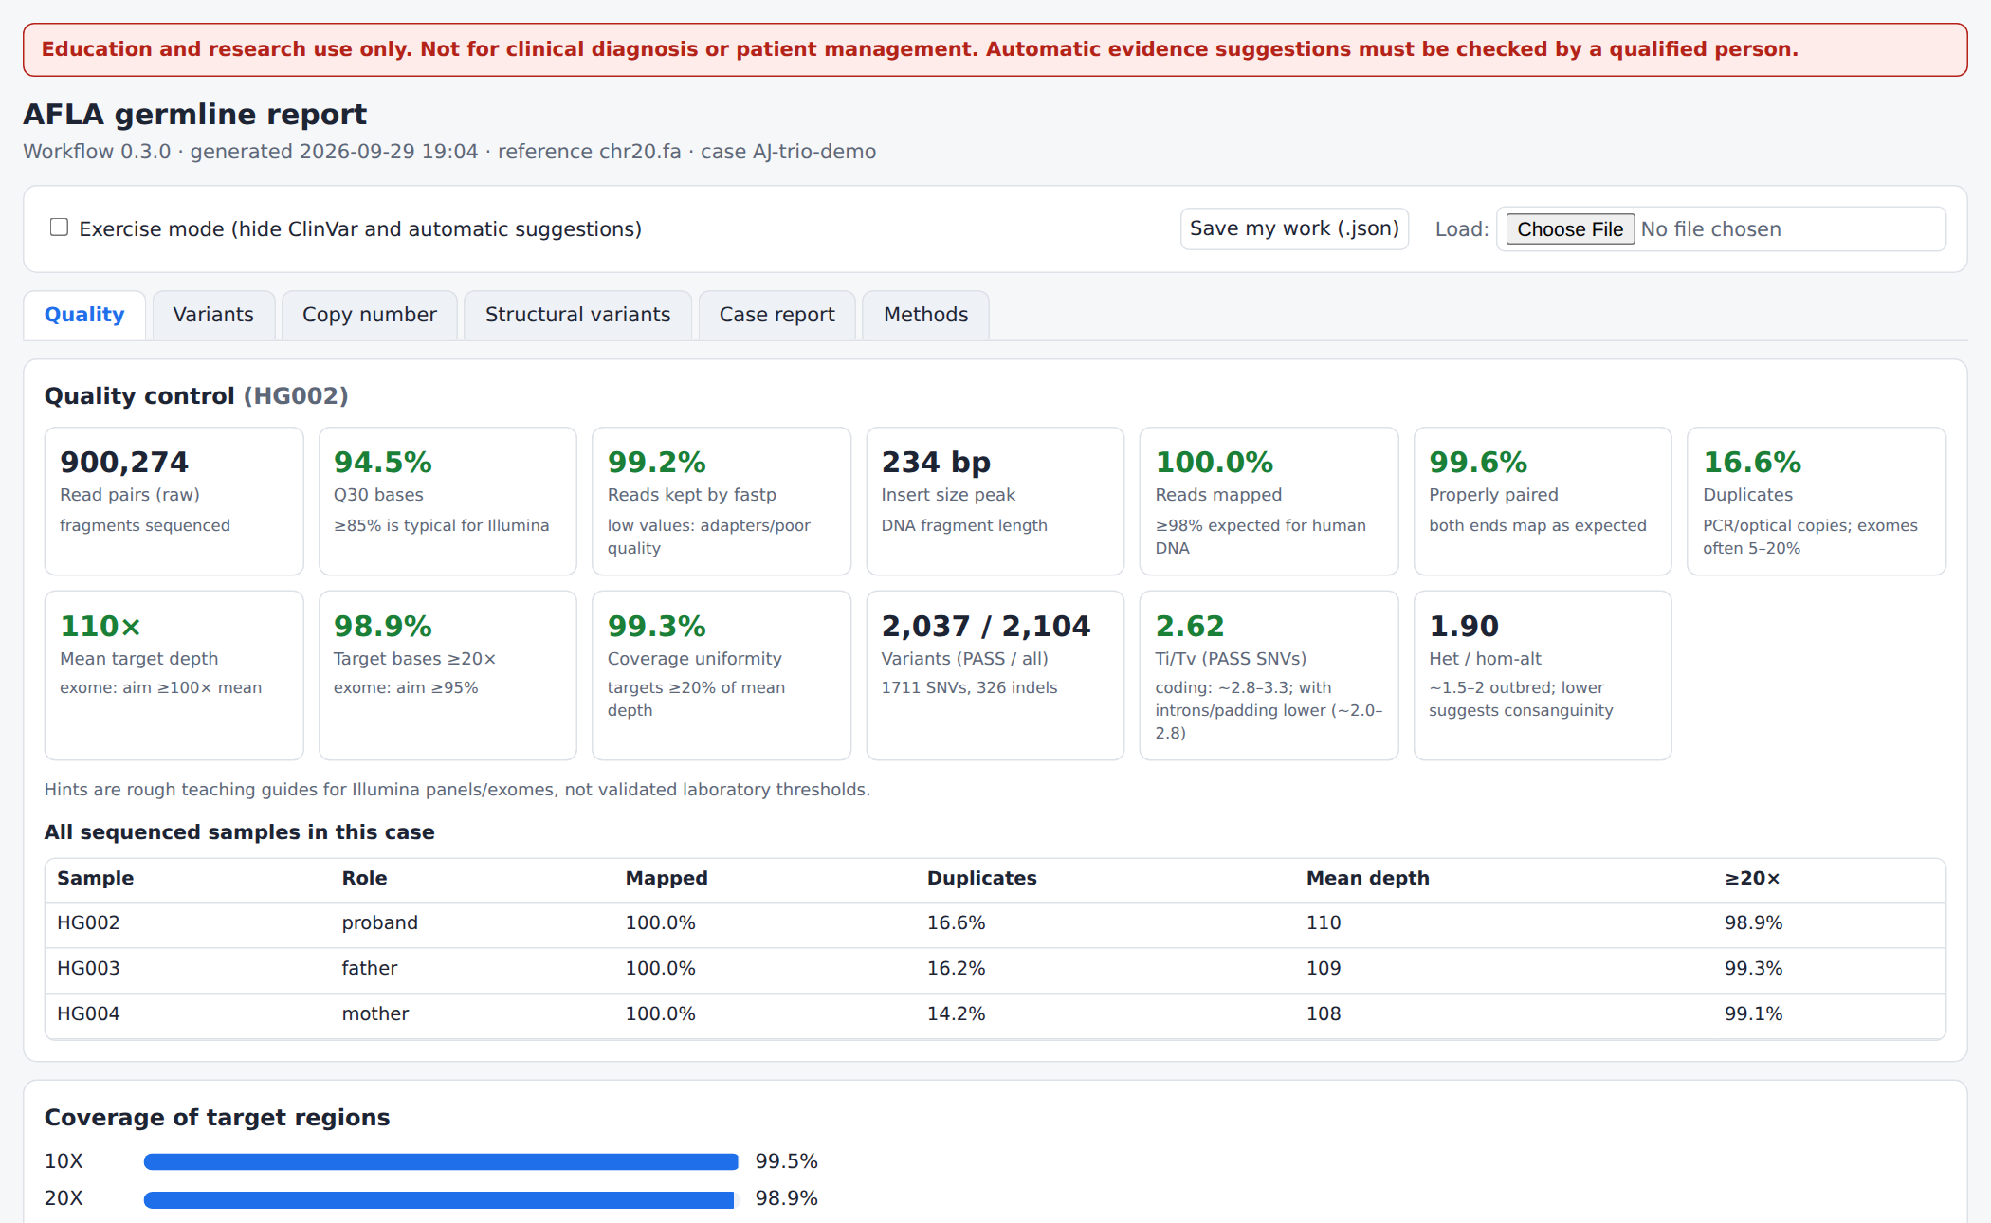
Tab 1: Quality
Is the sequencing good enough to trust a negative result?
Mapped reads ≥ 98% for human DNA.
Duplicates exomes often 5-20%.
Mean depth exome ≥ 100×.
≥ 20× aim for ≥ 95% of targets.
Ti/Tv, het/hom sanity checks of the calls.
Low-coverage list regions where a variant could be missed.
Real report: GIAB trio, chromosome 20 exome
AFLA · education and research only · 4

Slide 5
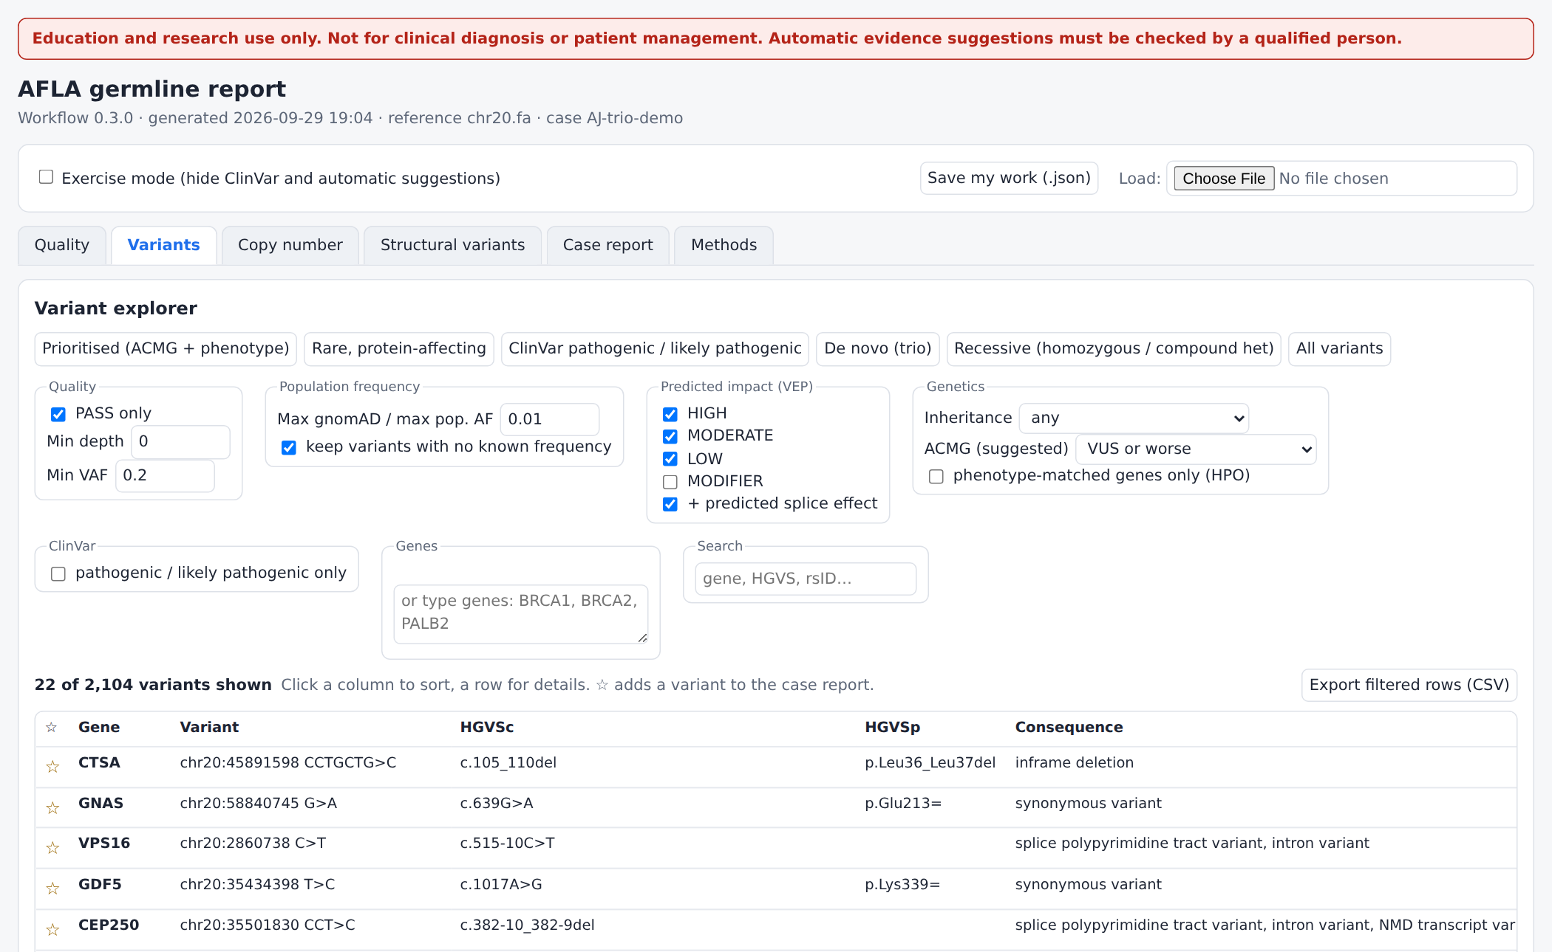
Tab 2: Variants
Presets do the first filtering for you
Prioritised ACMG points + phenotype match + your gene list.
Rare, protein-affecting gnomAD ≤ 1%, HIGH/MODERATE impact.
ClinVar P/LP already reported as disease-causing.
De novo / Recessive for trios.
Click a column to sort; a row to open details.
Presets, filters and the variant table
AFLA · education and research only · 5

Slide 6
Filtering is a funnel
Real numbers from one exome slice (HG002, chromosome 20)
A whole exome has 20,000-50,000 variants; most are common and harmless.
Filters remove what cannot explain a rare disease.
What remains is reviewed one by one: that is interpretation.
Too strict a filter can hide the answer: always know what you removed.
AFLA · education and research only · 6

Slide 7
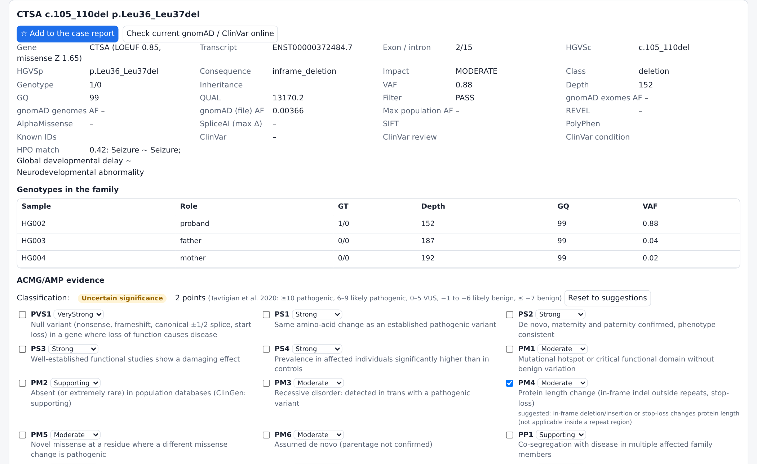
The variant card
Everything about one variant, plus the family
Gene, transcript MANE Select transcript, exon, HGVS names.
Frequency gnomAD exomes/genomes, max population.
Predictions REVEL, AlphaMissense, SpliceAI.
Family genotype, depth and VAF of each member.
Links gnomAD, ClinVar, UCSC, ClinGen, OMIM, PubMed, PanelApp.
Online check current gnomAD/ClinVar with one click.
Detail card with family genotypes and links
AFLA · education and research only · 7

Slide 8
Reading a trio
Inheritance labels AFLA adds automatically
Label | Child | Mother | Father | Think of
de novo | het (≈50%) | ref | ref | dominant disorders, new mutations
possible de novo (low VAF) | het < 25% | ref | ref | usually artefact; sometimes mosaic
homozygous | hom | het | het | recessive disorders (consanguinity)
compound heterozygous | het + het | one | the other | recessive, two different variants
hemizygous (X-linked) | hom (male) | het | ref | X-linked recessive in boys
inherited from ... | het | het | ref | dominant if that parent is affected
In our GIAB test, all 5 "de novo-looking" calls had 8-17% of reads: artefacts. True constitutional de novo variants sit near 50%.
AFLA · education and research only · 8

Slide 9
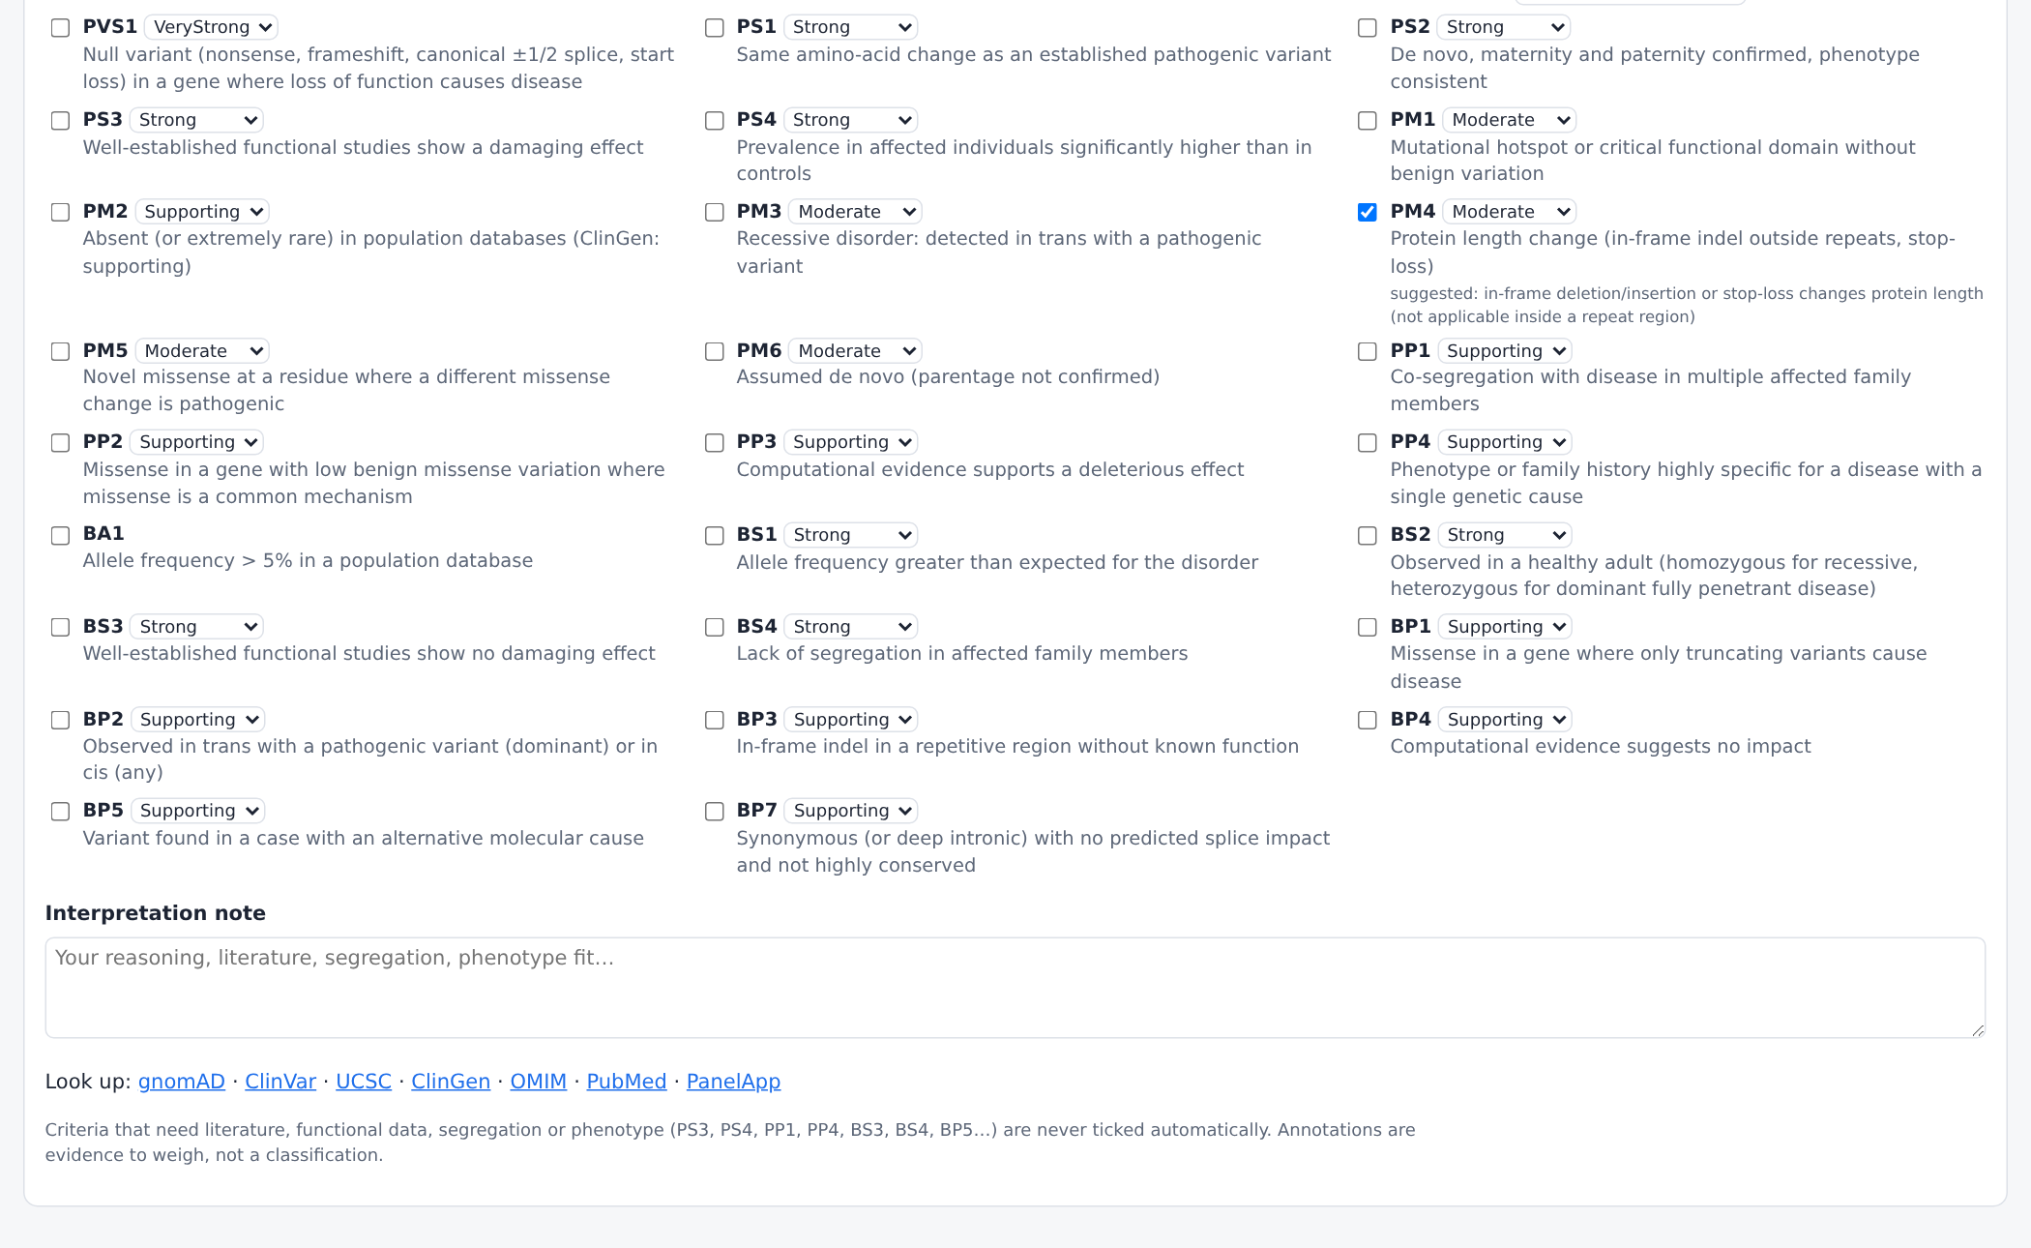
ACMG/AMP evidence panel
Tick the evidence; the class updates live
Suggested from data: PVS1, PS1, PM2, PM4, PM5, PP3/BP4, BA1, BS1, BP7, PM6, PM3.
Never automatic PS3, PS4, PP1, PP4, BS3, BS4, BP5: need literature, segregation or phenotype.
Strength change it with the drop-down (e.g. PP3 strong for REVEL ≥ 0.932).
Note write your reasoning; star ☆ to report.
All 26 criteria; suggested ones pre-ticked with the reason
AFLA · education and research only · 9

Slide 10
From evidence to a class
Bayesian points (Tavtigian et al. 2020)
8
4
2
1
Very strong (e.g. PVS1)
Strong (e.g. PS1, PP3 strong)
Moderate (e.g. PM4, PM5)
Supporting (e.g. PM2, PP3). Benign criteria count negative
Total points | ≥ 10 | 6 to 9 | 0 to 5 | -1 to -6 | ≤ -7 (or BA1)
Class | Pathogenic | Likely pathogenic | Uncertain significance | Likely benign | Benign
Example: stop-gain in a loss-of-function intolerant gene (PVS1 = 8) absent from gnomAD (PM2 = 1) and de novo (PM6 = 2) → 11 points → Pathogenic.
AFLA · education and research only · 10

Slide 11



Phenotype matching (HPO)
Which genes fit the patient?
You enter features
AFLA compares
Genes rise
e.g. seizure (HP:0001250) + global developmental delay (HP:0001263).
with each gene's known features in the Human Phenotype Ontology (semantic similarity, 0-1).
In our test, epilepsy genes (SLC12A5, KCNB1, KCNQ2, EEF1A2) ranked top on chromosome 20.
A high HPO score is support, not proof: the healthy GIAB sample has none of these diseases.
Precise, specific terms help more than general ones ("infantile spasms" beats "seizure").
AFLA · education and research only · 11

Slide 12
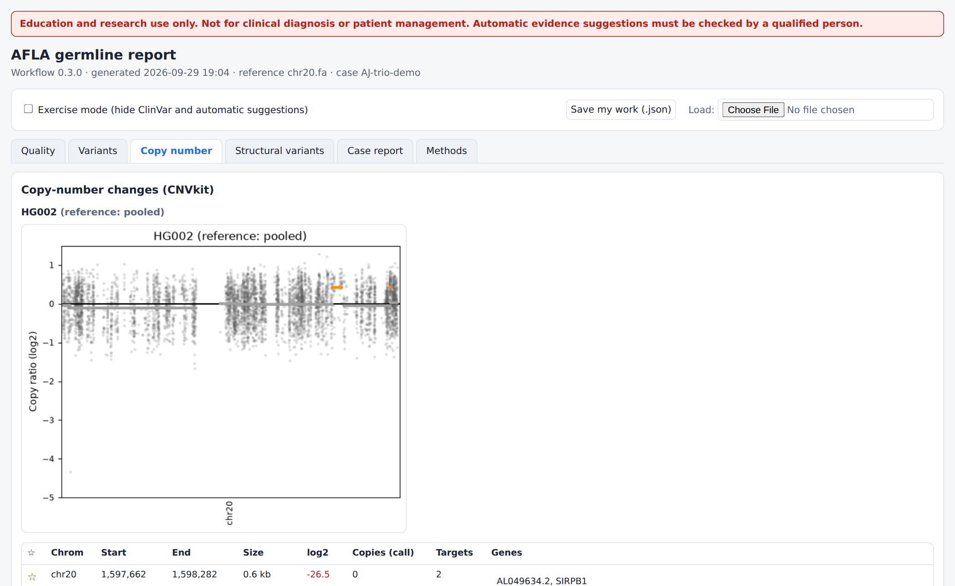
Copy number and homozygosity
Beyond single-letter changes
log2 ≈ -1 one copy lost; ≈ +0.58 one copy gained.
Reference matters "pooled" (3+ samples, same kit) or your own; "flat" is weak.
Confirm CNVs by MLPA, array or qPCR.
ROH long homozygous stretches: consanguinity, and where recessive genes hide.
CNVkit plot and segments (reference: other samples of the run)
AFLA · education and research only · 12

Slide 13
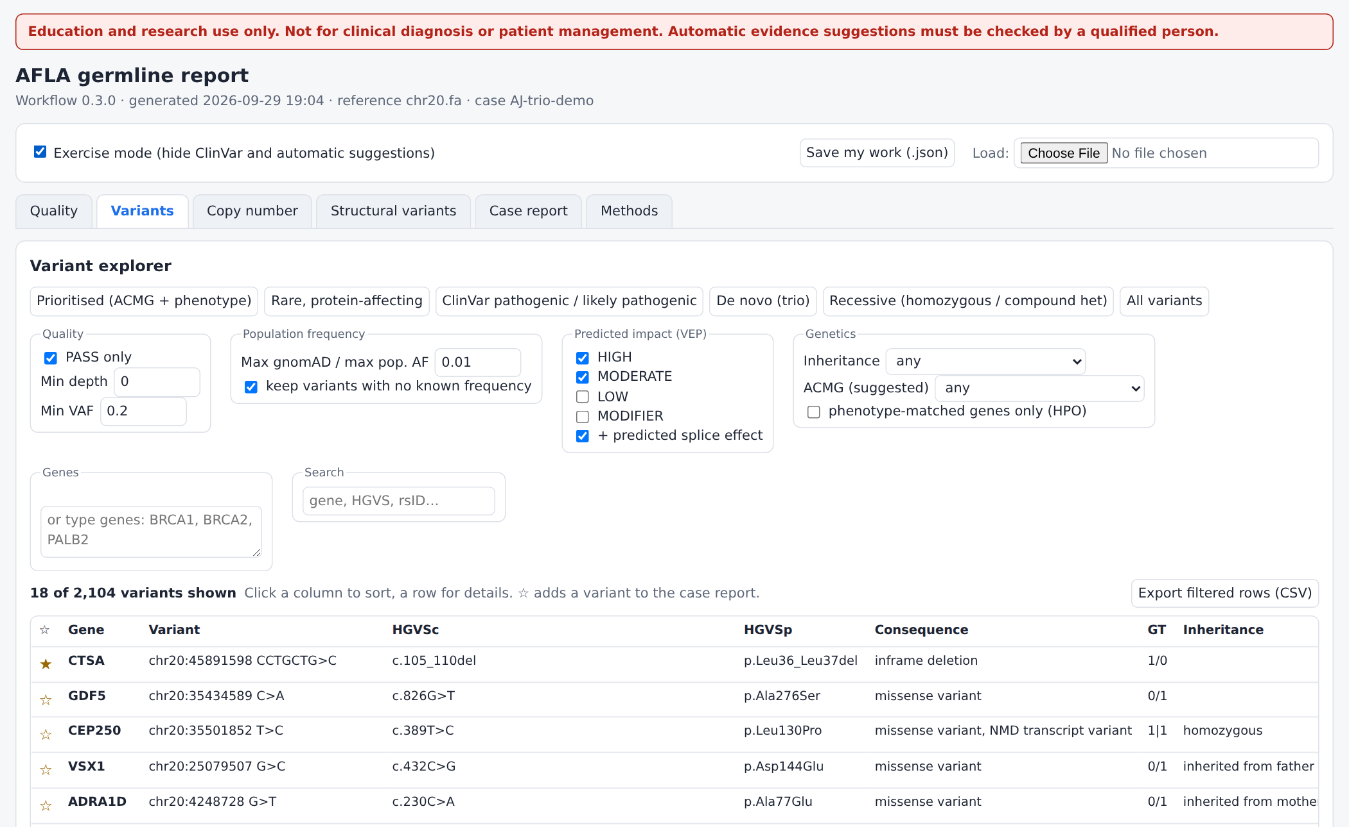
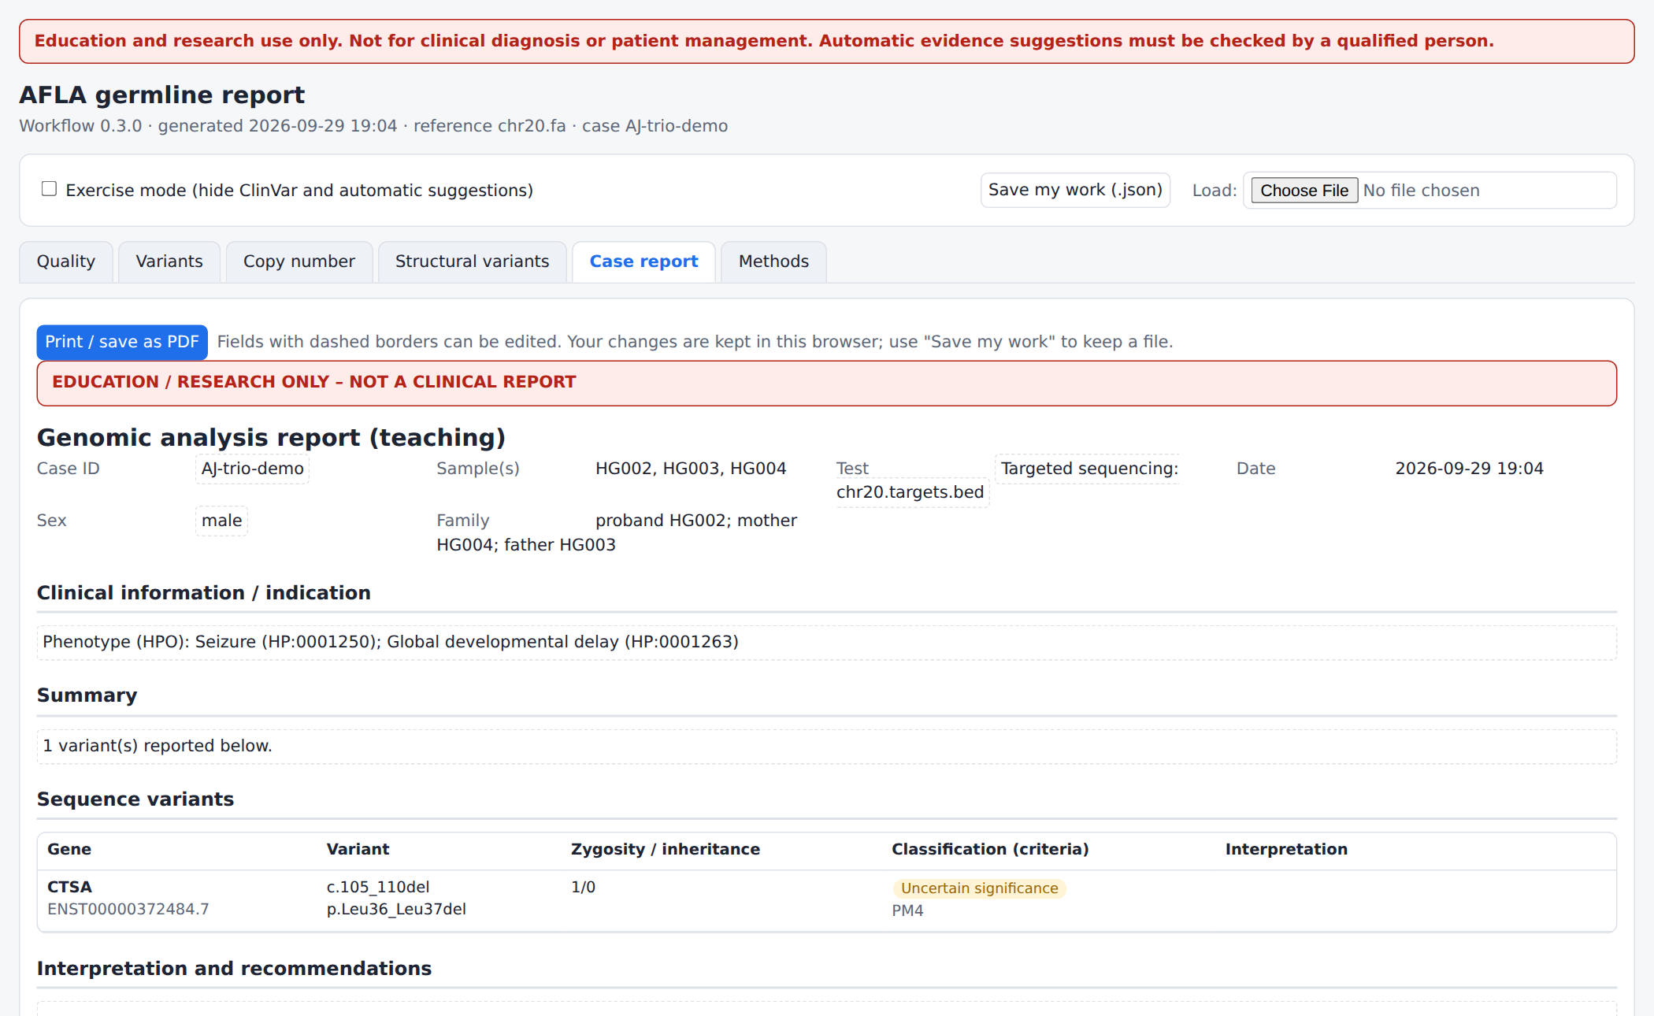
Exercise mode and the case report
Learn by doing, then compare
Exercise mode hides ClinVar and suggestions
Printable case report built from your ☆ choices
Students classify blind, then untick exercise mode to compare.
"Save my work" keeps stars, criteria and notes in a small file for marking.
AFLA · education and research only · 13

Slide 14
How accurate is it?
Scored against Genome in a Bottle truth sets (chr20 exome targets, GATK)
SNVs: > 99.7% found, almost no false calls.
Indels are harder (small numbers here: ~30 per sample).
Main false calls: low-VAF indels in homopolymers; the LowVAF label removes most of them.
Repeat this benchmark yourself: scripts/afla-benchmark.sh (deck exercise 2).
AFLA · education and research only · 14

Slide 15

Germline pitfalls to remember
No coverage, no conclusion: check low-coverage regions before calling a result negative.
Low VAF "heterozygous" calls are usually artefacts; confirm anything important by Sanger.
Pseudogenes and repeats (PMS2, SMN1, CYP2D6, repeat expansions) are not reliable with short reads.
ClinVar changes: re-check with the live button; frequencies matter as much as predictions.
Suggestions are a start: the classification is yours, with literature and family data.
AFLA · education and research only · 15

