Slide 1

AFLA BEGINNER GUIDE 3 OF 3
Somatic (tumour) analysis
Low-frequency variants, UMIs and amplicons, tumour-only vs paired, TMB, MSI, evidence and tiers
Education and research use only · not for clinical diagnosis or patient management

Slide 2
Germline vs somatic
Same reads, different questions
 | Germline | Somatic
Where the variant is | every cell, from conception | only in tumour cells
Expected VAF | ≈ 50% (het) or 100% (hom) | anything: 1-60%, depends on purity and clonality
Caller | GATK HaplotypeCaller / DeepVariant | GATK Mutect2
Depth needed | ≥ 20× per base | often ≥ 200-500× for panels
Main risk | missing a variant in low coverage | calling artefacts or germline variants as somatic
Interpretation | ACMG/AMP pathogenicity | AMP/ASCO/CAP tiers (clinical actionability)
AFLA · education and research only · 2

Slide 3
Running a tumour
EPI2ME → AFLA somatic
1
2
3
4
5
Input
Pairing
Library
Tumour type
Run
Tumour FASTQ/BAM; add the normal (blood) sample if you have it.
Sample sheet: roles tumour/normal with the same family (patient) ID, or type the normal's name.
Amplicon? tick it + primer BED. UMIs? inline or read_name.
Free text, e.g. "colorectal cancer": evidence in the same tumour type → tier I.
Mutect2, CNV, MSI, TMB, evidence, tiers, report.
AFLA · education and research only · 3

Slide 4


Amplicons and UMIs, simply
Two chemistries that change the analysis
Primer clipping
UMI consensus
Primer bases copy the oligo, not the patient. AFLA soft-clips them using the primer BED, so they cannot hide or fake variants at amplicon ends. In a test, 335,038 reads were clipped with 98% amplicon uniformity.
Each original DNA molecule carries a barcode (UMI). Reads with the same UMI are merged: random PCR and sequencing errors disappear. In a simulation, AFLA recovered the planted families of 1-4 reads exactly.
Read structures: "8M+T 8M+T" = 8-base UMI on both reads; "+T 12M11S+T" = QIAseq (UMI + spacer on read 2).
Illumina manifest → primer BED: python3 scripts/manifest_to_primers.py manifest.txt mypanel
AFLA · education and research only · 4

Slide 5


Tumour-only or tumour + normal?
The normal sample is the best germline filter
Tumour + matched normal
Tumour-only
Variants also in the normal are inherited, not tumour. Most reliable; needed for accurate TMB.
Germline variants must be guessed from gnomAD, the panel of normals and VAF. AFLA shows an "origin hint": somatic candidate / possible germline (VAF) / likely germline (population).
Practice data: an in-silico "tumour" made by mixing 20% of one person's reads into another's. Their private variants appear at ≈10-15% VAF, and common polymorphisms are correctly rejected as germline.
AFLA · education and research only · 5

Slide 6
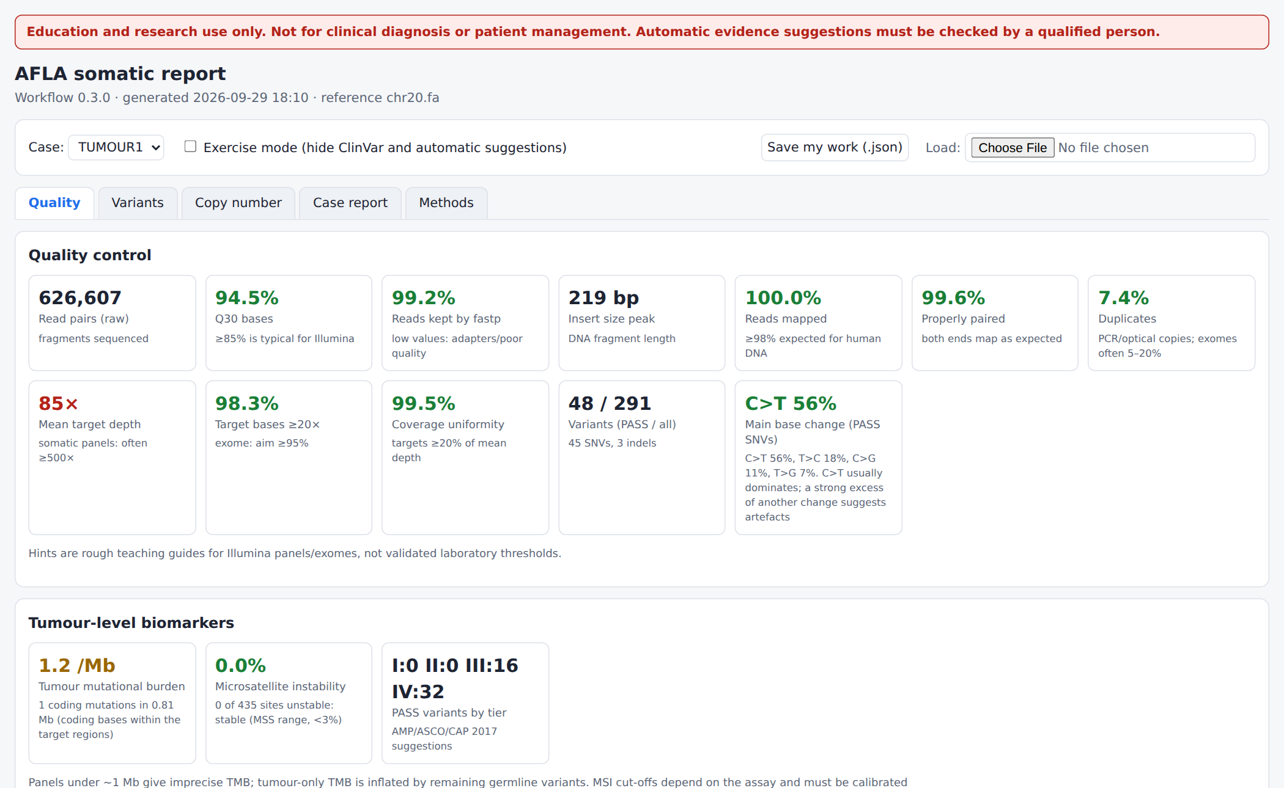
Tumour-level biomarkers
TMB and MSI in the Quality tab
TMB coding mutations per Mb. Panels < 1 Mb are imprecise; tumour-only inflates it.
MSI % unstable microsatellites (msisensor-pro). Cut-offs must be calibrated per assay.
Base-change spectrum one dominant unusual change (e.g. T>C) points to artefacts.
Somatic report: QC tiles, base-change spectrum, TMB, MSI, tiers
AFLA · education and research only · 6

Slide 7
Tiers: how actionable is a variant?
AMP/ASCO/CAP 2017, suggested by AFLA, decided by you
I
Strong clinical significance
Level A/B evidence (CIViC) or OncoKB level 1/2 in THIS tumour type
II
Potential clinical significance
A/B in another tumour type, level C/D, OncoKB 3/4, recurrent COSMIC hotspot
III
Unknown significance
No evidence found, rare in the population
IV
Benign or likely benign
Common in the population (≥ 1%) or ClinVar benign
AFLA · education and research only · 7

Slide 8
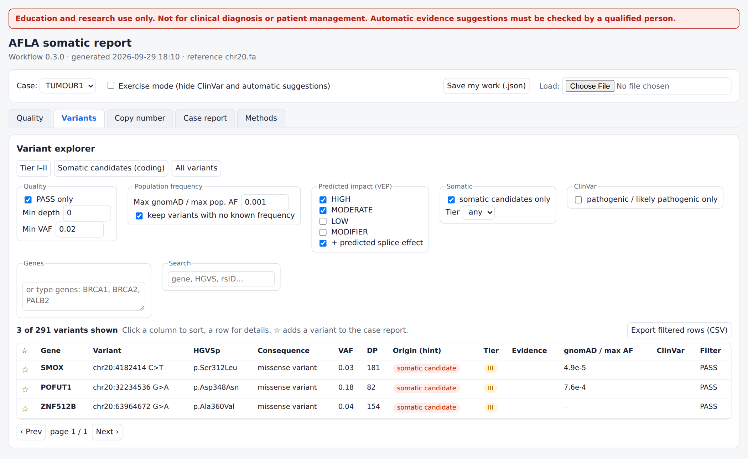
Variants tab (somatic)
Tier, origin hint and evidence in one view
Origin hint somatic candidate vs likely germline.
Tier hover to see why.
Evidence CIViC items, OncoKB level, COSMIC count.
Details click a row: evidence table with therapies and links.
Presets: Tier I-II, Somatic candidates, All
AFLA · education and research only · 8

Slide 9




Evidence sources
All free for education; some need registration
CIViC
OncoKB
Open (CC0) expert-curated cancer evidence: therapies, diagnosis, prognosis. Downloaded by afla-setup.sh.
Precision oncology knowledge base. Free academic token; queried online during the run.
COSMIC
ClinVar somatic
How often a mutation is seen in cancers. Free for academic use after registration; you download it.
Oncogenicity and clinical-impact classifications (ONC/SCI fields) in the same ClinVar file.
AFLA · education and research only · 9

Slide 10


Copy number and fusions in tumours
Amplifications, deletions, rearrangements
CNV (CNVkit)
Fusions (Manta)
Gains/losses vs the normal (or other normals). Strong amplifications/deletions are matched to CIViC (e.g. ERBB2 amplification). Purity dilutes log2 ratios.
Translocations between two genes appear as fusion candidates, only if the breakpoint lies near baited regions. Confirm by RNA or FISH.
Exome/panel CNV is screening-level: confirm clinically relevant changes by another method.
RNA fusion panels (e.g. anchored multiplex PCR) are not supported yet.
AFLA · education and research only · 10

Slide 11
Practice exercise
Work it through, then discuss
1
2
3
4
5
Run
Predict
Check
Tier
Report
AFLA somatic on the practice tumour + normal (samples.csv).
Before looking: what VAF do you expect for a 20% contamination?
VAF column, origin hints, TMB and MSI.
Explain one tier I-IV each; remove the tumour type and compare.
Star findings, write interpretation, print the somatic case report.
AFLA · education and research only · 11

Slide 12

Somatic pitfalls to remember
Tumour-only cannot prove a variant is somatic: consider a germline test for hereditary cancer genes.
Low VAF + one dominant base change or strand-bias = suspect artefact (FFPE, PCR).
Purity matters: a 30% tumour gives ≈15% VAF for heterozygous clonal variants.
TMB and MSI thresholds are assay-specific; panels under 1 Mb are imprecise.
Tiers are suggestions from databases; actionability needs a tumour board.
AFLA · education and research only · 12

