Slide 1

HDF5 To PCAPNG Converter
Dr. Francisco J. Garcia
Master Researcher
Keysight Laboratories
frankie_garcia@Keysight.com
Documentation
Notes:
Explain -

Slide 2
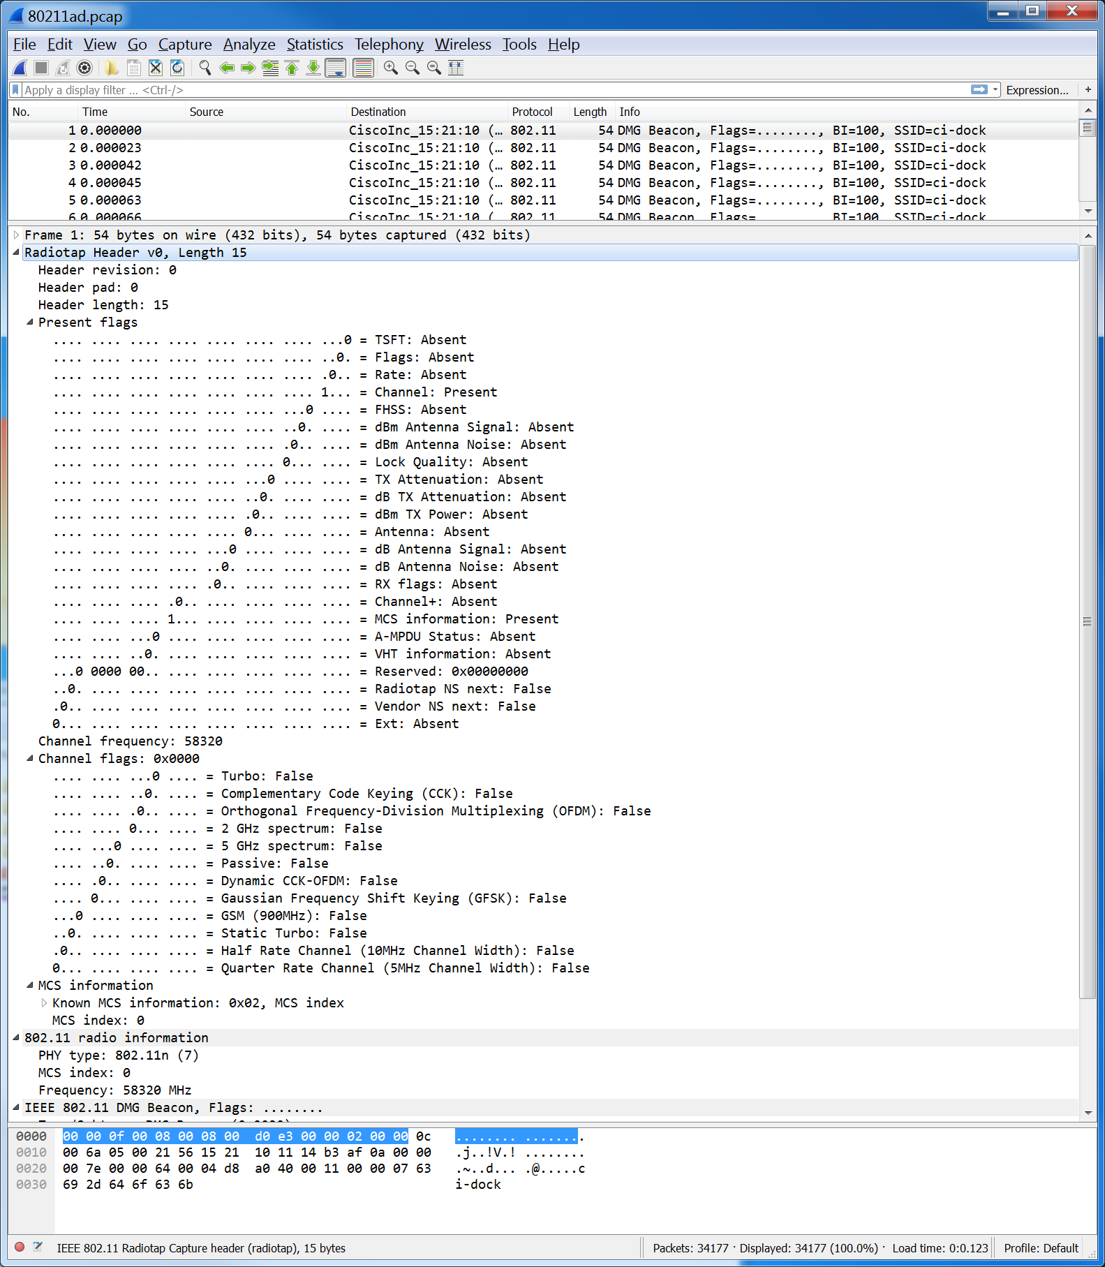
Wirshark Test Capture
File: 80211ad.pcapng
https://www.winpcap.org/ntar/draft/PCAP-DumpFileFormat.html#appendixLinkHeaders
This is where one wants to get too, which includes Time stamps, proper Radio Tap Header and interpretation of 802.11ad protocol

Slide 3
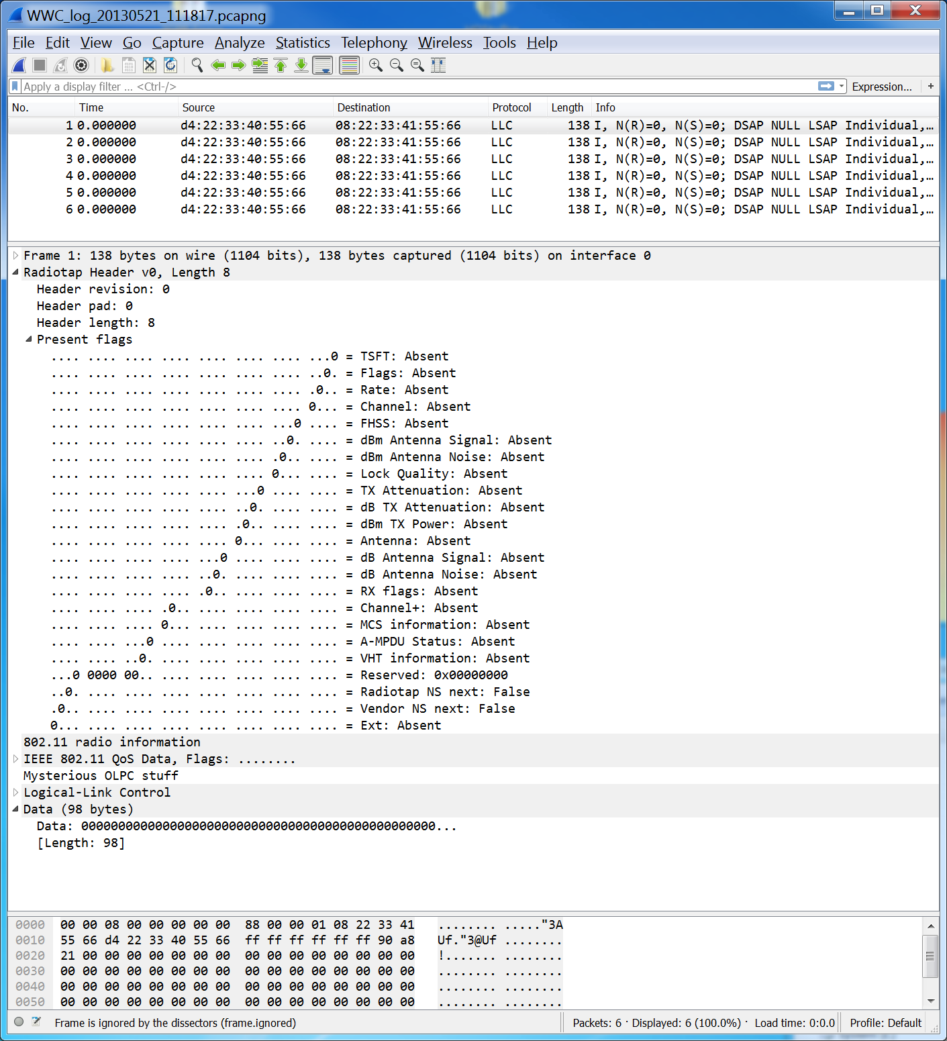
Wireshark Converted File
File: WWW_log_20130521_111817.pcapng
This is what we have put together for further development which needs:
Addition of proper time stamps, not sure how to extract or create these from HDF5 file?
Completion of proper Radio Tap Header, with addition of flag capabilities and fields. I think one of these fields identifies 802.11ad protocol? http://www.radiotap.org/
Templates are all there and the generated file parses, but it now need tuning!

Slide 4
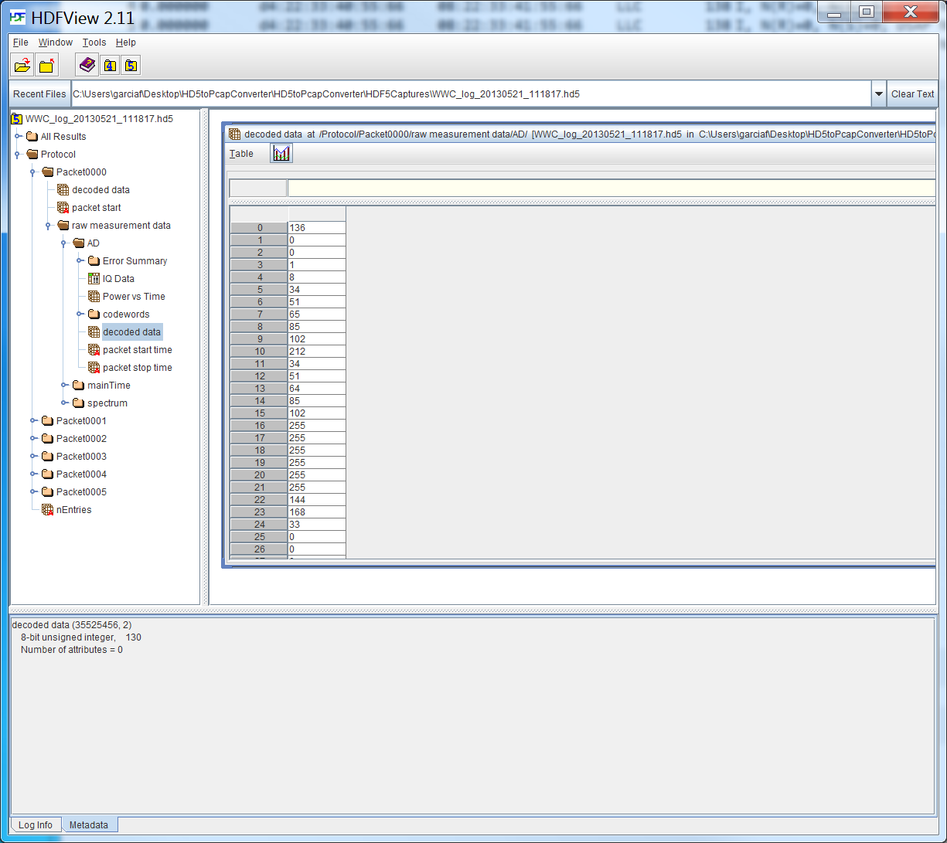
HDF5 Protocol Details
File: WWW_log_20130521_111817.hd5 – Using HDFView
Very rich data set from which we have only extracted the hex data representing the captured packet payload. The latter is written out as packet data wrapped around a pcapng:
Enhanced Packet Block
Radio Tap Header
Actual packet data, plus padding to align to 32-bit boundaries.
This is replicated for each packet in the “.hd5” capture file.

Slide 5
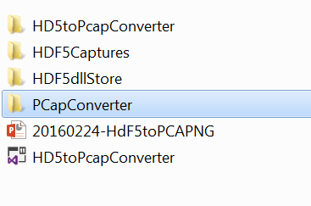
Tool Structure
HD5toPcapConverter – contains the Windows Console application that takes an “.hd5” file as input and converts it to an “.pcapng” file. This is where the parsing of both file types is controlled.
HDF5Captures – example “.pcapng” and “hd5” capture files
PCapConverter – C# library that contains implantations of the “.pcapng” headers use to create this capture format.
Some documentation with respect to the application
The pointer to the Microsoft Visual Studio Solution, use this to open the project, modify code, compile and test.
Need to download the .NET Framework assemblies from http://hdf5.net/
Typically we copy these dll’s to the HD5toPcapConveter/bin/Debug and /Release directories.

