Slide 1
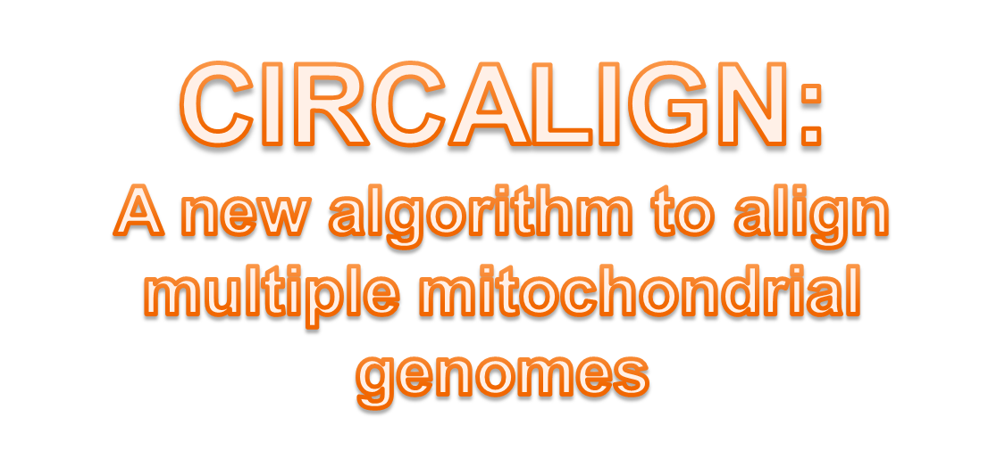


Jornadas de Bioinformática 2009
Francisco Fernandes, Luísa Pereira, Ana T. Freitas

Slide 2
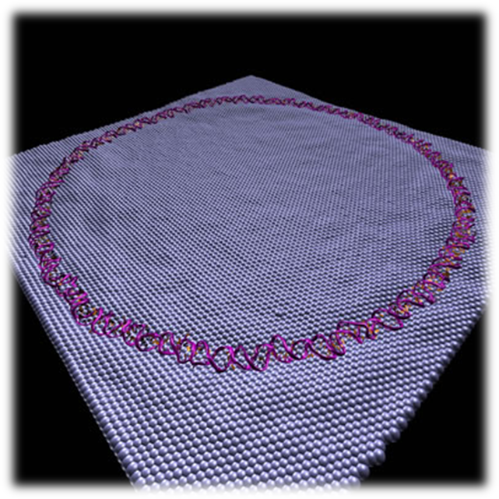
Circular DNA
Prokaryotes
Plasmids
Chloroplasts
Mitochondrias

Slide 3
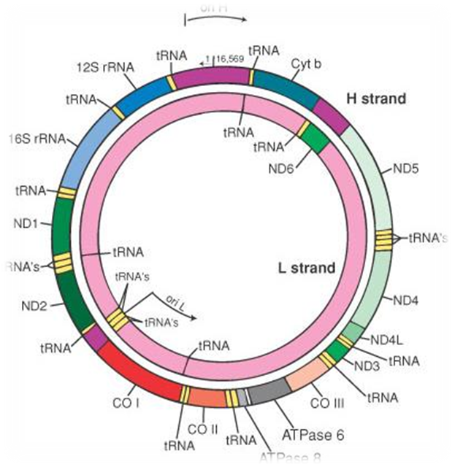
Circular to Linear
Human mtDNA
  (middle of D-loop)
Chimpanzee mtDNA
  (tRNA Phe + 577)

Slide 4
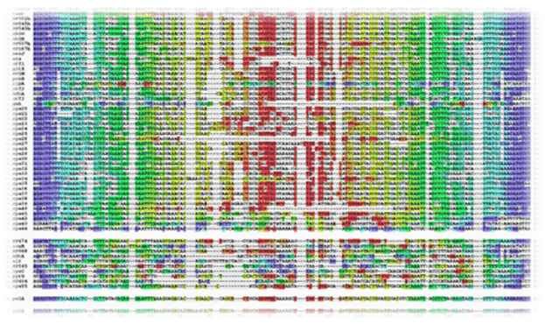
Background Tools
Dynamic Programming
Circal [1]
Cyclope [2]
[1] Fritzsch et al: Alignments of Mitochondrial Genome Arrangements: Applications to Metazoan Phylogeny, 2006.
[2] Mosig et al: Comparative Analysis of Cyclic Sequences: Viroids and other Small Circular RNAs, 2006.

Slide 5
Simple Example
Rotations:
A C A C G
C A C G A
A C G A C
C G A C A
G A C A C
A
G
C
C
A

Slide 6
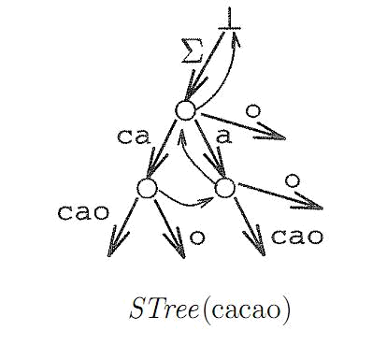
Suffix Tree
Ukkonen’s online construction algorithm
    string S of size n
    depth d
    character S[k]
  Right pointer of open leaf:
  k+(n-d-1)
  Reading node labels:
  if(k>n) k = k-n
Ukkonen: On-line Construction of Suffix Trees, Algorithmica, 1995.

Slide 7
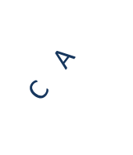
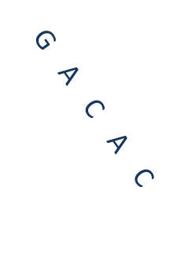
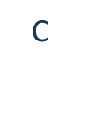

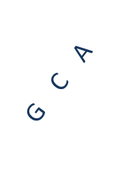
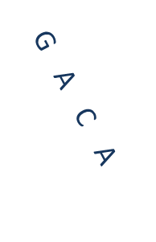

Cyclic Suffix Tree
0 | 1 | 2 | 3 | 4
A | C | A | C | G
5 | 6 | 7 | 8 | 9
A | C | A | C | G
0
4
1
1
1
2
4
2
4
4
6
5
7
8

Slide 8
Multiple Sequences
A C A C G
C G T G A
T G A C

Slide 9
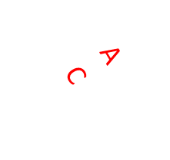
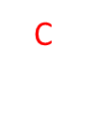
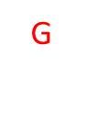
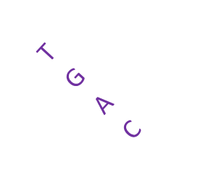
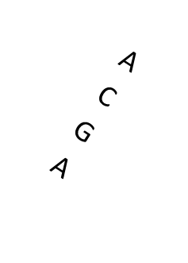
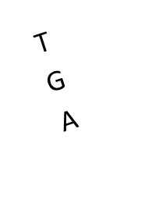

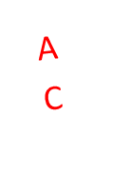
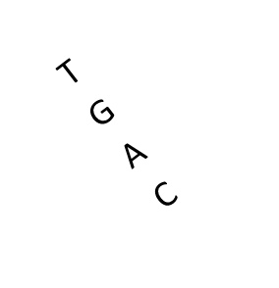
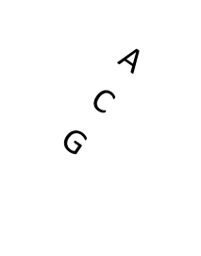
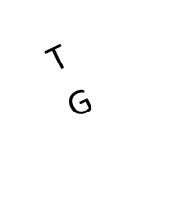
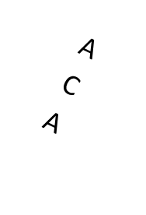

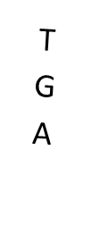
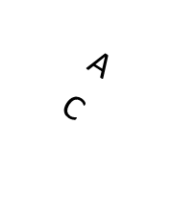
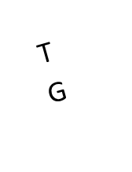
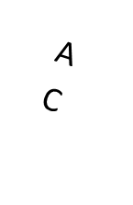
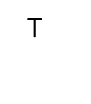
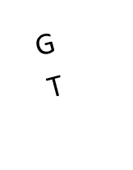
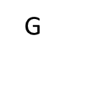
Generalized Cyclic Suffix Tree
A C A C G
C G T G A
T G A C

Slide 10
Best Rotation
Longest Unique Common Substrings: GAC
A C A C G
C G T G A
T G A C
G A C A C
G A C G T
G A C T

Slide 11
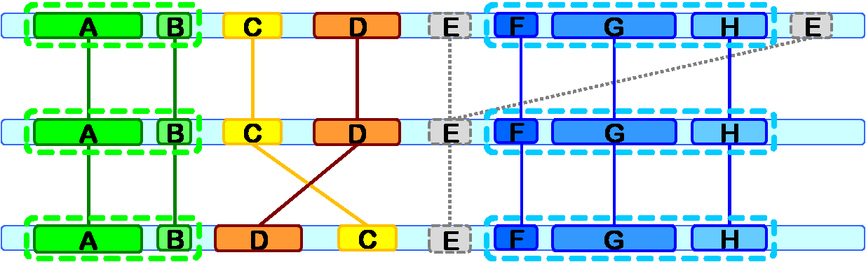
Longest Chain of Blocks

Slide 12
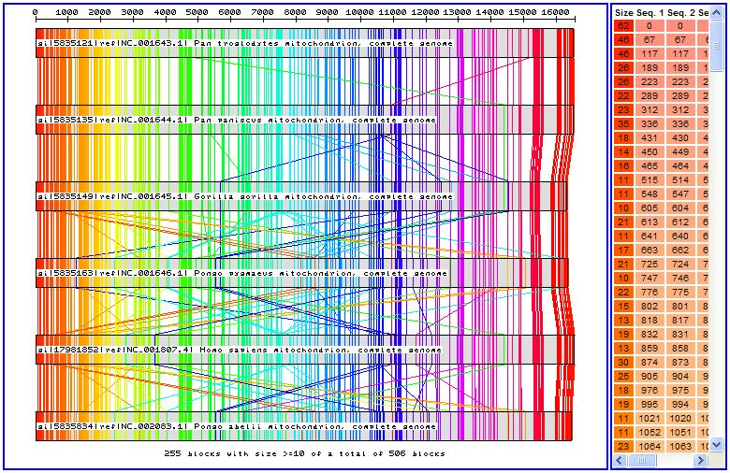
CSA Example
Fernandes et al: CSA - An efficient algorithm to improve circular DNA multiple alignment. BMC Bioinformatics, 2009.

Slide 13
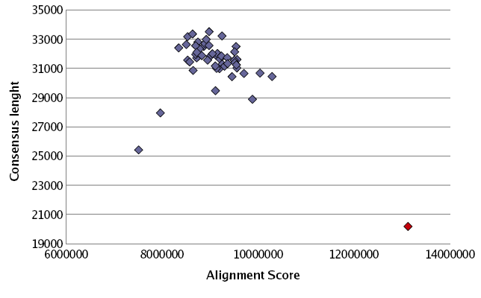
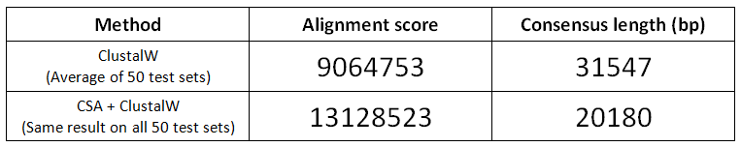
CSA Tests
Fernandes et al: CSA - An efficient algorithm to improve circular DNA multiple alignment. BMC Bioinformatics, 2009.

Slide 14
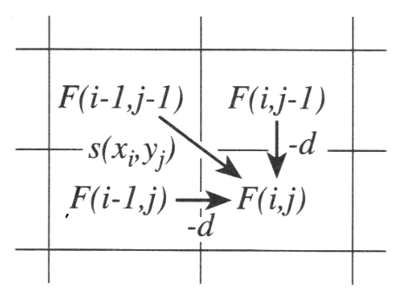
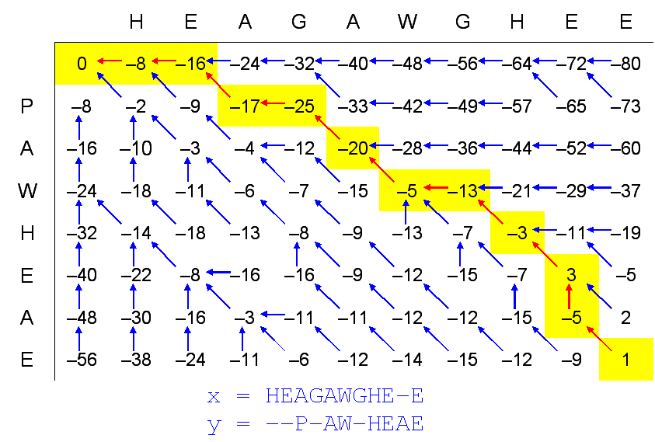
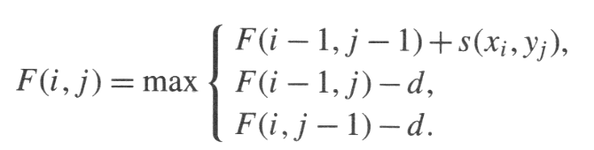
Needleman-Wunsch

Slide 15
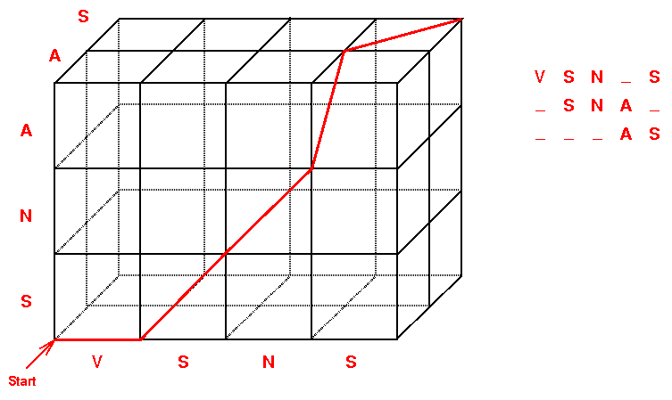
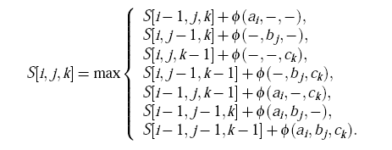
Exact Sequence Alignment
Number of sequences (of size 1000) | Alignment Time
2 | 1 second
3 | 17 minutes
4 | 11 days
5 | 31 years
6 | 317 centuries
... | ...

Slide 16
New Idea

Slide 17
Normal Progressive Alignment
ACCTT, ACGT, ACTT
ACCTT
ACGT
ACCTT
A-CGT
ACCGT
Alignment
Consensus
ACCGT
ACTT
ACCGT
ACT-T
Next Sequence
Alignment
Score(match)=+1
Score(mismatch)=-1
Score(gap)=-1
ACCTT
A-CGT
ACT-T
Score=3+(-1)+(-1)+(-3)+3=1

Slide 18
Our Method
ACCTT, ACGT, ACTT
ACCTT
ACGT
ACCTT
A-CGT
Alignment
ACCTT
A-CGT
ACCTT
A-CGT
Next Sequence
Alignment
ACTT
A-CTT
ACCTT
A-CGT
A-CTT
Score=3+(-2)+3+(-1)+3=6

Slide 19
Detailed Score Example
 | … |  | … | A | …
 | … |  | … | A | …
 | … |  | … | - | …
 | … |  | … | - | …
 | … |  | … | C | …
 | … |  | … | T | …
 | … |  | … | - | …
… | … |  | … | … | …
 |  | …
… | … |  | x | z
A | … |  | y |  | …
… |  |  |  | …
A
A
-
-
C
T
-
…
A
A
A
-
-
C
T
-
…
-
-
-
-
-
-
-
-
…
A
Diagonal
X+2*(1)+5*(-1)
Left
Y+4*(-1)
Up
Z+7*(-1)

Slide 20
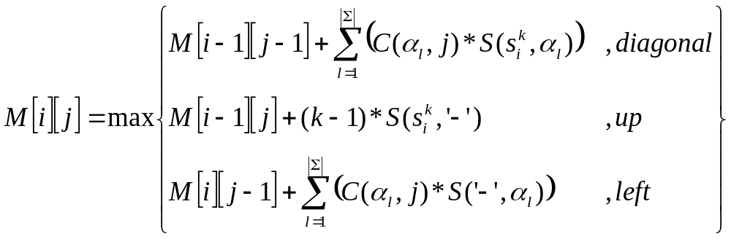
Recurrence
k-th sequence of a set of N sequences
∑={A,C,G,T,-}, alphabet
|∑|=5, alphabet size
α_{l}, l-th symbol of the alphabet
s^{k}_{i}, i-th symbol of the k-th sequence
C(α,j), number of occurrences of symbol α in the j-th column
S(α,β), substitution score when aligning symbol α to symbol β

Slide 21
Comparison
Tool | Consensus size | Average gaps per sequence | Number of conserved colums | Sum-Of-Pairs score | Time
CIRCALIGN | 19135 | 2553 | 7705 | 1078523 | 1m
CLUSTALW | 17447 | 865 | 7152 | 1034332 | 1h27m
FSA | 19159 | 2577 | 7160 | 991118 | 4m
MAFFT | 17620 | 1038 | 7159 | 1024408 | 2m
MAVID | 17793 | 1211 | 7130 | 1015530 | 4m
MUSCLE | 17585 | 1003 | 7214 | 1038265 | 2h8m
TCOFFEE | 21535 | 4953 | 7063 | 899956 | 11h16m

Slide 22
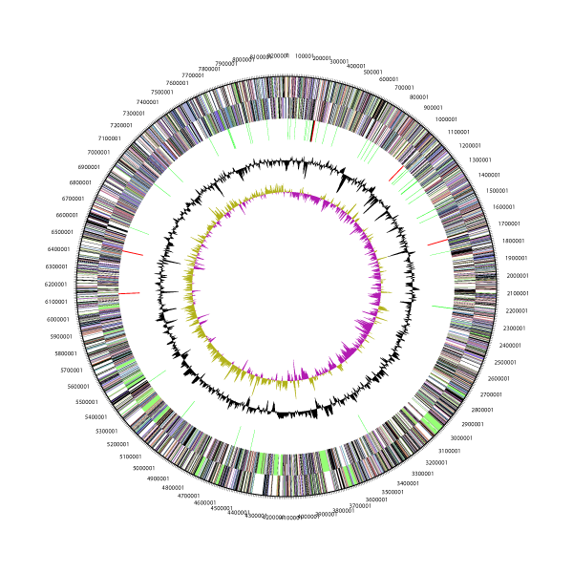
Future Work
Circular visualization
Counts on both consensus
Remove gaps phase
Extend to proteins
Standalone program

Slide 23
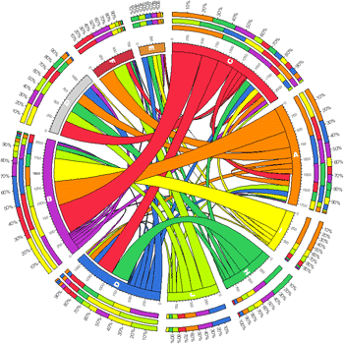
Thank you!
Ana T. Freitas
INESC-ID
Luísa Pereira
IPATIMUP
http://kdbio.inesc-id.pt/software/csa/
Project supported by FCT:
ARN project - Algorithms for the identification of genetic Regulatory Networks (PTDC/EIA/67722/2006)
Programa Operacional Ciência, Tecnologia e Inovação (POCTI), Quadro Comunitário de Apoio III

