Slide 1
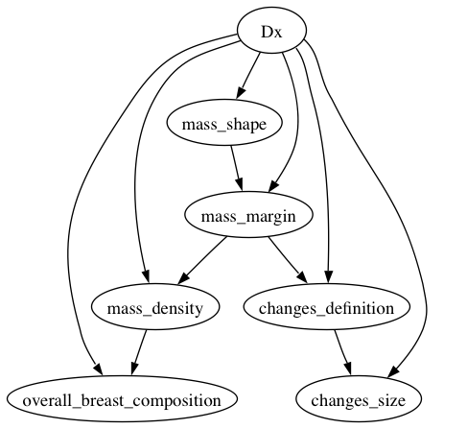
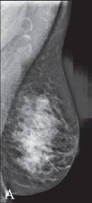
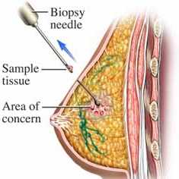
P(malignant):
32%
2. Estimate malignancy of incomplete case
3. Determine appropriate follow-up
1. Model observations and malignancy
S₁ | P=1%
S₂ | P=50%
S₃ | P=2%
S₄ | P=30%
Short-term follow up
Biopsy
Short-term follow up
Biopsy
✖
✔
✖
✔
P(complete):
50%
4. Simulate “observing” missing observations
5. Determine effect of new data on decision
6. Completeness score is probability of decision change

