Slide 1
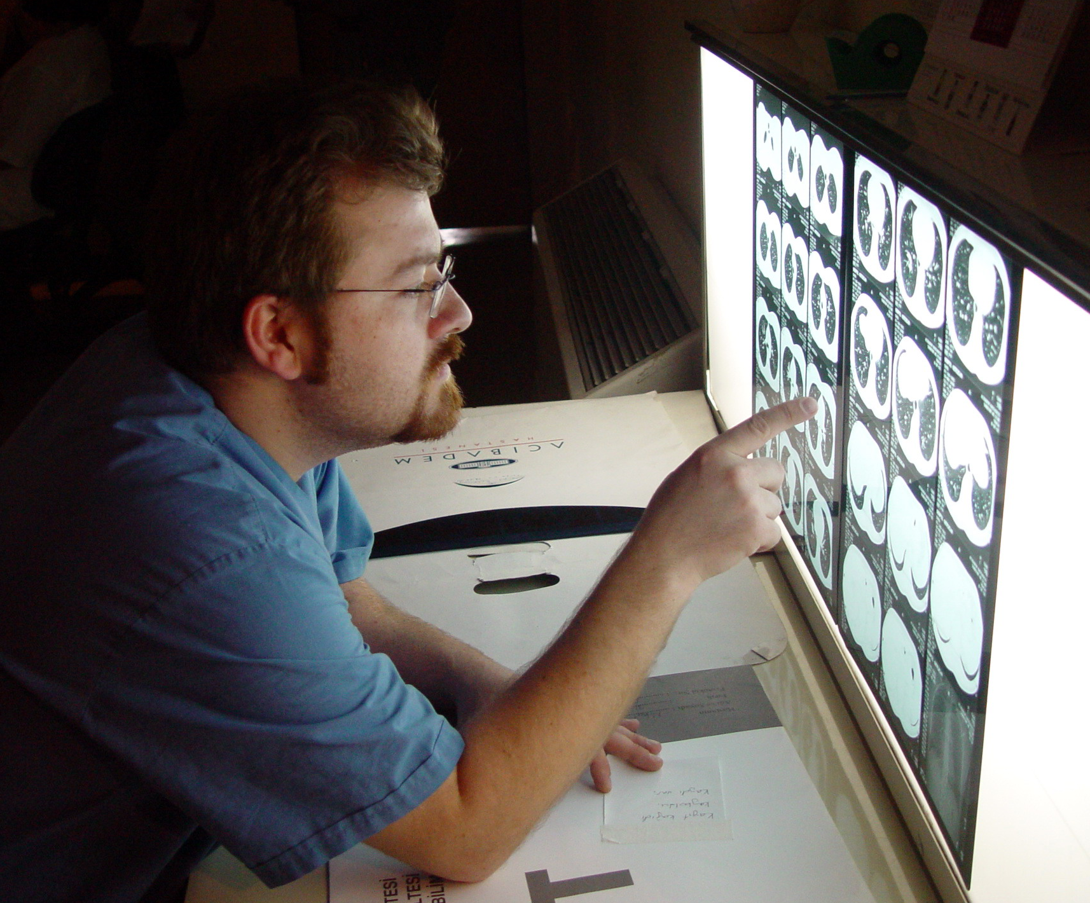
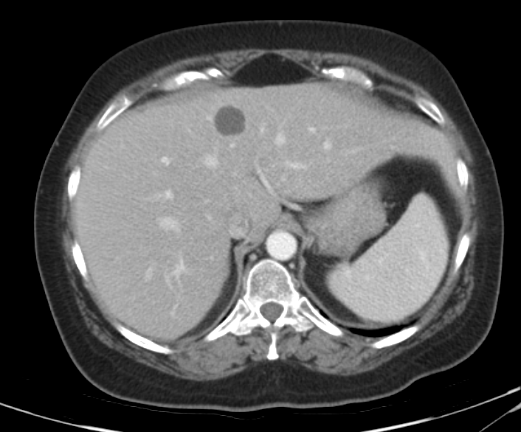
Radiologist annotates lesion using RadLex and ePAD
Semantic Feature Vector
(30 binary elements)
79 portal-venous CT of liver with lesions
Radiologist selects representative slice and draws ROI
?
Computer extracts quantitative imaging features
Quantitative Feature Vector
(431 real-valued elements)
Contrast (e.g. mean)
Texture (e.g. histogram, Gabor, wavelets)
Margin Sharpness (e.g. edge sigmoid)
Shape (e.g. compactness)

