Slide 1
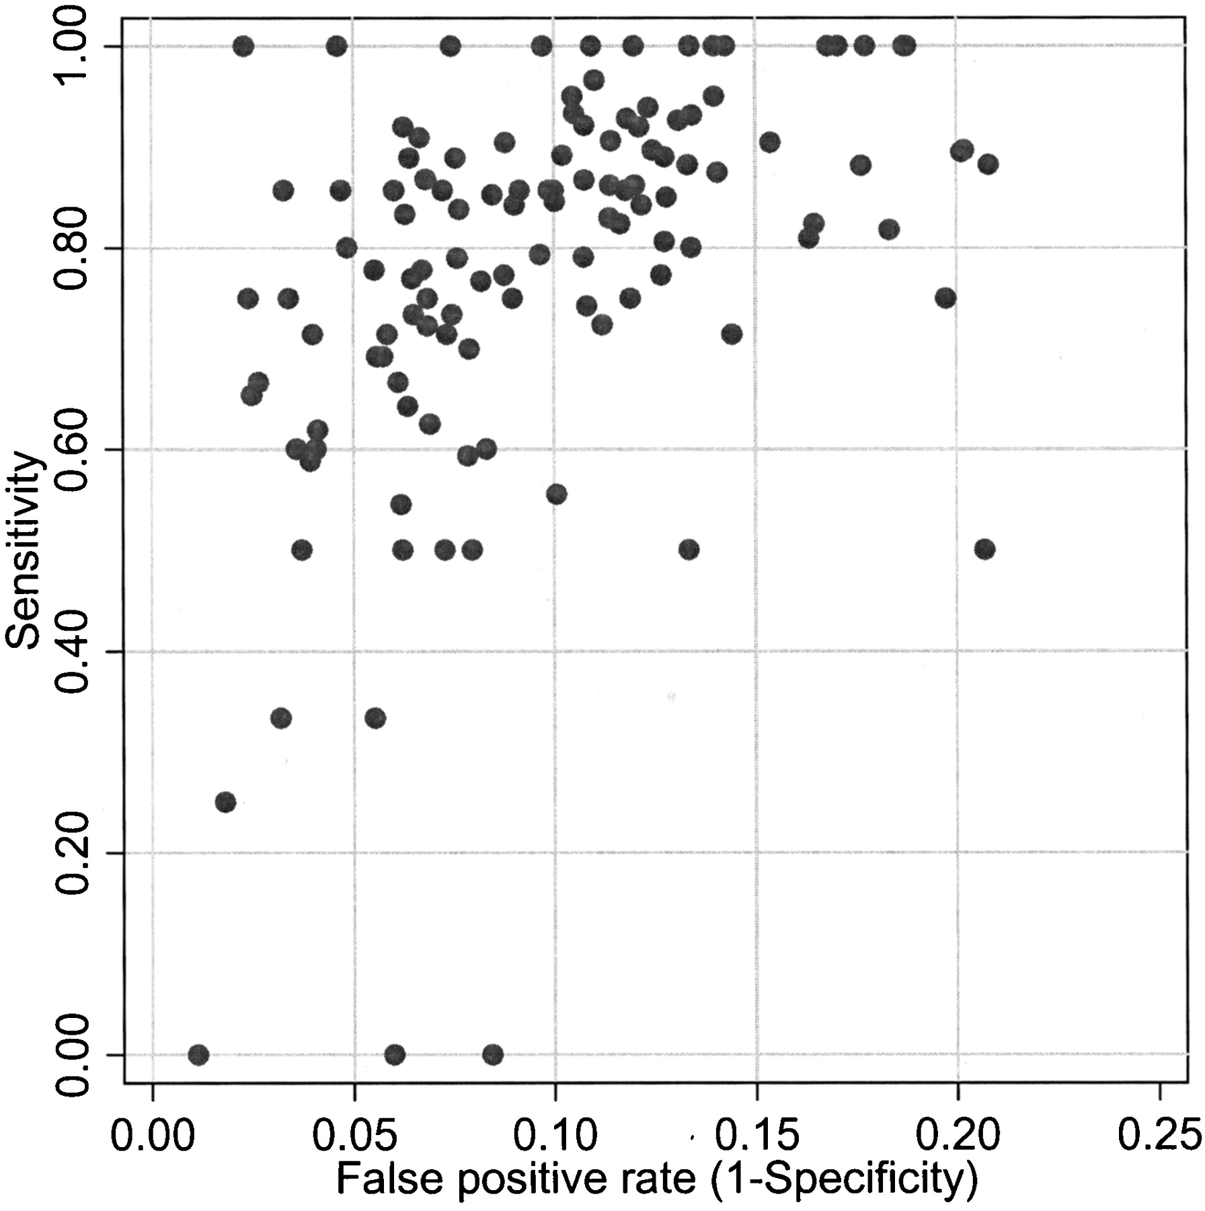

True positive rate (sensitivity) of the 124 radiologists versus the false positive rate (1 –specificity).
Barlow W E et al. JNCI J Natl Cancer Inst 2004;96:1840-1850
© Oxford University Press
Notes:
True positive rate (sensitivity) of the 124 radiologists versus the false positive rate (1 –specificity). Rates not adjusted for patient variables.

