Slide 1
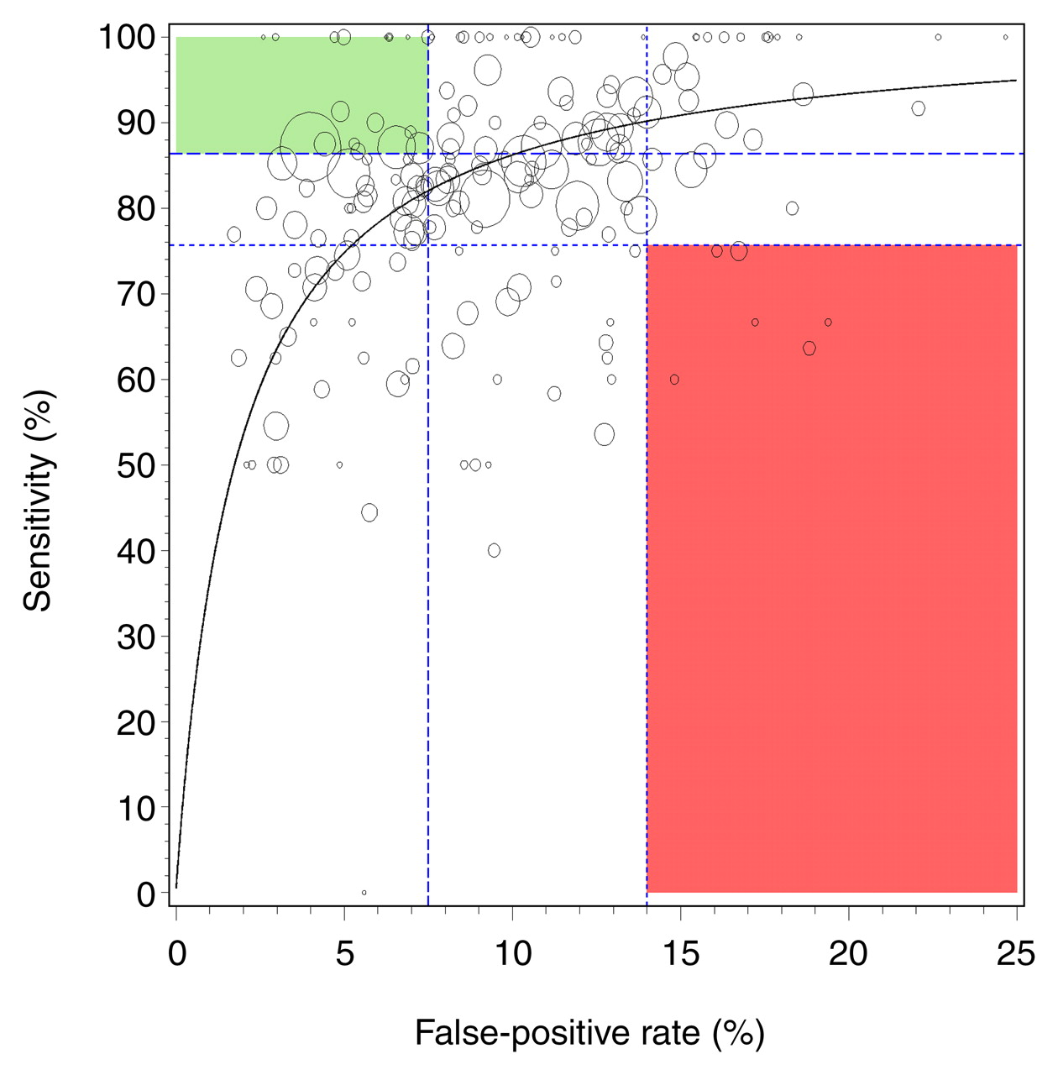
Performance of 187 U.S. radiologists who interpreted images from screening mammographic examinations (with images from one or more examinations associated with a cancer diagnosis).
Elmore J G et al. Radiology 2009;253:641-651
©2009 by Radiological Society of North America
Notes:
Performance of 187 U.S. radiologists who interpreted images from screening mammographic examinations (with images from one or more examinations associated with a cancer diagnosis). Sensitivity and false-positive rate are shown for each radiologist. Specificity was calculated by subtracting false-positive rate from one. Size of circle represents number of screening mammograms interpreted by that radiologist that were associated with a cancer diagnosis, with larger circles representing more cancers. Small circle may represent a radiologist with screening mammograms associated with one or two cancers. Normalized partial area under the curve is 0.82. Two areas are in color to highlight radiologists with both sensitivity and false-positive rate in highest (≥75th percentile in green) and lowest (≤25th percentile in red) rating for interpretive performance on basis of national BCSC benchmarks for screening performance (11).

