Slide 1
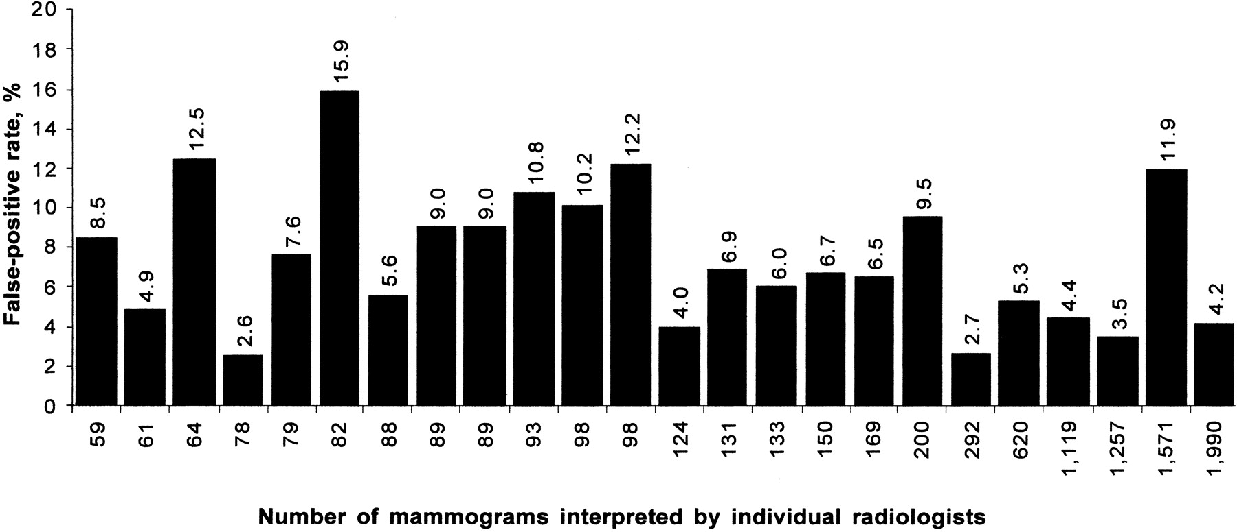

Observed false-positive rates for 24 radiologists reading 8734 mammograms.
Elmore J G et al. JNCI J Natl Cancer Inst 2002;94:1373-1380
© Oxford University Press
Notes:
Observed false-positive rates for 24 radiologists reading 8734 mammograms. Each column represents a single radiologist. The number of mammograms interpreted by a given radiologist is given at the base of the column and the false-positive rate is plotted on the y-axis, with the exact number describing the false-positive rate for an individual radiologist given at the top of the respective column.

