Slide 1
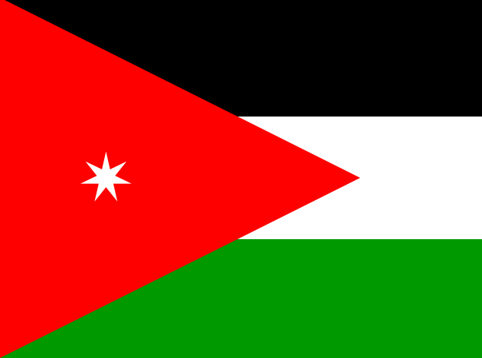
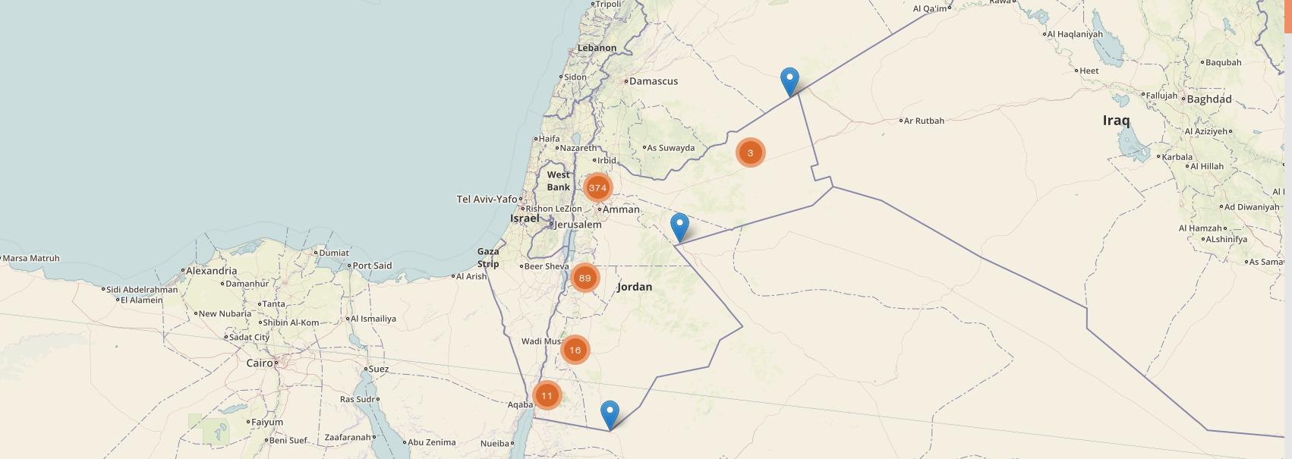
Jordan · Public Health Surveillance
Meerkat Software Training
Frontend Javascript Programming

Slide 2
Overview
Talk: Introducing Javascript [15]
Exercises: Javascript syntax and concepts [25]
Talk: Meerkat Frontend Javascript [10]
& “asynchronous” programming
Exercise: Getting and displaying data [45]
from Meerkat API
Summary [5]
[Total time: 90 mins]

Slide 3
A “client side” scripting language

Slide 4
Reviewing a simple script

Slide 5
A typical web page response

Slide 6
The web technology stack

Slide 7
Exercise: Javascript Basics
Syntax and Concepts

Slide 8
Meerkat Frontend Javascript
& Asynchronous Programming

Slide 9
Structure

Slide 10
JSON Data from Meerkat API

Slide 11
Asynchronous programming.

Slide 12
Exercise: Editing Meerkat Frontend
Using AJAX to display API data

Slide 13
Summary
A “client side” scripting language
Javascript code is a static resource that can be linked or inserted into HTML files
Code that is dependant on HTTP requests require asynchronous programming structures
Countless tutorials/docs online to help you e.g...
www.w3schools.com
jquery.com
and of course: google.com

