Slide 1
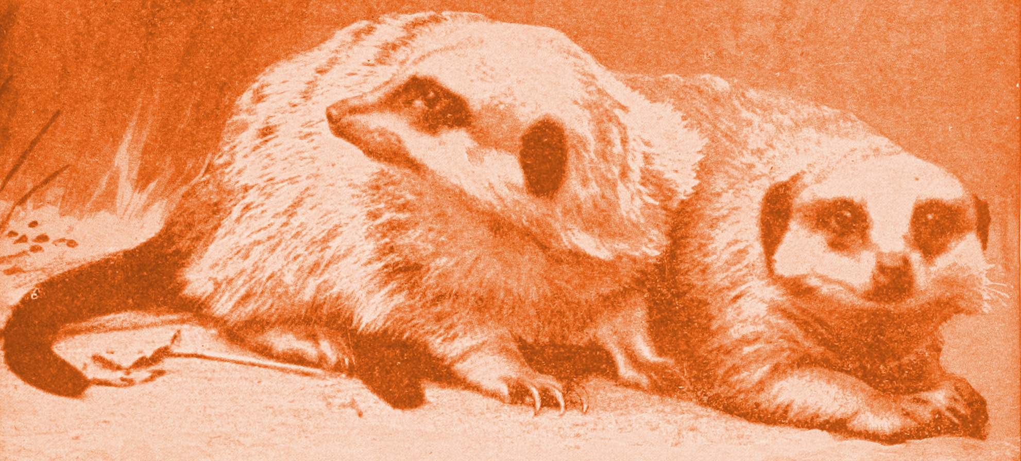
Meerkat workflow
Git
Mix (Mikolaj Kundegorski)
28 Feb 2017

Slide 2
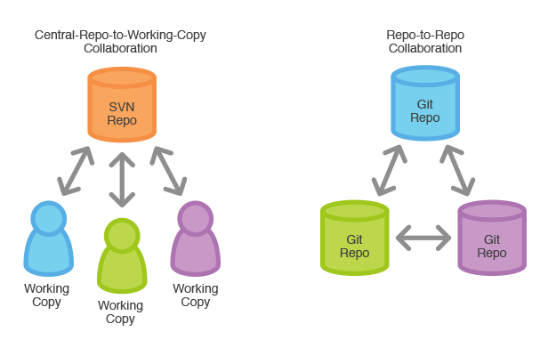
Distributed version control system
Source: http://sgdev-blog.blogspot.com/2014_03_01_archive.html

Slide 3
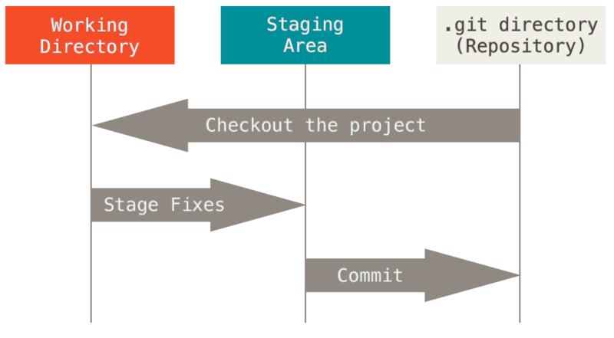
Git: working locally
Source: https://git-scm.com/book/en/v2/Getting-Started-Git-Basics

Slide 4
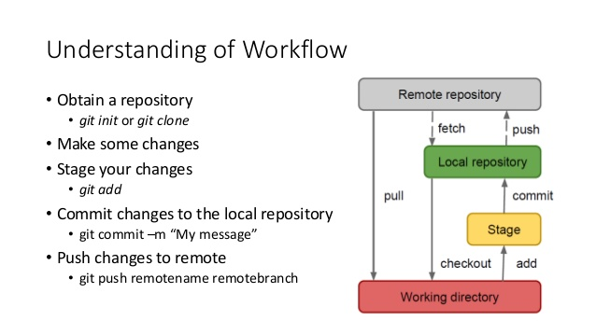
Git: communiacting with “remote”
Source: https://www.slideshare.net/garyyeh165/git-51265752

Slide 5
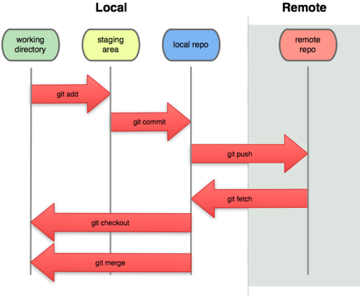
Remote repository
Acts as a backup
Can be on a local server, service (github.com, bitbucket.com) or any other machine on the network
Let’s clone our training repository! https://github.com/meerkat-code/training
Source: http://manvirbasra.com/category/uncategorized/

Slide 6
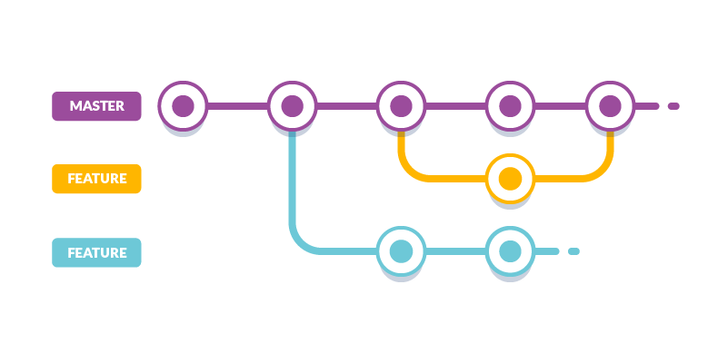
Git workflow
Let’s practice:
https://try.github.io/levels/1/challenges/1
https://github.com/meerkat-code/meerkat_git_training
Source: https://buddy.works/blog/5-types-of-git-workflows

Slide 7
Meerkat workflow
Linux
Mix (Mikolaj Kundegorski)
28 Feb 2017

Slide 8
What is UNIX
Peter H Salus in A Quarter-Century of Unix (1994): This is the Unix philosophy:
Write programs that do one thing and do it well.
Write programs to work together.
Write programs to handle text streams, because that is a universal interface.

Slide 9
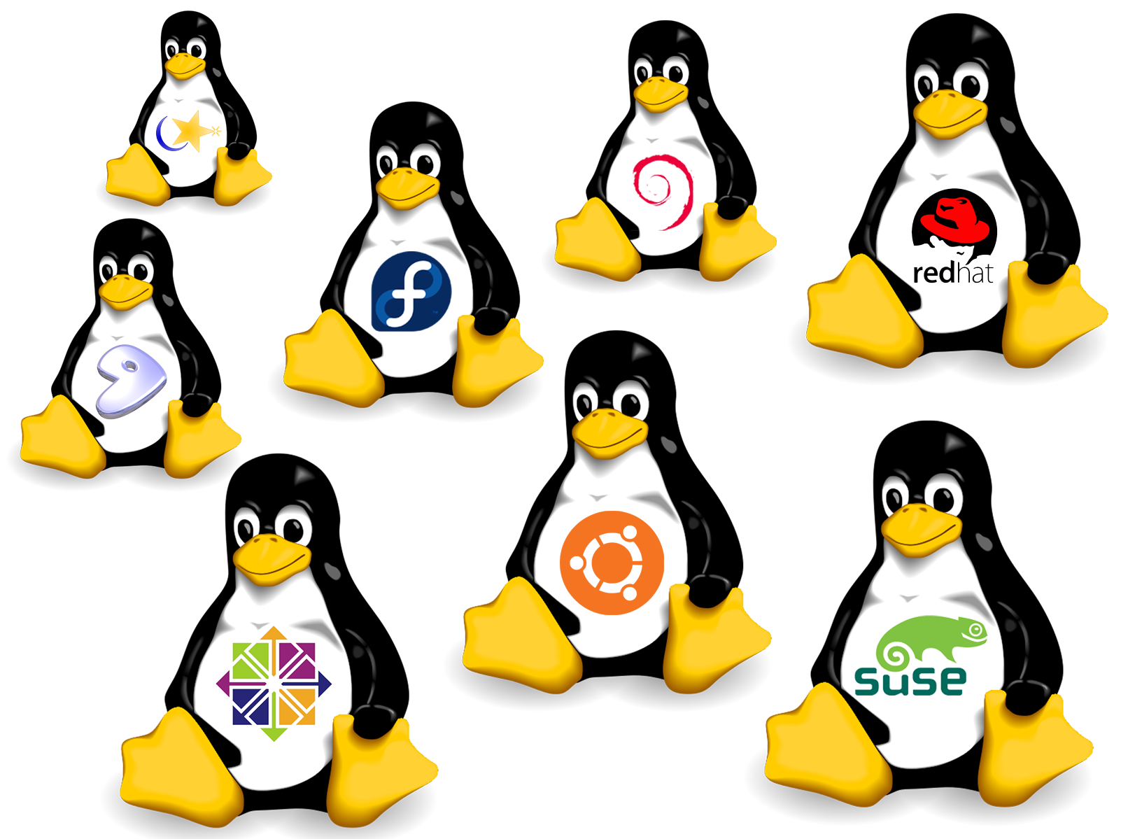
Linux
A family of free unix-like OS
Source: q-linux.com

Slide 10
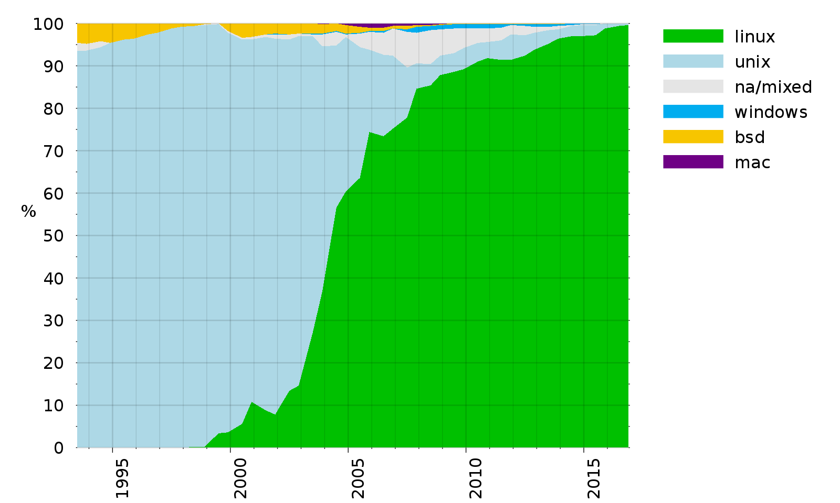
Top 500 supercomputers
Source: wikipedia

Slide 11
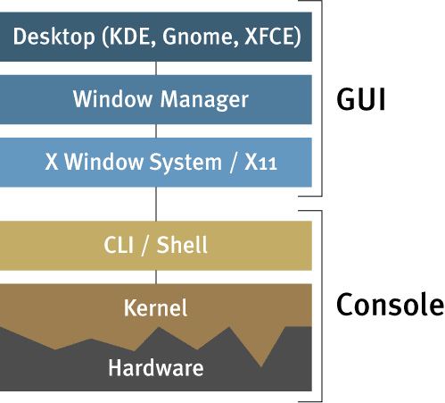
Linux architecture
Source:evidentsolutions.com

Slide 12
UNIX tutorial
http://www.ee.surrey.ac.uk/Teaching/Unix/index.html
Use boot2docker linux which shares filesystem with your Windows machine

Slide 13
Meerkat workflow
Docker
Mix (Mikolaj Kundegorski)
28 Feb 2017

Slide 14
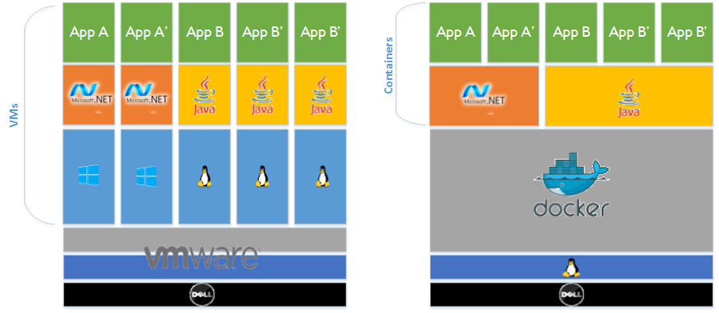
Virtualisation and contenerisation
Source: http://shoxx-website.com/2015/09/docker.html

Slide 15
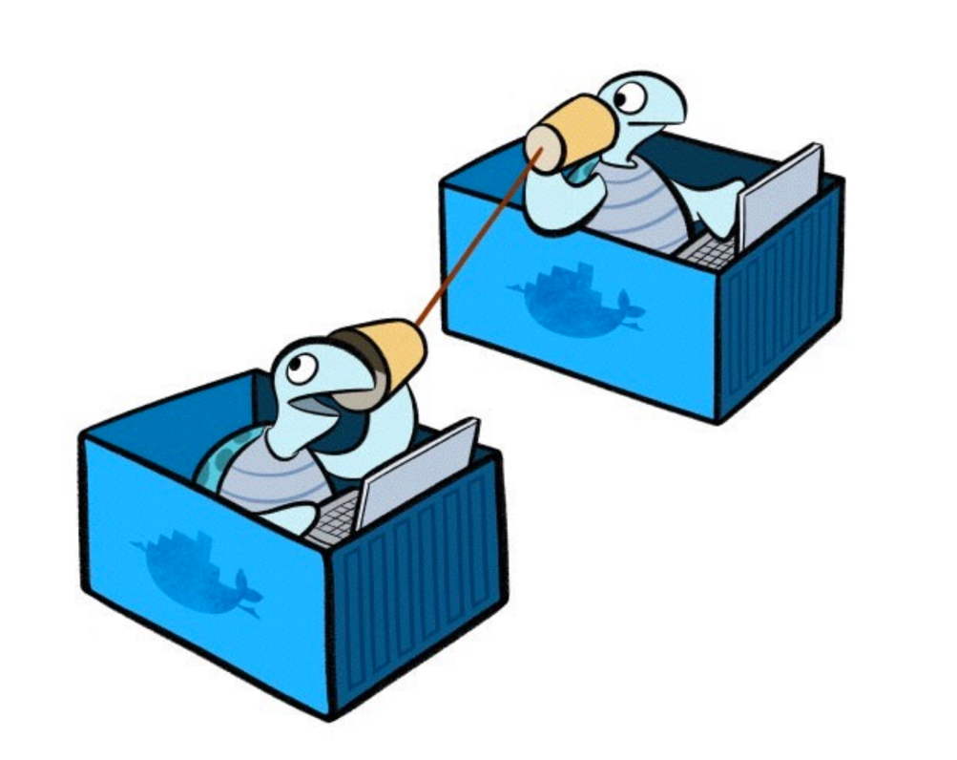
Contenerisation
Source: http://blog.arungupta.me/docker-bridge-overlay-network-compose-variable-substitution/

Slide 16
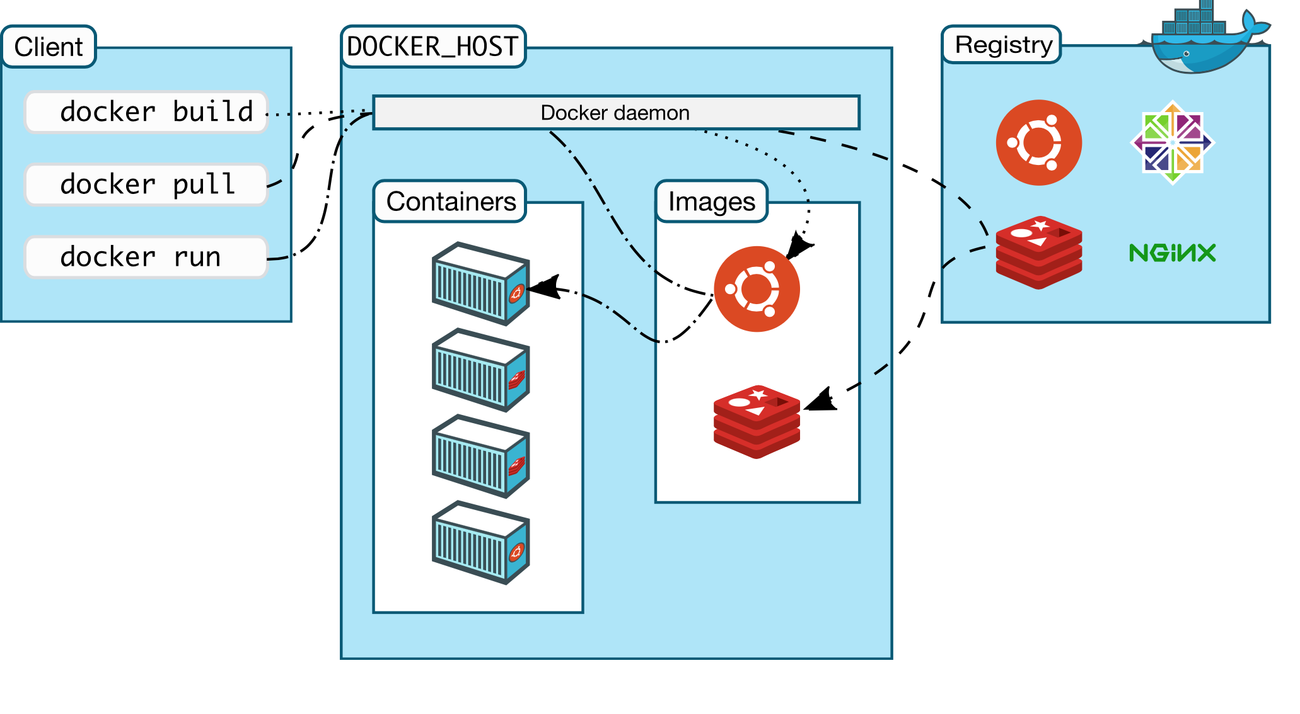
Docker
https://docs.docker.com/engine/understanding-docker/
Source: official docs

Slide 17
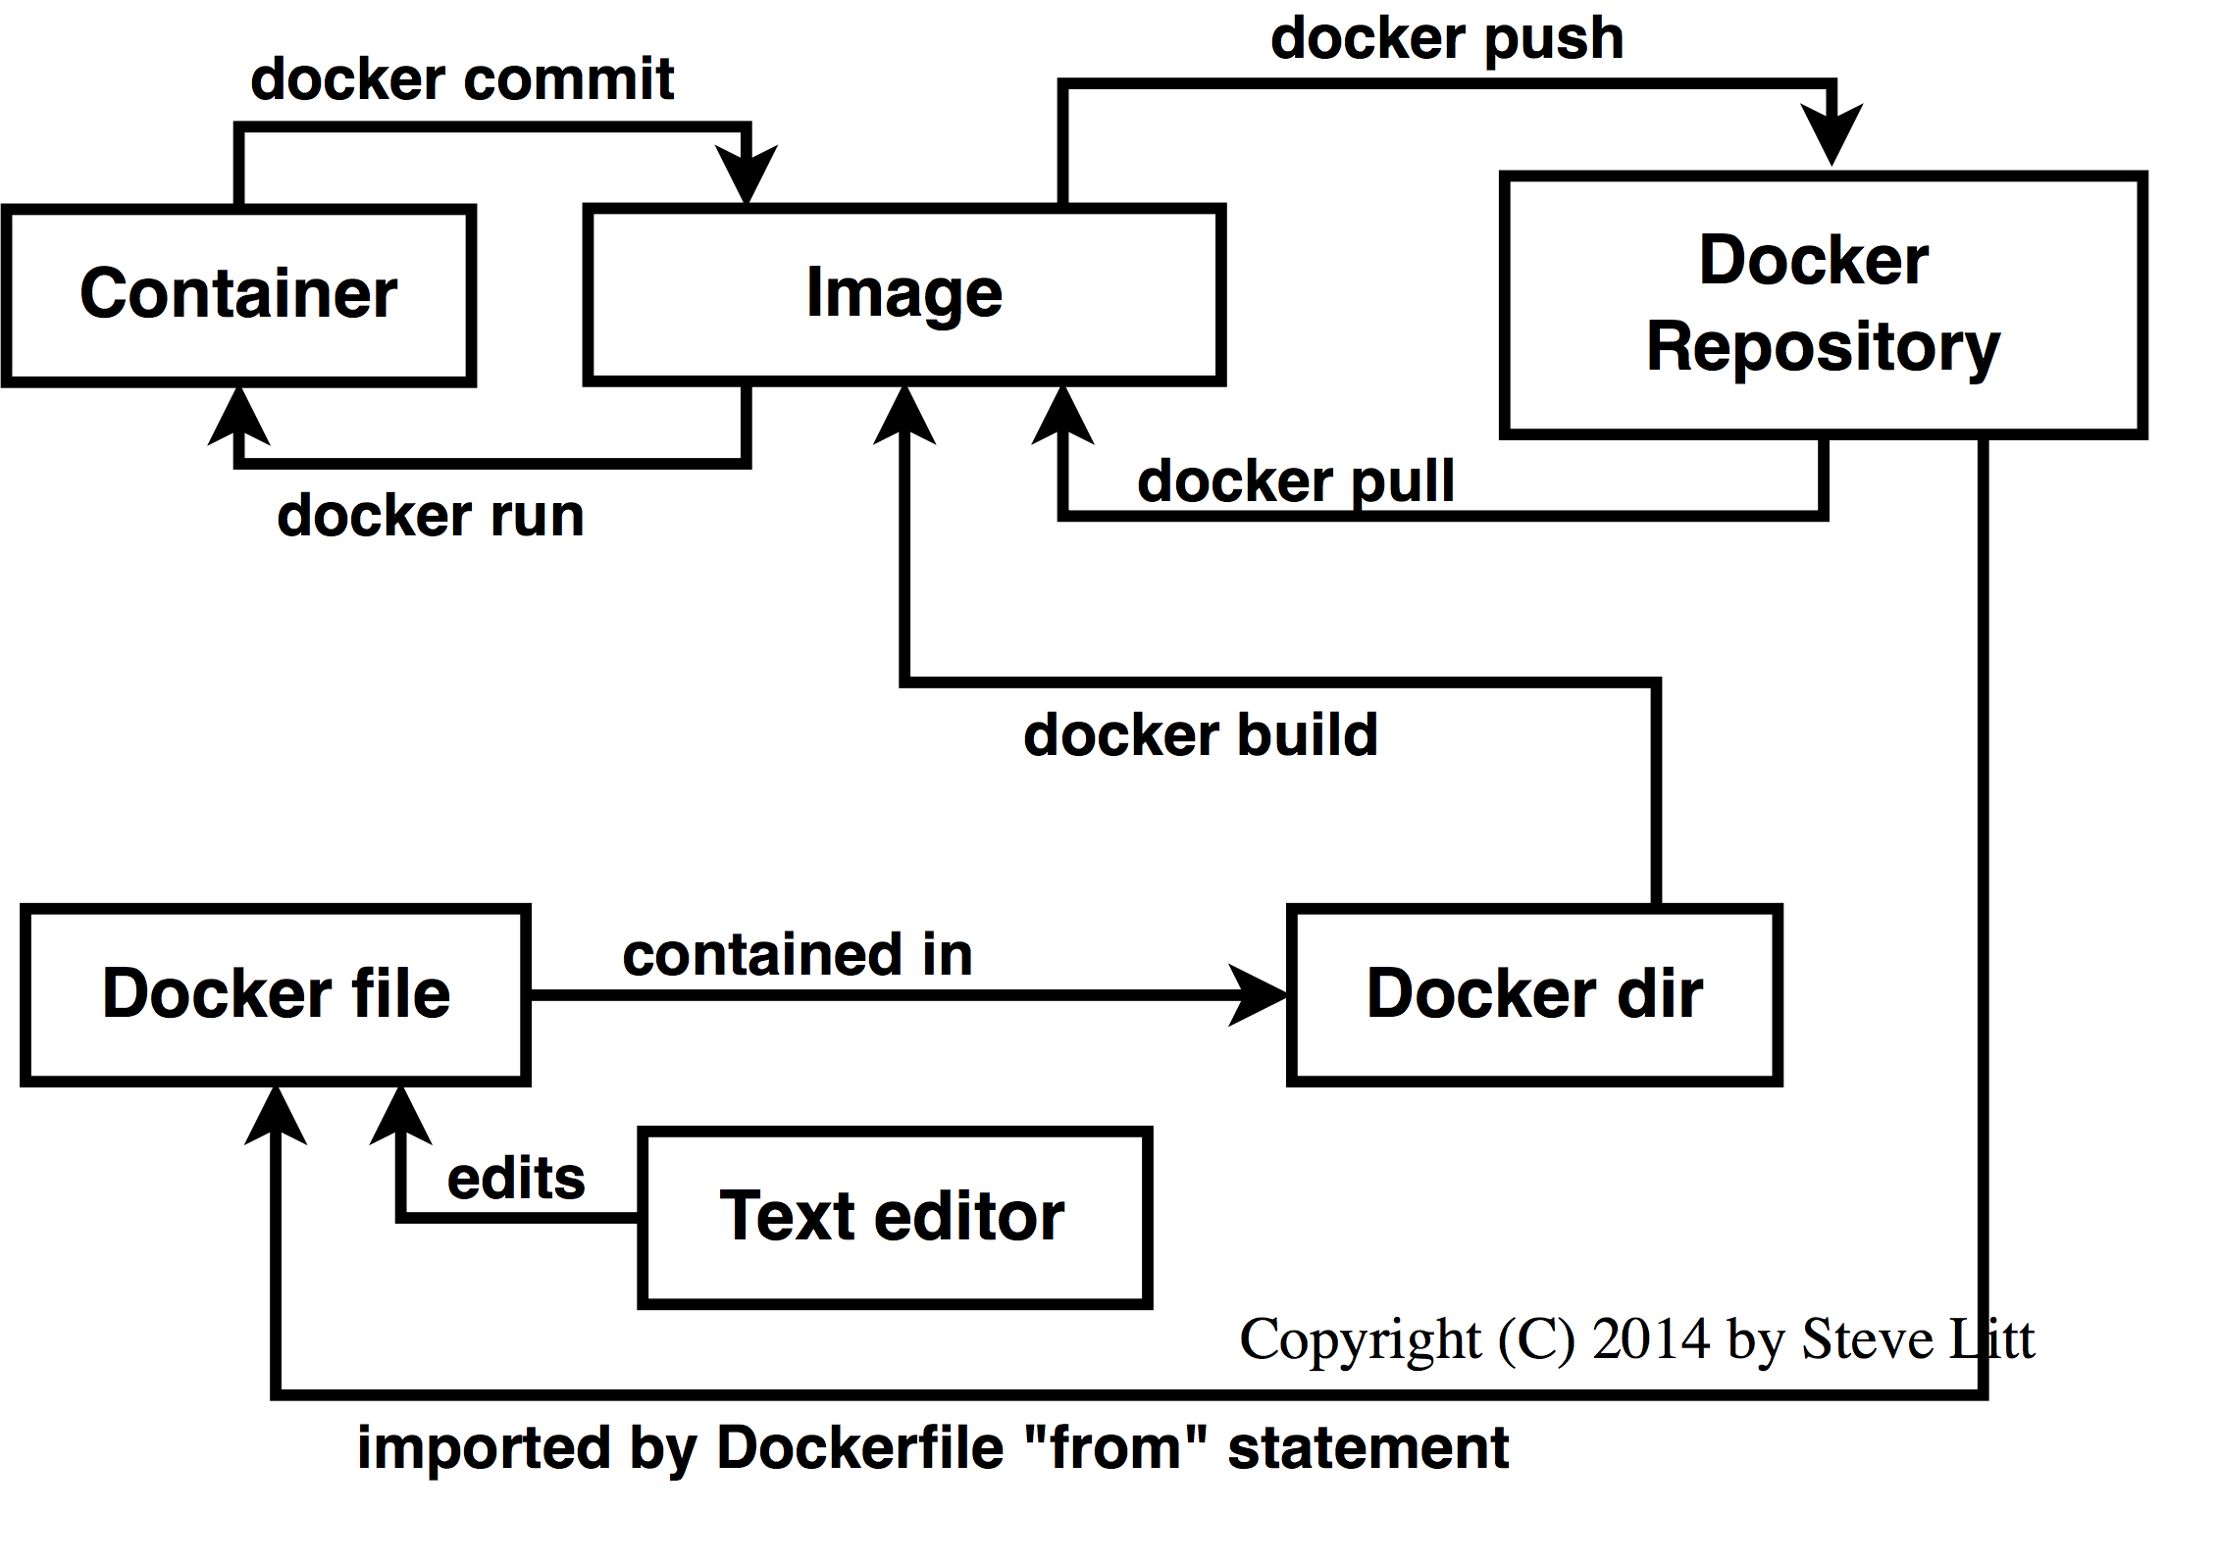
Docker workflow
Source:http://www.troubleshooters.com/linux/docker/docker_newbie.htm

Slide 18
Docker tutorial
https://docs.docker.com/engine/getstarted/step_one/ (start with Step 3, verifying your installation)
“Find and run the whalesay image”, skip steps 1-2
Finish tutorials by building your own container
Docker compose (if network allows): https://docs.docker.com/compose/gettingstarted/

Slide 19
Thank you and good luck!

