Slide 1
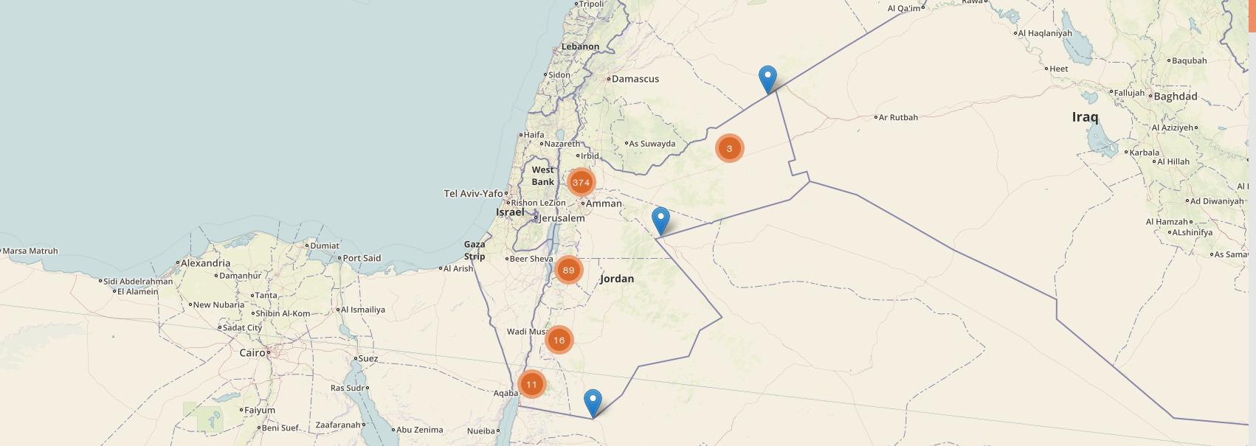
Jordan · Public Health Surveillance
Meerkat Software Training
The MOH Server Software Stack

Slide 2
Overview
Talk: Software on the MOH Server [10]
Talk: Spotlight on PostgreSQL [5]
Exercises: Setting up PostgreSQL [20]
Talk: Spotlight on the NGINX Webserver [5]
Exercise: Setting up a Webserver [45]
Summary [5]
[Total time: 90 mins]
Notes:
Key aims:
Understand how the MOH server works.
Practise working in Linux with some larger applications.
Learn about setting up and installing PostgreSQL
Learn about setting up and installing the NGINX webserver.

Slide 3
Software Stack
Form Submissions
NGINX
Tomcat
ODK Aggregate
Meerkat Nest
Anonymised data
to website
PostgreSQL

Slide 4

NGINX - Webserver
NGINX
Tomcat
ODK Aggregate
Meerkat Nest
PostgreSQL

Slide 5

Tomcat - Webserver
NGINX
Tomcat
ODK Aggregate
Meerkat Nest
PostgreSQL

Slide 6

ODK Aggregate – Form Hub
NGINX
Tomcat
ODK Aggregate
Meerkat Nest
PostgreSQL

Slide 7

Meerkat Nest – Data export
NGINX
Tomcat
ODK Aggregate
Meerkat Nest
Anonymised data
to website
PostgreSQL

Slide 8
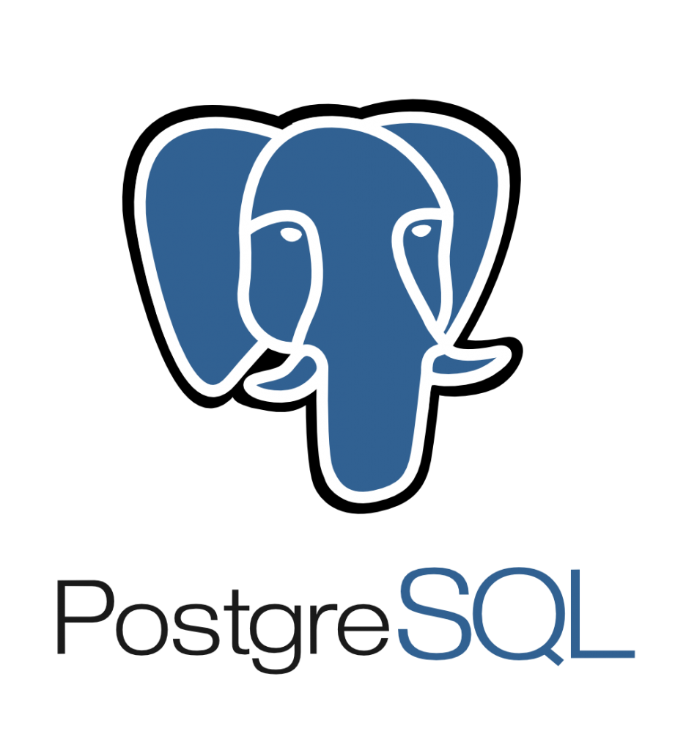
PostgreSQL – Database
NGINX
Tomcat
ODK Aggregate
Meerkat Nest
PostgreSQL

Slide 9

Spotlight: PostgreSQL

Slide 10
Why PostgreSQL?
Open source, community driven and free
Strong support community and documentation
Cross platform
Incredibly reliable and stable
Does everything!

Slide 11
PostgreSQL – Some Key Concepts
PostgreSQL can hold multiple databases
Each database holds multiple tables
“Roles” determine access and authorisation for these objects.
By default postgresql will try to log you in using the same role title as your Linux username

Slide 12
Exercise: PostgreSQL Databases
Installation and Setup

Slide 13
Spotlight: NGINX Webserver

Slide 14
Why NGINX?
Fast! Performs well in benchmarking tests.
Extremely scalable
Flexible – write and install plugins
Well supported and documented
Free and open source!
Notes:
Javascript is both included in the Jinja2 templates and in the static assets source folder.
All the Javascript in the src folder is combined by the Gulp build process into a single file called app.js that is found in the static assets folder. This helps reduce the number of separate requests made for Javascript files.
Javascript from installed packages are also copied into the static folder by Gulp. All this Javascript is then imported into the HTML files using Jinja2.
The debug/development trail begins in a Jinja2 template, and will make reference to functions defined in the imported Javascript.

Slide 15
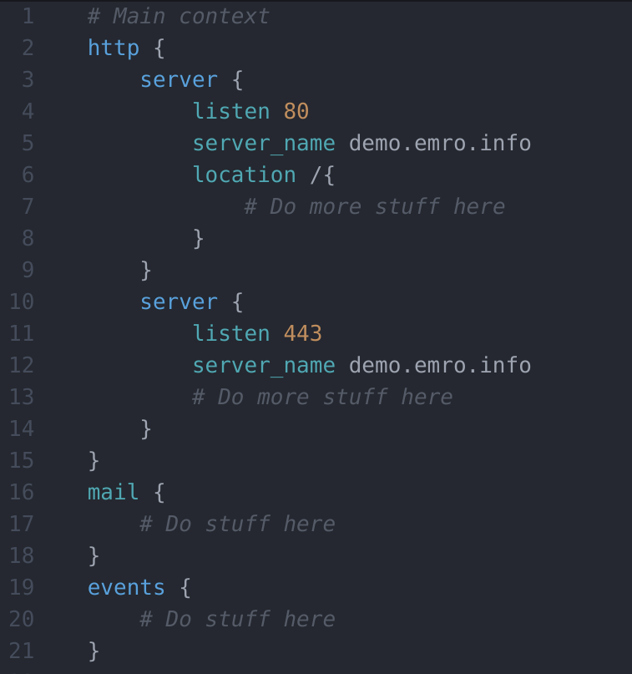
NGINX Configuration Files
Kept in /etc/nginx/
Nested contexts
Very powerful
Beyond our scope

Slide 16
Exercise: NGINX Webserver
Setting up a secure webserver
Notes:
If you’re super keen… you could try to setup nginx to serve up information from the PostgreSQL database. I thought about it but decided it was too hard.

Slide 17
Summary
The MOH Server Software Stack:
NGINX
Tomcat
ODK Aggregate
Meerkat Nest
PostgreSQL
Installed significant Linux packages: PostgreSQL & NGINX
Countless tutorials/docs online to help you e.g…
https://www.nginx.com/resources/wiki/
https://www.postgresql.org/docs/
and of course: google.com

