Slide 1

Data Collection Framework
M. Kundegorski, Antananarivo, May 2018

Slide 2
Plan
Part 1: Preparing simple questionnaire for a study using the same tools as used in IEES.
Part 2: Using mobile app and data collection server to test more complex forms.
Part 3: Complex forms with external datasets.
Optional:
Part 4: Using Github to exchange and collaborate on forms.
Part 5: Editing existing, challenging, forms of the program.

Slide 3

Data collection framework part 1

Slide 4
Data collection within IEES
ODK data collection framework
Tab
Form submissions
ODK Aggregate server
IEES
Tab
Tab
Tab
Tab
Tab
Tab
Data export
Tab
Tab
Tab
Tab
Tab
DB

Slide 5
ODK: Open Data Kit
One of the most popular frameworks (set of computer programs for servers, computers and mobiles) for gathering survey data.
Used by many governments, UN agencies and NGOs
Uses Xforms format which is the most popular format to store survey questionnaires
The most flexible and fairly easy way to generate Xforms is using XLSForms which allow creating definitions in Excel

Slide 6
The simplest form…
Let’s make a study about this training attendees!

Slide 7
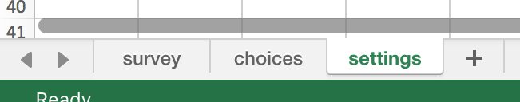
Simple forms with Excel
Create a new xlsx file and save it as YOURNAME_simple_form.xlsx
Create three sheets in it named “survey”, “choices” and “settings”:
All names are CaSe seNsiTive! Please mind “_” in names.

Slide 8
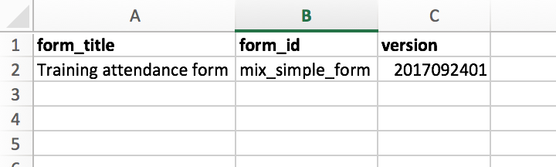
“Settings” tab
In this tab we specify a form title, id and version.
form_title is a friendly name for a user
form_id, lowercase, unique name. Please use your name in it.
version, up to 10 numbers. For instance: YYYYMMDDxx where xx is the version number after the date of form preparation.

Slide 9
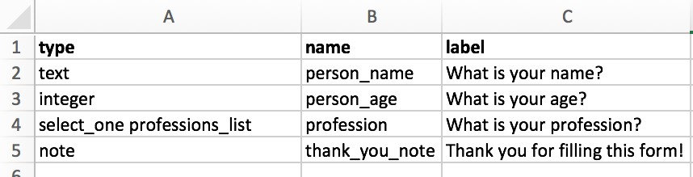
“Survey” tab
This is the main spreadsheet including your questions.
There are many columns, but three main ones are type, name, label.
type: Defines what kind of information is gathered in a field.
name: a unique name used for data analysis.
label: a question name displayed to a user.

Slide 10
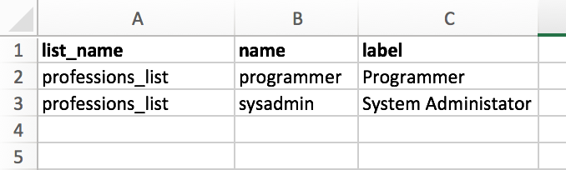
"Choices" tab
every list of choices needs a list_name which is referenced in survey
every choice needs a name and label

Slide 11
What's the name of your form?
GOOD:
jonathan_simple_form_version1.xlsx
toavina_training_survey_v2.xlsx
case_report_v3rev3.xlsx
active_case_finding_v12_2017sep.xlsx
malaria_surveyMay18.xlsx
BAD
My Form.xlsx
MoH Surveillance Form Case.xlsx
CaseReporrts.xlsx
enquête_nationale.xlsx

Slide 12
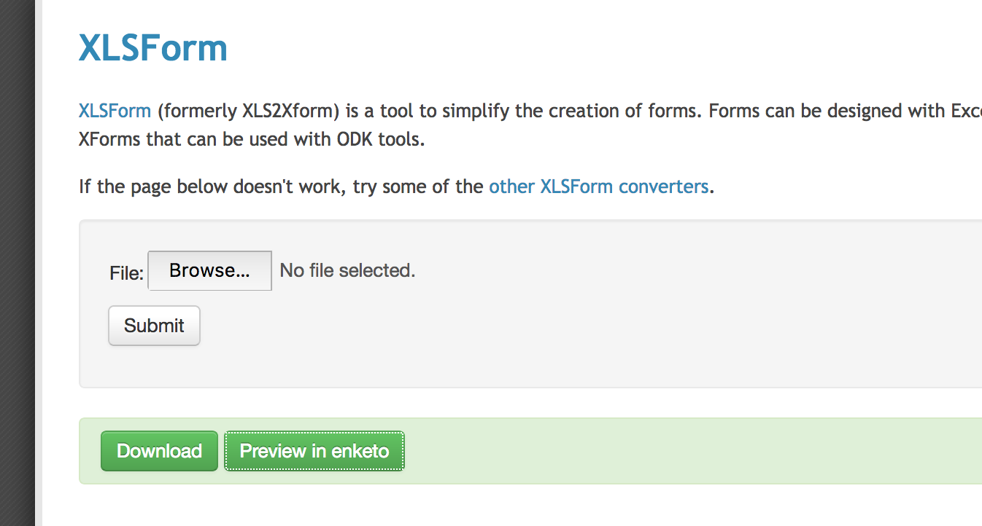
Generate XML (Xform) and preview.
Online form converter: http://opendatakit.org/xiframe/

Slide 13
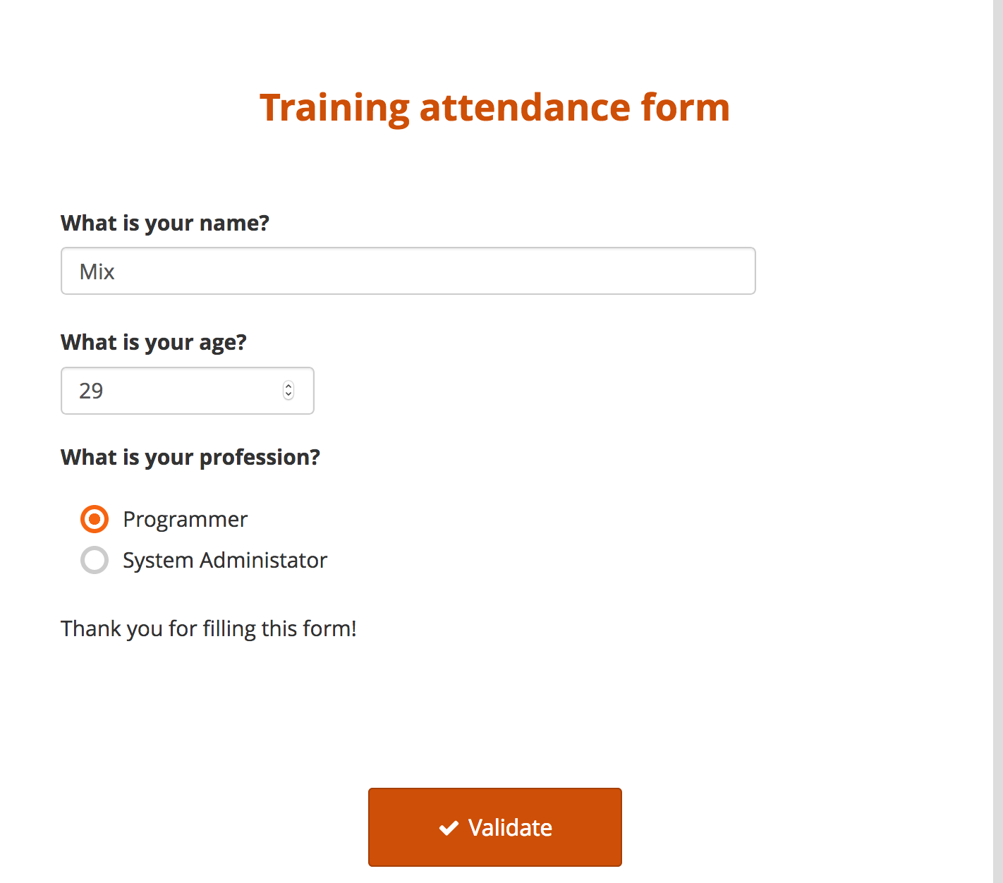
Form preview (in Enketo)

Slide 14
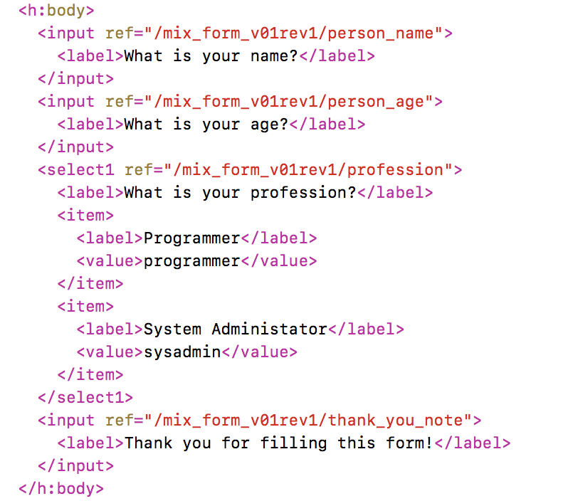
XForm in XML

Slide 15
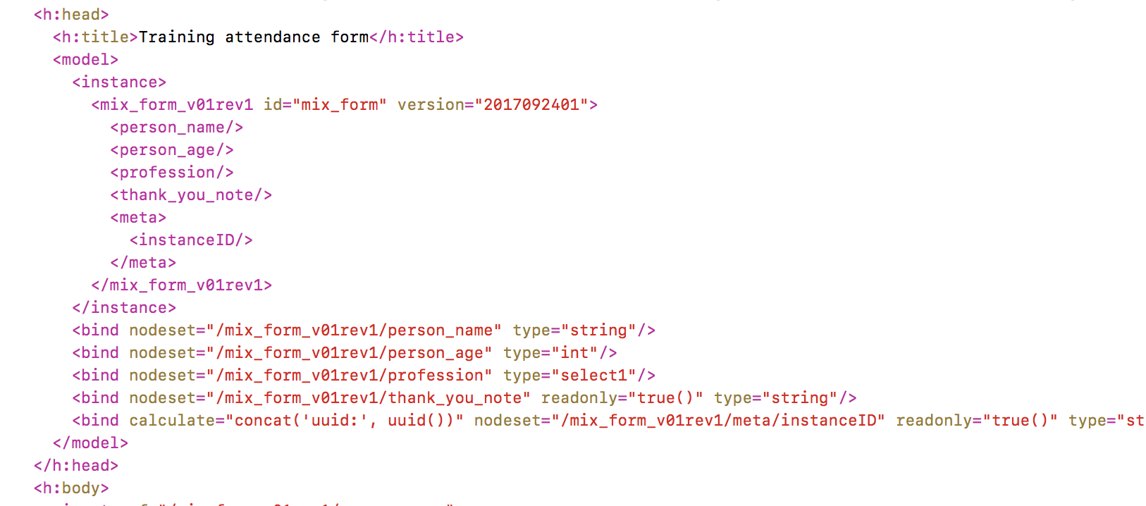
XForm: model

Slide 16
Time for a break!

Slide 17
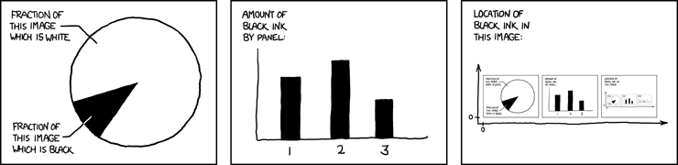
Data collection framework part 2
https://xkcd.com/688/

Slide 18
Data collection within IEES
ODK data collection framework
Tab
Form submissions
ODK Aggregate server
IEES
Tab
Tab
Tab
Tab
Tab
Tab
Data export
Tab
Tab
Tab
Tab
Tab
DB

Slide 19
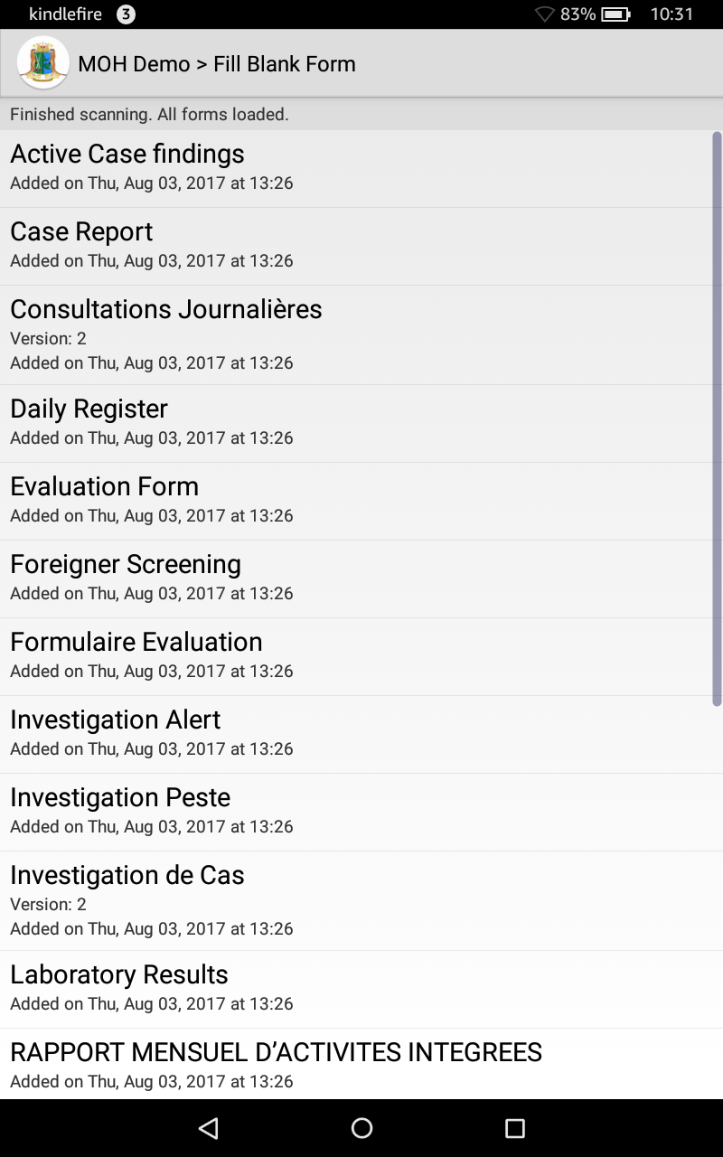
Demo App / ODK Collect
Android app working on phones and tablets
Displays forms and connects to ODK Aggregate
Let's install it on our phones/tablets
Admin Password: 1005

Slide 20
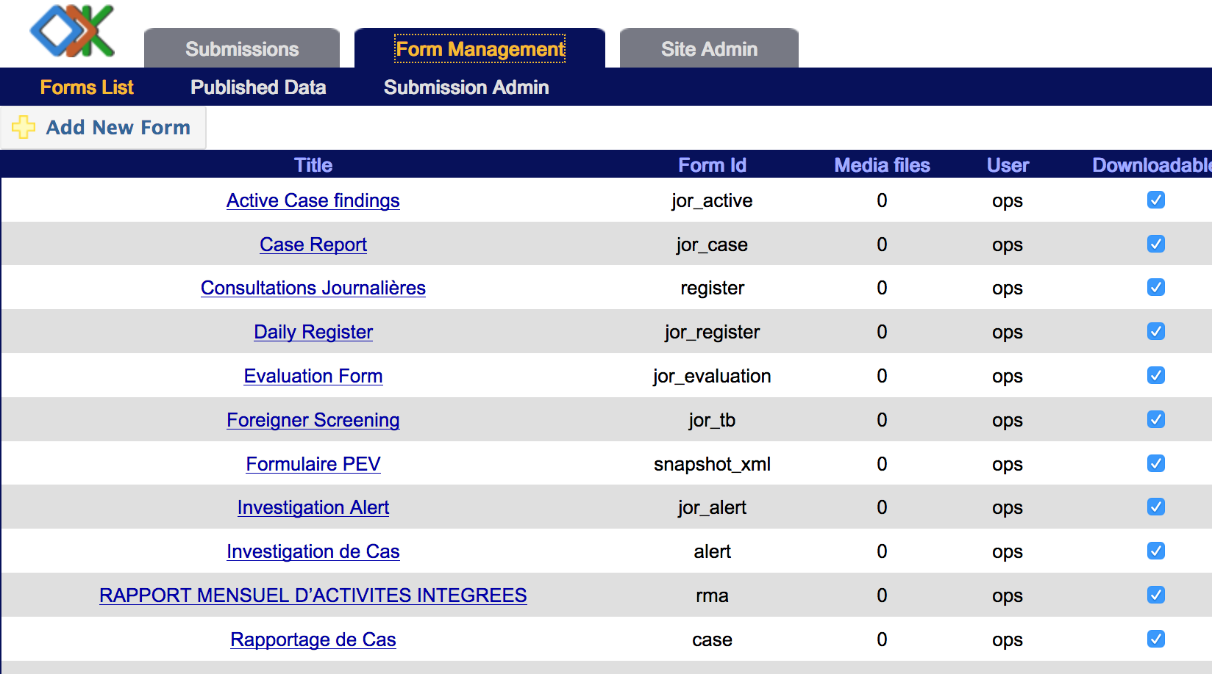
ODK Aggregate
Demo aggregate: https://odkdemo.emro.info/ [user:training password:trainingtana]

Slide 21
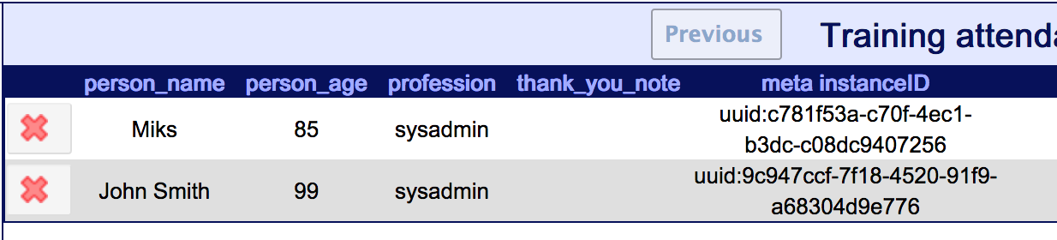
Our simple form with the app
Get the form on your device:
Publish the form to the Aggregate and pull on your mobile
or
Copy the xml form file to the /odk/forms
Send your submission!

Slide 22

Note: How we update forms in IEES?
Administrator manually pulls new forms from aggregate.
ODK Aggregate server
Tab
Tab
automagically!
Any changes to my forms?
Yes, new version (v17) of case_report.xml!

Slide 23
Analysing simple data
Pull the following form: "Training Opinion Form"/training_opinion_form.xml
Fill it in (you can do it multiple times as different people) and submit the answers
Log in to the aggregate and analyse the data

Slide 24
Designing a form
All relevant information and more examples at http://xlsform.org/
use XLSForms program to convert forms on your computer. Test on your device.
Often mobile application is not compatible with XLSform methods: make changes gradually and see if they work. (e.g. group within group, grid list appearance, text formatting are not working)
Automatic tools (kobo, Ona) for form creation might generate difficult to fix, incompatible forms

Slide 25
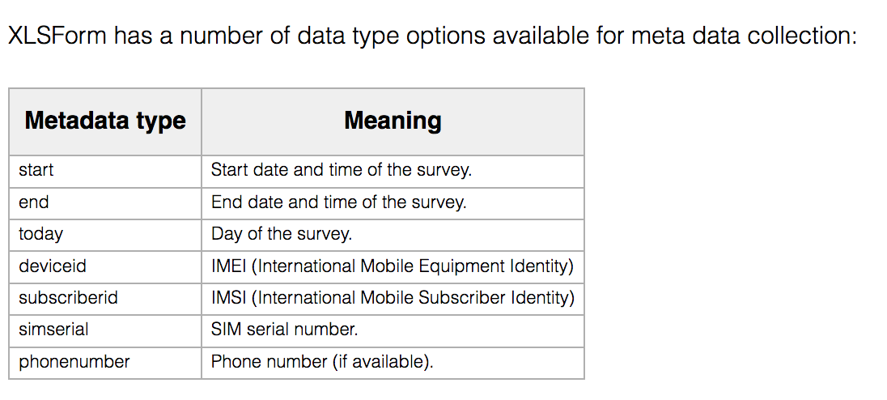
Metadata

Slide 26
Field properties
column | meaning | example
type | type of the field (or a question) | text
name | name of the variable to which users answer will be assigned to | user_name
label | Displayed name of the question | What is your user name?
required | Field can be empty if question is not compulsory | yes
appearance | Applies to groups of questions only to show them on one page | field-list
relevant | What condition must be fulfilled to show this question? | ${user_age} < 18
default | pre-fill the field with a value for quicker completion | 0
calculation | create a variable with the output of one or more previous field's answers | if( selected(${smoking}, "yes"), "risk", "no-risk")

Slide 27
Main field types
Question type | Answer input
integer | Integer (i.e., whole number) input.
decimal | Decimal input.
text | Free text response.
select_one [options] | Multiple choice question; only one answer can be selected.
select_multiple [options] | Multiple choice question; multiple answers can be selected.
note | Display a note on the screen, takes no input.
geopoint | Collect a single GPS coordinates.
date | Date input.
time | Time input.
dateTime | Accepts a date and a time input.
image | Take a picture.
calculate | Perform a calculation; see the Calculation section below.
acknowledge | Acknowledge prompt that sets value to “OK” if selected.

Slide 28
Now, let's analyse training_opinion_form.xls

Slide 29
Time for a break!

Slide 30
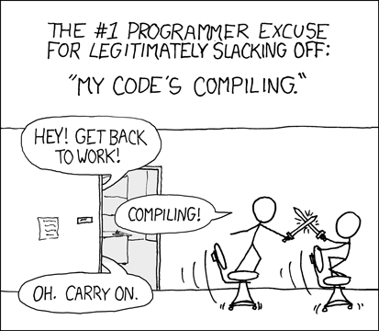
Data collection framework part 3
https://xkcd.com/303/

Slide 31
Creating your own form
Gather persons age, education level and a region where he or she lives.
Ask if a person was vaccinated against Influenza within last year
If yes, ask for the date of the vaccination and a dose.
Ask the person to list diseases he or she had in the last 10 years.
Make sure that a person won't send a form without acknowledging that all the data gathered will be now owned by the MOH

Slide 32
Improve your form!
Add translations to French/English
Add constraints on the answers to help correct obvious mistakes (can a person have 200 years?
Allow a person to choose from a list of diseases read from a csv file.

Slide 33
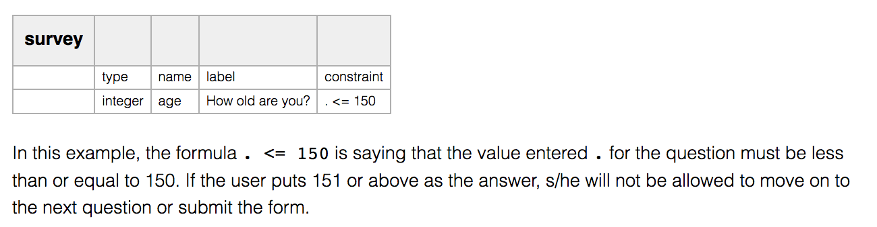
Constraints

Slide 34
Translations
instead of label use label::english and label::french
As an example, see "translated" version of a previous form "Training Opinion"
You can also translate constraint column

Slide 35
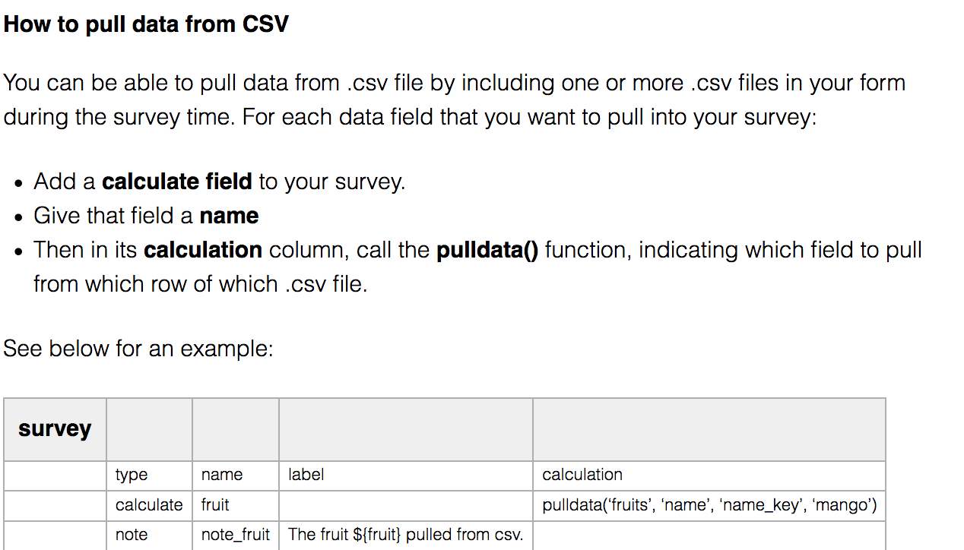
Reading an external data from a CSV file
http://xlsform.org/#pre-loading-csv-data

Slide 36
Modifying forms during the study
Changing labels, descriptions displayed for the user
Adding new options to the questions
Adding new validation
Adding and removing questions
Changing questionnaire flow (groups)

Slide 37
Thank you! ;)

