Slide 1

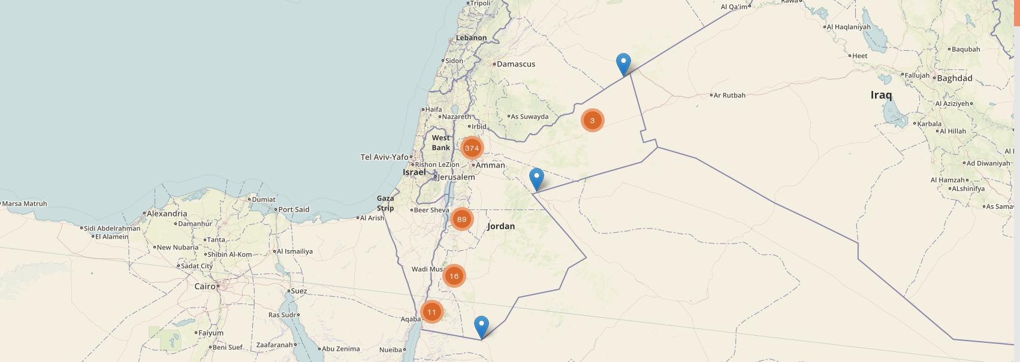
IERS · Public Health Surveillance
Meerkat Software Training
Recapping Linux & Docker

Slide 2
Overview
Talk: Recapping Linux [15]
Exercises: Getting started with Linux [30]
Talk: Recapping Docker [15]
Exercise: Getting started with Docker [55]
Summary [5]
[Total time: 120 mins]

Slide 3
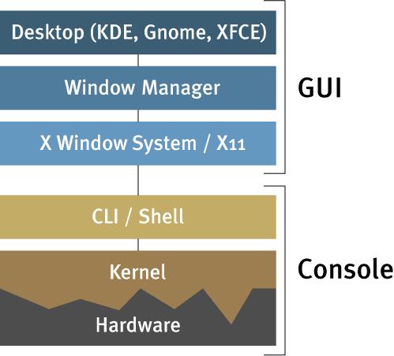
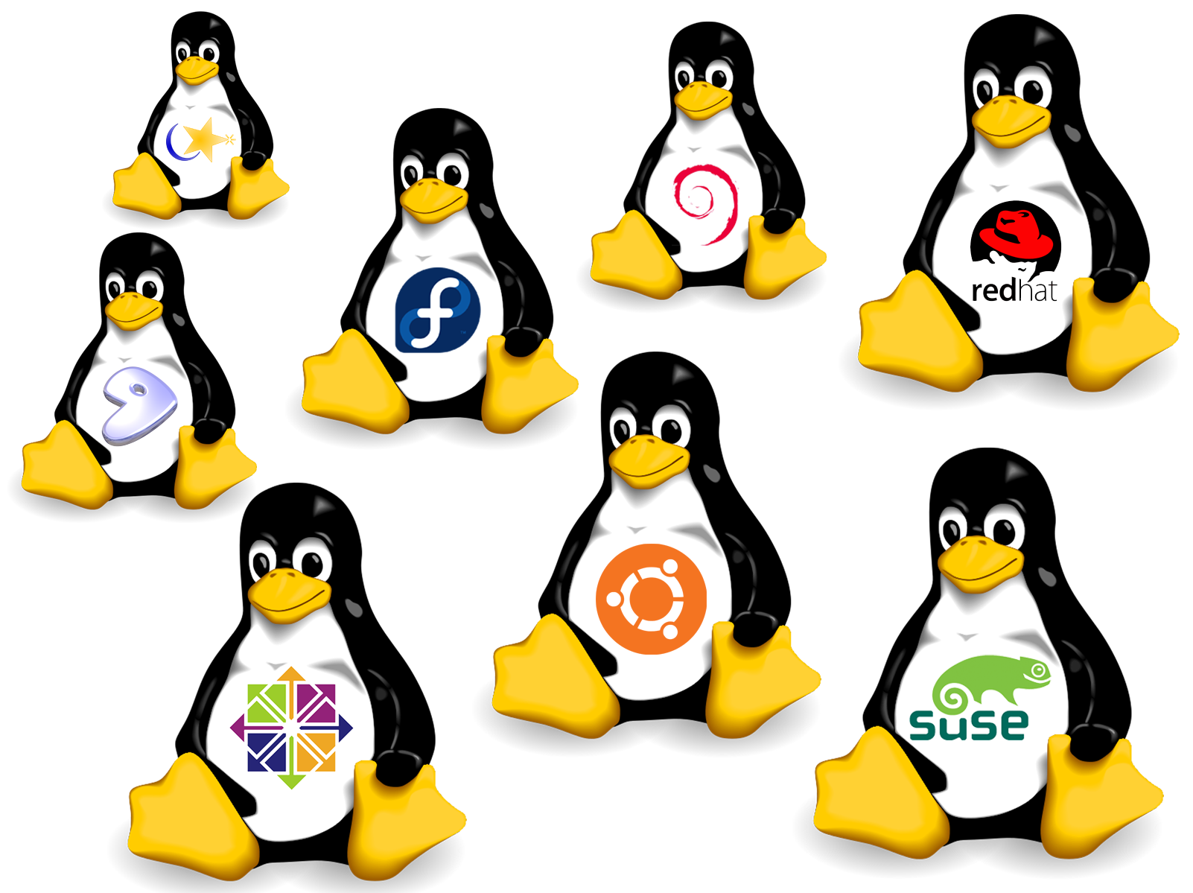
What is Linux?
Notes:
An operating system – An alternative to windows, or Apple MacOS.
Open source! What does this mean?
It means it is free, with no license fees.
It has a HUGE freely available support community.
It is incredibly flexible because anyone can take the code and do what they want with it.
It comes in many different flavours, for the rest of this talk we will be discussing Ubuntu.
Because it is open source, and well built, it has become incredibly popular in the software engineering community, which has started a self perpetuating cycle.

Slide 4
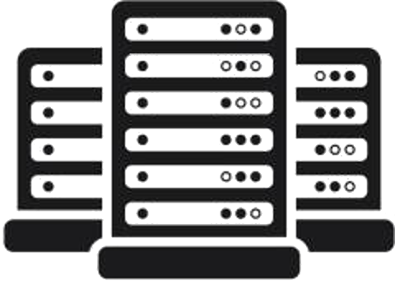
Why Linux?
Power.
Flexibility.
Support.
100% use in
Top500 supercomputers
66% use in
public servers
71%
of mobile devices
(Android)
Source: https://en.wikipedia.org/wiki/Usage_share_of_operating_systems
Notes:
Linux is not some strange niche specialist solution.
It has a small “personal computer” base, BUT...
If you want to offer powerful computing, create innovative software, have wide range of influence, then linux is the go-to standard in the industry.
MacOS is based on linux. Android is based on linux. Sony playstation is based on linux!
Real time Public Health surveillance on a national scale is a big complex project. Orders of magnitude more complicated than a normal website. We need linux for it’s power, flexibilty and massive support network free without license fees.

Slide 5
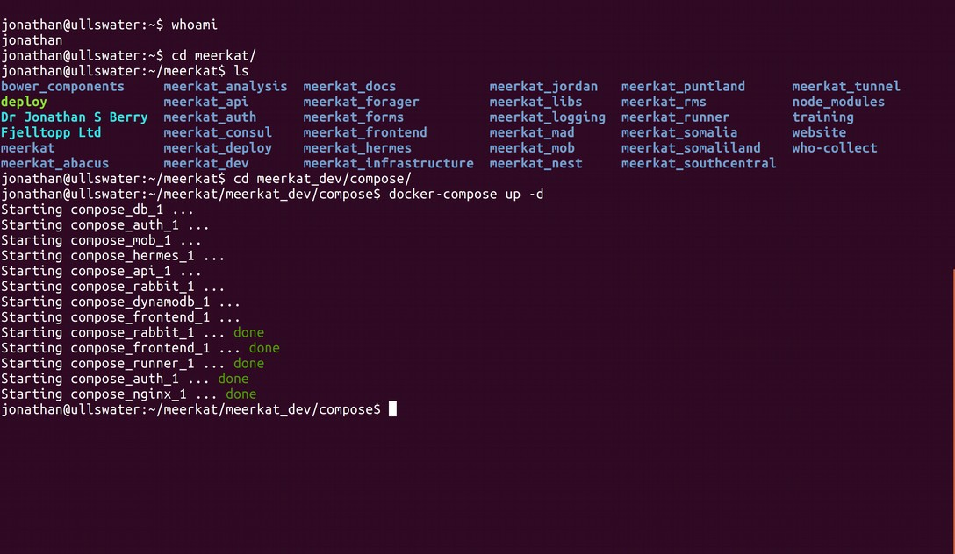
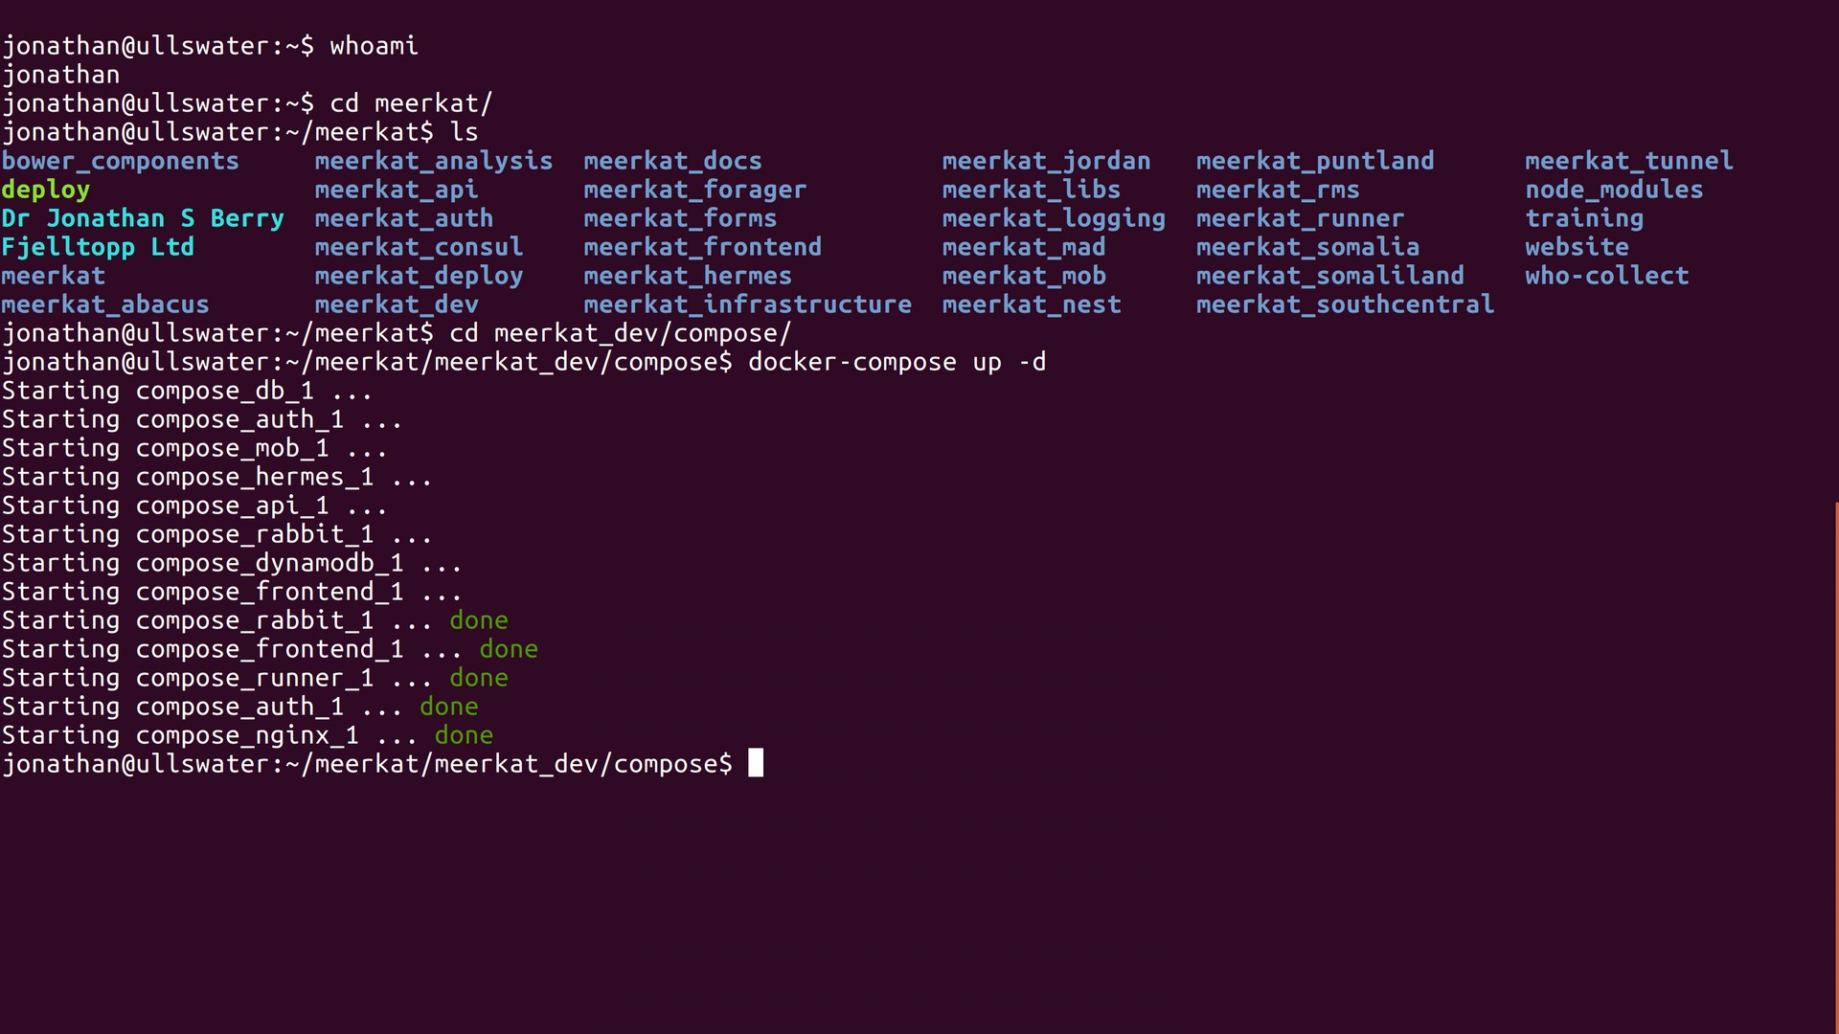
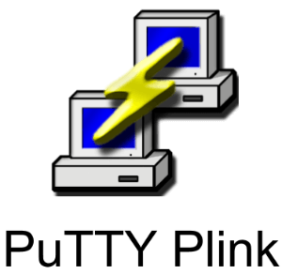
How do we use Linux?
PuTTY
Notes:
Linux has a graphical user interface with windows and pointers. But this actually makes work very hard for software engineers!
We use Linux “from the command line”.
Instead of clicking buttons we type commands
You can access this command line remotely using something called SSH – Secure Shell Access.
This is dead easy from linux to linux, but from windows to linux we have to install a special program: Putty.
From the command line there is a whole language of commands we can use to harness the power of a linux machine.

Slide 6
Exercise: SSH into a linux server
http://guide.bash.academy/
Notes:
We’re going to begin by getting Putty installed and logging into a Linux server.
It is beyond the scope of this talk to teach you how to use the command line properly. The only way to learn this is to learn it the hard way: follow online tutorials and commit to using linux and googling to solve your problems.
Once we are logged on, however, do take some time to work through

Slide 7

What is Docker?
Meerkat Software
other
docker
containers
Docker container
Notes:
Codify the relationship between software and the host. We use Docker as a way of getting your program to work in any environment.
When you write software, it depends on many other pieces of software. Meerkat depends on over 70 other pieces of software, which themselves might each depend on 70 other pieces of software.
Docker solves this problem by running your programs inside lightweight “virtual” machines – or “containers”.
You can write code the defines exactly how these virtual machines should be created and started, and exactly how they should talk to each other and the host machine.
Meerkat runs 16 docker containers to operate.

Slide 8
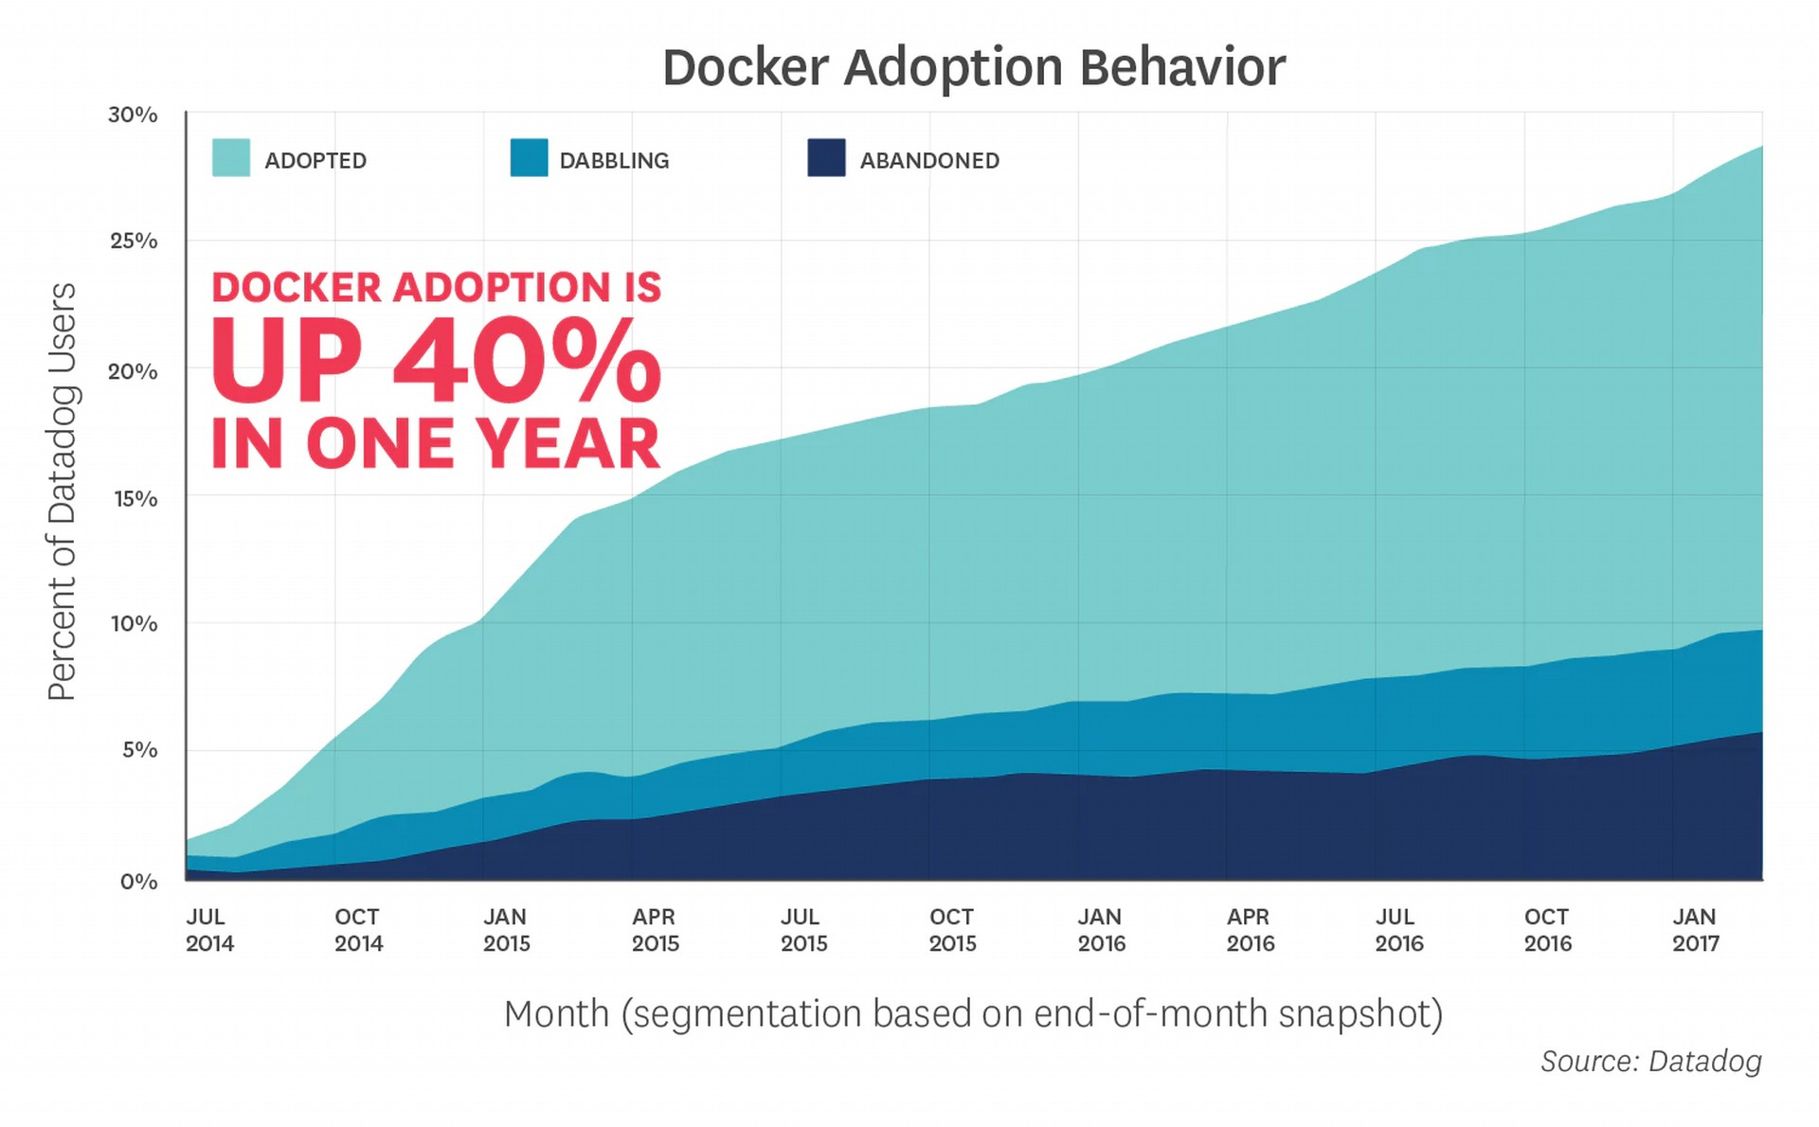
Why Docker?
Notes:
Put simply, there is no way we would have stood a chance at getting our software out of the cloud and into your sever room without docker. It would have taken months and months of work.
But docker makes it “comparatively easy” to run software on our own development machines (linux, mac, and maybe even windows), in the cloud, in the MoH server room.
Datatdog say they have seen approximately 40% market share growth in 2016-2017. Usage grew from 1% -15% in 2015-Jan2017. Interest is led by big companies such as Visa, Paypal, Cornell University.
Again it is freely available and open source with a massive support community. Docker run training is available around the globe.

Slide 9
How do we use Docker?
Docker
Container
Running machine
docker up
Docker
Image
Compiled form
docker build
Docker
File
Code form
Notes:
Installing docker in Linux is easy! We’ll do that in a moment. Docker itself allows us to define and run individual containers.
Docker-compose is a tool that can be used to define how multiple containers should be configured and talk to each other. We need to install both.
A docker container is built from a docker image. An image is a compiled snapshot, or blueprint, of what the container should look like.
Docker has a whole clever way of building, saving, and sharing these images.
We want to be able to get the meerkat images, and from them start the meerkat_containers.

Slide 10
Exercise: Installing Docker
Create some containers
Notes:
Let’s try and actually get some docker containers running on our Linux servers.
First install docker. Follow this tutorial:
https://docs.docker.com/install/linux/docker-ce/ubuntu/#install-docker-ce
Then install docker-compose:
https://docs.docker.com/compose/install/

Slide 11
Summary
Linux is essential to working with Meerkat
There is a huge amount of freely available support
e.g. http://guide.bash.academy/
Docker separates software from infrastructure
Docker is essential to administering Meerkat
There is a huge amount of freely available support
e.g. https://docs.docker.com/
Notes:
Understanding Linux is essential to working with Meerkat.
Linux is not that scary! Ubuntu is very user friendly and well worth playing with.
We cannot teach you how to use linux here, you have to do it yourself. The same for docker.
By using docker, we can make sure all our software appears to run on the same linux machine, whether or not it is in the cloud, in your server room or on our own computers.
We run meerkat software by running meerkat docker containers.
Go get proper training, and start teaching yourself.

