Slide 1

Databases & Data Design
The Meerkat Data Pipeline
Jonathan Berry
Fjelltopp Technology with impact.
<footer> · <number> / 28

Slide 2
Overview
Talk: Overview
Exercise: Data collection
Talk: The data collection server
Exercise: Data transformation
Talk: The website server

Slide 3
Restrictions on the data design
Security
Real Time
Accessibility
Open Data Kit
Open Source
Micro-services

Slide 4
In a nutshell...
Open Data Kit
Open Data Kit

Slide 5
In a nutshell...
Open Data Kit
Open Data Kit
Meerkat Nest
Nest Persistant

Slide 6
In a nutshell...
Open Data Kit
Open Data Kit
Meerkat Nest
Nest Persistant
Meerkat Tunnel
Abacus Persistant

Slide 7
In a nutshell...
Open Data Kit
Open Data Kit
Meerkat Nest
Nest Persistant
Meerkat Tunnel
Abacus Persistant
Meerkat Abacus
Abacus Generated

Slide 8

In a nutshell...
Open Data Kit
Open Data Kit
Meerkat Nest
Nest Persistant
Meerkat Tunnel
Abacus Persistant
Meerkat Abacus
Abacus Generated
Meerkat Api
Meerkat Frontend
Meerkat API

Slide 9

In a nutshell...
Open Data Kit
Open Data Kit
Meerkat Nest
Nest Persistant
Meerkat Tunnel
Abacus Persistant
Meerkat Abacus
Abacus Generated
Meerkat Api
Meerkat Frontend
Meerkat API

Slide 10
Other data
Meerkat Abacus
Meerkat Api
Meerkat Frontend
Meerkat API

Slide 11
Other data
Auth
Meerkat Auth
Meerkat Abacus
Meerkat Api
Meerkat Frontend
Meerkat API

Slide 12
Other data
Hermes
Auth
Meerkat Hermes
Meerkat Auth
Meerkat Abacus
Meerkat Api
Meerkat Frontend
Meerkat API

Slide 13
Other data
Hermes
Auth
Meerkat Hermes
Meerkat Auth
Meerkat Abacus
Meerkat Api
Meerkat Frontend
Meerkat API

Slide 14
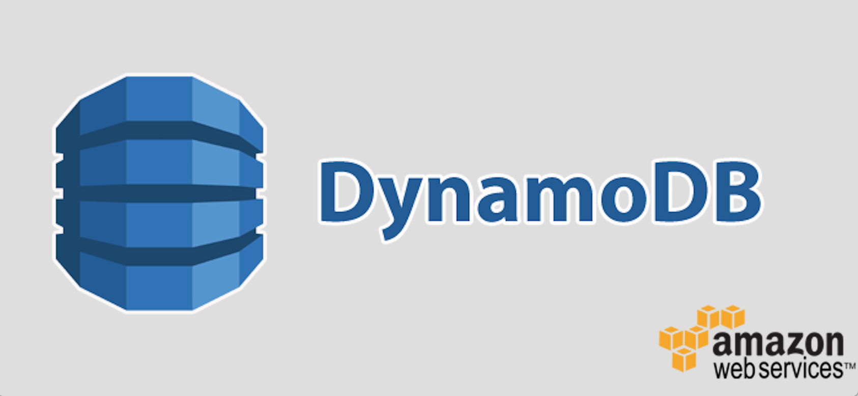

Relational vs. Non-relational Databases
No fixed schema!
Scalable, flexible, with
strong consistency.
PostgreSQL allows a half-way house with the JSON data type.

Slide 15
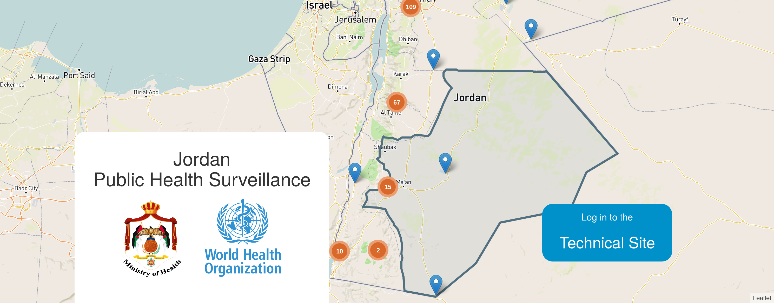
Exercise
Data Collection
Fjelltopp Technology with impact.
<footer> · <number> / 28

Slide 16

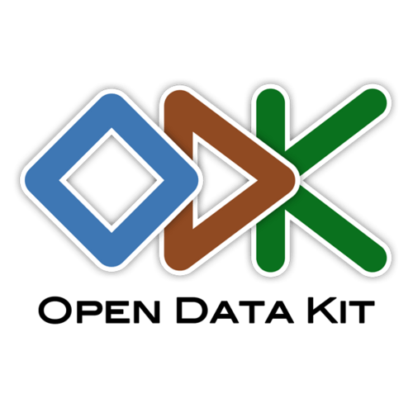
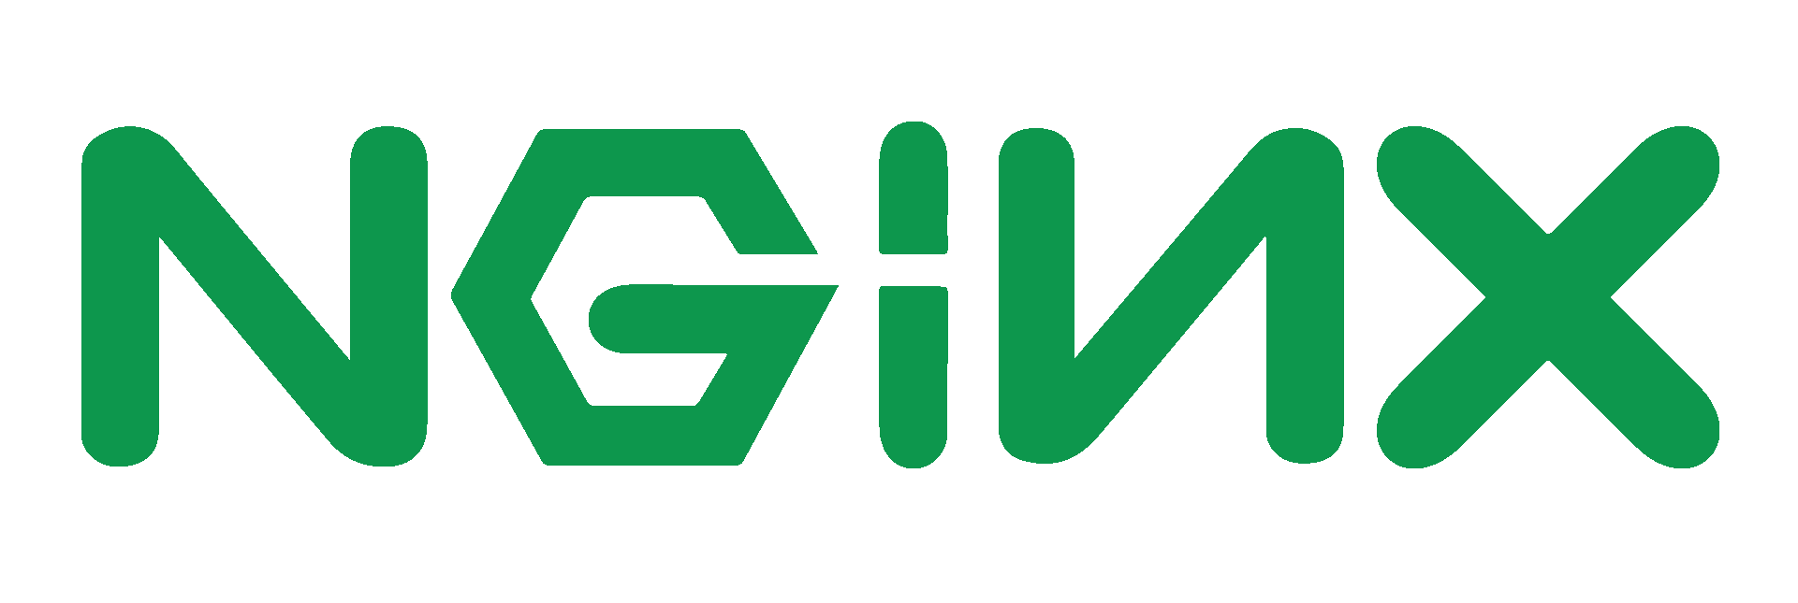

Open Data Kit (ODK)
ODK Collect
NGINX
Meerkat Nest
ODK Aggregate
Tomcat

Slide 17
Meerkat Nest
ODK Collect
1) Write to raw data table
NGINX
2) Process data
Meerkat Nest
Meerkat Drill
ODK Aggregate
3) Write to processed data tables
Tomcat
3) Push submission into tunnel

Slide 18
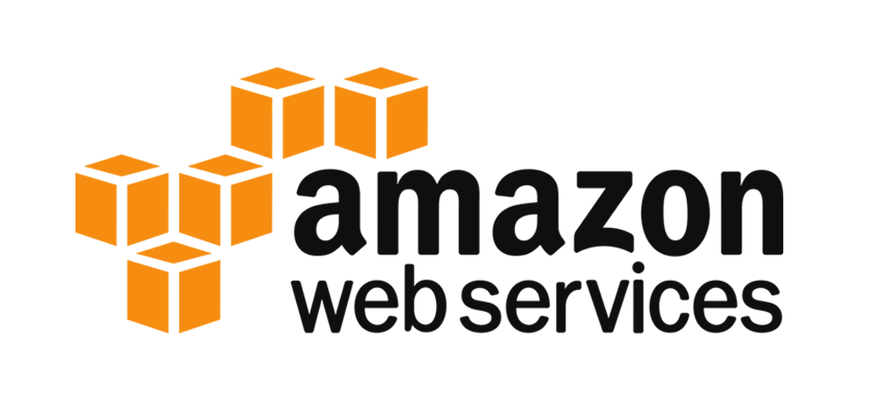
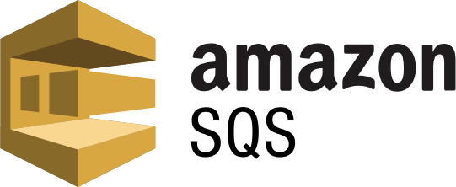
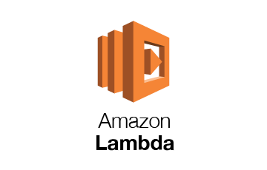

Meerkat Tunnel
1) Write to raw data table
2) Process data
Meerkat Tunnel
Meerkat Abacus
Meerkat Nest
Meerkat Drill
3) Write to processed data tables
3) Push submission into tunnel

Slide 19
But Without Cloud?
1) Write to raw data table
1) Receive in a local Rabbit MQ
2) Process data
2) Write to Abacus persistent DB
Meerkat Abacus
Meerkat Nest
Meerkat Drill
3) Write to processed data tables
3) Transform data
3) Push submission into tunnel
4) Write to Abacus generated DB

Slide 20
There are improvements to be made!
Do we need the Abacus persistent DB?
Does this need to be on two separate servers?
The Jordan fix was put together in a rush:
  Code quality and refactoring
  Testing
  Hardware backups and fail-safe methods

Slide 21
Exercise
The Website Server
Fjelltopp Technology with impact.
<footer> · <number> / 28

Slide 22
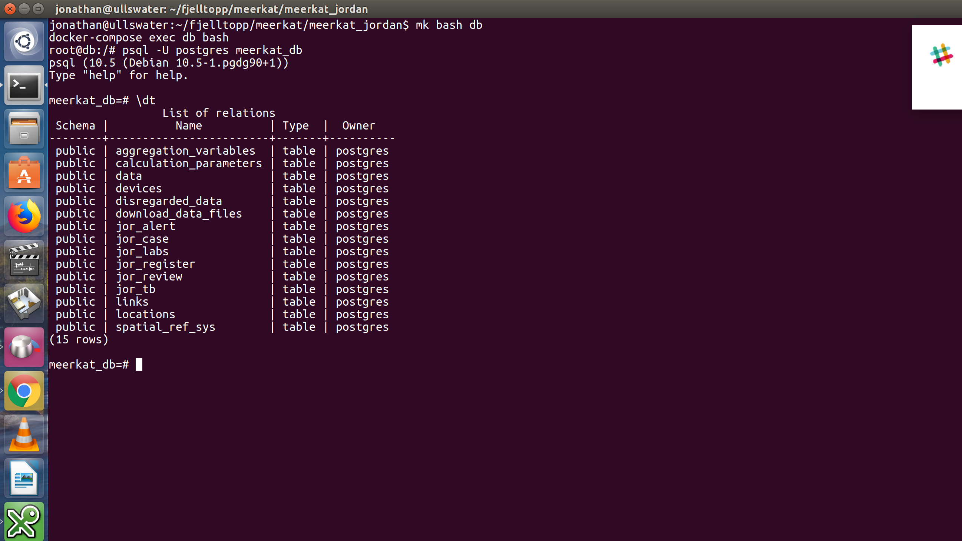
Meerkat Abacus Data Tables

Slide 23
Meerkat Abacus: Data Transformation
jor_case
id | Auto assigned key
uuid | The ID we use!
data | JSON raw data
data
id | Auto assigned unique key
uuid | This is the ID we use!
device_id | Tablet device ID
epi_week | Week number
epi_year | Year
region | ID of the device’s region
district | ID of the device’s district
clinic | ID of the device’s clinic
variables | JSON transformed data
locations
devices
aggregation_variables

Slide 24
Meerkat Abacus: Data Transformation
Where?
[Abacus Country Configs]/variable_codes
What?
A selection of CSV files that are concatenated together
Example?
Code: { “id”: “gen_1”,
“method”: “match”,
“db_column”: “pt1./gender”
“condition”: “male” }
Raw: { “pt1./gender”: “male” }
Variables: { “gen_1”: 1 }

Slide 25

Meerkat Runner: Asynchronous Tasks
Asynchronous tasks:
  Processing new submissions
  Generating data sets for download
  Sending reports by email
Remember to check
Meerkat Runner
logs as well!

Slide 26

Meerkat API: Data Aggregation
Provides a HTTP RESTful API interface to explore the data in meerkat_db.
Enter the world of
Web Programming
in Python...

Slide 27
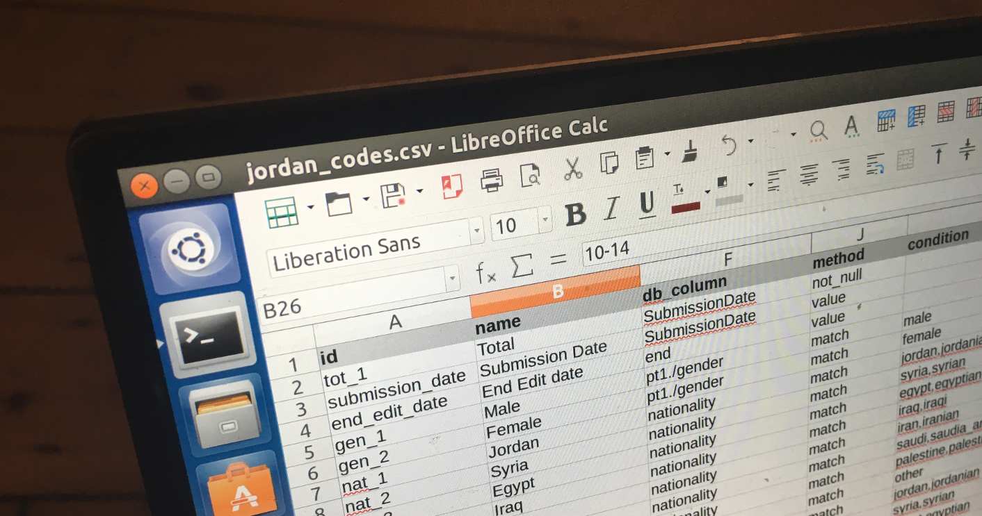
Exercise
Data Transformation
Fjelltopp Technology with impact.
<footer> · <number> / 28

Slide 28
Summary
Securely managing and processing data in real time is a complex task.
ODK aggregate is used to collect data only.
Meerkat Nest DB should be considered the single source of truth.
All data after that can be regenerated, though this takes a long time!
Nest & Abacus process and transform data.
Challenge: Can we refactor the data pipeline to simplify it for local infrastructure?
Fjelltopp Technology with impact.
<footer> · <number> / 28

