Slide 1

Madagascar IEES Training
Introduction to Python
Jonathan Berry
Fjelltopp Technology with impact.
<footer> · <number> / 8

Slide 2
Overview
Talk: Introduction to python
Exercises: Python tutorial
Exercises: Advanced python problems
Talk: No more PhP - Web programming in Python
Exercises: Python websites
Talk: Javascript in Meerkat Frontend
Exercises: Editing Meerkat Frontend

Slide 3
Where?
Meerkat Abacus
Meerkat Frontend
Meerkat API
Meerkat Hermes
Meerkat Nest
Meerkat Auth

Slide 4
Why?
Cross platform
4th most popular code language (After C, Java, C++)
Very few lines do an awful lot!
You can do almost anything you want in Python
Stats and science speciality

Slide 5
What?
A scripting language
An interpreted language
An object orientated language
Dynamically typed
Functional programming support

Slide 6
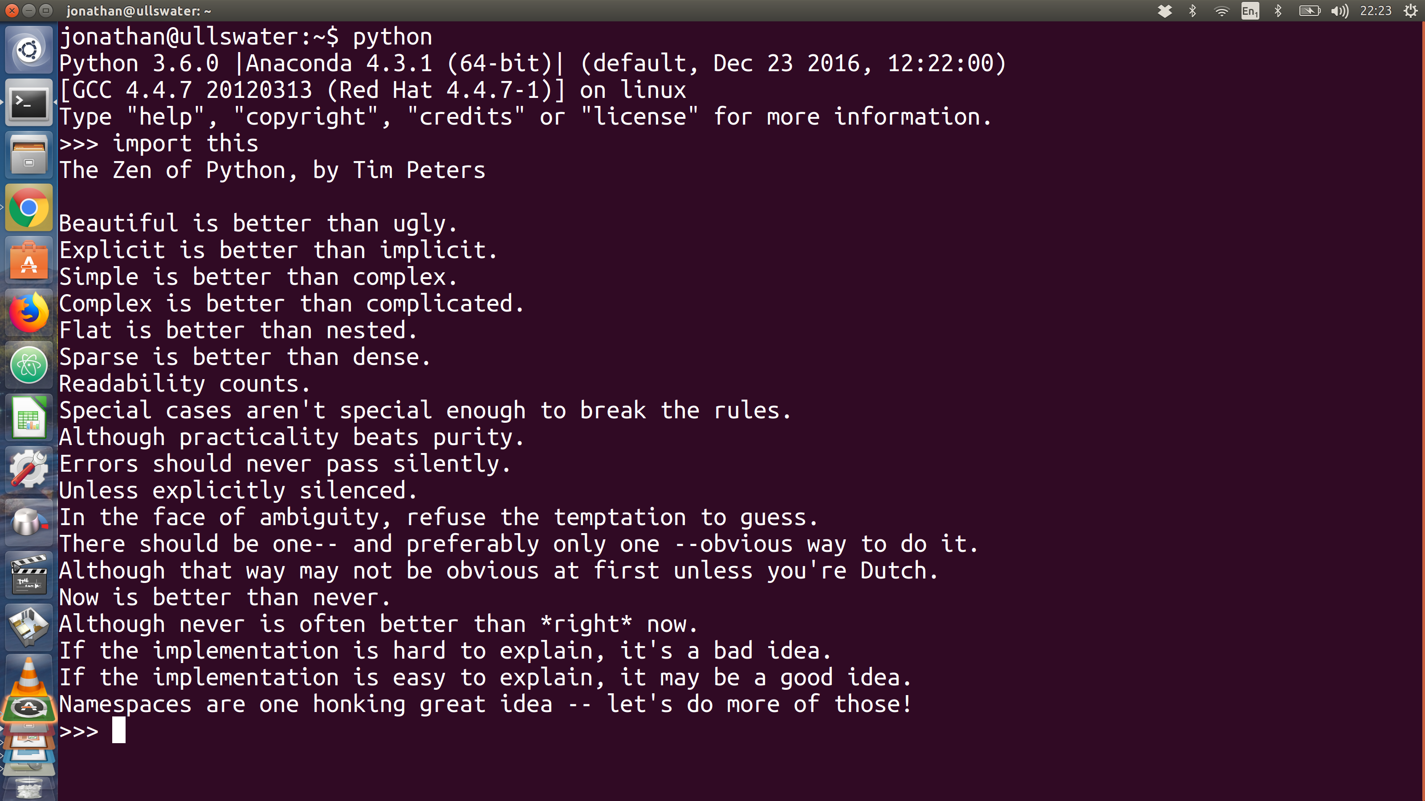
How?

Slide 7

How?
Who?
Key features:
Uses white-space and indentation!
No curly braces, no semi colons.
Can use Python console
Can run Python files
Statements are very simple!
for x in array:
print(x)
Guido van Rossum

Slide 8
Exercise
A simple French Python Tutorial
python.50webs.com
Fjelltopp Technology with impact.
<footer> · <number> / 8

