Slide 1

Jordan IERS
Technical Handover Training
Jonathan Berry
Fjelltopp Technology with impact.
<footer> · <number> / 9

Slide 2
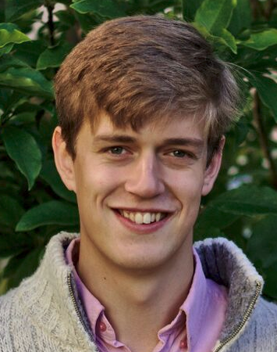
Introductions
Dr Jonathan S Berry
BSc in Computer Science and Physics
PhD in Human-Computer interaction
Three years building IERS
Director and Chief Operating Officer
Jordan Project Technical Manager
Fjelltopp Ltd

Slide 3

Fjelltopp ...a not-for-profit organisation.
Fjelltopp
(pron. fee-yell-topp)
A mountain top.

Slide 4
Fjelltopp ...a not-for-profit organisation.
Support
Innovation
Sustainability

Slide 5
Training Overview
Day 1: Introduction to Meerkat architecture
System Architecture – Docker configurations - Dev Env
Day 2: Data flow and data bases
ODK – Meerkat Nest – Python/SQL
Day 3: Documentation and Debugging
Documentation review – Hands on the server

Slide 6
Aims and Objectives
Inspire and motivate
Bridge the gap between developers and maintainers
Transfer system ownership
Build confidence!
What do you want from this training?

Slide 7
Principles of training
Doing is better than listening.
Slow is better than fast.
Resources should be freely available.
Teach the “real-deal”.
Focus on end goals.

Slide 8

Exercises
“
You don’t learn to walk by following rules.
You learn by DOING!
”
...and by falling over.

Slide 9
Let’s get on with it...
SoftwareDataScienceResearchITConsultingPublicHealthTech
Fjelltopp Technology with impact.
<footer> · <number> / 9

