Slide 1

Meerkat Health Surveillance
Architecture and Design
Jonathan Berry
Fjelltopp Technology with impact.
<footer> · <number> / 27

Slide 2
Overview
Talk: Introducing Meerkat
Exercise: Installing Meerkat
Talk: Meerkat Dev Environment
Exercise: Exploring Meerkat
Talk: Understanding Meerkat

Slide 3

Why “Meerkat”?
Exclusive IT
WHO
UNICEF
IERS
(Jordan)
IEES
(Madagascar)
HOQM
(Somalia)
Meerkat Software
Fjelltopp

Slide 4
Project Aims
“
To enable real-time case-based surveillance at the health facility level that improves public health and clinical decision making at all levels of the health system.
”
Open Source
Micro-services
Continuous Integration
Inter-operable

Slide 5


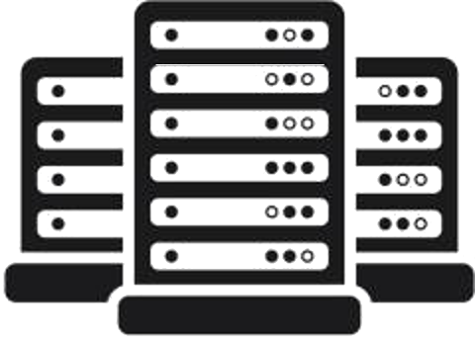

In a nutshell...
Website Server
Data Collection Server
Includes Patient
Identifiable Data!

Slide 6


Design Principle: Open Source
Benefits:
No licensing costs etc.
Other groups can use and improve our software
Can determine in detail how everything works if needed
Much industry leading software is open source

Slide 7
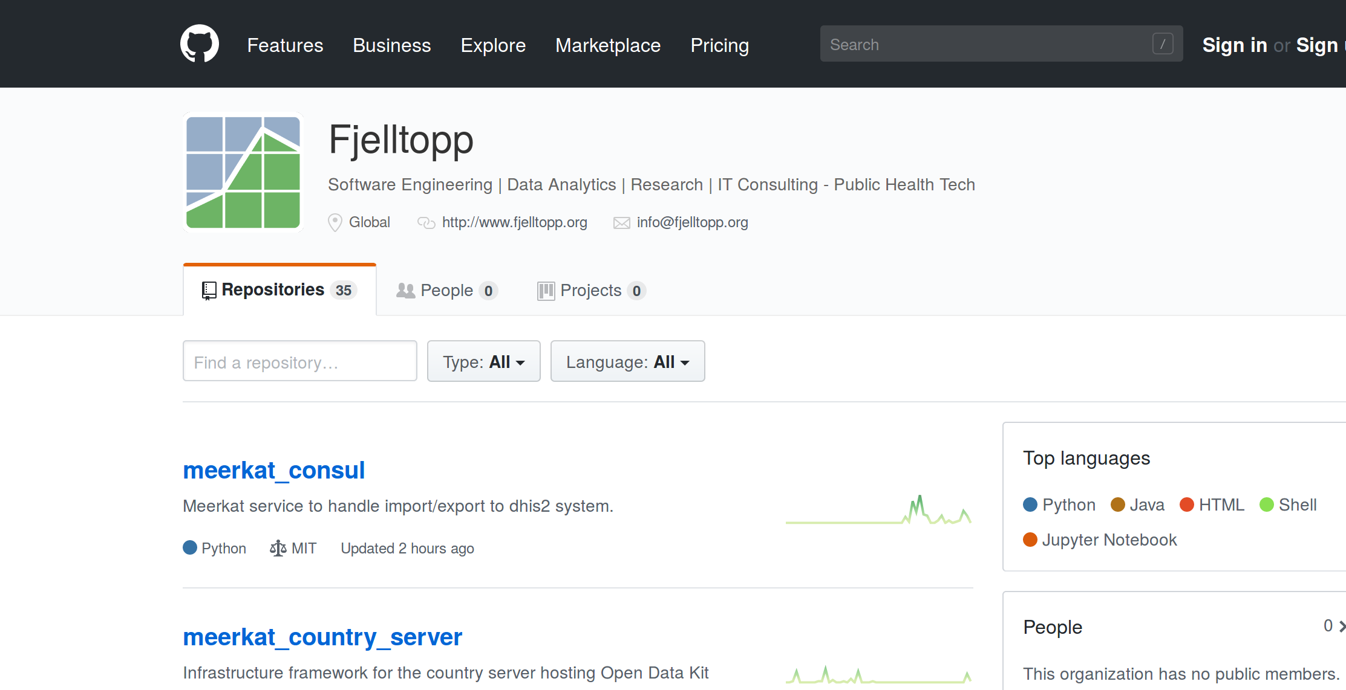
Design Principle: Open Source
Benefits:
No licensing costs etc.
Other groups can use and improve our software
Can determine in detail how everything works if needed
Much industry leading software is open source
github.com/fjelltopp

Slide 8
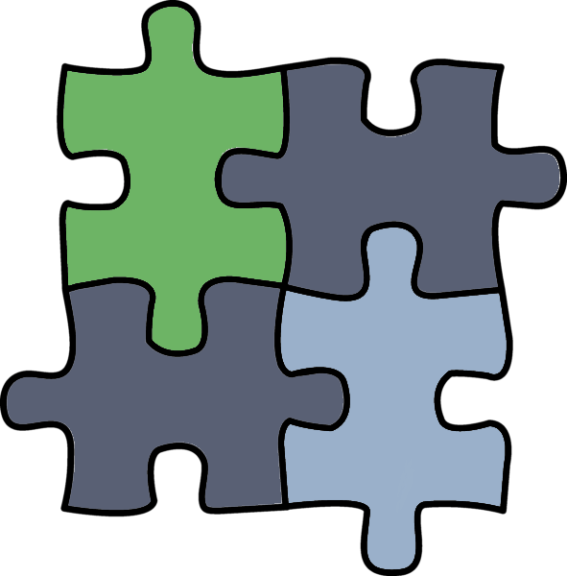
Design Principle: Microservices Architecture
Benefits:
Each component developed independently
Can make different design decisions for each component
Components easily replaced if needed
Separation of responsibilities reduced code repetition

Slide 9

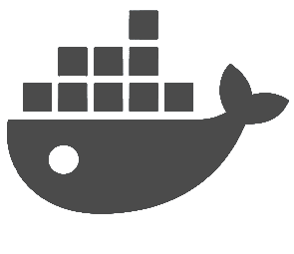

Design Principle: Continuous Integration
Benefits:
Faster deployment of needed changes
Continuous feedback on changes and incremental improvements
Agile development

Slide 10

Design Principle: Continuous Integration
Will it be possible to continue this in Jordan, without using the cloud?

Slide 11
Exercise
Installing Meerkat
“The Dev Env”
Fjelltopp Technology with impact.
<footer> · <number> / 27

Slide 12
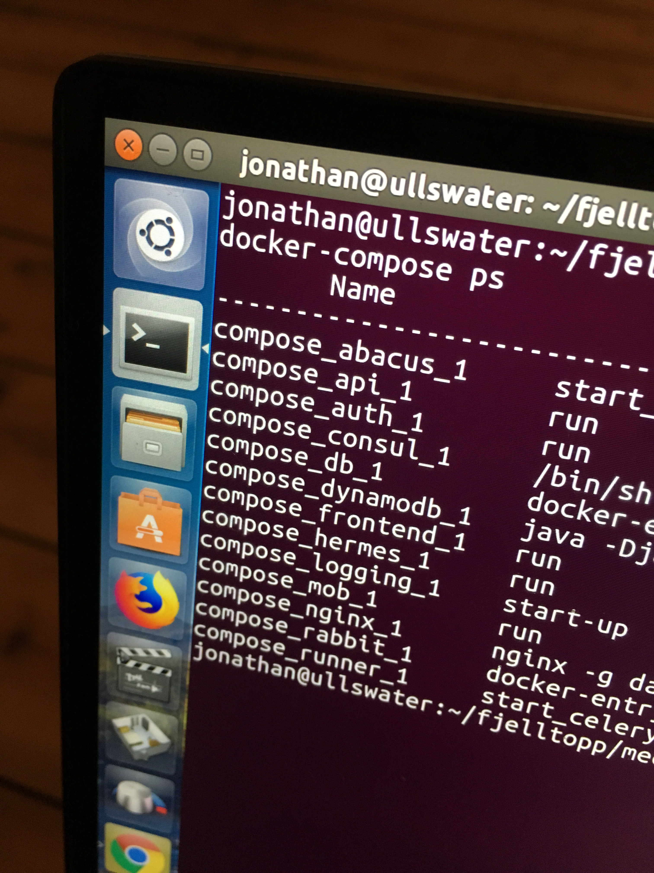
Meerkat Dev: The Glue
The glue that holds it all together:
Country configs
Meerkat code
Third party dependencies.
CODE → RUNNING APPLICATION
Meerkat Dev includes:
Dockerfiles
Docker Compose configs
Utility scripts

Slide 13
The Old Workflow
Dev
Master
Deploy
Server

Slide 14
The Old Workflow
to-local
development
master

Slide 15
The Live Infrastructure
We will look at the live infrastructure tomorrow!
Challenge: How will Jordan
administer & deploy code?

Slide 16
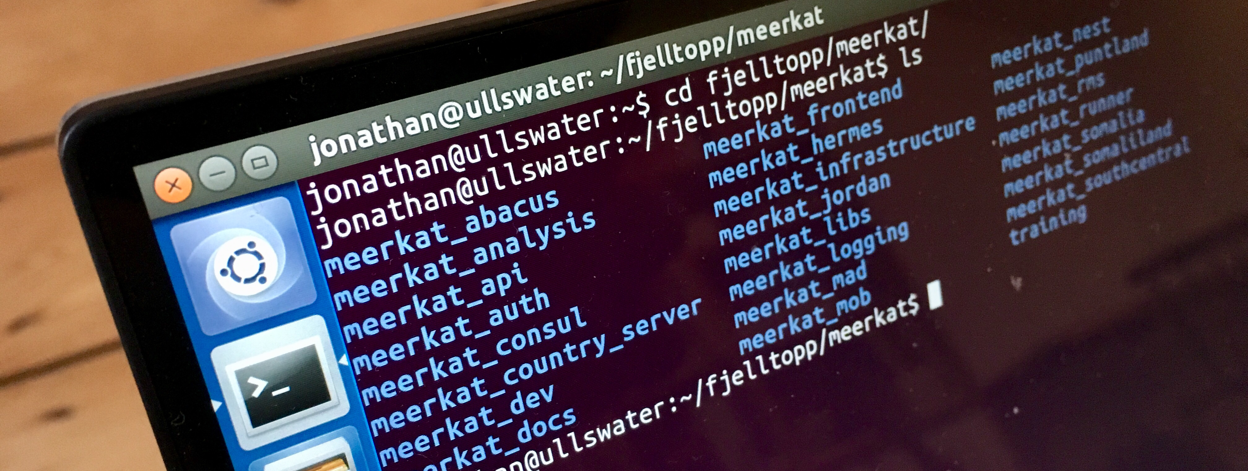
Exercise
Exploring Meerkat
Fjelltopp Technology with impact.
<footer> · <number> / 27

Slide 17
Meerkat Abacus: Data Transformation
Question: How many males are over 60 years old?
We could:
Query DB for all ages
Load into memory
Start calculating
What we actually do:
Pre-empt questions like this
Abacus determines the answer as each submission arrives...
...then tags submission in db
All that is left: quick SQL count

Slide 18
Meerkat Abacus: Data Transformation
Question: How many males are over 60 years old?
Transforms the data so that
complex queries are reduced
to simple counts.
We could:
Query DB for all ages
Load into memory
Start calculating
What actually we do:
Pre-empt the question
Abacus determines the answer for each submission...
...then tags submission in db
All that is left: quick SQL count

Slide 19
Meerkat Abacus: Data Transformation
Question: How many males are over 60 years old?
Does this for over 13,000
different questions!
We could:
Query DB for all ages
Load into memory
Start calculating
What actually we do:
Pre-empt the question
Abacus determines the answer for each submission...
...then tags submission in db
All that is left: quick SQL count

Slide 20
Meerkat API: Data Aggregation
Question: Incidence of Hepatitis A in Amman?
# New Cases Hepatitis
=
Population of Amman

Slide 21
Meerkat API: Data Aggregation
Question: Incidence of Hepatitis A in Amman?
Aggregates data &
provides HTTP access
# New Cases Hepatitis
=
Population of Amman

Slide 22
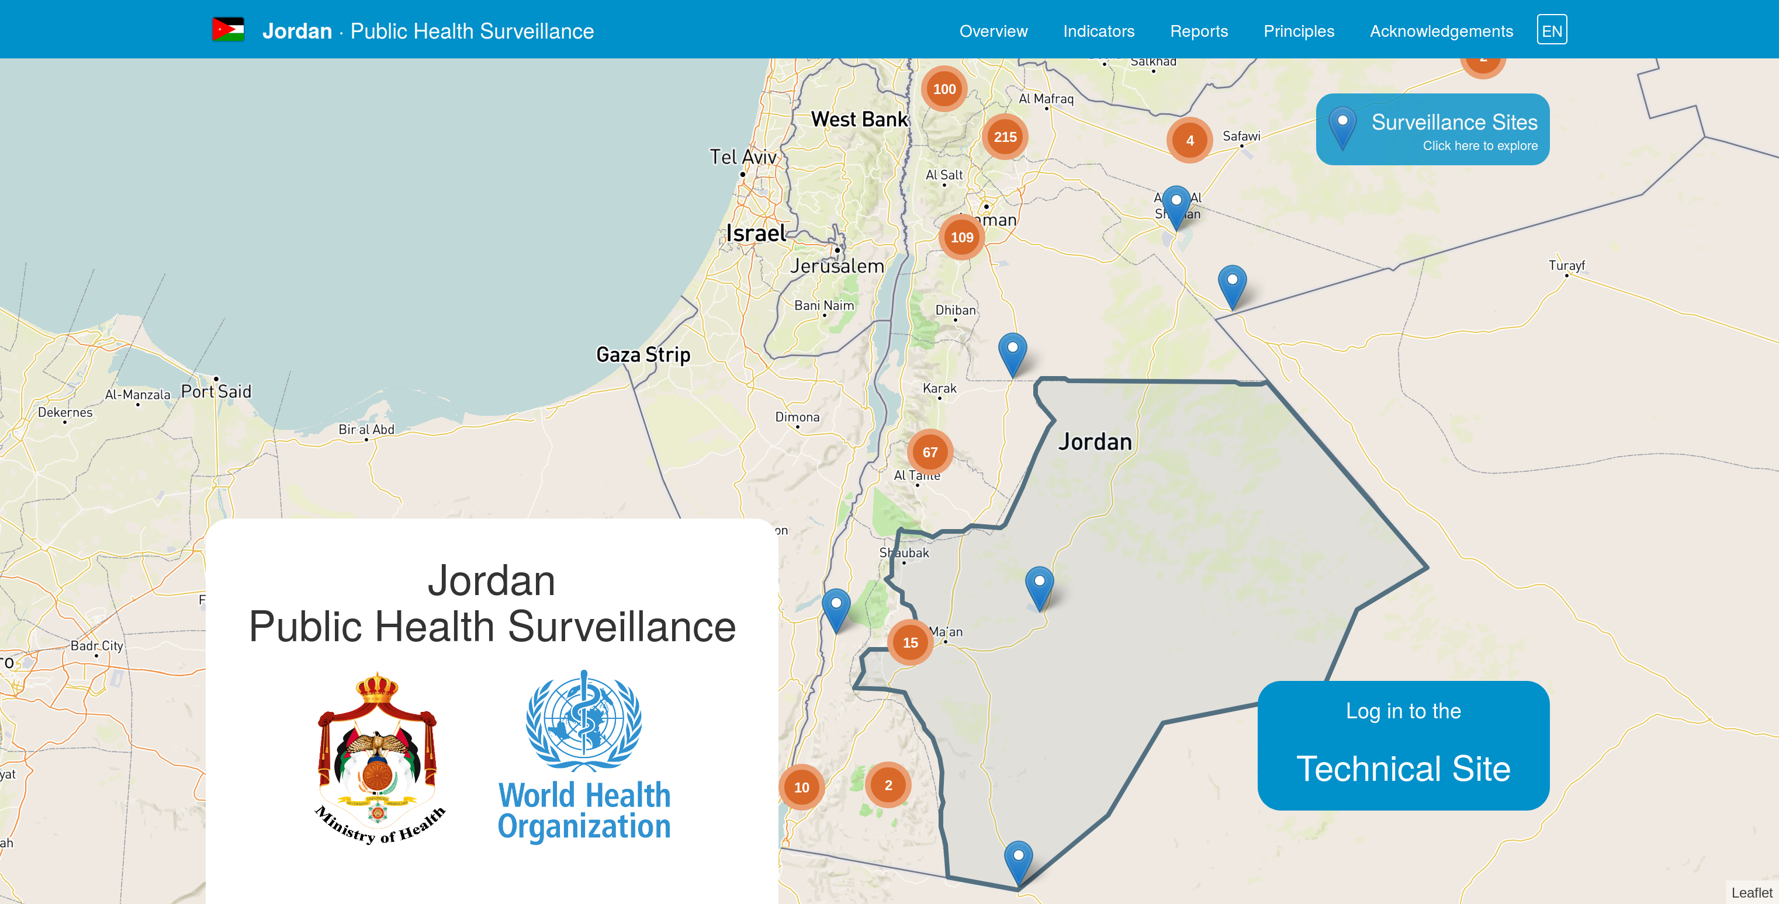
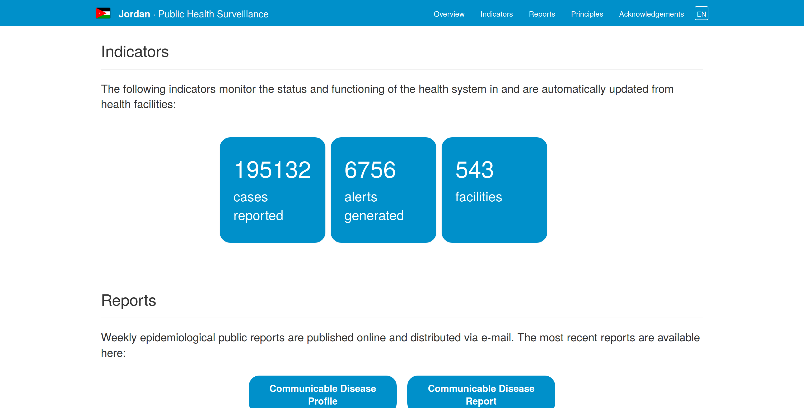
Meerkat Frontend: Data Visualisation
Question: Where are diseases occurring?

Slide 23
Meerkat Frontend: Data Visualisation
Question: Where are diseases occurring?
Visualises data & provides
tools for exploration

Slide 24
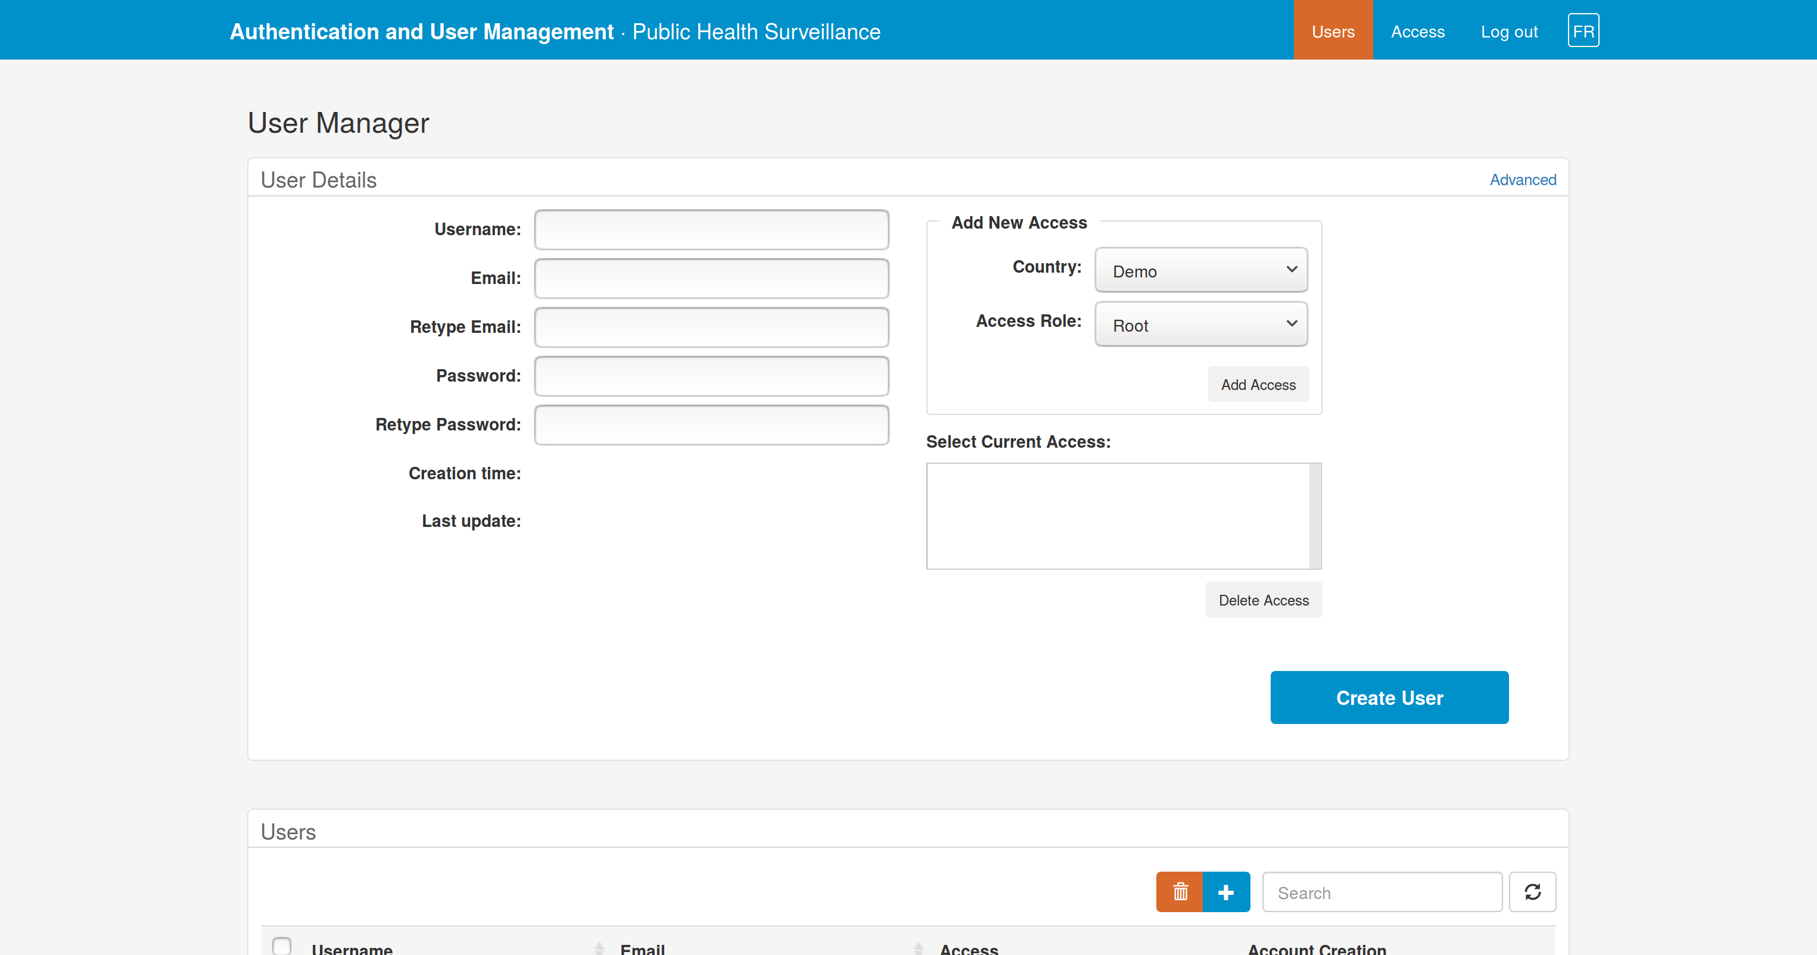

Meerkat Auth: User Authentication
Question: Who can access the data downloads?

Slide 25
Meerkat Auth: User Authentication
Question: Who can access the data downloads?
Authenticates users &
manages access

Slide 26
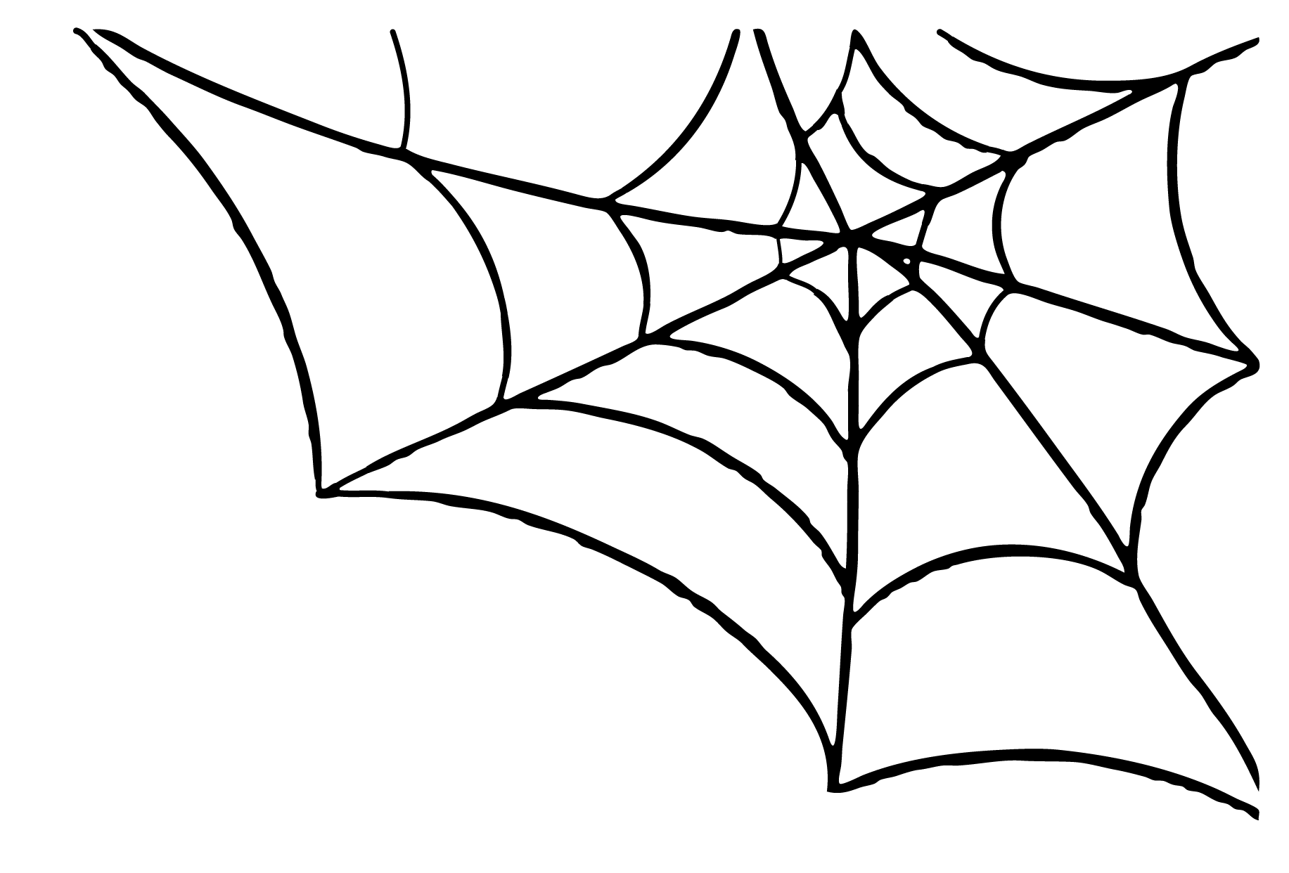
Other Repositories
Meerkat Hermes – Messaging/Notification Service for sending SMS/Emails
Meerkat Runner – Asynchronous scheduling of data processing tasks
Meerkat Analysis – Deeper data analysis functions
Meerkat Libs – Shared code libraries
Meerkat Mob – Google cloud messaging to tablets
Meerkat Logging – Logging of all system actions
Meerkat Consul – [Beta] DHIS2 Integration
(Meerkat Jordan – Country-specific configs)

Slide 27
Summary
IERS is built using “Meerkat” software, freely available from Fjelltopp’s GitHub page.
Meerkat uses a micro-services architecture.
Understanding each service’s purpose is the first essential step to debugging.
Each micro-service is packaged in a Docker container.
Challenge: How will IERS code be administered & deployed moving forwards?
Fjelltopp Technology with impact.
<footer> · <number> / 27

