Slide 1

Using Python for API
Mix Kundegorski, Antananarivo, May 2018
kundegorski@fjelltopp.org

Slide 2
Materials
Python request library tutorial: http://www.python-requests.org/en/latest/user/quickstart/
Python official French tutorial: https://docs.python.org/fr/3/tutorial/index.html
Meerkat documentation: https://s3-eu-west-1.amazonaws.com/meerkat-docs

Slide 3
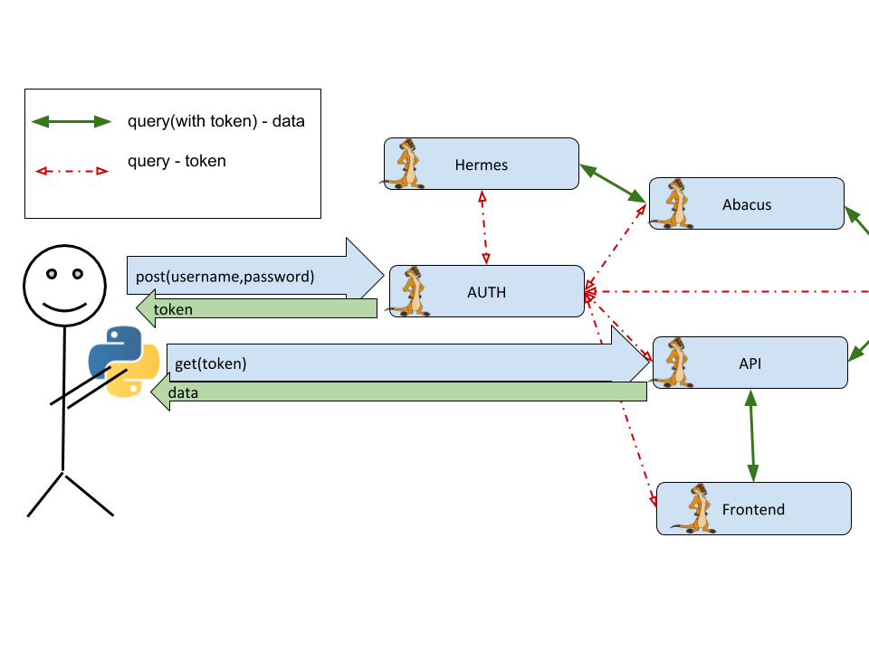
Authenticate through API

