Slide 1

Data Collection Framework
Mix Kundegorski, Antananarivo, May 2018
kundegorski@fjelltopp.org

Slide 2
Plan
Today: - Extended review of previous training content. - API and technical use of IEES
Tomorrow: Form design and workflow
Friday: TBD (To Be Decided)

Slide 3
Jonathan’s principles
Doing is better than listening.
Slow is better than fast.
All training resources should be freely available on the internet.
Teaching should not be abstract – all ideas and exercises should be explicitly and directly related back to IEES, with live examples where possible.
Focus on the goals of the training – maintaining and developing IEES, inspiring andimproving understanding of IEES.

Slide 4
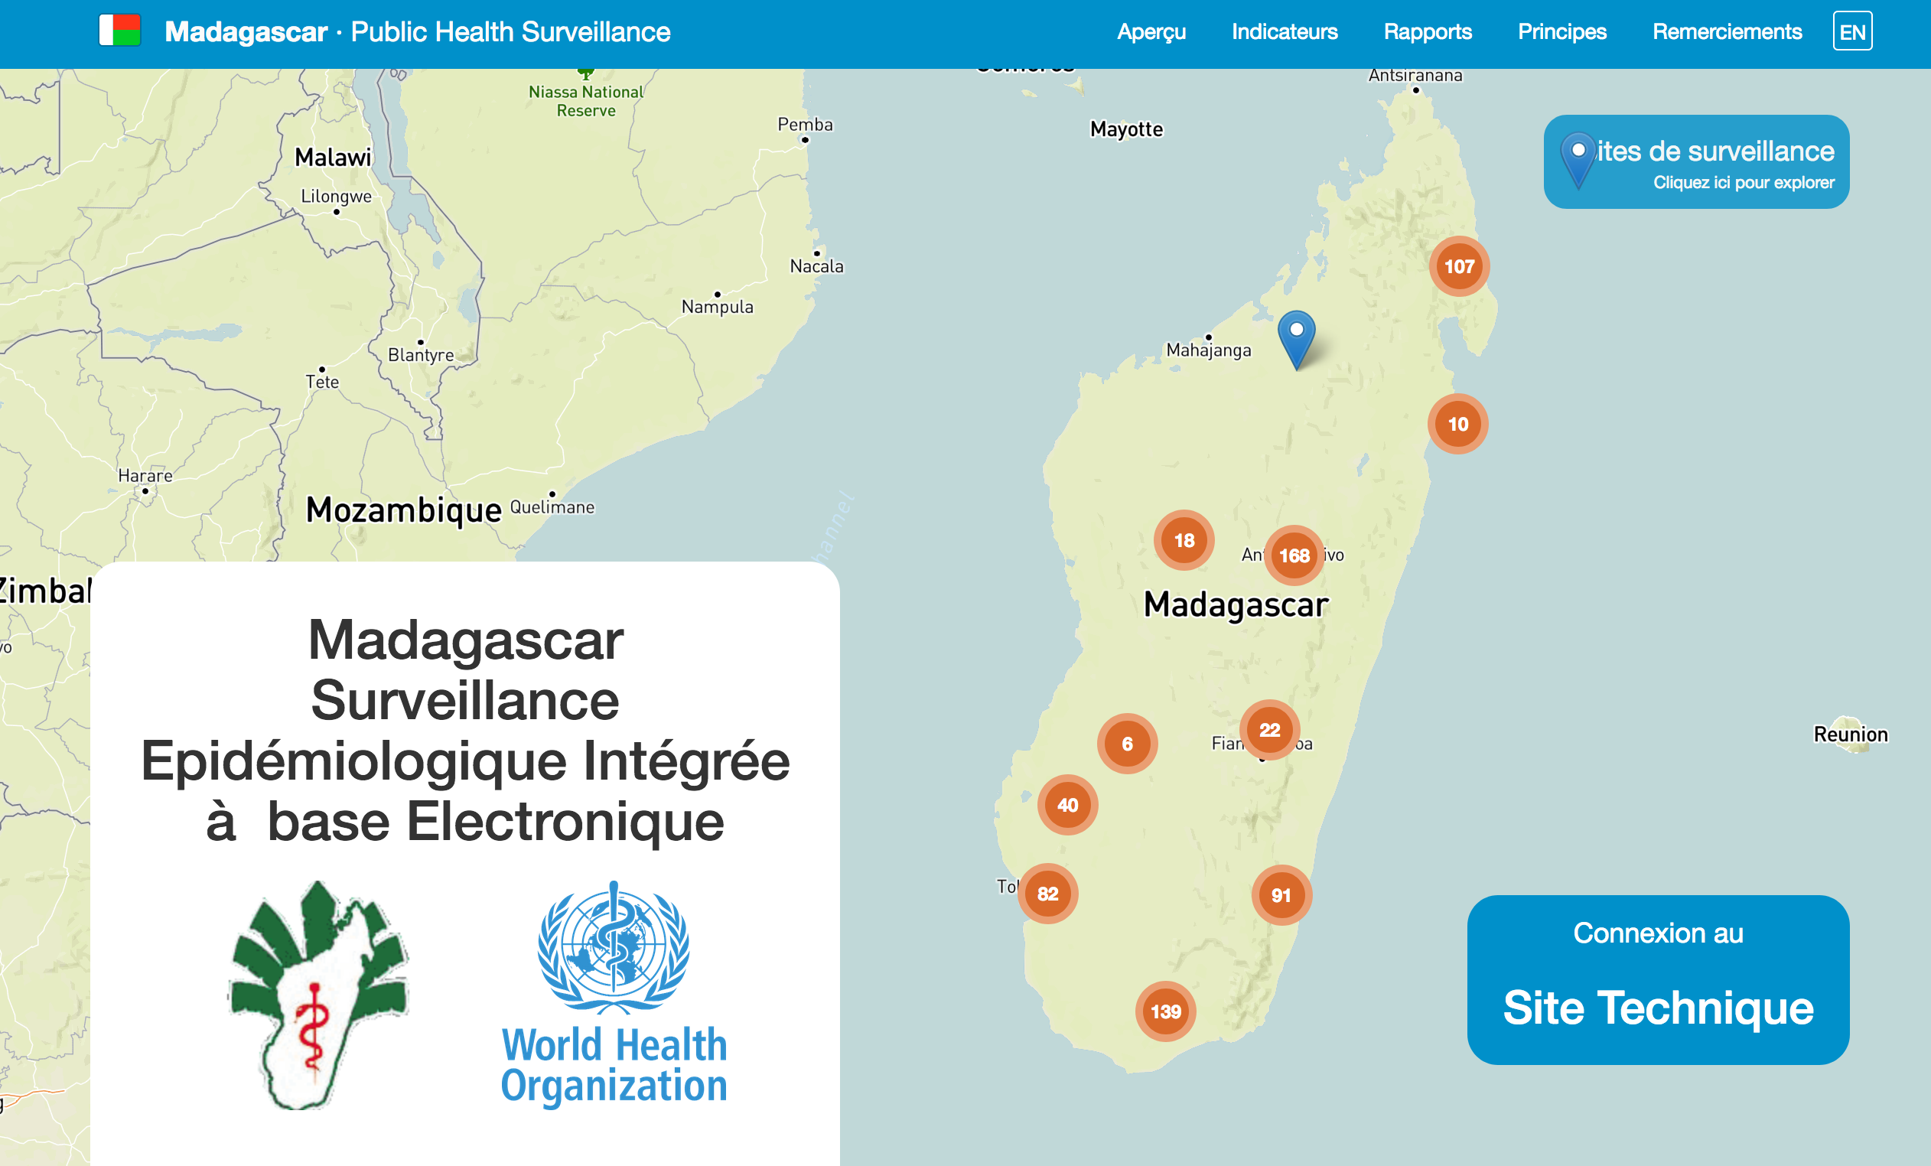
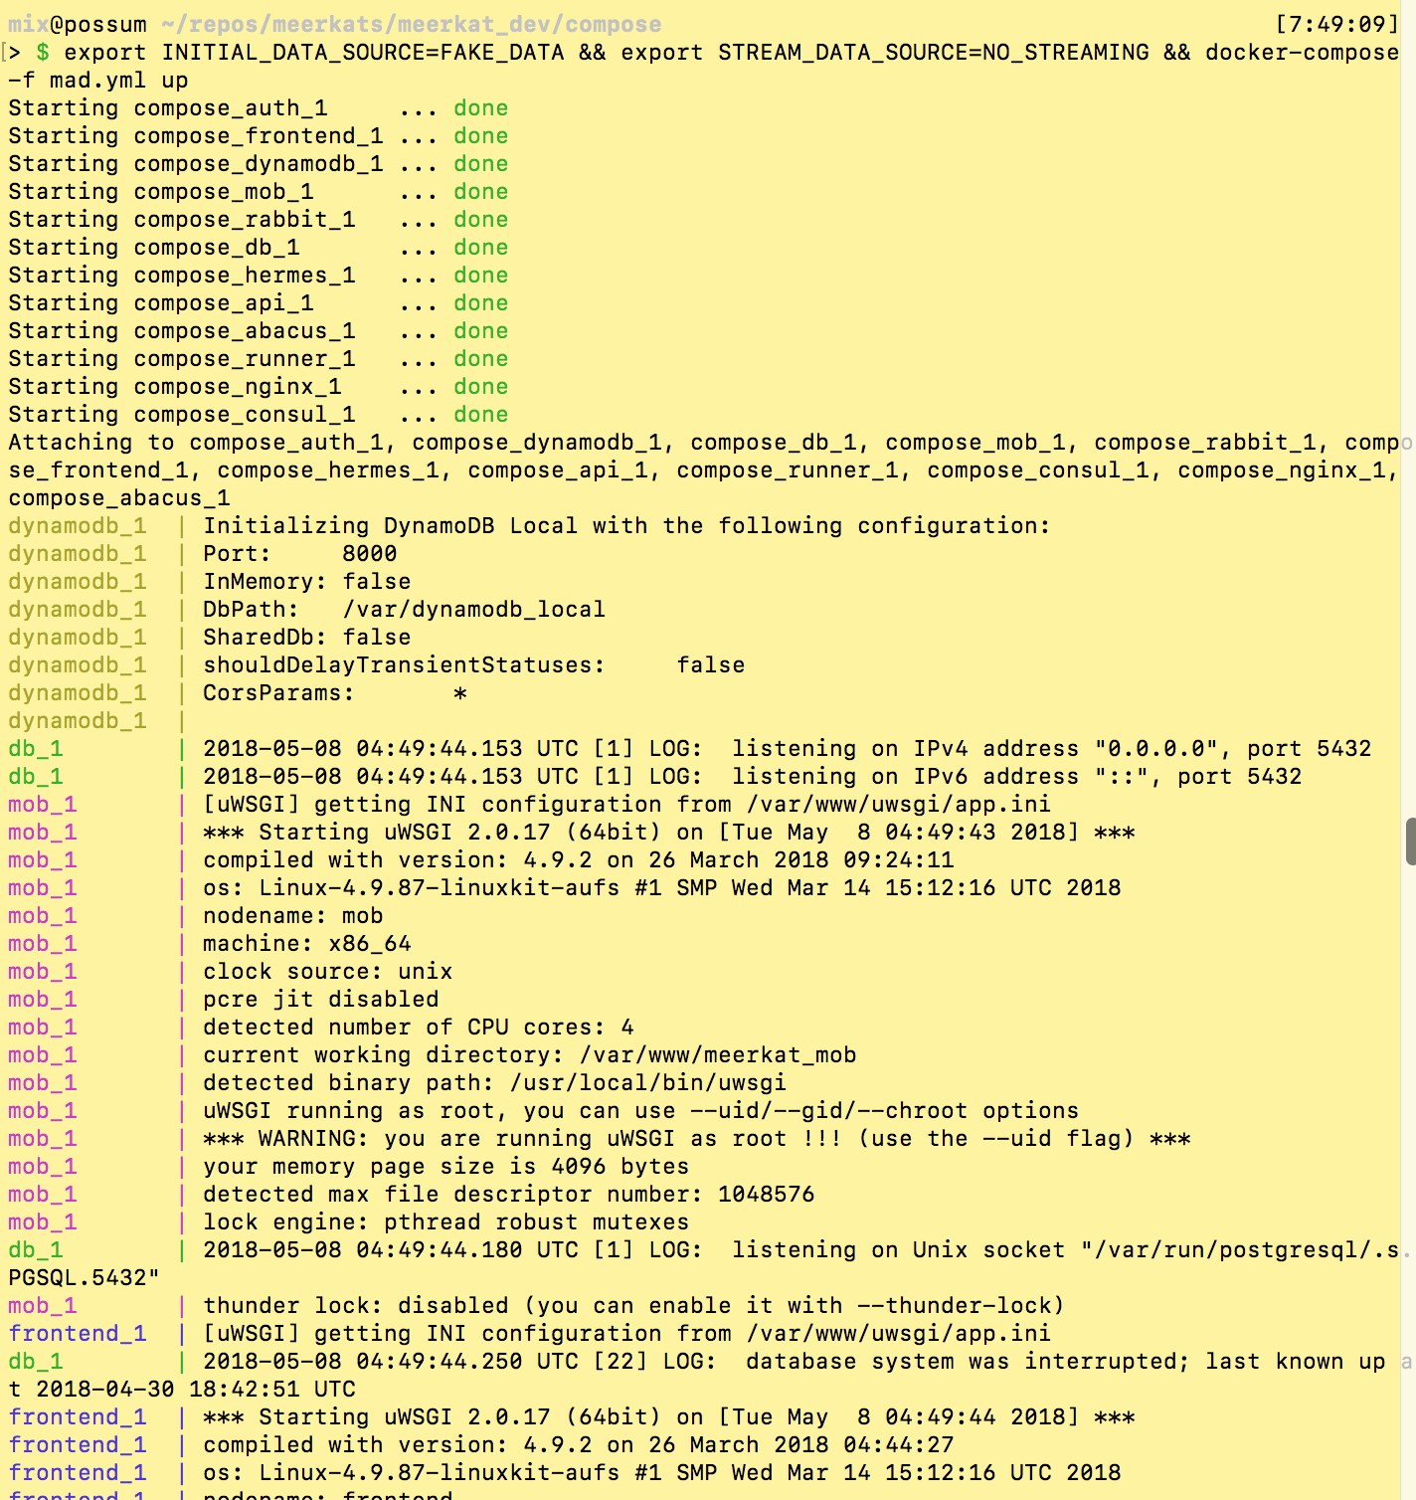
System overview

Slide 5
Data collection within IEES
ODK data collection framework
Form submissions
Tab
ODK Aggregate server
IEES
Tab
Tab
Tab
Tab
Tab
Tab
Data export
Tab
Tab
Tab
Tab
Tab
DB

Slide 6
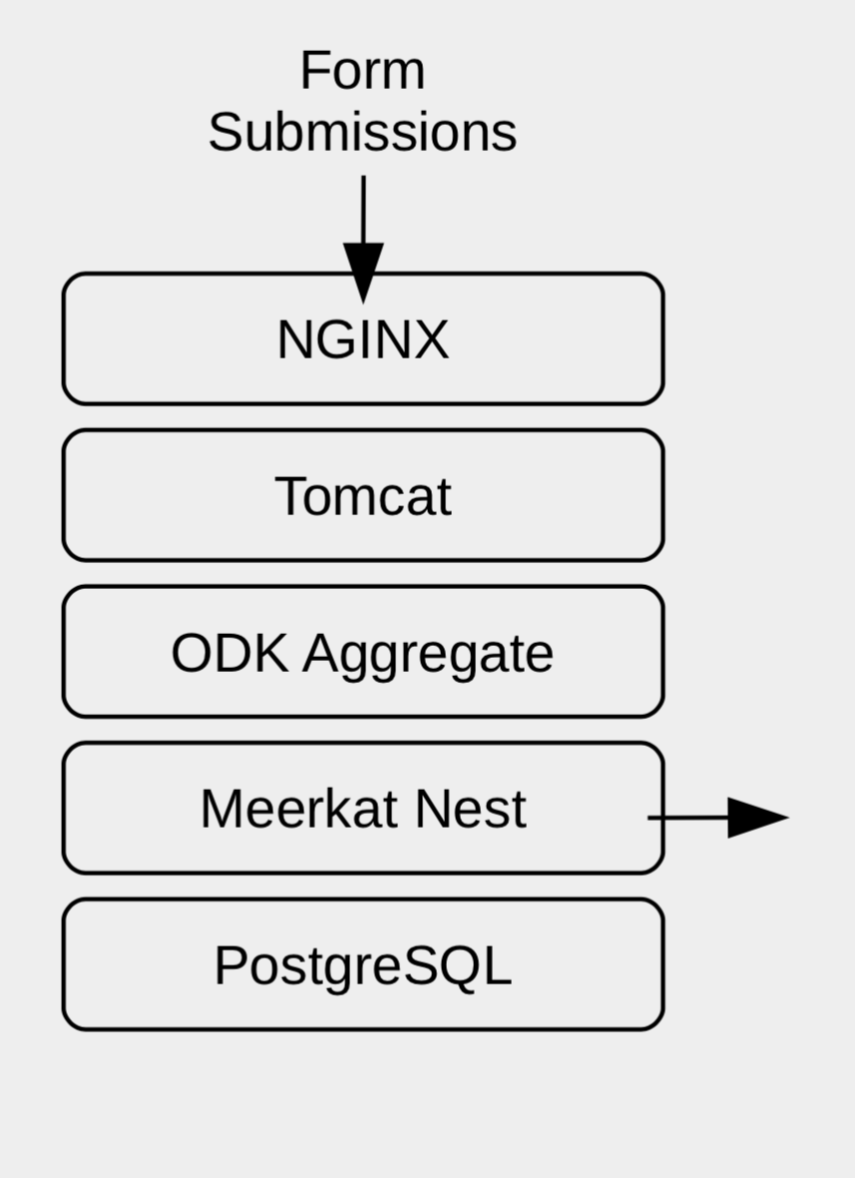
Data collection within IEES
ODK data collection framework
Form submissions
Tab
ODK Aggregate server
IEES
Tab
Tab
Tab
Tab
Tab
Tab
Data export
Tab
Tab
Tab
Tab
Tab
DB

Slide 7
ODK: Open Data Kit
One of the most popular frameworks (set of computer programs for servers, computers and mobiles) for gathering survey data.
Used by many governments, UN agencies and NGOs
Uses Xforms format which is the most popular format to store survey questionnaires
The most flexible and fairly easy way to generate Xforms is using XLSForms which allow creating definitions in Excel

Slide 8
ODK vs DHIS2
ODK: Allows quick and easy data gathering in small and medium sized surveys with little analysis. Can be deployed within few days.
DHIS2: Complex and powerful system for data gathering analysis and reporting. Requires months of integration and trainings

Slide 9
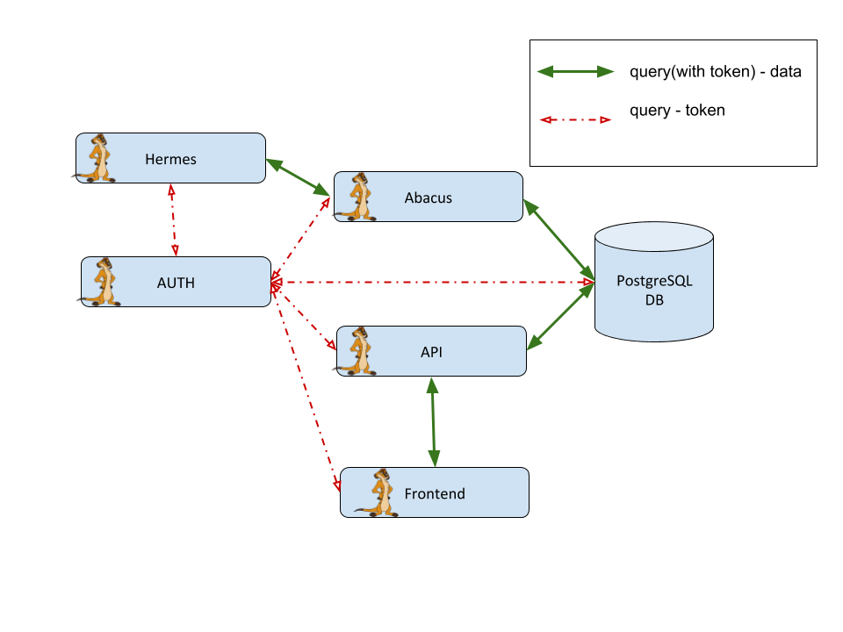
IEES reporting server

Slide 10
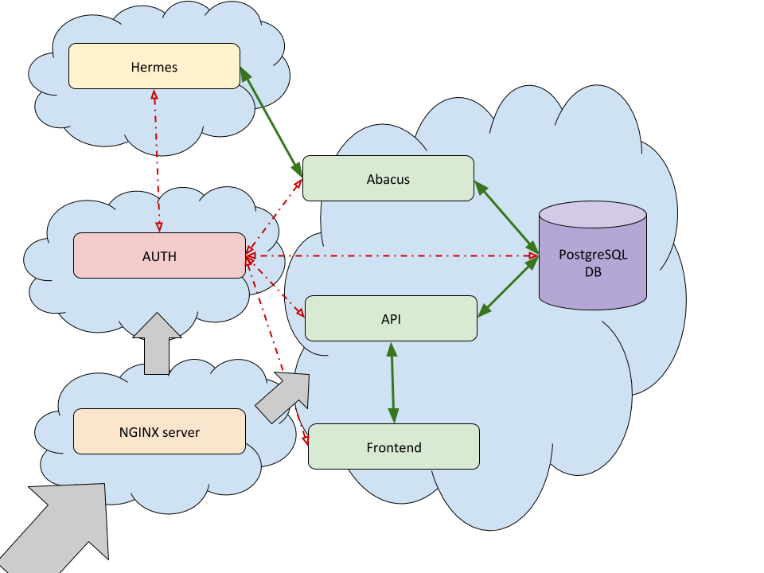
IEES in the cloud

Slide 11
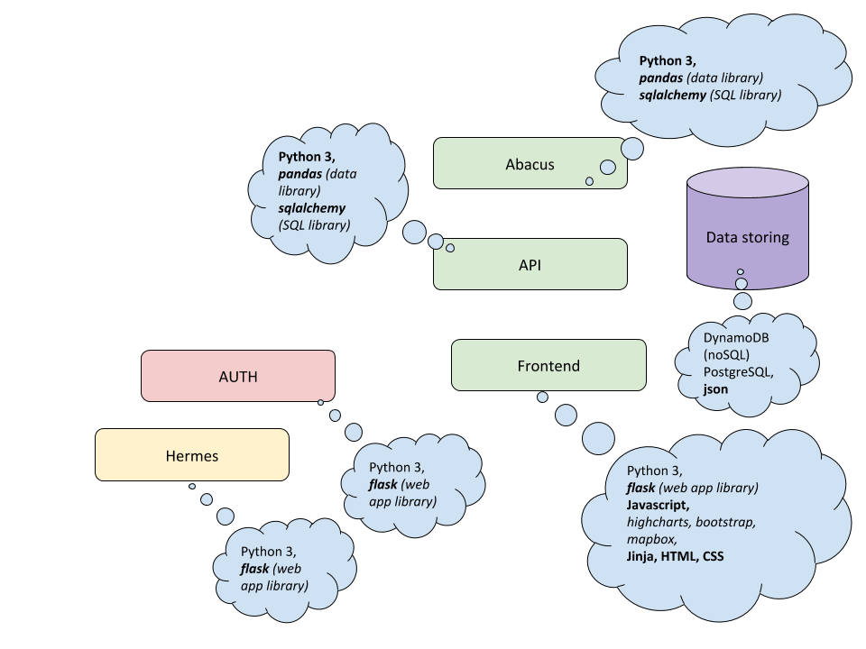
IEES reporting server

Slide 12
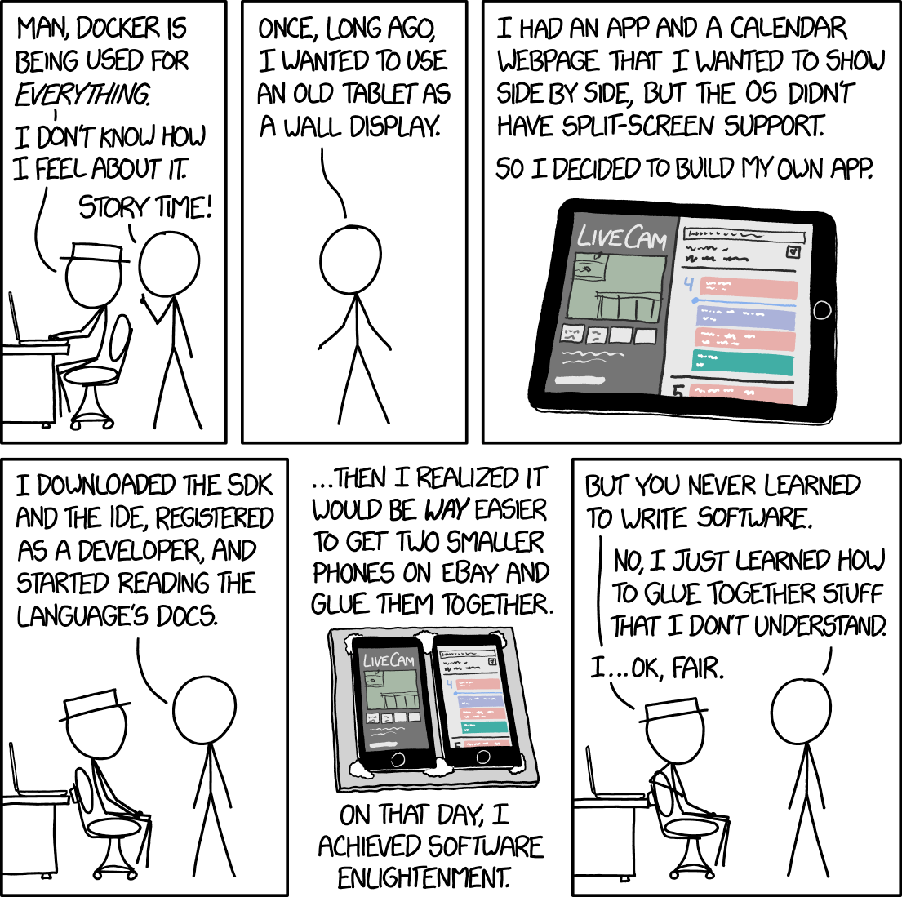
Docker...

Slide 13
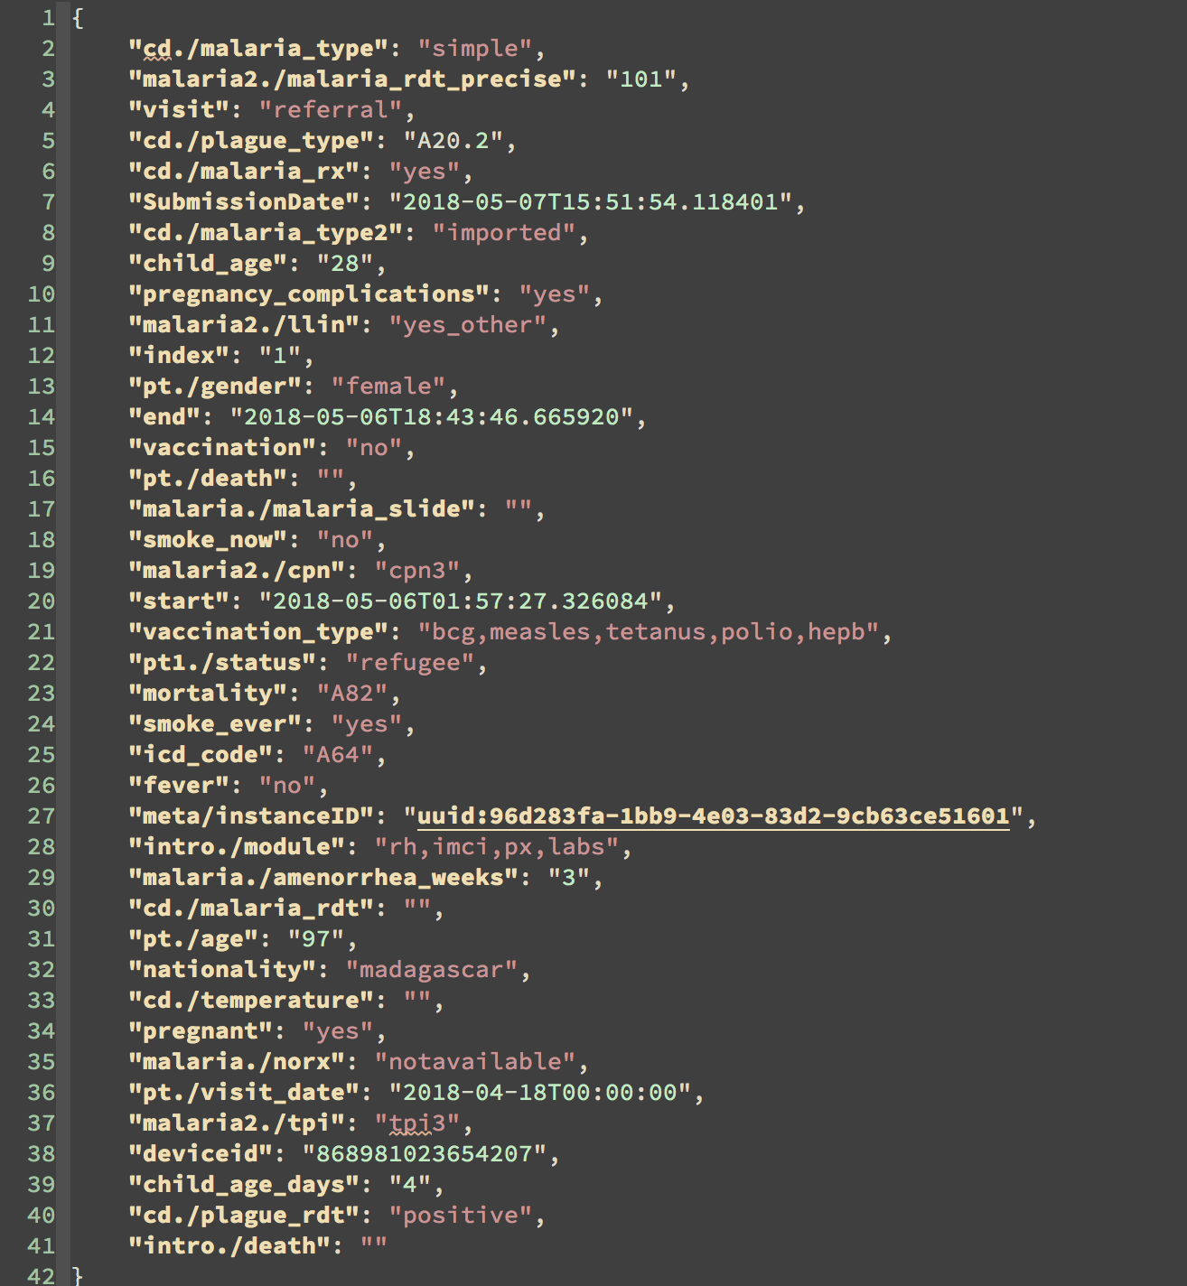
Data processing: Form submission

Slide 14
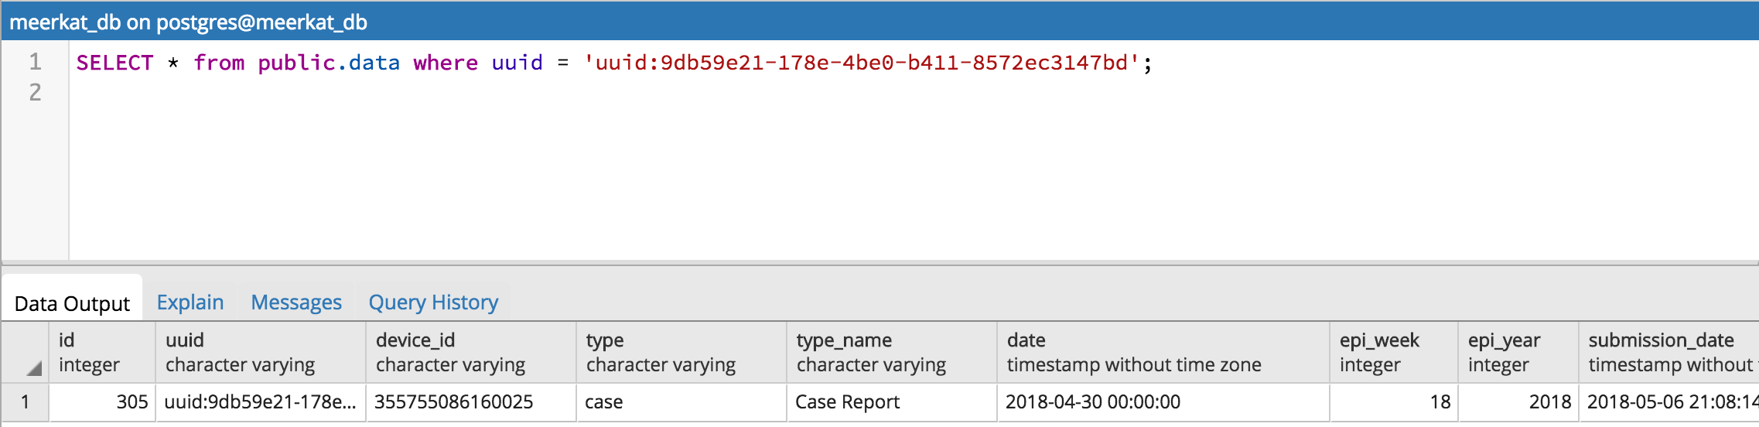
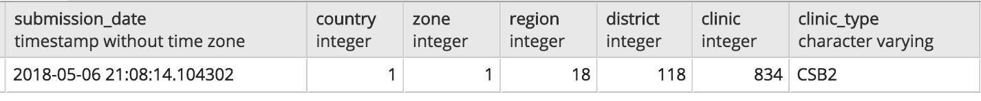
Data processing: case entry

Slide 15
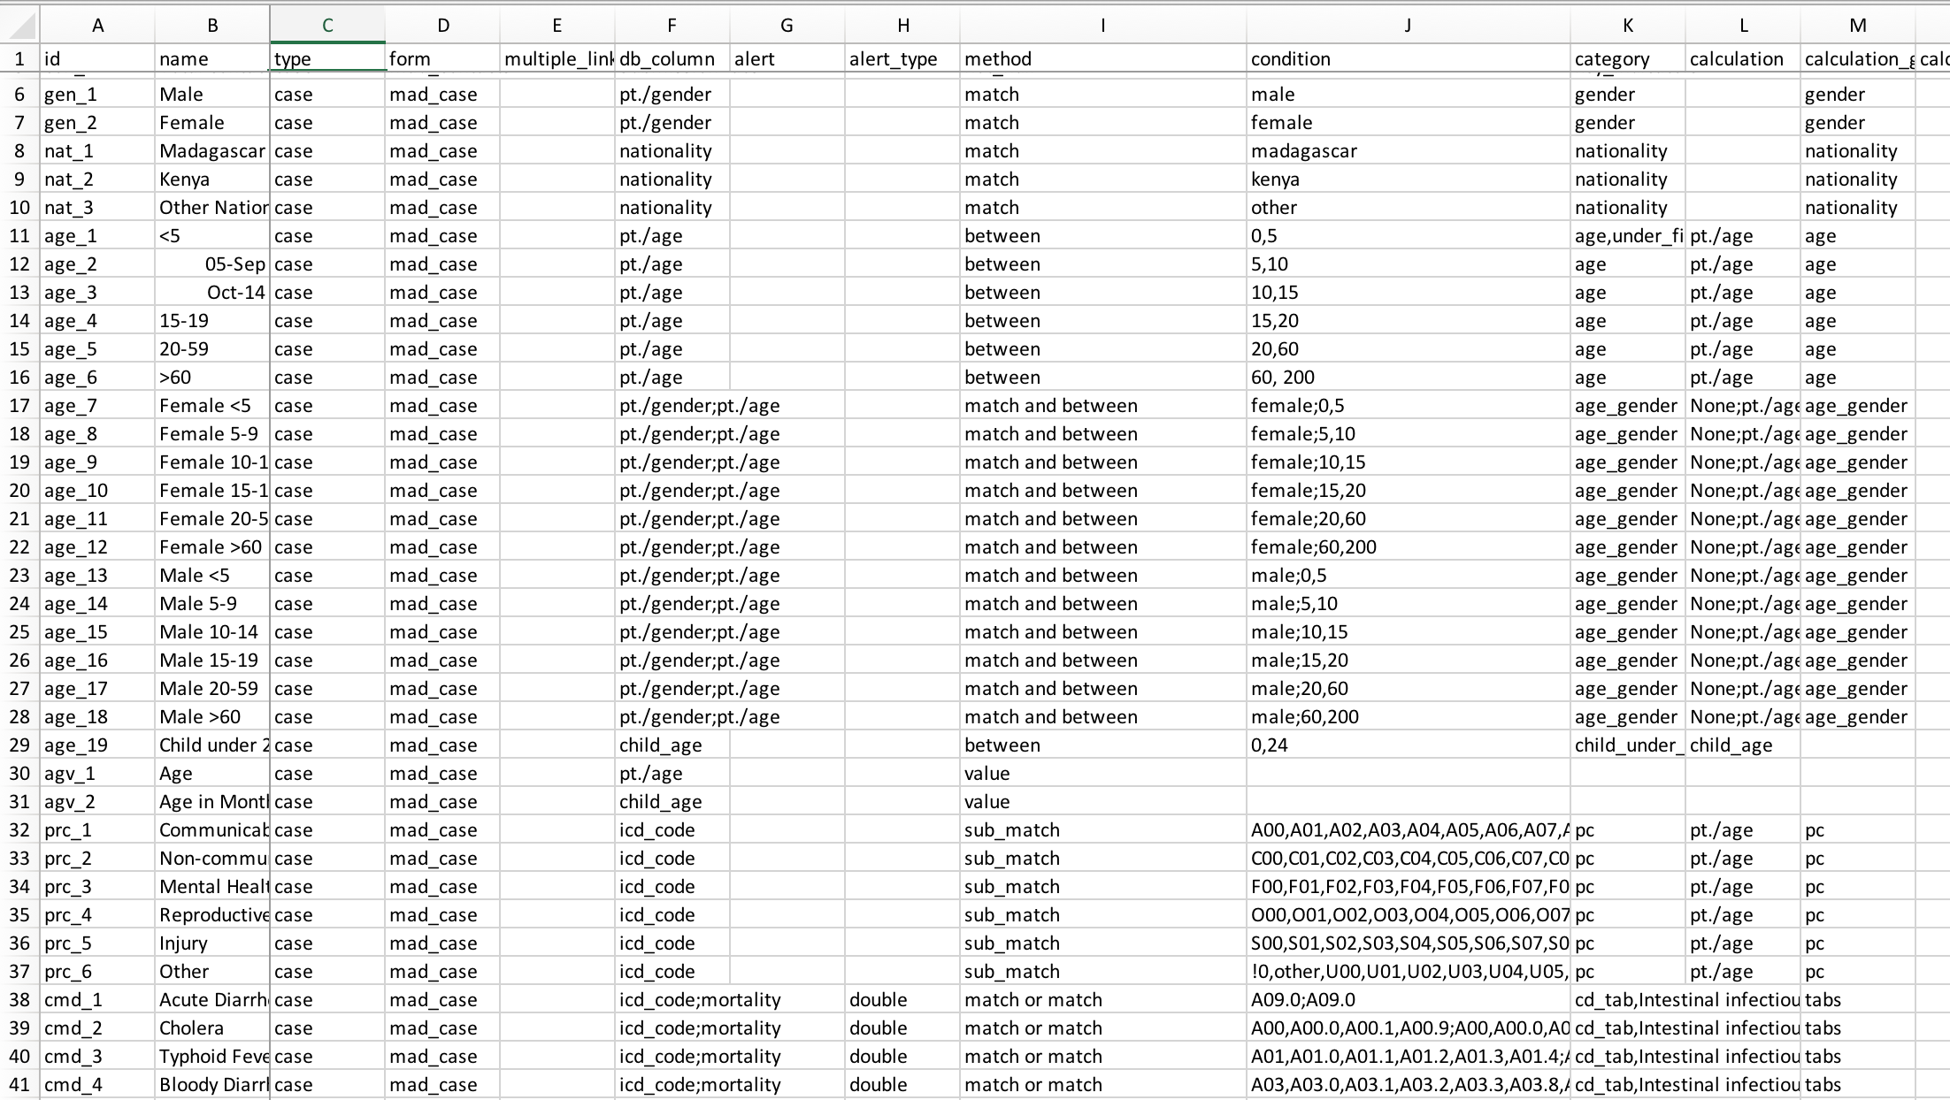
Data processing: codes

Slide 16
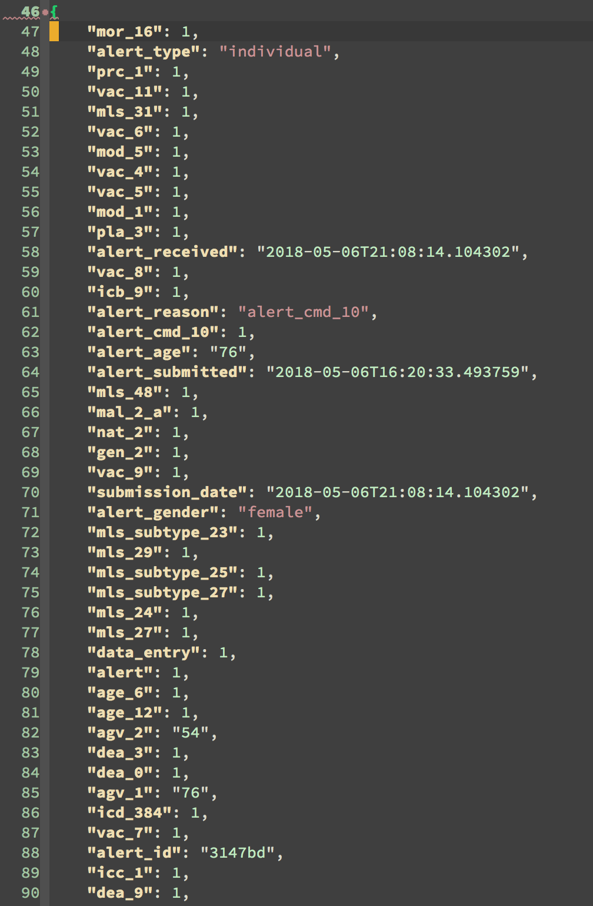
Data processing: codes

Slide 17
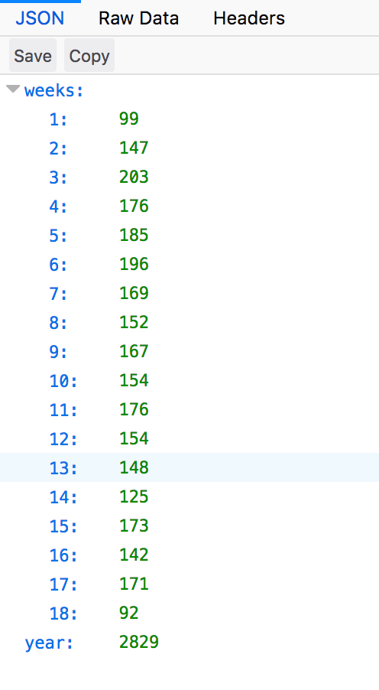
Data processing: API

