Slide 1

Design Topic of Robotics engineering ——Farewell Robot
team members：曾庆怡 温佩松 范嘉骏 韦知辛 李天奕

Slide 2

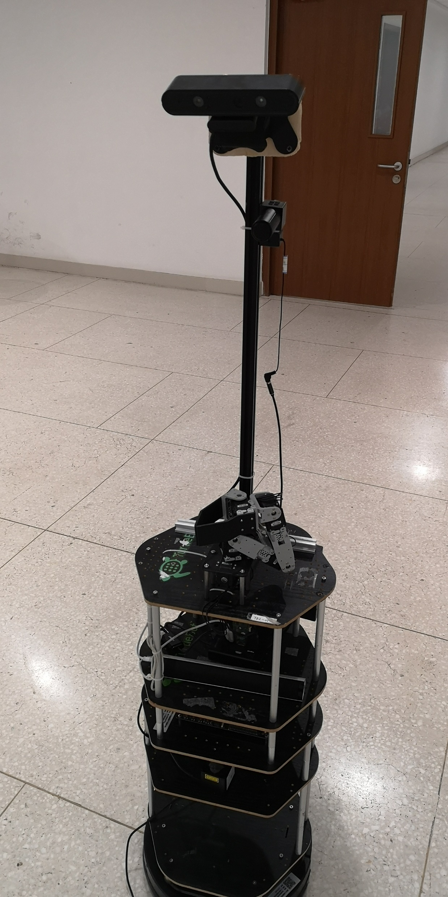
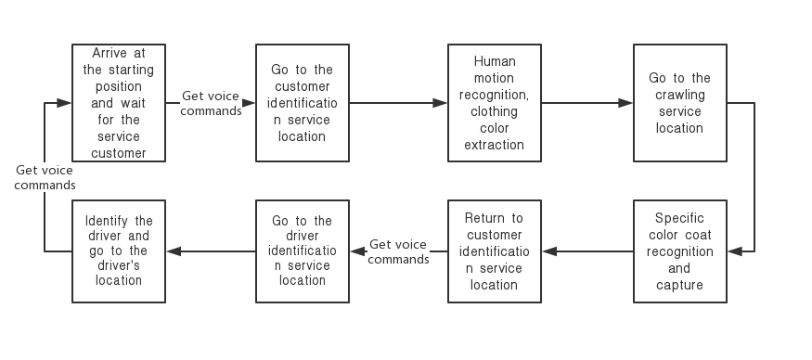
Topic Goal
Background：People who had just finished their meal began to take taxis and go home. The robot helps them carry their luggage and leads them to a designated taxi spot.

Slide 3
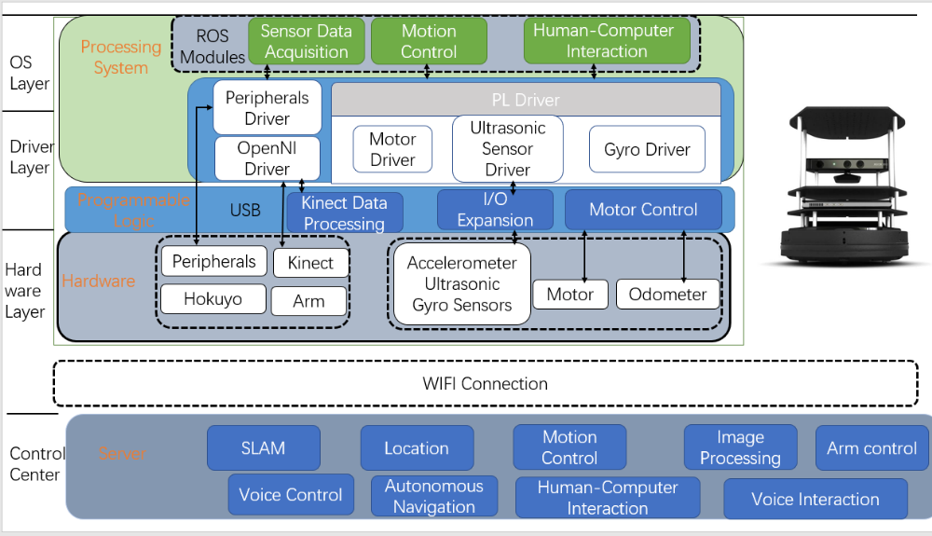
Navigation
𝑹𝒐𝒃𝒐𝒕 𝒔𝒚𝒔𝒕𝒆𝒎 𝒅𝒆𝒔𝒊𝒈𝒏 𝒇𝒓𝒂𝒎𝒆𝒘𝒐𝒓𝒌

Slide 4
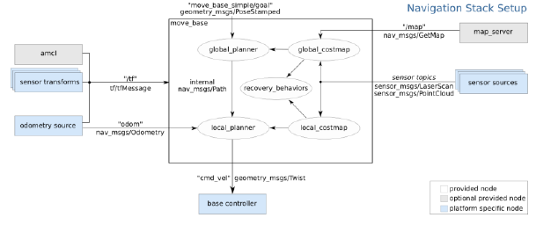
Navigation
Move base

Slide 5
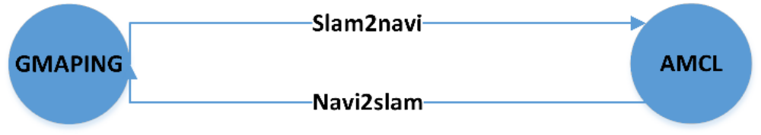
Navigation
𝑫𝒚𝒏𝒂𝒎𝒊𝒄 𝑺𝒕𝒂𝒕𝒆 𝑺𝒘𝒊𝒕𝒄𝒉𝒊𝒏𝒈 𝑻𝒆𝒄𝒉𝒏𝒐𝒍𝒐𝒈𝒚
To complete the state switching, we have designed the dynamic state switching algorithm
𝑫𝒚𝒏𝒂𝒎𝒊𝒄 𝑺𝒕𝒂𝒕𝒆 𝑺𝒘𝒊𝒕𝒄𝒉𝒊𝒏𝒈 𝑻𝒆𝒄𝒉𝒏𝒐𝒍𝒐𝒈𝒚

Slide 6
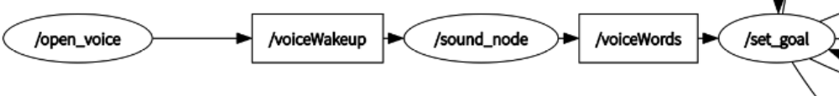
Voice
𝑲𝒆𝒅𝒂 𝑿𝒖𝒏𝒇𝒆𝒊 𝑺𝒑𝒆𝒆𝒄𝒉 𝑹𝒆𝒄𝒐𝒈𝒏𝒊𝒕𝒊𝒐𝒏
Based on the 𝐾𝑒𝑑𝑎 𝑋𝑢𝑛𝑓𝑒𝑖 API, we designed the ROS interface to design the corresponding speech recognition and speech recognition wake-up operations.

Slide 7
THANK YOU FOR WATCHING

