Slide 1

Design Topic of Robotics engineering ——Farewell Robot
team members：曾庆怡 温佩松 范嘉骏 韦知辛 李天奕

Slide 2

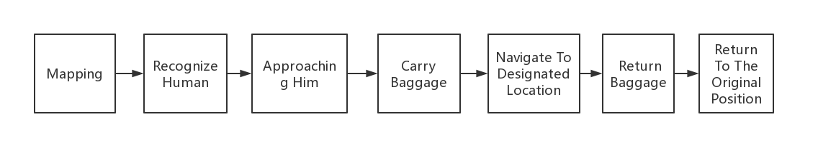
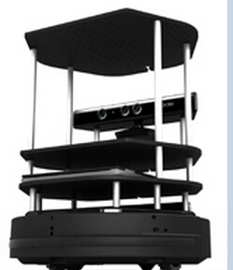
Topic Goal
Background：People who had just finished their meal began to take taxis and go home.The robot helps them carry their luggage and leads them to a designated taxi spot.

Slide 3
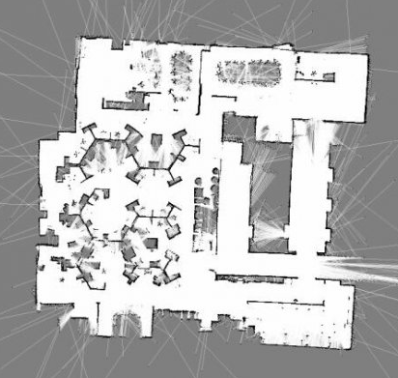
SLAM And Navigation
01
02
Leading Our Guest
Return To Position
The robot will safely lead customers to designated taxi locations by navigation package.
The robot can reach the coordinate position of each service location
范嘉骏

Slide 4
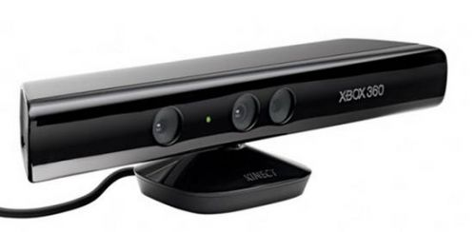
Machine Vision
Identify The
Target Person
The characteristic of the target is identified: he will wave. What's more, the color feature need to be extracted.
The color feature of the luggage are similar to those of its owner's clothing.
Identify His Luggage
温佩松
李天奕

Slide 5
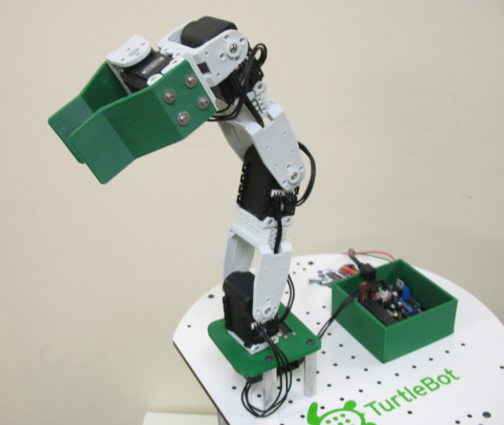
Mechanical Arm
Carry Baggage
Return Baggage
The robot reaches out its arm and the customer takes the luggage down.Then robot retracts the arm and leave.
The robot extends its arm, and the customer hangs his luggage on it. The robot then retracts the arm and carry it.
曾庆怡

Slide 6
Speech Recognition
Identification command
Basic dialogue
The robot can answer some simple questions from customers on the road.
The robot needs to recognize the basic language commands, such as "I want to go out","Let's go out" etc.
范嘉骏
韦知辛

Slide 7
THANK YOU FOR WATCHING

