Slide 1
CrisPRO × Sanofi
Decoding MSS Colorectal Cancer Patient Selection
A validated biomarker framework for SAR445877, SAR445953,
and the next CEACAM5 program
Sanofi Oncology Partnering · Finalist Pitch · July 1, 2026
CONFIDENTIAL — Not for distribution

Slide 2
The Problem Sanofi Has
Three assets. One shared failure mode: patient selection in MSS CRC.
SAR445877
(PD1×IL-15 fusion)
SAR445953
(CEACAM5-Topo1 ADC)
Tusamitamab ravtansine
(CEACAM5-DM4 ADC)
NCT07500298
1L MSS mCRC
mFOLFOX6 + bev
Phase 1 — not yet recruiting
NCT06131840
CRC expansion cohort
≤2 prior chemo regimens
Phase 1 — recruiting
CARMEN-LC03
NSCLC Phase 3
Discontinued Dec 2023
⚠ Patient Selection Gap:
⚠ Patient Selection Gap:
⚠ Patient Selection Gap:
No validated biomarker
for MSS CRC IO response
CEACAM5 IHC threshold
insufficient — same gate
as CARMEN-LC03
FAILED: PFS HR=1.14
Post-hoc signal at
CEACAM5 ≥80% (OS HR=0.71)
MSS CRC is the hardest IO indication. 7 IO trials have failed or shown marginal benefit. The difference between responders and non-responders is patient biology — not drug mechanism.
CrisPRO · Confidential · July 2026

Slide 3
What CrisPRO Delivers
A clinical-stage patient selection engine — built on published trial data, not theory.
What We Analyze
What We Produce
What You Get
Published biomarker subgroup data
from failed and marginal IO trials
Responder archetype definition:
which patients respond, and why
Immediate: MSS CRC responder
archetype package — ready to license
Observed hazard ratios by patient
biology subgroup
Non-responder identification:
who to exclude from enrollment
Months 1–6: SAR445877 biomarker
co-selection protocol for NCT07500298
Mechanism of action vs. patient
biology alignment
Biomarker selection rules:
translatable to trial eligibility criteria
Months 3–12: Validation science
package — Sanofi pays, CrisPRO retains IP
Two-gate validation: signal confirmed
+ mechanism not invalidated
Validation experiment roadmap:
3 experiments, 6–12 weeks
IP: CrisPRO retains; Sanofi licenses
for specific indication
CrisPRO decoded the MSS CRC IO landscape to position our own anchor trial. That work is directly applicable to SAR445877. This is a license — not a research proposal.
CrisPRO · Confidential · July 2026

Slide 4
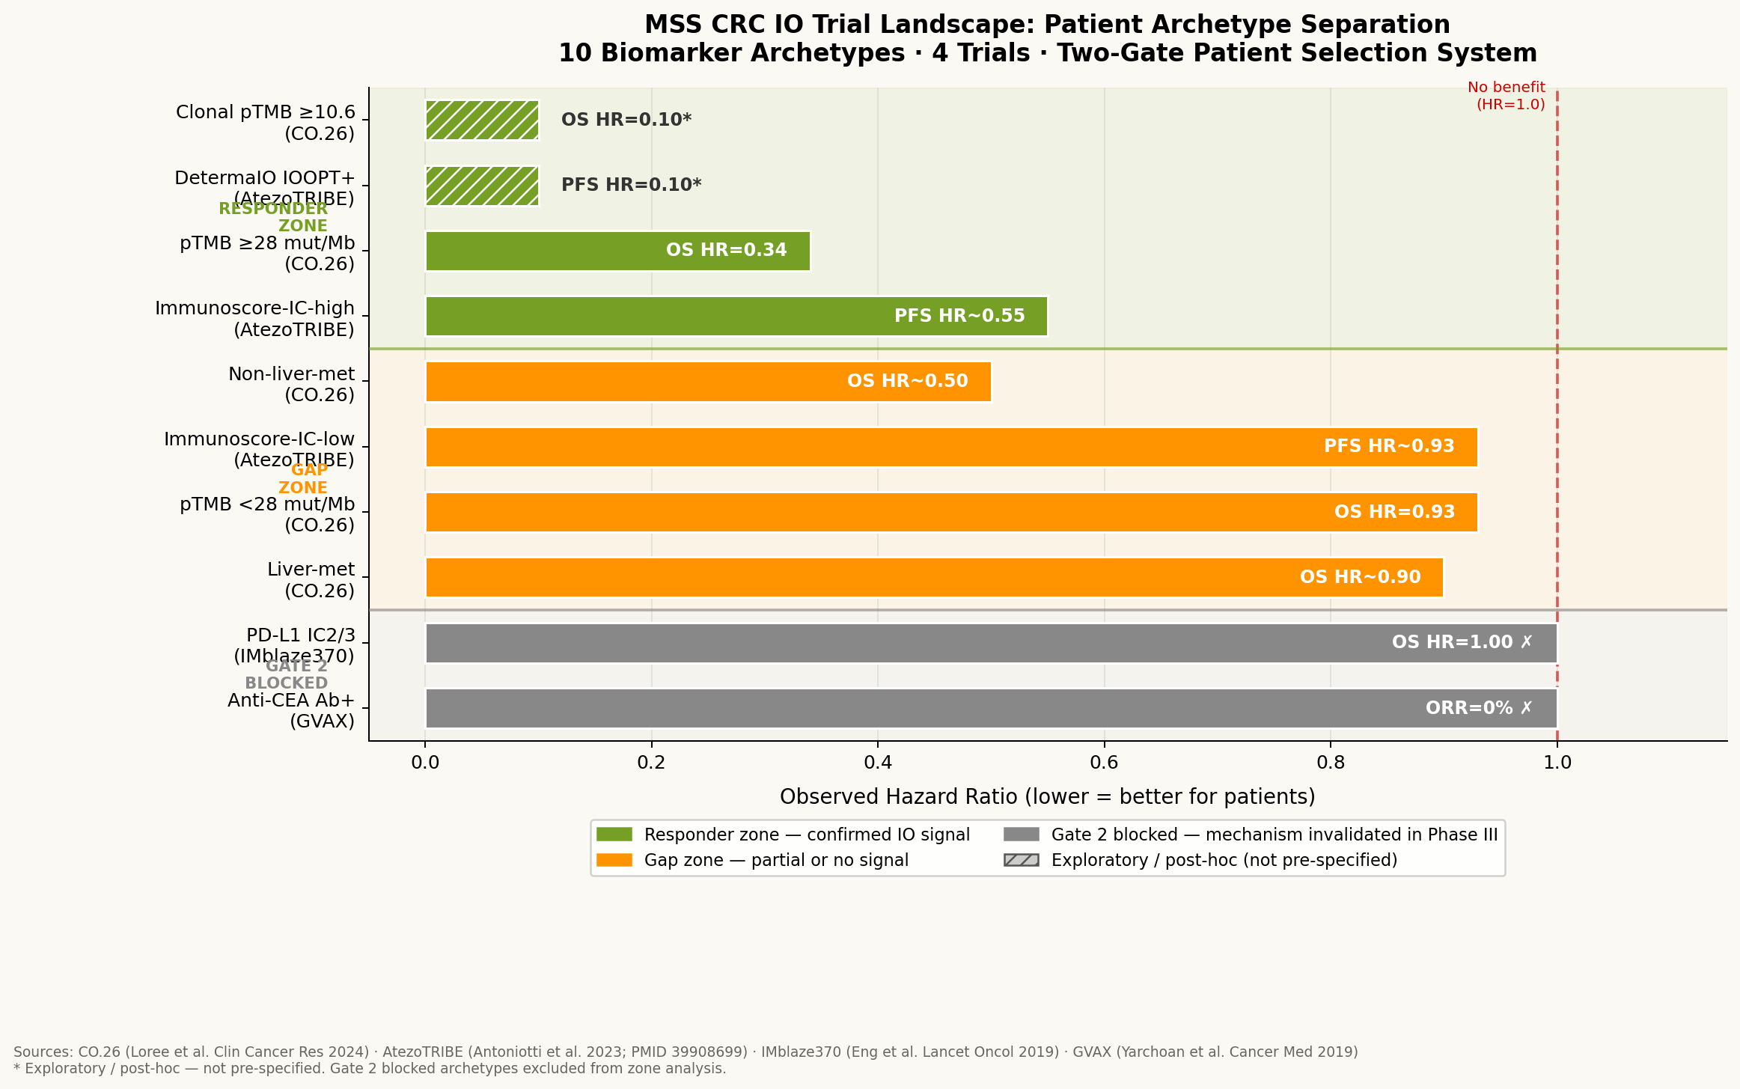
The MSS CRC Patient Selection Landscape
10 biomarker archetypes across 4 IO trials — responder zone clearly separated from gap zone.
Key Findings
Responder zone (HR ≤ 0.55):
pTMB ≥28 mut/Mb
DetermaIO IOOPT+
Immunoscore-IC-high
Gap zone (HR 0.50–0.93):
Non-liver-met patients
pTMB <28 mut/Mb
Immunoscore-IC-low
Liver-met patients
Gate 2 blocked:
PD-L1 IC2/3 (IMblaze370)
— Phase III negative
Anti-CEA Ab+ (GVAX)
— ORR=0%
Same patient biology that
predicts IO response in CO.26
also predicts SAR445877
response in NCT07500298.
CrisPRO · Confidential · July 2026

Slide 5
Decode 1: SAR445877 in MSS CRC
NCT07500298 — the responder archetype is defined before Phase 1 enrolls patient 1.
SAR445877 — Trial Facts
CrisPRO Patient Selection Package for NCT07500298
Mechanism:
PD-1 × IL-15 fusion protein — targeted expansion
of CD8+ T and NK cells
Biomarker
Threshold
Recommendation
pTMB (GuardantOMNI)
≥28 mut/Mb
ENRICH
Trial:
NCT07500298 · Phase 1 · MD Anderson
DetermaIO IOOPT
Positive
ENRICH
Status:
Not yet recruiting (2026)
Immunoscore-IC
High tertile
CONSIDER
Backbone:
mFOLFOX6 + bevacizumab
Liver metastases
Absent
STRATIFY
N:
41 participants
pTMB (GuardantOMNI)
<28 mut/Mb
EXCLUDE
Indication:
1L MSS metastatic CRC
Liver metastases
Present
STRATIFY
Biomarker:
UNDEFINED — no validated patient
selection biomarker for MSS CRC
Backbone identical to STC-1010 BreAK CRC-001 (mFOLFOX6 + bev). CrisPRO already has the patient selection data.
Source: CO.26 (Loree et al. 2024) · AtezoTRIBE (Antoniotti et al. 2023; PMID 39908699)
CrisPRO · Confidential · July 2026

Slide 6
Decode 2: SAR445953 CRC Cohort
CEACAM5 IHC alone is not enough — a second gate is required.
The CARMEN-LC03 Lesson
CrisPRO Two-Gate Patient Selection
CEACAM5 IHC 2+ in ≥50% cells
Gate 1 — CEACAM5 Expression
→ PFS HR = 1.14 (no benefit)
Threshold: CEACAM5 ≥80% (not ≥50%)
Based on CARMEN-LC03 post-hoc signal (OS HR=0.71 trend)
IHC assay: validated anti-CEACAM5 antibody
Post-hoc: CEACAM5 ≥80%
AND
→ OS HR = 0.71 (trend)
Gate 2 — IO Permissiveness
Biomarker: pTMB ≥28 mut/Mb OR Immunoscore-IC-high OR DetermaIO IOOPT+
Rationale: CEACAM5-Topo1 ADC requires IO-permissive TME for immune
activation cascade following cytotoxic payload release
Conclusion: Higher expression threshold
+ IO permissiveness co-selection required.
Patients passing both gates:
SAR445953 CRC cohort (NCT06131840)
Estimated 8–12% of MSS CRC (vs. ~25% with CEACAM5 ≥2+/≥50%)
Smaller but enriched population — higher probability of response
is using the same IHC gate.
Without a second gate, history repeats.
CrisPRO · Confidential · July 2026

Slide 7
The CARMEN-LC03 Lesson
CrisPRO decoded what went wrong — and can prevent it from happening in the CRC cohort.
Phase 1/2
CRC: 2/18 ORR
(11%)
FAILED
PFS HR=1.14
No benefit
SAR445953
CRC cohort
Same IHC gate risk
2019
2022
Dec
2023
2024
2026
CARMEN-LC03
Phase 3 launched
CEACAM5 ≥2+/≥50%
Post-hoc:
CEACAM5 ≥80%
OS HR=0.71 trend
CrisPRO Retrospective Decode:
CARMEN-LC03 enrolled CEACAM5 ≥2+/≥50% — this includes IO-suppressed patients who cannot mount an immune response to ADC-mediated cell killing. The ≥80% post-hoc signal reflects higher antigen density → better ADC internalization. The missing gate: IO permissiveness. The correct patient: CEACAM5 ≥80% + pTMB ≥28 OR Immunoscore-IC-high.
CrisPRO · Confidential · July 2026

Slide 8
The STC-1010 Parallel
CrisPRO already has the MSS CRC data — because we decoded our own anchor trial first.
STC-1010 (BreAK CRC-001)
SAR445877 (NCT07500298)
Mechanism:
Haptenated whole-cell therapeutic vaccine
Mechanism:
PD-1 × IL-15 fusion protein
Indication:
1L MSS metastatic CRC
Indication:
1L MSS metastatic CRC
Backbone:
mFOLFOX6 ± bevacizumab
Backbone:
mFOLFOX6 + bevacizumab
=
Sponsor:
Brenus Pharma
Sponsor:
Sanofi / MD Anderson
Same
backbone
Phase:
1/2
Phase:
1
Patient selection:
ESCAPE-decoded
✓ Responder archetype defined
Patient selection:
UNDEFINED
✗ No validated biomarker
This is not a proposal to do the work. This is a proposal to license the work we have already done — and extend it to SAR445877's specific mechanism.
CrisPRO · Confidential · July 2026

Slide 9
What Sanofi Gets
Three deliverables. One integrated patient selection package.
01
MSS CRC Responder
Archetype Package
02
SAR445877 IST
Support Package
03
Validation Science
Package
Timeline: Immediate
Timeline: Months 1–6
Timeline: Months 3–12
10-archetype patient selection map
across 4 MSS CRC IO trials
Biomarker co-selection protocol
for NCT07500298 expansion cohort
pTMB threshold validation
in MSS CRC FFPE samples
Biomarker selection rules for
SAR445877 and SAR445953
Interim analysis biomarker
readout plan
Immunoscore-IC + DetermaIO
co-selection concordance
Two-gate system specification
for CRC cohort (NCT06131840)
Responder / non-responder
classification at interim
SAR445877 mechanism ×
IO axis correlation
Format: PDF report + slide deck
Format: Protocol amendment
+ statistical analysis plan addendum
Sanofi pays · CrisPRO retains IP
Sanofi gets exclusive license
CrisPRO · Confidential · July 2026

Slide 10
Validation Science
Three experiments de-risk the patient selection claim — $65–270K total, 6–12 weeks.
Experiment
Question
Method
Cost
Timeline
Output
pTMB threshold
validation
Is ≥28 mut/Mb the right
cut in MSS CRC?
GuardantOMNI on archival
FFPE from CO.26 /
AtezoTRIBE patients
$15–40K
6–8 wks
Validated threshold
+ IHC correlation
Immunoscore-IC +
DetermaIO co-selection
Do both biomarkers
identify the same
patients?
Retrospective analysis
of AtezoTRIBE
biomarker data
$30–80K
8–12 wks
Co-selection
concordance rate
SAR445877 ×
IO axis correlation
Does PD1×IL-15
require IO-permissive
TME?
Patient-derived organoid
co-culture with
SAR445877 + immune cells
$20–150K
3–6 mo
Mechanism validation
for two-gate system
At $65–270K total validation cost, a successful Phase 2 enrichment strategy for SAR445877 in MSS CRC is worth $50–150M in milestone payments alone.
CrisPRO · Confidential · July 2026

Slide 11
Deal Structure
Three revenue streams — IP licensing, IST support, validation package.
Stream 1
Stream 2
Stream 3
IP Licensing
IST Support
Validation Package
Asset:
MSS CRC Responder Archetype Package
(ESCAPE decode + two-gate system)
Asset:
SAR445877 NCT07500298
biomarker co-selection protocol
Asset:
3 validation experiments
(pTMB · Immunoscore · Organoid)
Upfront:
$3–8M
SRA:
$500K–$1.5M
Structure:
$1–3M per package
Milestones:
$30–80M
(Phase 2 initiation · Phase 3 · Approval)
Milestones:
At interim analysis readout
Who pays:
Sanofi pays
Royalty:
2–4% on net sales
Data rights:
Sanofi gets trial data
CrisPRO retains IP
IP:
CrisPRO retains all data
Sanofi gets exclusive license
for SAR445877 indication
Exclusivity:
SAR445877 indication only
CrisPRO retains all other rights
Deliverable:
Protocol amendment language
+ statistical analysis plan
Timeline:
Months 3–12
Trigger:
Signed term sheet before July 1
Timeline:
Months 1–6
Total deal value (floor): $4.5–12.5M upfront + $30–80M milestones + royalty
CrisPRO · Confidential · July 2026

Slide 12
The Ask
Three specific requests before July 1, 2026
01 Finalist Slot
02 Pre-Pitch Data Room
03 Term Sheet Discussion
CrisPRO requests inclusion in the July 1 final pitch event.
We have the MSS CRC patient selection data. We are ready to present.
Share SAR445877 Phase 1 monotherapy biomarker data (NCT05584670)
for CrisPRO to refine the archetype scoring before July 1.
30-minute call with Sanofi oncology BD team before June 15.
NCT07500298 is not yet recruiting — the patient selection decision has not been made.
"We decoded the MSS CRC IO landscape. You are running a trial in it.
Let's talk before you enroll patient 1."

