Slide 1
CrisPRO
Precision Trial Intelligence
Saving Trials. Saving Lives.
The oncology industry spends $50–60 billion every year on clinical trials that fail.
Most failures are predictable. All of them are preventable.
April 2026 | Confidential
1

Slide 2
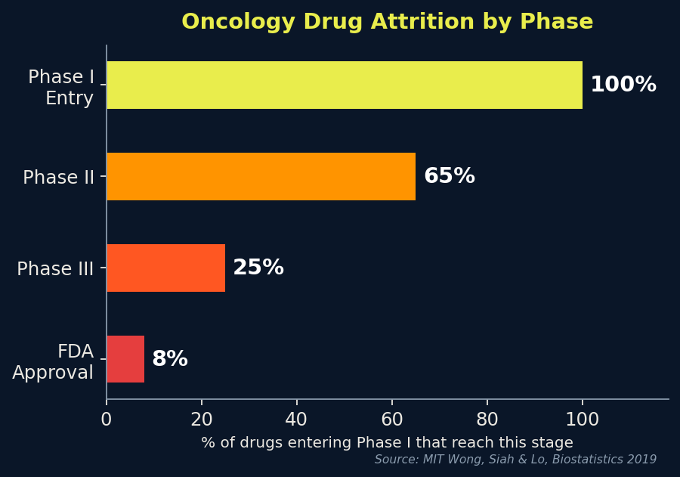
THE PROBLEM
Clinical Trials Are Broken
The oncology drug development system is failing patients, scientists, and investors at scale.
5.3%
$2.6B
$50–60B
76%
Probability a cancer
drug reaches approval
(from Phase I)
Average all-in cost
to develop one
approved drug
Spent annually on
failed oncology
trials industry-wide
Of Phase III oncology
trials fail to reach
approval
Sources: MIT Wong, Siah & Lo, Biostatistics 2019 | Tufts CSDD 2016 | JAMA Network Open 2023 | BIO/Informa Pharma Intelligence 2021
Oncology is the hardest therapeutic area:
▸ Lowest Phase III success rate of all 14 disease areas (47.7%)
▸ Only 24.6% of Phase II programs advance to Phase III
▸ Colorectal cancer: 3rd largest drug pipeline — yet one of the lowest success rates
2

Slide 3
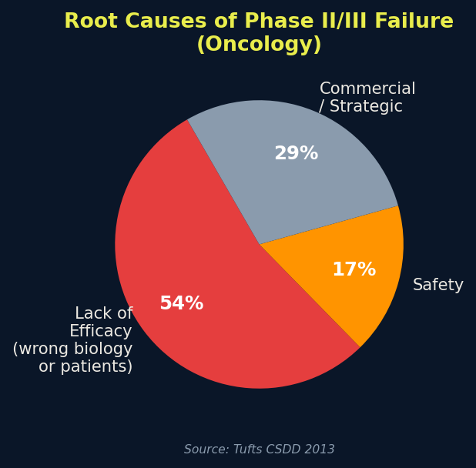
ROOT CAUSE ANALYSIS
Why Trials Fail: It's Not Bad Science — It's Bad Design
Wrong Biology
Wrong Patients
Wrong Design
Drug works in the lab but the mechanism doesn't translate. The target is real but not the rate-limiting step in the patient's tumor.
The drug works — but only in a subgroup. Enrolling all-comers dilutes the signal into noise. The trial fails. The drug gets abandoned.
Single-arm trials can't separate drug effect from SOC. No pre-specified biomarker plan. No adaptive enrichment. No early stopping rules.
▸ 54% of Phase II/III failures: lack of efficacy — the drug didn't work in the enrolled population
▸ Biomarker-selected trials achieve 2.1× higher approval rates (15.9% vs 7.6% LOA)
▸ ORR in biomarker-selected trials: 48% vs 23% in unselected (JNCI Jardim et al. 2015)
▸ The fix is not a better drug. It's a smarter trial.
3

Slide 4
THE HUMAN COST
Behind Every Failed Trial: Patients Who Ran Out of Time
1.93M
16.2%
5-year survival for
metastatic CRC
Source: SEER 2015–2021
new colorectal cancer cases globally every year
~95%
of mCRC patients are
MSS — IO-refractory
903,859 deaths in 2022 — 2nd leading cause of cancer death worldwide
Source: Kim SY, Ann Coloproctol 2026
Source: GLOBOCAN 2022
0
IO therapies approved
for MSS CRC despite
dozens of trials
Source: FDA / Kim SY 2026
130,000–150,000 MSS mCRC patients per year in the US + EU alone have no effective immunotherapy option.
Every failed trial is not just a financial loss — it is years of patient lives spent on a trial that was designed to fail.
4

Slide 5
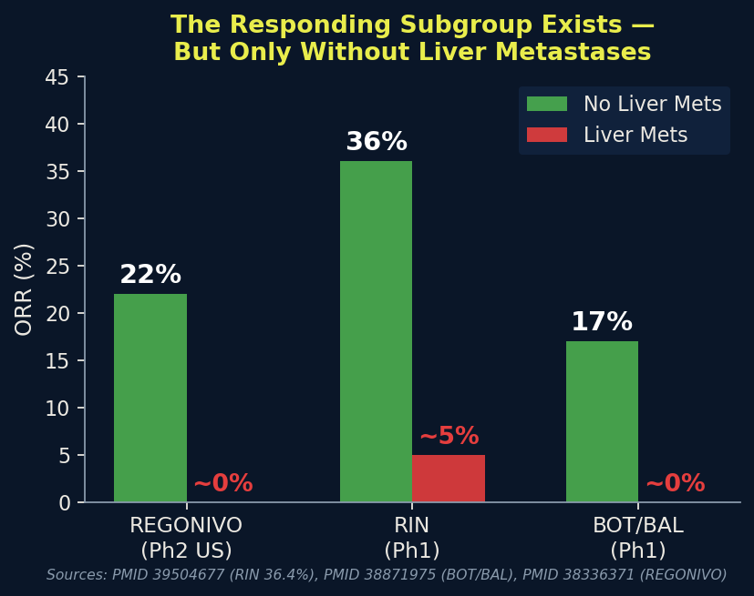
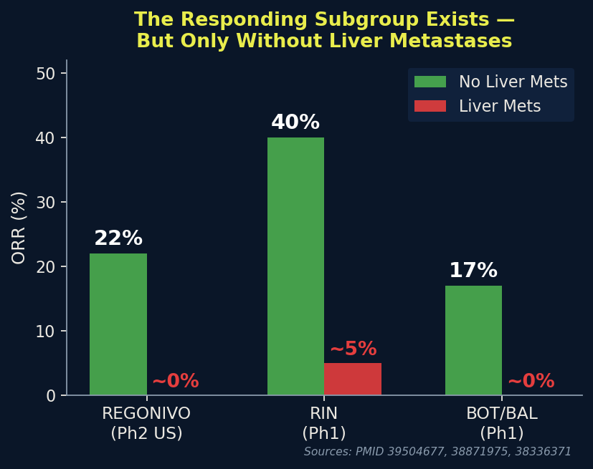
THE INSIGHT
The Responding Subgroup Exists — It's Just Never Been Found in Time
Across every MSS CRC IO program, a consistent signal emerges in the right patients. The problem is trial design, not biology.
▸ REGONIVO Phase 2 (US): ORR 22% in non-liver-met MSS CRC vs. ~0% with liver mets (n=70)
▸ RIN (regorafenib + ipi + nivo): ORR 36.4% in non-liver-met cohort vs. ~5% with liver mets
▸ BOT/BAL Phase 1: ORR 17%, DCR 61% — exclusively in non-liver-met patients
▸ CO.26: pTMB ≥28 mut/Mb subgroup OS HR 0.34 — a separable molecular signal
▸ AtezoTRIBE: Immunoscore-IC high pMMR patients PFS HR ~0.50
▸
▸ → The biology is real. The patients exist. The signal is consistent across 5 independent programs.
▸ → Every trial that enrolled all-comers buried this signal in noise.
▸ → CrisPRO's job: find the signal before the trial opens, not after it fails.
5

Slide 6
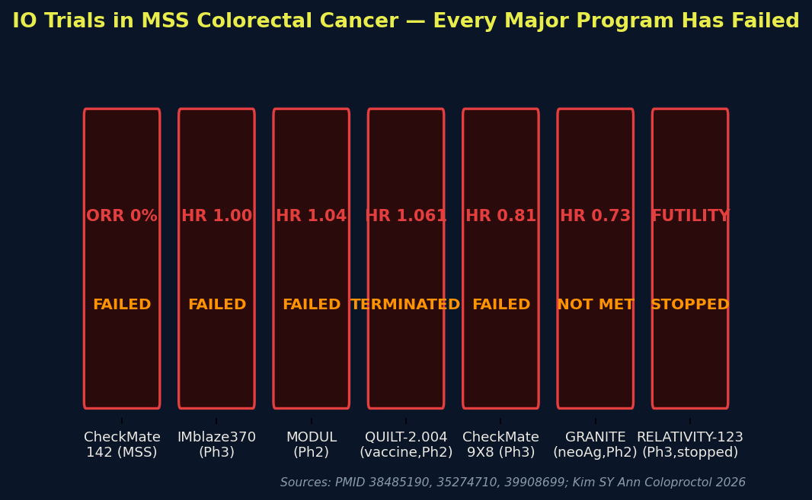
THE FAILURE LANDSCAPE
Every Major IO Program Has Failed in MSS Colorectal Cancer
Checkpoint inhibitors, vaccines, MEK combinations, dual checkpoint blockade — all failed. The pattern is not random.
▸ CheckMate 142 (MSS): ORR 0% with nivolumab
▸ IMblaze370 (Ph3): HR 1.00 — atezolizumab + MEKi
▸ MODUL (Ph2): HR 1.04 — atezolizumab maintenance
▸ QUILT-2.004: HR 1.061 — vaccine + avelumab, TERMINATED
▸ CheckMate 9X8 (Ph3): HR 0.81, p=0.30 — nivo + FOLFOX
▸ GRANITE (Ph2): HR 0.73 — neoantigen vaccine, NOT MET
▸ RELATIVITY-123 (Ph3): STOPPED for futility Dec 2023
▸
▸ Common failure mode: unselected enrollment.
▸ The drug may work. The trial design guaranteed failure.
6

Slide 7
WHY NOW
The Window Is Open — And It Closes When Phase IIa Enrollment Locks
Phase Ia
Active
(n=6, 0 DLTs)
Phase Ia
Complete
Q2 2026
Phase IIa
Design
Locked ←
Phase IIa
Enrollment
Opens
Phase IIa
Complete
2028
← CrisPRO engagement window
Three Decisions Still Open
Phase IIa Amendment Is Possible Now
The Data Is Being Collected Right Now
Patient selection strategy, biomarker analysis plan, and combination timing are all unresolved in the current BreAK CRC-001 protocol. Each one is a trial-design failure waiting to happen.
A Phase IIa protocol amendment costs weeks. A Phase III redesign costs years and hundreds of millions. The leverage point is now — before enrollment locks.
Phase I patients are generating exploratory biomarker data (cytokines, ctDNA, immunophenotyping, TLS) at this moment. Without a pre-specified analysis plan, this data will be analyzed post-hoc and will not be credible to regulators.
7

Slide 8
THE PLATFORM
CrisPRO: Precision Trial Intelligence
We convert the accumulated failure landscape of oncology trials into actionable design intelligence — before the trial opens.
Evidence Wall Engine
Biomarker Stratification Engine
Trial Design Intelligence
Systematic retrieval and source-verification of every relevant trial, biomarker, and failure mode for a specific program.
Converts the published biology into a ranked, pre-specified biomarker hypothesis for patient selection.
Translates biomarker hypotheses into protocol amendments, power calculations, and adaptive enrichment designs.
▸ 12+ comparator trials mapped per program
▸ Three-axis failure mode partition (M/P/A)
▸ Verified Claim Ledger — every claim source-tagged
▸ Blocked inputs registry — no unverified claims leak
▸ Multi-domain biology map (6 immunosuppressive axes)
▸ Composite enrichment score for Phase IIa design
▸ Clinical accessibility classification (SOC vs. research)
▸ Pre-specified analysis plan for regulatory submission
▸ Adaptive enrichment design with Bayesian framework
▸ Liver metastasis stratification protocol
▸ ctDNA early pharmacodynamic co-primary endpoint
▸ Historical control benchmark analysis
8

Slide 9
HOW IT WORKS
From Trial Protocol to Actionable Design Intelligence in 60 Days
01
Evidence Wall
Construction
→
02
Biomarker
Hypothesis Generation
→
03
Trial Design
Intelligence Delivery
▸ Retrieve and source-verify every relevant trial
▸ Map comparator failure landscape (3-axis partition)
▸ Build Verified Claim Ledger — every claim tagged
▸ Identify blocked inputs and active conflicts
▸ Output: 12-trial failure map + NDA request list
▸ Map 6-domain immunosuppressive biology
▸ Rank candidate biomarkers by clinical accessibility
▸ Build composite enrichment score
▸ Pre-specify response thresholds from literature
▸ Output: Ranked biomarker panel + analysis plan
▸ Adaptive enrichment design for Phase IIa
▸ Liver metastasis stratification protocol amendment
▸ Power calculations for biomarker-enriched analysis
▸ ctDNA early stopping rule design
▸ Output: Protocol amendment proposal + regulatory package
Timeline: 30 days (Evidence Wall) → 45 days (Biomarker Plan) → 60 days (Protocol Amendment)
9

Slide 10
CASE STUDY
BreAK CRC-001: CrisPRO Already Has the Evidence Wall Built
Brenus Pharma / STC-1010 — haptenated whole-cell vaccine, 1L MSS/pMMR mCRC (NCT06934538)
What CrisPRO Found
What CrisPRO Delivers
▸ 12 comparator trials mapped — every MSS CRC IO program
▸ 3-axis failure mode partition: mechanism / patients / architecture
▸ SC-001 active conflict: HT29 (BRAF V600E) in vaccine vs. BRAF-WT trial eligibility
▸ Liver met stratification absent from current protocol — highest-priority gap
▸ No pre-specified biomarker analysis plan in public protocol
▸ Bevacizumab scheduling risk: lymphopenic nadir at days 7–10
▸ 10-item NDA request list, priority-ranked
▸ 25 verified / 8 provisional / 12 blocked claims in Verified Claim Ledger
▸ Deliverable 1 (30 days): Adaptive enrichment design for Phase IIa — liver met stratification protocol amendment + power calculations
▸
▸ Deliverable 2 (30 days): Pre-specified biomarker analysis plan — standardized assay panel, response thresholds, regulatory-grade analysis plan
▸
▸ Deliverable 3 (45 days): Combination timing optimization — vaccination window relative to mFOLFOX6 nadir + bevacizumab normalization window
▸
▸ All deliverables: grounded in 10 verified primary sources (PMIDs, NCTs, DOIs). Zero unverified claims.
10

Slide 11
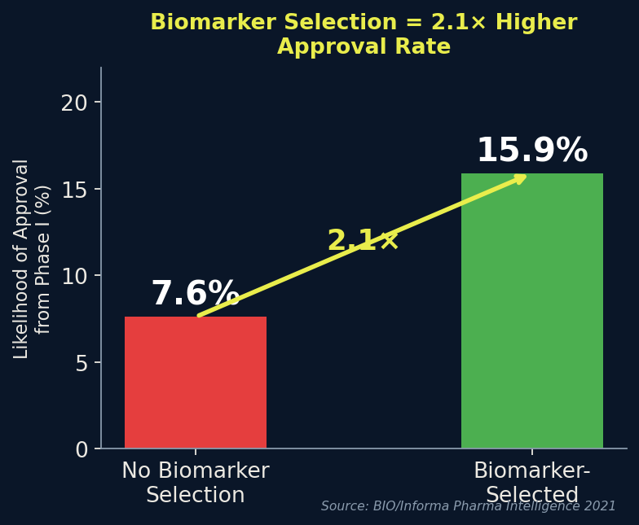
THE EVIDENCE FOR OUR APPROACH
Biomarker-Driven Trial Design: The Data Is Unambiguous
▸ BIO/Informa Pharma Intelligence 2021 (n=12,728 transitions):
▸ Biomarker-selected LOA: 15.9% vs. Unselected LOA: 7.6% → 2.1× advantage
▸
▸ JNCI Jardim et al. 2015 (58 FDA-approved drugs, 112 registration trials):
▸ Biomarker-selected ORR: 48% vs. Unselected ORR: 23% → 2× higher response rate
▸ Biomarker-selected median PFS: 8.3 months vs. 5.5 months unselected
▸ Biomarker-selected median OS: 19.3 months vs. 13.5 months unselected
▸
▸ JAMA Oncology Schwaederle et al. 2016 (346 Phase I trials, 13,203 patients):
▸ Biomarker-matched tumor shrinkage: 30.6% vs. 4.9% unmatched
▸ Biomarker-matched median PFS: 5.7 months vs. 2.95 months
▸
▸ MIT Wong, Siah & Lo 2019:
▸ Biomarker use raises Phase I-to-approval probability by +13.3 percentage points
▸
▸ → The ROI on biomarker-driven trial design is the most robust finding in clinical trial science.
▸ → CrisPRO operationalizes this finding for every program we touch.
11

Slide 12
COMPETITIVE MOAT
Why CrisPRO — Not Tempus, Foundation Medicine, or Anyone Else
Every competitor offers a platform. CrisPRO offers program-specific depth at the moment of maximum leverage.
Competitor
Core Product
Key Limitation
Decisive Gap vs. Brenus Need
Tempus AI
($6.1B IPO, $693M rev)
Retrospective RWD platform
Needs large patient populations
n=6 patients — nothing to analyze
Foundation Medicine
(Roche, $2.4B)
Tumor profiling (CGP)
Individual patient diagnostics
Roche owns atezolizumab — conflict of interest in MSS CRC IO
Guardant Health
($10.9B mkt cap)
ctDNA liquid biopsy
One biomarker (ctDNA)
GRANITE used GuardantOMNI — trial still failed
Academic Collaborator
(CGFL Dijon)
Scientific expertise
6–18 month timelines
Study coordinator = compromised independence
General-Purpose AI
Scale & infrastructure
No oncology domain depth
Zero program-specific work
CrisPRO
Trial design intelligence
Program-specific depth
6-agent evidence wall already built for BreAK CRC-001
12

Slide 13
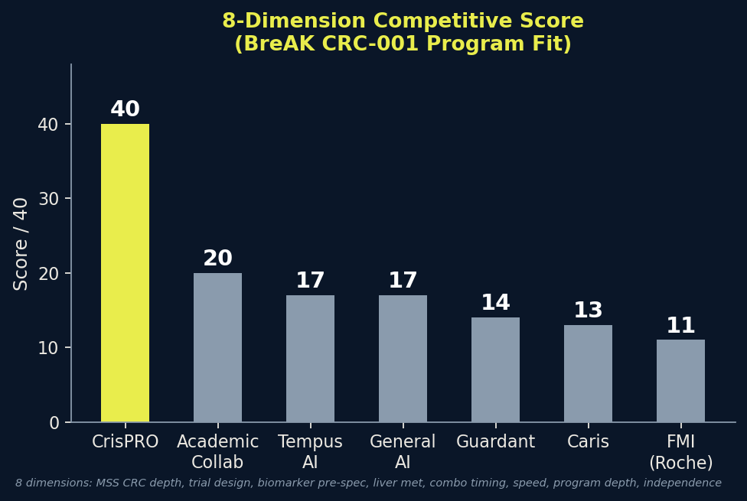
COMPETITIVE MATRIX
Scored on 8 Dimensions Specific to the BreAK CRC-001 Problem
▸ 8 scoring dimensions (1–5 each, max 40):
▸ 1. MSS CRC IO depth
▸ 2. Trial design intelligence
▸ 3. Biomarker pre-specification
▸ 4. Liver met stratification capability
▸ 5. Combination timing modeling
▸ 6. Speed to deliverable
▸ 7. Program-specific depth (BreAK CRC-001)
▸ 8. Independence / no conflict of interest
▸
▸ CrisPRO: 40/40 ← Only partner with program-specific work already done
▸ Academic (CGFL): 20/40 ← Scientific depth but slow + conflicted
▸ Tempus AI: 17/40 ← Strong platform, wrong problem (needs large RWD)
▸ Foundation Medicine: 11/40 ← Roche conflict; diagnostic not trial design
▸
▸ The irreplaceable differentiator: the evidence wall is already built.
▸ No competitor can replicate this in the Phase IIa design window.
13

Slide 14
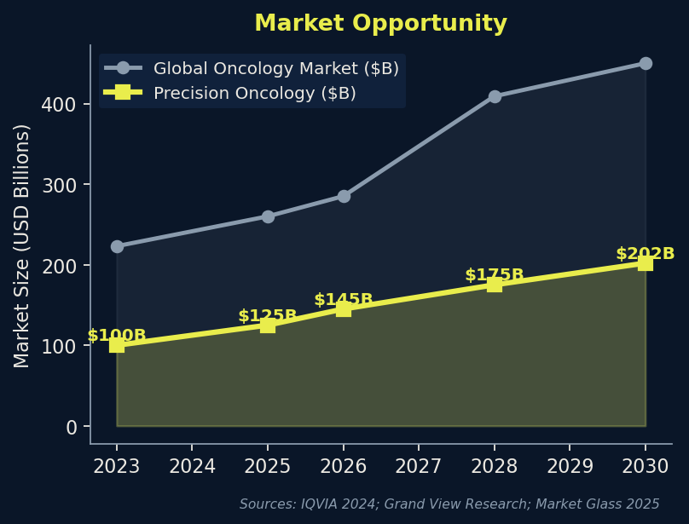
MARKET OPPORTUNITY
A $202B Market Growing at 11% CAGR — With a $50B Annual Waste Problem
$223B
$409B
Global oncology
drug market 2023
(IQVIA)
Projected by 2028
(13% implied CAGR)
(IQVIA)
$202B
$5.2B→
$9.5B
Precision oncology
market by 2030
(Grand View Research)
Clinical trial mgmt
market 2024→2030
(Strat. Mkt Research)
The MSS CRC opportunity alone:
▸ 130,000–150,000 patients/year in US + EU with no effective IO option
▸ A drug achieving 20–30% ORR in MSS mCRC = $3–6B peak sales potential
▸ PD-1/PD-L1 market: $52B (2023) → >$90B by 2028 — MSS CRC is the last major unsolved indication
▸ Keytruda alone: $29.5B in 2024 global sales — MSS CRC is its largest remaining unaddressed population
14

Slide 15
BUSINESS MODEL
Fee-for-Service + Milestone + Embedded Partnership
Three engagement tiers — structured to protect CrisPRO's scientific credibility and align incentives with trial success.
Phase 1
Discovery
(30 days, no fee)
Phase 2
Analytical Engagement
(90 days, fee-for-service)
Phase 3
Embedded Partnership
(ongoing, milestone-based)
▸ Mutual NDA/CDA execution
▸ Data-sharing commitment confirmed
▸ This document + Repaired Brief v2 Final
▸ Adaptive enrichment design
▸ Pre-specified biomarker analysis plan
▸ Combination timing optimization model
▸ Real-time biomarker monitoring
▸ Interim analysis support
▸ Regulatory submission support
Go/no-go gate: data-sharing commitment within 60 days of NDA
50% on NDA execution | 25% on data delivery | 25% on deliverable acceptance
Milestone payments + co-authorship rights + reference case rights
Non-Negotiable Conditions:
▸ (1) Mutual NDA within 30 days | (2) Patient-level data sharing within 60 days of NDA | (3) CrisPRO approval required for any public communication referencing our involvement | (4) Protocol amendment willingness
15

Slide 16
TRACTION
What We've Already Built for BreAK CRC-001
No other partner is starting from this position. The evidence wall is complete. The analysis is done.
Agent 1
Corporate Dossier
Agent 2
Trial Protocol Analysis
Brenus Pharma company profile, leadership, funding (€30M Series A), SAB, investor base, 5 recruiting sites
BreAK CRC-001 full protocol dissection: 3 arms, eligibility, endpoints, biomarker schedule, 7 dilution risks ranked
Agent 3
Comparator Trial History
Agent 4
Biomarker Biology Map
12 MSS CRC IO trials mapped: failure modes, subgroup signals, HR values, source-verified
6-domain immunosuppressive biology map: TGF-β, MDSC, MHC-I, KRAS-IRF2, liver met, VEGF-A/TOX axes
Agent 5
Fit-Gap Analysis
Agent 6
Strategy + Outreach
CrisPRO capability assessment: 6 HIGH-fit capabilities, 4 gaps, 7 guardrails, PATH A formula locked
Internal strategy memo, outreach email, competitive positioning, partnership proposal
Governance
Verified Claim Ledger v1.0
Governance
Repaired Brief v2 Final
25 verified / 8 provisional / 12 blocked claims. Source-integrity adjudication: 20 supported / 11 press-release / 16 blocked
All 16 blocked-source items removed or rewritten. Zero unverified claims. Change log with manager compliance checklist
All artifacts committed to GitHub (fjkiani/Brenus). Reproducible. Auditable. Source-verified.
16

Slide 17
THE ASK
One Conversation. One NDA. Three Deliverables That Could Save This Trial.
What We're Asking For
What Brenus Gets
▸ 30-minute call with Brenus scientific leadership (Paul Bravetti / Benoit Pinteur / George Alzeeb)
▸ Mutual NDA/CDA execution within 30 days
▸ Written data-sharing commitment: Phase I patient-level data within 60 days of NDA
▸ Willingness to consider Phase IIa protocol amendment (liver met stratification)
▸ Adaptive enrichment design for Phase IIa (30 days)
▸ Pre-specified biomarker analysis plan — regulatory grade (30 days)
▸ Combination timing optimization model (45 days)
▸ The only partner who has already done the work
The Phase IIa design window is open now. It closes when enrollment locks.
A protocol amendment costs weeks. A Phase III redesign costs years.
The question is not whether to get this right — it's whether to get it right now.
17

Slide 18
APPENDIX
Evidence Anchors & Key Sources
Clinical Evidence
Industry & Market Data
Alzeeb et al. 2024 | DOI: 10.3389/fonc.2024.1427428
BIO/Informa 2021 | Clinical Development Success Rates 2011–2020
Murine STC-1010 mechanism; CT26/CMT-93/LTPA/MC38 efficacy
Biomarker LOA 15.9% vs 7.6%; oncology LOA 5.3%
BreAK CRC-001 registry | NCT06934538
MIT Wong et al. 2019 | Biostatistics 2019; Project ALPHA
Trial design, eligibility, endpoints, biomarker schedule
Oncology Phase 1→approval 3.3%; biomarker +13.3pp
QUILT-2.004 | NCT03050814; PMID 35274710
Tufts CSDD 2016 | Journal of Health Economics 2016
HR 1.061, p=0.91, terminated — primary negative benchmark
All-in drug development cost $2.6B
CheckMate 9X8 | PMID 38485190
JAMA Network Open 2023 | Jentzsch et al. 2023
HR 0.81, p=0.30 — identical backbone to BreAK CRC-001
$50–60B/yr spent on failed oncology trials
BOT/BAL Phase 1 | PMID 38871975
JNCI Jardim et al. 2015 | JNCI 2015; 107(11): djv253
ORR 17%, DCR 61% in non-liver-met MSS mCRC
Biomarker-selected ORR 48% vs 23% unselected
RIN Phase 1 | PMID 39504677
IQVIA Institute 2024 | Global Oncology Trends 2024
ORR 36.4%, mOS 27.5m — non-liver-met enrichment
$223B oncology market → $409B by 2028
CO.26 pTMB | PMID 38727700
GLOBOCAN 2022 | Bray et al., CA Cancer J Clin 2024
pTMB ≥28 mut/Mb HR 0.34 — molecular enrichment signal
1.93M new CRC cases/yr; 903,859 deaths
AtezoTRIBE Immunoscore | PMID 39908699
SEER 2015–2021 | NCI Cancer Stat Facts
Immunoscore-IC high pMMR PFS HR ~0.50
16.2% 5-yr survival metastatic CRC; 23% diagnosed metastatic
REGONIVO CMS4 | PMID 38336371
Kim SY, Ann Coloproctol 2026 | PMC12971173
CMS4 associated with IO response, p=0.035
IO ORR 0–3% in MSS CRC; 4+ Phase 3 trials failed
18

