Slide 1
Convert infix to postfix and prefix notation

Slide 2
Convert Infix To Postfix
Let, X is an arithmetic expression written in infix notation. This algorithm finds the equivalent postfix expression Y.
Scan X from left to right and repeat Step 3 to 6 for each element of X until the Stack is empty.
If an operand is encountered, add it to Y.
If a left parenthesis is encountered, push it onto Stack.
If an operator is encountered ,then:
Repeatedly pop from Stack and add to Y each operator (on the top of Stack) which has the same precedence as or higher precedence than operator.
Add operator to Stack. [End of If]

Slide 3
If a right parenthesis is encountered ,then:
Repeatedly pop from Stack and add to Y each operator (on the top of Stack) until a left parenthesis is encountered.
Remove the left Parenthesis. [End of If] [End of If]
END.

Slide 4
Convert To Prefix
1. Reverse expression string
2. Replace open paren with close paren and vice versa
3. Get Postfix and reverse it

Slide 5
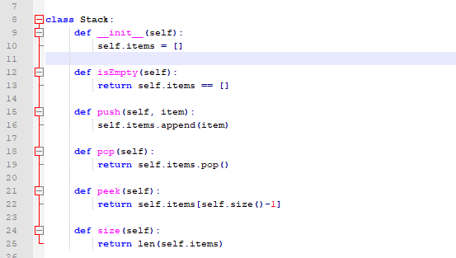
Stack

Slide 6
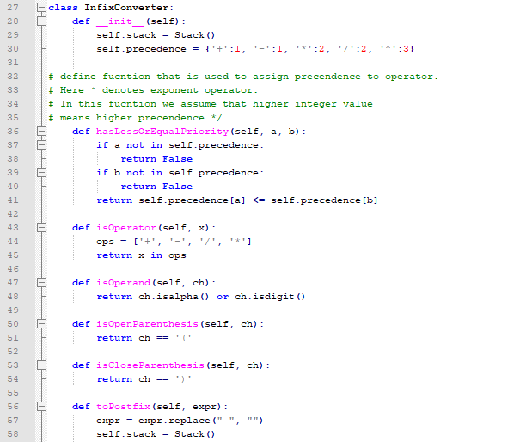

Slide 7
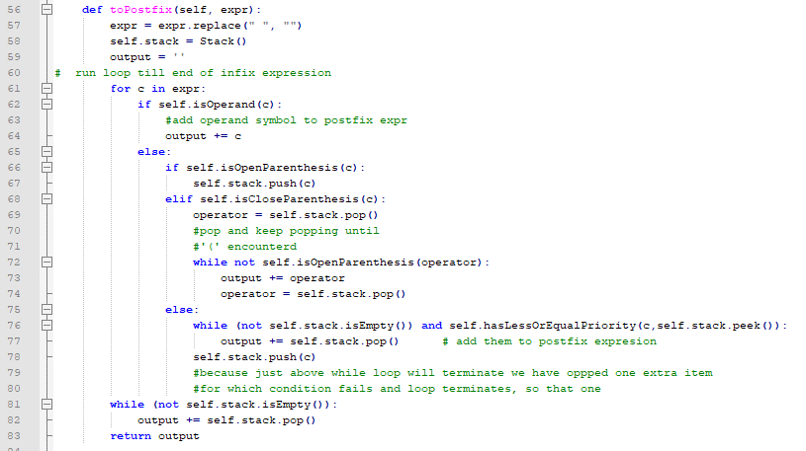
To PostFix

Slide 8
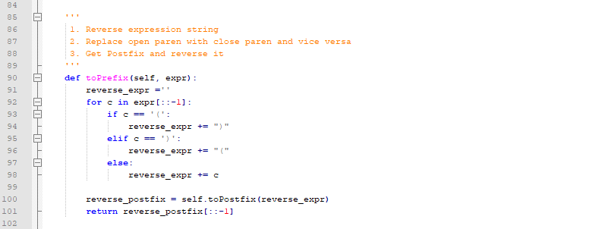
To Prefix

Slide 9
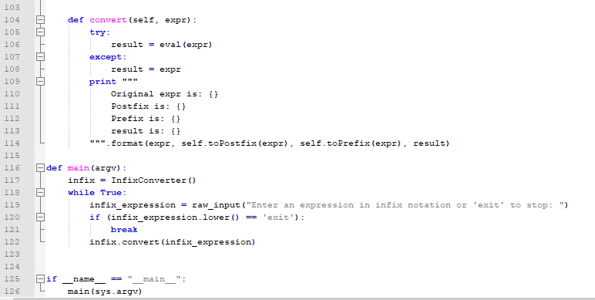
Main

Slide 10
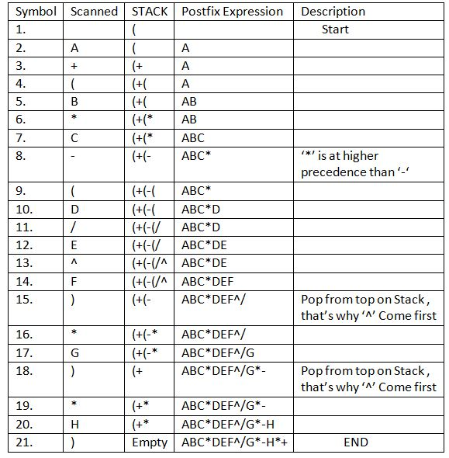
Example

Slide 11
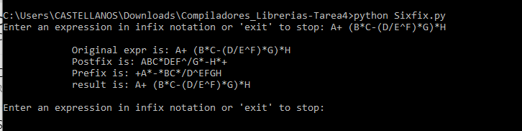

Slide 12
NOTA: El resto de las imágenes de los resultados junto con el código fuente se encuentra en el repositorio de github:
https://github.com/fjlic/Compiladores_Librerias/tree/Tarea4

