Slide 1

PPT
COMP 7940
Telegram Chatbot
Fan Junliang 21448973
Song Ningning 21444579
Notes:
We are group 7
Next, I will show our group’s work
我们是第七组
接下来由我来介绍小组作业内容
----------------（拖出telegram）
首先是chatbot的功能部分，我们实现了两个功能，一个是TV show review，
输入/review可以看到。。。And I can check 某个topic的内容
一个是Sharing a hiking route and photos，通过输入/start开始，然后根据提示可以浏览其它人的分享或者自己添加分享
------------------（切回来）
然后是云技术的部分
首先，我们肯定是用了git进行项目版本管理，在报告上就可以看到我们的github项目地址
然后我们的数据库系统用的是微软Azure的redis数据库，虽然它写的是缓存数据库，容量相对较小，但根据我们的实际情况并不会有大量的数据存储，所以这个database可以让数据交换更加效率，最后我们决定使用它
------------------------
云平台我们选择的是Azure app service，这个服务是一个web的云托管平台，chatbot获得的数据将会传到web然后webhook会自动发往app service，同时我们也将所有的密钥存储在了Azure的账户里，根据azure的文档显示，所有存入其账户的信息都会进行加密。
-----------------------
然后是workflow，我们用github actions进行自动部署，在每次commit之后，it will 把local中的内容打包成image推送给azure container registry，然后azure app service会重新获取image进行部署。

Slide 2
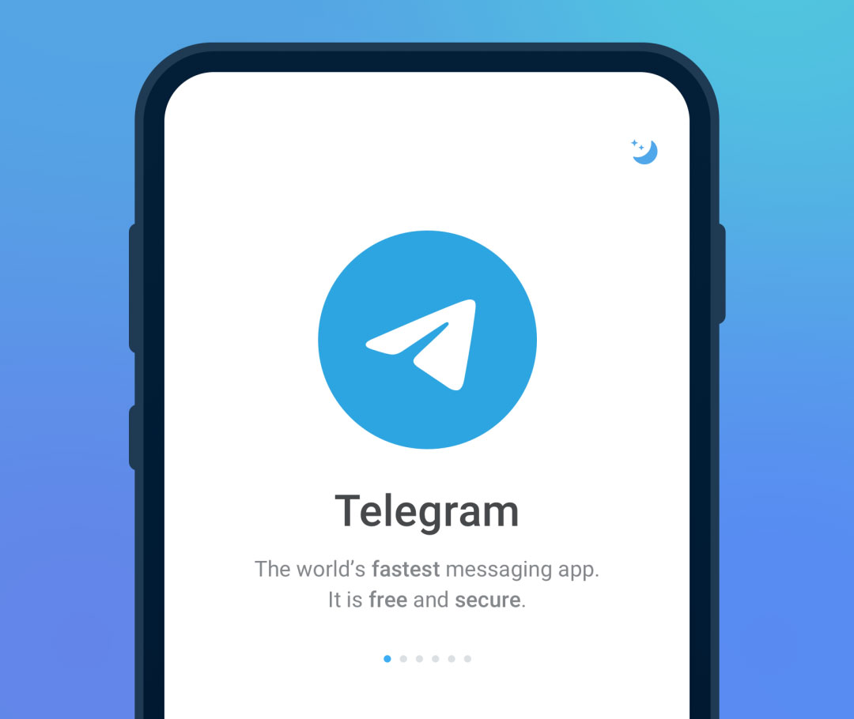
Chatbot Part
Notes:
The first is the functional part of Chatbot. We have developed two functions:
one is TV show review, Enter / review to see some topic... It only show 3
Can choose receive new review or not
And I can check the content of a topic
Also I can write a new review…and check again
It only show recent 3 reviews
The other one is sharing a hiking route and photos,
which starts by typing /slash start,
and then you can see other people's shares or add your owns’
according to the prompt,or can cancel it
When choose add, can upload photo and type words
When choose check, it will randomly show other peoples share
That is our chatbot’s function

Slide 3




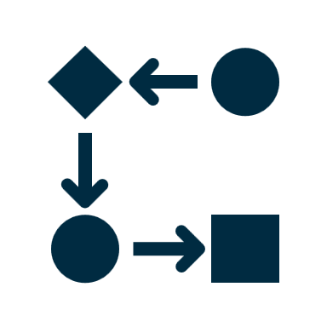
Cloud Part
git
Redis
Azure
Workflow
Notes:
Then there is the part of cloud technology
First, of course we use git for project version management. You can see our GitHub project https address on the report
Then our database system uses the redis database of Microsoft azure.
Although it writes it’s a cache database with relatively small capacity, there will not be a large amount of data storage according to our actual situation,
so this database can make data exchange more efficient. So we decided to use it

Slide 4






Azure
webhook
web
Azure App Service
Azure Redis Cache
Tpye Message
Send Message
Cloud Platform
Database
Notes:
The cloud platform we choose is azure app service, which is a web cloud hosting platform. The data obtained by Chatbot will be transferred to web, and then webhook will automatically send it to azure app service.
At the same time, we also store all keys in azure's account. According to azure's file, all information stored in its account will be encrypted.

Slide 5






Workflow
Azure Container Registry
Azure App Service
Github Actions
Commit
Hub
Notes:
Then there is our workflow.
We use GitHub actions for automatic deployment.
When there is a commit finish, it will package the content in local into an image and push it to azure container registry, which also is a could service from azure. Then azure app service will retrieve the image for deployment.
And that’s all

Slide 6

您
Listen attentively

