Slide 1

Module 1
Chapters 13 - 16, 67 & 68
By: Professor Marpole

Slide 2
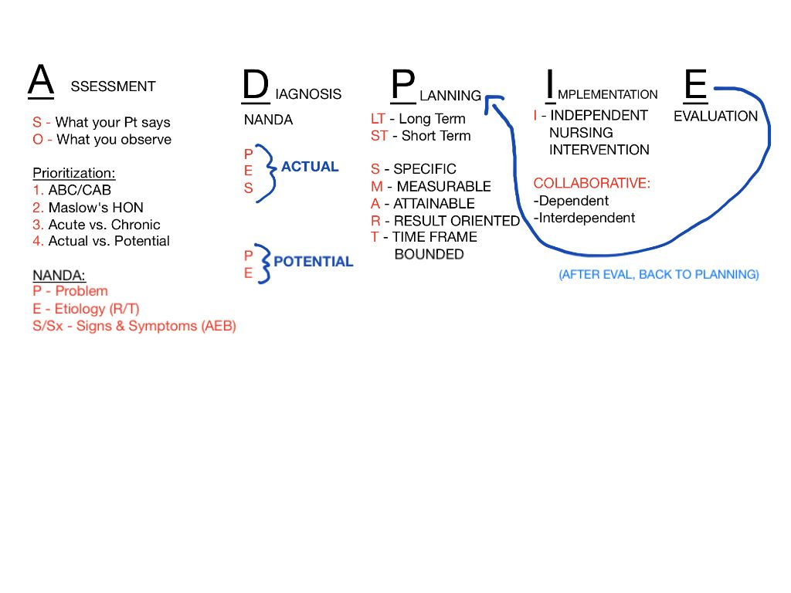
ADPIE Review

Slide 3
4-Step Method for test taking
ADPIE
Problem Type
  Active
  Risk
Priority Hierarchy
  ABC
  Maslow’s
Intervention Strategy
  Safety
  Least Invasive
  Correct Action
  Expected vs Unexpected
A client arrives to the emergency department with slurred speech and right-sided weakness. Vital signs are stable. What is the nurse’s priority action?
Administer aspirin
Obtain a CT scan of the head
Assess the client’s last known well time
Start IV fluids

Slide 4

Chapter 67 – Emergency Nursing

Slide 5
Key Terms and Definitions
Antivenin – antitoxin manufactured from venom of poisonous snakes to assist the patient’s immune system response to an envenomation
Carboxyhemoglobin – hemoglobin that is bound to carbon monoxide and is unable to bind with oxygen resulting in hypoxemia
Primary Survey – assessment of the patient triaged to the emergent or resuscitation category that focuses on stabilizing life-threatening conditions
Secondary Survey – assessment of the patient triaged to the emergent or resuscitation category that commences after the primary survey is completed
Rhabdomyolysis – toxic syndrome caused by widespread injury to skeletal muscle resulting in myoglobinuria and AKI (creatine kinase)
Sentinel Event – an unanticipated event that results in patient harm

Slide 6
Emergency Nursing
Refers to care given to patients with urgent and critical needs
Emergency Nurse Responsibilities:
  Establishes priorities
  Monitors
  Continuously assess patients who are acutely ill and injured
  Supports and attends to families
  Supervises allied health personnel
  Educated patients and families
  Day in the life of an ED nurse

Slide 7
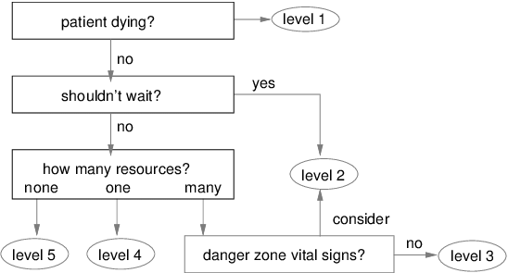
Principles of Emergency Nursing
Triage
Emergency Severity Index (ESI)
Used to sort patients into groups based on severity of their health problems
Emergent
Urgent
Nonurgent

Slide 8
Issues in Emergency Nursing Care
Documentation of consent and privacy
Violence in the emergency department
Consent for treatment must be obtained
  Unless critical situation and patient unresponsive
HIPAA
Emergency Medical Treatment and Active Labor Act (EMTALA)
Prisoners must have handcuff restraint and guard present at all times
Mask can be placed to avoid spitting or biting
Physical restraints can be used ensure safety

Slide 9
Principles of Emergency Nursing
Assess and Intervene
ABCDE
Priorities: stabilization, provision of critical treatments, and prompt transfer to the appropriate setting (ICU, etc.)
Primary Survey:
  ABCDE’s
  C/C
Secondary Survey:
  PMHx, SHx, Allergies, H-T-T, labs
Airway
Breathing
Circulation
Disability
Exposure
TRIAGE NURSE: ESI

Slide 10
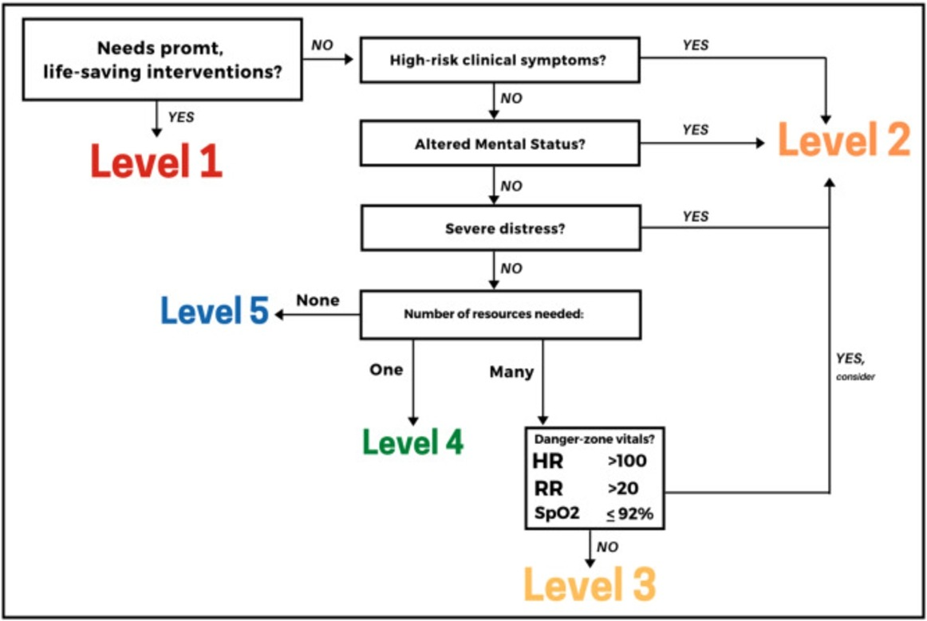
ESI

Slide 11
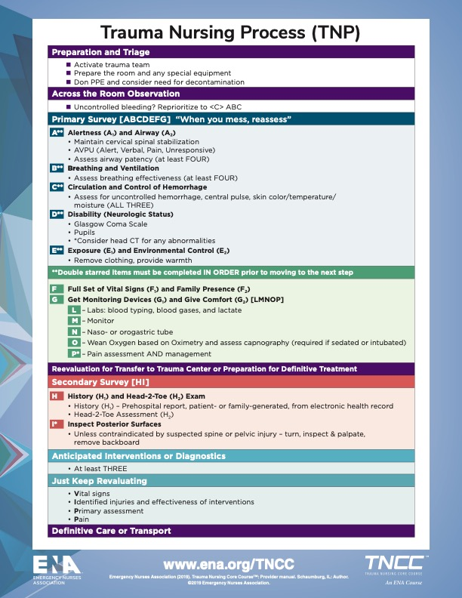
Primary Survey
ABCDE → FGLMNOP

Slide 12
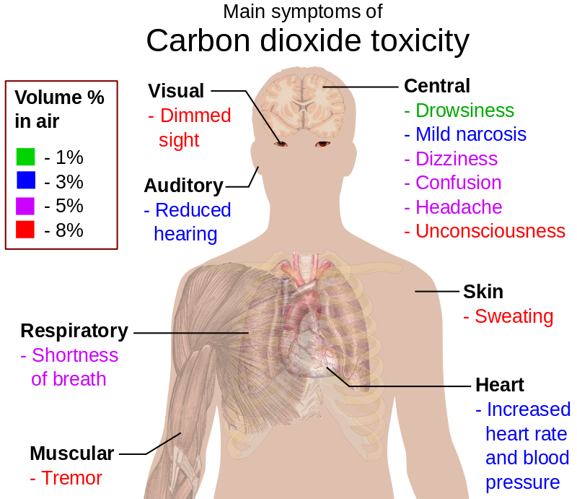
Airway Obstruction
We’ve discussed this topic before. Remember:
Establish an airway!!!!!
Partial obstruction can lead to progressive hypoxia, hypercarbia, and respiratory and cardiac arrest
Complete obstruction can cause permanent brain injury or death within 3-5 minutes
Cricothyroidotomy – opening of the cricothyroid membrane to establish airway

Slide 13
Hemorrhage
Definition
Management
Bleeding
FAST Exam
Large reduction of circulating blood volume is a main cause of shock
  Which Kind?
Internal Hemorrhage can be hidden therefore causing greater problem
  Assess patient thoroughly
  CT scan is best to rule out
Fluid Replacement
Control of External Hemorrhage
Control of Internal
Hemorrhage

Slide 14
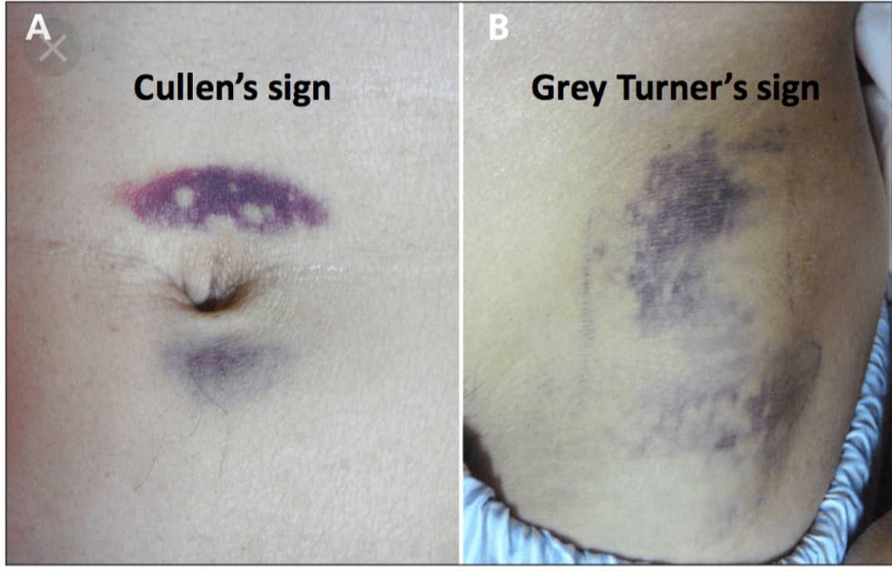
Hemorrhage
Assessment for internal bleed
Very common to find in the following conditions:
  Pancreatitis
  Ectopic Pregnancy
  Hemoperitoneum
  Organ laceration (spleen & liver)
  Ruptured Artery will not show these signs… why?

Slide 15
Wounds
Types of wounds
Management
Laceration – skin tear with irregular edges and vein bridging
Avulsion – tearing away of tissue from supporting structures
Ecchymosis/contusion – blood trapped under the surface of the skin
Hematoma – tumorlike mass of blood under the skin
Stab – incision of the skin with well-defined edges caused by sharp object typically deeper than long
Cut – incision of the skin with well-defined edges usually longer than deeper
Wound Cleansing
Tetanus Shot
Primary Closure
  Sutures
  Staples
  Dermabond
  Steri-Strips
Delayed Primary Closure
  Wet to Dry dressing if high risk for infection if closed

Slide 16
Collection of Forensic Evidence
Sexual Assault Nurse Examiner (SANE)
Ensure proper documentation as nurses may be asked to stand witness to assist the judicial process
All deaths of patients who experienced trauma are reported to the medical examiner; all tubes and lines must remain in place

Slide 17
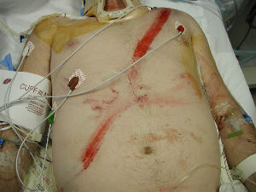
Intra-Abdominal Injuries
Penetrating or blunt trauma
Penetrating abdominal injuries require surgery (minimal for exploration)
  GSW /Stab Wounds
Blunt trauma have a challenge because injuries are hard to detect and can be delayed
MVC, Falls, Explosions
Labs: H/H, lactate, ABGs, INR, WBC
FAST exam

Slide 18
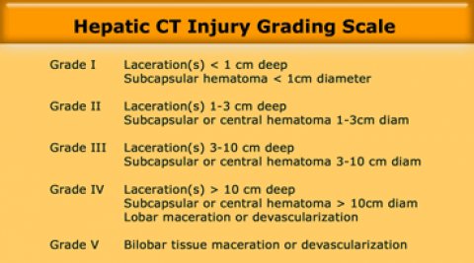
Intra-Abdominal Injuries
Internal Bleeding
Intraperitoneal Injury
Hemorrhage is most common, especially if liver or spleen has been traumatized
Abdominal CT is indicated
Abdomen is assessed for rebound tenderness, guarding, rigidity, spasm, increasing distention, and pain
U/S or CT to r/o bleed
Genitourinary Injury
Rectal and/or vaginal exam (every trauma alert)
Determine injury to pelvis, bladder, urethra, vagina, or intestinal wall

Slide 19
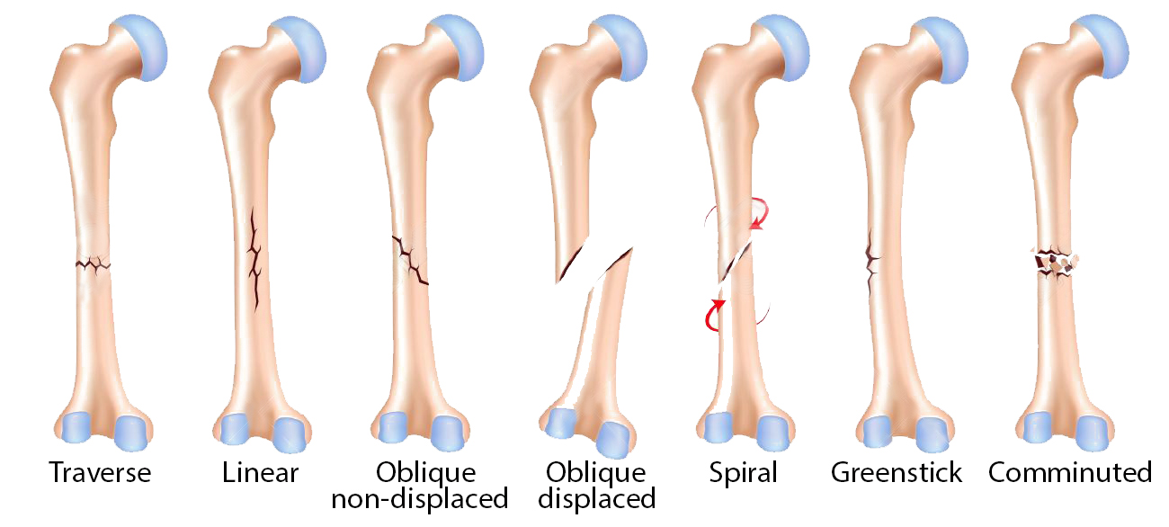
Crush Injuries
Fractures
Person is caught between opposing forces
Assess:
  Hypovolemic shock,
  Spinal cord injury,
  Fractures,
  AKI (Rhabdomyolysis) – myoglobin
  Fasciotomy vs Escharotomy

Slide 20
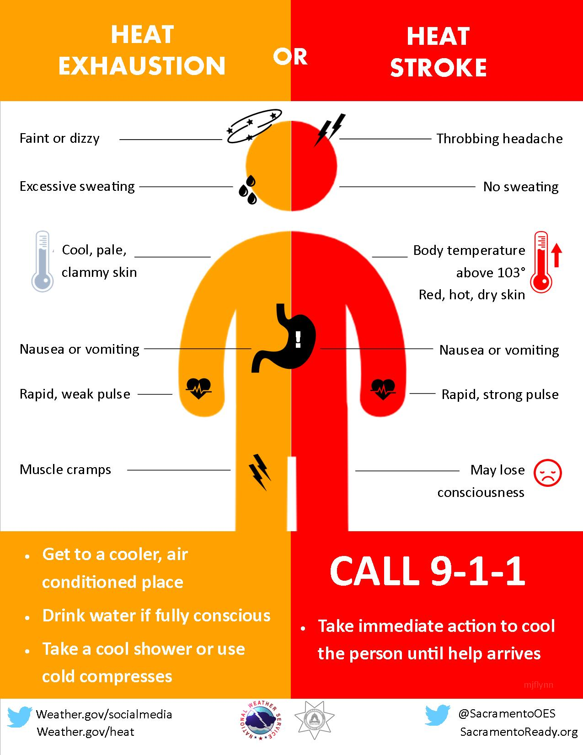
Environmental Emergencies
Heat-Induced Injuries
Use ABCs and reduce temperature to 39.2°C (102°F) as quickly as possible
Cooling methods:
  Cool sheets, towels, or sponging with cool water
  Ice to neck, groin, chest, and axillae
  Cooling blankets
  Immersion in cold water bath
Monitor temperature, VS, ECG, CVP, LOC, I&O
IVs to replace fluid losses
Medications: anticonvulsant, potassium, sodium bicarbonate, benzodiazepines

Slide 21
Environmental Emergencies
Frostbite
Trauma from exposure to freezing temperatures and freezing of the intracellular fluid resulting in cellular and vascular damage
Restore body temperature
Restrict ambulation if frostbite is in lower extremities due to clotting effects
Elevated area to reduce swelling
Analgesics for pain

Slide 22
Environmental Emergencies
Hypothermia
Nonfatal Drowning
Condition in which the core temperature is 35°C (95°F) or less
Monitor; ABCs, VS
Rewarm
  Internal methods can be used for below 90°F: warm fluid, cardiopulmonary bypass, humidified oxygen, and peritoneal lavage
Expect shivering to occur
”Survival for at least 24 hours after submersion that caused a respiratory arrest”
Ingestion of fluid can cause lung expansion problems
Therapeutic Goals:
  Maintaining cerebral perfusion
  Adequate oxygenation
  Cardiopulmonary resuscitation

Slide 23
Environmental Emergencies
Animal and Human Bites
Other bites in text:
Dog bites are most common
Cat bites have highest risk for infection due to the presence of Pasteurella in saliva
All animal bites are reported to public health authorities which require a follow up for risk for rabies
Human bites tend to occur with rapes, sexual assaults, and forms of battery
Snake Bites
  Most often has antivenin
Tick Bites
Spider Bites

Slide 24
Poisoning
Definition
Treatment Goals
Poison is any substance that when ingested, inhaled, absorbed, applied to the skin, or produced within the body in relativity small amounts injures the body by its chemical action
Remove or inactivate the poison before it is absorbed
Provide supportive care in maintaining vital organs systems
Administer specific antidotes
Implement treatment to hasten the elimination of the poison

Slide 25
Ingested Poisons
Management
Assessment
Measures to remove the toxin or decrease its absorption:
  Use of emetics
  Gastric lavage
  Activated charcoal
  Cathartic when appropriate
  Administration of a specific antagonist as early as possible
  Other measures may include diuresis, dialysis or hemoperfusion
ABCs
Monitor VS, LOC, ECG, UO
Laboratory specimens
Determine what, when, and how much substance was ingested
Signs and symptoms of poisoning and tissue damage
Health history
Age and weight

Slide 26
Carbon Monoxide Poisoning
Inhaled carbon monoxide binds to hemoglobin as carboxyhemoglobin. Carboxyhemoglobin does not transport oxygen
Clinical Manifestations:
  CNS symptoms: intoxication effect
  Headache
  Muscular weakness
  Palpitations
  Dizzy / Confusion
  Skin Color: pink to cherry-red
Pulse Ox will show high O2 saturation
  Therefore, O2 goal is 99%
Management:
  Move patient to fresh air
  Loosen all tight clothing
  CPR (PRN)
  Prevent chilling
  Keep patient quiet
  MUST check carboxyhemoglobin levels prior to treatment with oxygen
  Hyperbaric chamber
  https://www.youtube.com/watch?v=m9gg4oTg0oc&t=16s

Slide 27
Other Conditions
Acute Alcohol Intoxication:
  Monitor S/S, aspiration, NGT if needed
Alcohol Withdrawal Syndrome
  Monitor S/S, treatment: Ativan
Violence: always screen for violence
Sexual Assault
Human Trafficking
Psychiatric Emergencies
  PTSD
  Suicidal

Slide 28
Chapter 68 – Terrorism, Mass Causality, and Disaster Nursing

Slide 29
Key Terms and Definitions
Biological Weapon – a biological agent that is used to spread disease among the general population or the military
Chemical Weapon – a chemical agent that is used to cause disability and mortality in the general population or the military
Decontamination – process of removing, or rendering harmless, contaminants that have accumulated on personnel, patients, and equipment
Mass Casualty Incident (MCI) – the number of casualties exceeds the number of available resources
Radiologic Weapon – by-product of radiation contamination that are used to cause morbidity and mortality in the general population

Slide 30
Federal, State, and Local Responses to Emergencies
Disaster Type
Type 1 & 2 – national and state level
Type 3 – state or metropolitan area level
Type 4 – city, county, or fire district level
Type 5 – local village, and township level
When resources become too scarce, the mode of operations switches:
  “The Greatest Good for the Greatest Number of Patients”
Local communities must prepare to act in isolation (sustainability planning) and provide care for 5 days until federal or state resources become available
There are federal and state agencies that can provide support as needed

Slide 31
Hospital Emergency Preparedness Plans
Emergency Operations Plans (EOP)
Protection of the community
Should integrate with local, state, and federal government
All hospitals are required to have an emergency preparedness committee that constantly evaluates this plan

Slide 32
Hospital Emergency Preparedness Plans
EOP Components
Activation response – where, how, and when the response is initiated
Internal/External Communication – to and from prehospital arena
Plan for coordinated patient care
Identification of external resources
Plan for people management and traffic flow
Data management strategy
Demobilization response
Acter-action report or corrective plan
Plan for practice drills
Anticipated resources
MCI planning
Education plan for all of the above

Slide 33
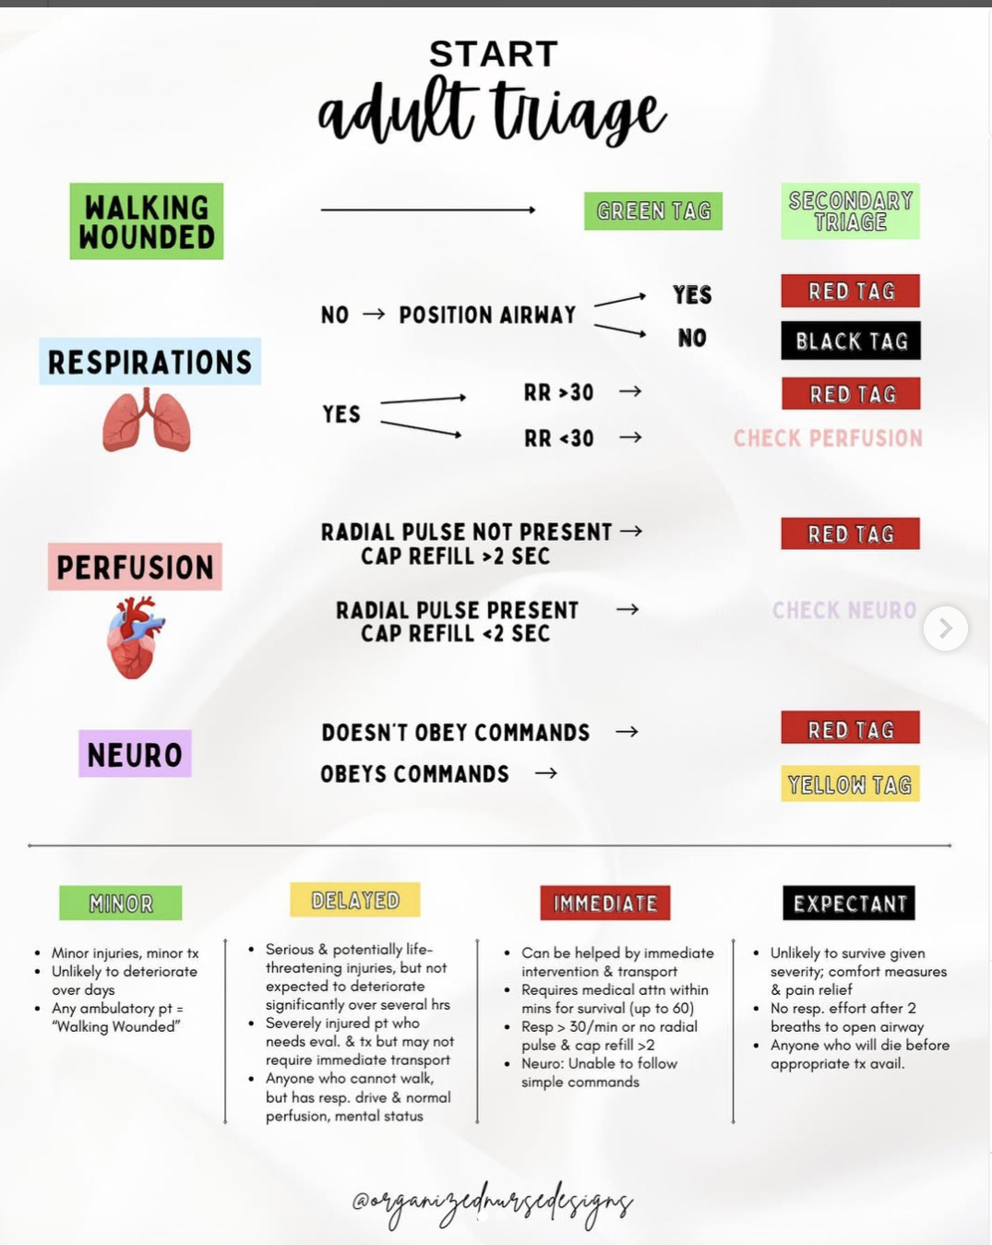
Red, Yellow, Black Tag System

Slide 34
Hospital Emergency Preparedness Plans
Triage
The sorting of patients to determine priority health care needs and the proper site of treatment
In nondisaster situations, health care workers assign highest priority and allocate most resources to the most critically ill patients.
In disaster situations with large numbers of casualties, decisions are based on the likelihood of survival and the consumption of resources.
North Atlantic Treaty Organization (NATO) triage system or START
  Red, yellow, and black

Slide 35
Hospital Emergency Preparedness Plans
Triage Considerations
The Nurse’s Role
Managing internal problems
Communicating with the media and family
Managing media requests for information
Caring for families
Stress management
Nurse’s role varies during disaster
May be asked to perform duties outside of expertise: intubate, insert chest tube, suture
May serve as triage officer
Nurses must strive to maximize patient sagety
Be aware of state regulation

Slide 36
Preparedness and Response
Personal Protective Equipment
Purpose: to shield the health care provider from chemical, physical, biological, and radiological hazards that may exist when caring for contaminated patients
Categories of protective equipment
  Level A: self-contained breathing apparatus (SCBA) and vapor-tight chemical resistant suit, gloves, and boots
  Level B: high level of respiratory protection (SCBA) but lesser skin and eye protection; chemical-resistant suit
  Level C: air-purified respirator, coverall with splash hood, chemical-resistant gloves and boots
  Level D: typical work uniform

Slide 37
Preparedness and Response
Recognition and Awareness
Nurses are quick to recognize patterns and trends:
  An unusual increase in the number of people seeking care for fever, respiratory, or GI symptoms
  Clusters of patients who present with the same unusual illness from a single location
  A large number of fatalities, especially when death occurs within 72 hours after hospital admission
  Any increase in disease incidence in a normally health population

Slide 38
Isolation Precautions for Biological Terrorism Agents
Biological agents may be delivered or spread in a number of ways.
Because off modern travel, spread of infection may occur in areas thousands of miles apart.
Health care providers need to be aware of potential signs of biological weapon dissemination. Signs and symptoms are similar to those of common disease process.
Isolation practices depend on the infecting agent.
Always use standard precautions.
Some agents require transmission-based precautions.
Terminal disinfection and disposal of wastes depend on the infecting agent.

Slide 39
Types of Biologic Weapons: Anthrax
Incubation 1-6 days
Clinical Manifestation:
  Skin contact, GI ingestion, inhalation
  Skin lesions, fever, N&V, abdominal pain, diarrhea
  Respiratory symptoms that mimics influenza
Treatment: Penicillin V, Erythromycin

Slide 40
Types of Biological Weapons: Smallpox
Virus, Incubation 12 days
Extremely contagious; spread by direct contact, by contact with clothing or linens, Or by droplets person-to-person
Manifestations: High fever, malaise, headache, backache, and prostration; after 1 to 2 days a maculopapular rash appears on the face, mouth, pharynx, and forearms
Treatment is supportive care with antibiotics for any additional infection

Slide 41
Chemical Weapons
Effects are more apparent and occur more quickly than those caused by biologic weapons
Characteristics of Chemicals
  Volatility – tendency for a chemical to become a vapor
  Persistence – chemical is less likely to vaporize and disperse
  Toxicity – ability for agent to cause injury to body
  Latency – time from absorption to appearance of signs/symptoms
  Limiting exposure
Limitation of exposure is essential with evacuation and decontamination as soon possible and as close to the scene of the incident as possible

Slide 42
Types of Chemical Agents
  Vesicants
  Nerve agents
  Blood agents
  Pulmonary agents

Slide 43
Vesicants
Lewisite, sulfur mustard, nitrogen mustard, phosgene
Cause blistering and burning
Respiratory effects can be serious and cause death
Decontamination with soap and water; do not scrub or use hypochlorite solutions
Eye exposure requires copious irrigation
Treatment: soap and water

Slide 44
Nerve Agents
Sarin, soman, tabun, organophosphates, and VX
Inhibit cholinesterase, causing cholinergic symptoms progressing to loss of consciousness, seizures, copious secretions, apnea, and death
Treatment: supportive care, atropine, benzodiazepine and pralidoxime. Soap and water can be used to clean skin and clothing
Decontaminate with copious amounts of soap and water or saline for at least 20 minutes
Blot; do not wipe off
Plastic equipment will absorb sarin gas

Slide 45
Blood Agents
Hydrogen cyanide and cyanogen chloride
Direct effect on cellular metabolism, resulting in asphyxiation through alterations in hemoglobin
Can be inhaled, ingested, or absorbed in the skin and mucous membranes
Leads to respiratory muscle failure, respiratory arrest, cardiac arrest, and death
Rapid administration of amyl nitrate, sodium nitrite, and sodium thiosulfate is essential; especially after patient is intubated and placed on ventilator

Slide 46
Pulmonary Agents
Phosgene and Chlorine: both vaporize rapidly causing pulmonary injury
Destroy the pulmonary membrane that separates the alveolus from the capillary bed, disrupting alveolar–capillary oxygen transport mechanisms. Capillary leakage results in fluid-filled alveoli
Manifestations include pulmonary edema with shortness of breath, especially during exertion. An initial hacking cough is followed by frothy sputum production

Slide 47
Radiation Exposure
Radiation exposure may occur because of nuclear weapon, nuclear reactor incidents, or exposure to radioactive samples
Exposure to radiation is affected by time distance and shielding
Types of radiation-induced injury
  External irradiation: all or part of the body is exposed to radiation; decontamination is not necessary; not a medical emergency
  Contamination: exposure to radioactive gases, liquids, or solids; requires immediate medical management to prevent incorporation
  Incorporation: uptake of the radioactive material into the body

Slide 48
Radiation Decontamination
Triage outside the hospital
Cover floor and use strict isolation precautions to prevent the tracking of contaminants
Air ducts and vent are sealed
Waste is double bagged and labeled “radiation waste”
Staff protection
  Water-resistant gowns, two pairs of gloves, caps, goggles, masks, and booties
  Dosimetry devices

Slide 49
Radiation Decontamination
Patients are surveyed for radiation and directed to the decontamination area
Decontaminate each patient outside the ED with a shower
Water, tarps, towels, soap, gowns, all patient belongings, and so on must be collected and contained
Patients are resurveyed and reshowered as necessary
Showering should be performed to not contaminate clean areas with runoff from the showering
Biologic samples: nasal and throat swabs, blood
Internal contamination requires additional treatment—catharsis and gastric lavage with chelating agents

Slide 50
Acute Radiation Syndrome
Acute radiation syndrome (ARS): dose of radiation determines if ARS will develop
All body systems are affected by ARS
Presenting signs and symptoms determine predicted survival
Probable survivors have no initial symptoms or only minimal symptoms
Possible survivors present with nausea and vomiting that persists for 24 to 48 hours
Improbable survivors are acutely ill with nausea, vomiting, diarrhea, and shock. Neurologic symptoms suggest a lethal dose

Slide 51

Chapter 13 –
End-of-Life Care

Slide 52
Ted Talk: What Really Matters at the End of Life

Slide 53
Nursing and End-Of-Life Care
Clinicians’ Attitudes toward death
Assisted Suicide
This remains one of the greatest barriers
Four Identified “Awareness Contexts”
  Closed Awareness: patient is unaware of terminal state
  Suspected Awareness: patient suspects what others know and try to figure out details
  Mutual Pretense Awareness: everyone knows but pretend otherwise
  Open Awareness: awareness is open and its reality acknowledged
Definition: to provide another person the means to end their own life
Physician Assisted Suicide is now called “Death with Dignity” and only legal in 10 states and Washington D.C.

Slide 54
Settings for End-of-Life Care
Palliative Care
Hospice Care
Comprehensive symptom management, psychosocial care, and spiritual support needed to enhance the quality of life for any person with advanced illness
Interdisciplinary collaboration
Settings:
  - Hospitals
  - Skilled nursing facilities
  - Outpatient
Coordinated program of interdisciplinary services provided by professional caregivers and trained volunteers to patients with serious, progressive illnesses that are not responsive to cure
Root of the word hospice is hospes, meaning “host”

Slide 55
Principles of Hospice Care
Death must be accepted
Patient’s total care best managed by interdisciplinary team whose members communicate regularly
Pain and other symptoms must be managed
Patient/family should be viewed as single unit of care
Home care of dying necessary
Bereavement care must be provided to family members
Research and education should be ongoing

Slide 56
Barriers to Improving End-of-Life Care
Physicians reluctance to refer to hospice:
  Difficulties in making a terminal prognosis (especially for those patients with noncancer diagnoses)
  The strong association of hospice with death
  Advances in “curative” treatment options in late-stage illness
  Financial pressures on health care providers that may cause them to retain rather than refer hospice-eligible patients

Slide 57
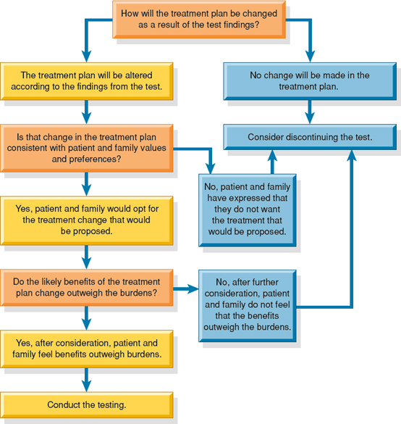
Four Levels of Hospice Care
Routine home care
Inpatient respite care
Continuous care
General inpatient care

Slide 58
Most Common Hospice Diagnoses
Dementia
Heart disease
Lung disease
Most patients who enrolled in hospice in previous decades had cancer diagnoses, just 36.6% of hospice enrollees in 2014 had cancer diagnoses

Slide 59
Legal Aspects in the Dying Process
Advanced directives
Proxy directives
Advance directives are written documents that allow competent people to document their preferences regarding
  Use or refrain use of medical treatment at the end of life
  Specify their preferred setting for care
  Communicate other valuable insights into their values and beliefs
Appointment and authorization of another person to make medical decisions on behalf of the person who created the advance directive when he or she can no longer speak for himself or herself
An important addition to the living will or medical directive that specifies the signer's preferences

Slide 60
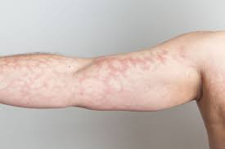
Managing Physiologic Responses to Terminal Illness
Pain
Dyspnea
Anxiety
Nutrition and Hydration
Delirium
Depression

Slide 61
Post-Mortem Care
https://www.youtube.com/watch?v=vtraSJQ6fsE
Physician only provider than can call time of death
Death certificate
Autopsy vs non-autopsy
  Remove lines/drains or keep in place

Slide 62

5 Stages of Grief

Slide 63

Chapter 14
Pre-Operative Nursing Management

Slide 64
Ambulatory Surgery: includes outpatient, same-day, or short-stay surgery that doesn’t require an overnight hospital stay
Informed Consent: the patient’s autonomous decision about whether to undergo a surgical procedure, based on the nature of the condition, the treatment options, and the risks and benefits involved
Minimally Invasive Surgery: surgical procedure that uses a specialized instruments inserted into the body either through natural orifices or through small incisions
Preadmission Testing: diagnostic testing performed before admission to the hospital
Key Definitions

Slide 65
Preoperative Phase: begins when the decision to proceed with surgical intervention is made and ends with the transfer of the patient onto the operating room (OR) bed
Intraoperative Phase: beings when the patient is transferred onto the OR bed and ends with admission to the PACU
Postoperative Phase: begins with the admission of the patient to the PACU and ends with a follow-up evaluation in the clinical setting or home
Perioperative Nursing

Slide 66
Decision to Perform Surgery:
- Facilitating a diagnosis
- A cure
- Repair
Classification of Surgery
- Emergent – without delay (severe hemorrhage)
- Urgent – within 24-30 hours (closed fractures or infected wounds)
- Required – within few weeks to months (thyroid disorders)
- Elective – not life/death, but may be medically necessary (repair of scars, hernia)
- Optional – personal preference (cosmetics)
Surgical Classifications

Slide 67
- Should be in writing before nonemergent surgery
- Legal mandate
- Surgeon must explain the procedure, benefits, risks, complications, alternatives, etc.
- Nurse clarifies information and witness’ signature
- History and Physical (H&P) must be present prior to signing
- Consent is valid ONLY when signed before administering psychoactive premedication
- Consent accompanies patient to OR
- Must be in patient’s native language
- Emergency situations, consent may be skipped if deemed emergent by two physicians
Patient who is incompetent must have a proxy or surrogate sign the consent
Required Preoperative Documents:
Informed Consent

Slide 68
Preadmission Testing
- Initiates initial preoperative assessment
- Initiates education appropriate to patient’s needs
- Involves family in interview
- Verifies completion of preoperative diagnostic testing
- Verifies understanding of surgeon-specific preoperative orders
- Discusses and reviews advance directive document
Preoperative Nursing

Slide 69
Initiates the nursing process
Admission data: demographics, health history, other information pertinent to the surgical procedure
Verifies completion of preoperative diagnostic testing
Begins discharge planning by assessing patient’s need for postoperative care
Preadmission Testing

Slide 70
Admission to Surgical Center
- Completes preoperative assessment
- Assesses for risks for postoperative complications
- Reports unexpected findings or any deviation from normal
- Verifies that operative consent has been signed
- Coordinates patient education and plan of care with nursing staff and other health team members
- Reinforces previous education
- Explains phases in perioperative period and expectations
- Answers patient’s and family’s questions
Preoperative Nursing

Slide 71
In the Holding Area
- Identifies patient
- Assesses patient’s status, baseline pain, and nutritional status
- Review medical record
- Verifies surgical site and that it has been marked per institutional policy
- Establishes IV line
- Administers medications if prescribed
- Takes measures to ensure patient’s comfort
- Provides psychological support
Preoperative Nursing

Slide 72
If a patient is on any antihypertensive medications such as a beta blocker, last dose should be expressed to Anesthesia
Surgical Site Infections (SSI) and VTE Prevention – do not hold VTE chemoprophylaxis
Patients Undergoing Ambulatory Surgery
- Outpatient, same-day, or short-stay and DOES NOT require hospital admission
- Must have family member or caregiver with them
Patients Undergoing Emergency Surgery
- Unplanned and occur with little or no time for preparation
- PMHx including allergies, and informed consent must be obtained from family
- Emergently medically necessary status can be obtained for live/death situations
Special Considerations During the Perioperative Period

Slide 73
Gerontologic Considerations
- Cardiac reserves are lower
- Renal and hepatic functions are depressed
- Gastrointestinal activity is likely to be reduced
- Respiratory compromise
- Decreased subcutaneous fat; more susceptible to temperature changes
- May need more time and multiple explanations to understand and retain what is communicated restrictions
Special Considerations During the Perioperative Period

Slide 74
- Health History and Physical Exam
- Medications and Allergies
- Nutritional & Fluid Status – hydration, protein, malnutrition, obesity (Table 14-2)
- Dentition – poor tooth health can cause dislodging during intubation
- Drug or Alcohol Use – substances can impede effectiveness of medications
- Respiratory & Cardiovascular Status
- Hepatic & Renal Function – medication metabolism, distribution, and excretion
- Endocrine Function – over/under-production of hormones (stress = sugar)
- Immune Function – infection risk
- Previous Medication Use
- Psychosocial Factors
- Spiritual & Cultural Beliefs
Preoperative Assessment

Slide 75
Medications with the Potential to Affect the Surgical Experience
- Corticosteroids
- Diuretics
- Phenothiazines
- Tranquilizers
- Insulin
- Antibiotics
- Anticoagulants
- Anticonvulsant medications
- Thyroid hormone
- Opioids
- Over-the-counter and herbals
Preoperative Assessment

Slide 76
Is the following statement true or false?
The primary goal in withholding food before surgery is to prevent aspiration
Question

Slide 77
True
Rationale: The primary goal in withholding food before surgery is to prevent aspiration
Answer

Slide 78
Providing Patient Education
- Deep Breathing, Coughing, IS
- Mobility and Active Body Movement
- Pain Management
- Cognitive Coping Strategies
- Education for Patients Undergoing
Ambulatory Surgery
Providing Psychosocial Interventions
- Reducing Anxiety and Decreasing Fear
- Respecting Cultural, Spiritual, and
Religious Beliefs
Preoperative Nursing Interventions
Managing Nutrition & Fluids
- Purpose for NPO before surgery is to prevent
aspiration
Preparing the Bowel
- Enemas needed for abdominal / bowel surgery
Preparing the Skin
- Surgical wash prior to OR to prevent infection
- Hair is not removed unless it can interfere with
operation

Slide 79
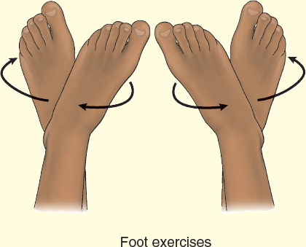
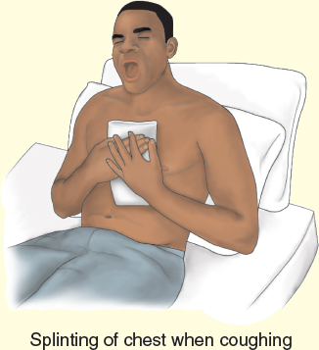
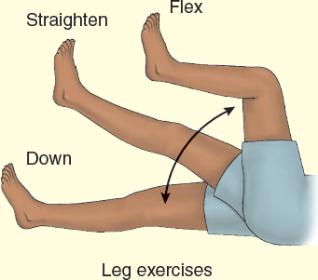
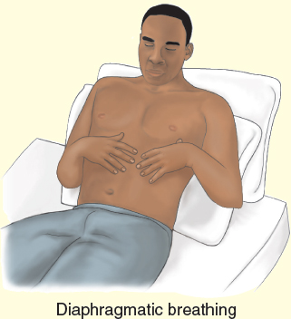
Preoperative Nursing Interventions

Slide 80
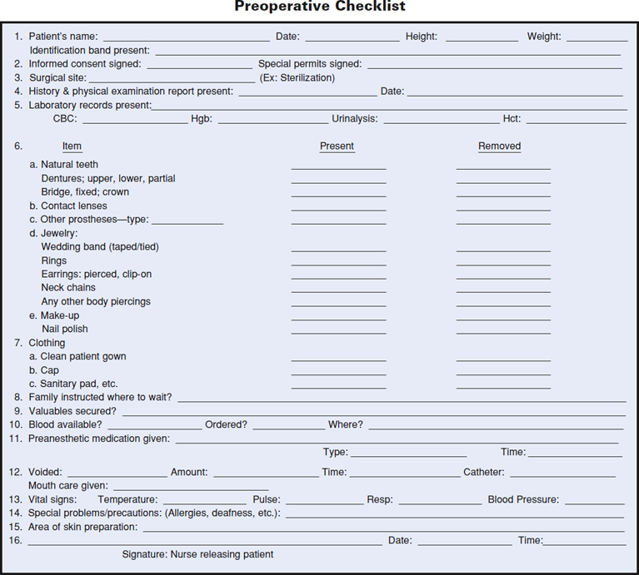
Patient changes into gown, mouth inspected, jewelry removed, valuables stored in a secure place
Administering preanesthetic medication
Maintaining preoperative record
Transporting patient to presurgical area
Attending to family needs
Pre-op warming
Immediate Preoperative Nursing Interventions

Slide 81
Expected Patient Activities in the Preoperative Phase of Care
- Relief of Anxiety
- Decreased Fear
- Understanding of the Surgical Intervention
Pre-Op Nursing – A Day In The Life
Immediate Preoperative Nursing Interventions

Slide 82
- Relief of Anxiety
- Decreased Fear
- Understanding of the Surgical Intervention
- No Evidence of Preoperative Complications
Expected Outcomes

Slide 83
A nurse is assessing a client’s laboratory values before surgery. Which of the following results should the nurse report to the provider? SATA
Potassium 3.9 mEq/L
Sodium 145 mEq/L
Creatinine 2.8 mg/dL
Blood glucose 235 mg/dL
WBC 17,850/mm3

Slide 84
A nurse is providing preoperative teaching to a client who is to have abdominal surgery. Which of the following statements should the nurse make? SATA
“Take your heart medication with a sip of water before surgery”
“Splint the abdominal incision with a pillow when coughing and deep breathing”
“Bed rest is recommended for the first 48 hours”
“Anti-embolic stockings are applied before surgery”
“You can eat solid foods up to 4 hours before surgery”

Slide 85
A nurse is verifying informed consent for a client who is having a paracentesis. Which of the following actions should the nurse take? SATA
Explain to the client the purpose of the procedure
Inform the client of risks to having the procedure
Ensure the client understands information about the procedure
Witness the client signing the informed consent form
Determine if the client is capable of understanding the reason for the procedure

Slide 86
A nurse is caring for a client who is scheduled for an exploratory laparotomy. The client’s temperature is 39 degrees Celsius orally (102.2F). Which of the following actions should the nurse take?
Inform the surgeon of the elevated temperature
Transfer the patient to the preoperative unit
Apply ice packs to the groin
Encourage the client to increase intake of clear liquids

Slide 87
A preoperative nurse is caring for a client who is having a colon resection. Which of the following actions should the nurse take?
Encourage the client to void after preoperative medication administration
Administer antibiotics 2 hours prior to surgical incision
Remove hair using a manual razor
Remove nail polish on fingers and toes

Slide 88
Chapter 15
Intra-Operative Nursing Management

Slide 89
Circulating Nurse – registered nurse who coordinates and documents patient care in the operating room
Malignant Hyperthermia – life-threatening condition triggered by exposure to anesthesia. This exposure can cause an increase in skeletal muscle oxidative metabolism which overwhelms oxygen supply, removes CO2, and regulation of body temperature.
Moderate Sedation – use of sedation without altering patient’s ability to maintain a patent airway. (LEMON Score)
Scrub Role – one who scrubs and dons sterile surgical attire, prepares instruments and supplies, along with handing instruments to surgeon.
Key Definitions

Slide 90
Intraoperative phase: begins when the patient is transferred onto the OR bed and ends with admission to the PACU (post anesthesia care unit)
Intraoperative Nursing

Slide 91
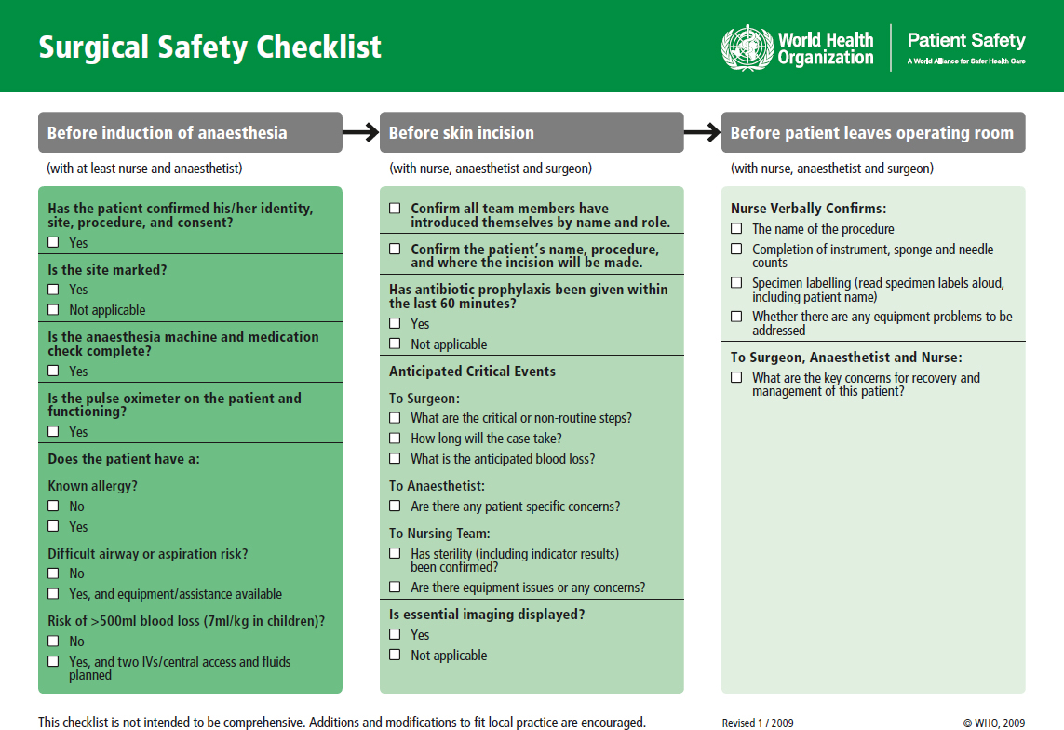
- Patient
- Anesthesiologist or CRNA
- Surgeon
- Nurses
- Circulating RN performs Timeout!
TIMEOUT is a NURSING EBP!
- Surgical Technicians
- Registered Nurse First Assistants
The Surgical Team

Slide 92
Patient
- Gerontologic Considerations are needed due to loss of tissue elasticity and reduction of lean tissue mass that can result in longer effects of anesthesia
- Decrease in plasma proteins allows for anesthetic agents to remain unbound
- Impaired ability to increase metabolic rate and thermoregulation
The Surgical Team

Slide 93
Stark appearance and cool in temperature
Situated in central location – pathology, x-ray, and laboratory
Contains own air supply
Unrestricted Zone – street clothes are allowed
Semi-Restricted Zone – attire consisted of scrubs clothes and caps
Restricted Zone – scrub clothes, shoe covers, caps, and masks
The Surgical Environment

Slide 94
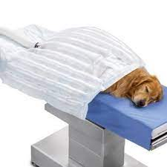
Warming the patient has been linked to enhanced healing, lower infection rates, decreased pain intensity, and reduced malaise
The Surgical Environment

Slide 95
Principles of Surgical Asepsis
- All materials in contact with the surgical wound or used within the sterile field must be sterile
- Gowns considered sterile in front from chest to level of sterile field, sleeves from 2 inches above elbow to cuff
- Sterile drapes are used to create a sterile field, ONLY the top drape is considered sterile.
- Movement among the OR is sterile to sterile and unsterile to unsterile
The Surgical Environment

Slide 96
Types of Anesthesia
- General Anesthesia
- Regional Anesthesia
- Moderate Sedation
- Local Anesthesia
The Surgical Experience

Slide 97
Anesthesia is a state of narcosis (severe CNS depression), analgesia, relaxation, and reflex loss
- Patients are unarousable (altered GCS), and lose the ability to maintain ventilatory function and occasionally cardiovascular function
Four Stages
- Stage 1 – beginning anesthesia: dizziness and feeling detachment; ringing, roaring or buzzing in the ears and inability to move extremities may occur
- Stage 2 – excitement: struggling, shouting, talking, singing, laughing or crying may occur (can be avoiding with administration of medications appropriately)
- Pupils dilate, HR increases, RR irregular
- Stage 3 – surgical anesthesia: administration of gas or vapor and supported with IV agents.
- Pupils normalize, RR regular, HR normal
- Stage 4 – medullary depression: too much anesthesia given.
- RR shallow, HR weak, pupils no longer constrict when exposed to light
General Anesthesia

Slide 98
Goal – patient passes through each stage gradually
Larger amounts of anesthesia must be given at induction due to the body depositing medication in body tissues; once these sites are saturated medication can cross BBB and be delivered to brain
Note: medical condition that diminishes peripheral blood flow can reduce medication need
Inhalation: all are given in combination with O2. Most common is nitrous oxide
- Elimination of medication is through exhaling through the lungs
IV: advantage is that onset of anesthesia is pleasant compared to inhalation; easier
- See Table 18-2 for medication list
General Anesthesia

Slide 99
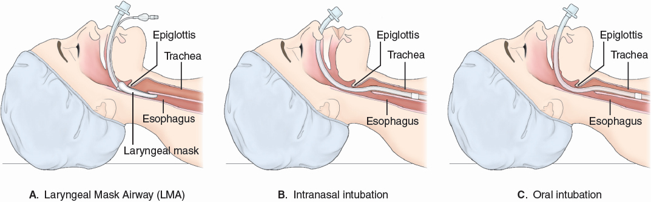
General Anesthesia

Slide 100
IV Medications:
Opioids:
Fentanyl
Morphine
Alfentanil
Sufentanil
Muscle Relaxants:
Succinylcholine
Rocuronium
Vecuronium
Pancuronium
Metocurine
General Anesthesia
IV Medications:
Anesthetic Agents:
Etomidate
Diazepam
Ketamine
Midazolam
Propofol

Slide 101
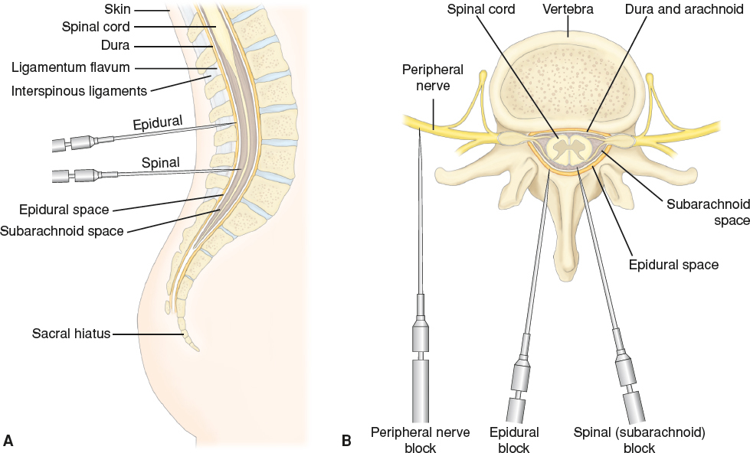
Anesthetic agent injected around nerves so that region can be anesthetized
Epidural Anesthesia:
- Injection in epidural space
- Blocks sensory, motor and autonomic functions
- Requires higher amount of medication
Spinal Anesthesia:
- Injection through dura mater into subarachnoid space (L4 and L5)
- Highly extensive
- Used for BLE, perineum, and lower Abd
- Sterile Technique
Regional Anesthesia
Notes:
Lidocaine with Epi = highly vascularized area such as face – Professor Marpole

Slide 102
Use of IV administration of sedatives and used for short-term surgical procedures
Goal – depress patient’s consciousness to a moderate level but patient can still maintain patent airway, retain reflexes, and respond to physical stimuli
RR will depress with slight decrease in O2
Moderate Sedation

Slide 103
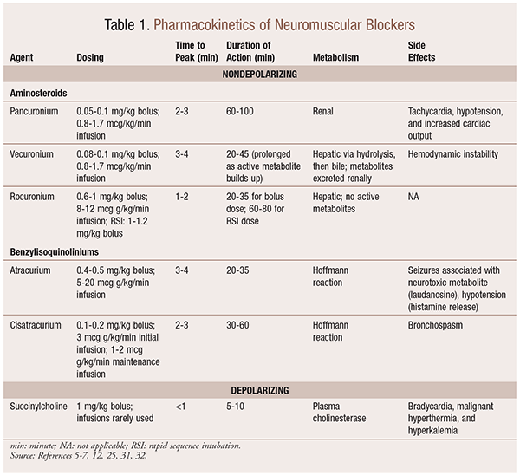
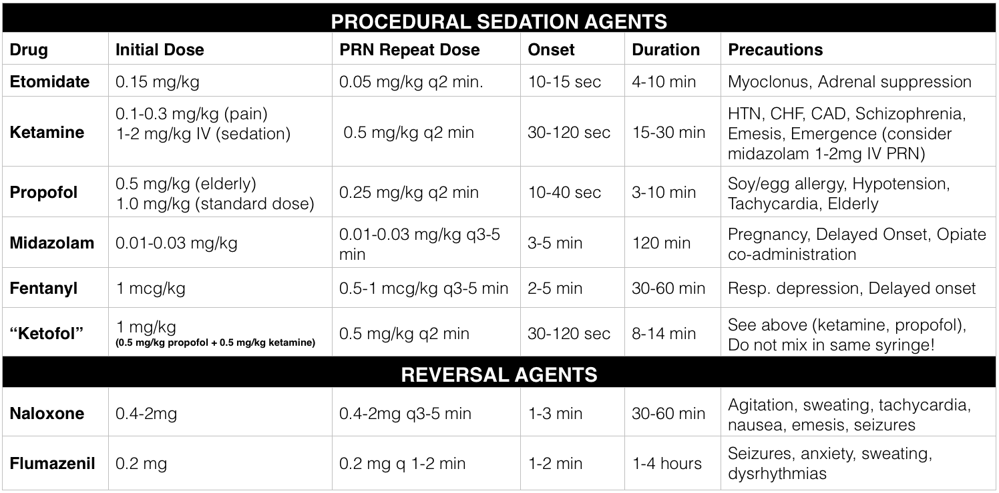
Moderate Sedation

Slide 104
Injection of anesthetic agent into the tissues at a planned injection site; may be combined with regional anesthesia; preferred method if practical
Advantages:
- Simple and nonexplosive
- Minimal equipment needed
- Recovery is brief
- Limited undesirable effects from anesthesia
- Used for short and minor procedures
Combined with epinephrine which constricts blood vessels and can prevent rapid absorption of medication
Local Anesthesia

Slide 105
Anesthesia Awareness
Nausea and Vomiting
Anaphylaxis
Hypoxia and Other Respiratory Complications
Hypothermia r/t glucose metabolism reduction
Malignant Hyperthermia: rare muscle disorder induced by anesthetic agents
- S/S: tachycardia (150’s), Ventricular Dysrhythmia, Hypotension, decreased
Cardiac Output, Oliguria, hypercapnia, hypoventilation, lock-jaw
- Temperature rise is late sign
- Results in cardiac arrest
- Nursing Management: identify risks and be ready with medications
- Medical Management: treat symptoms, postpone surgery, administer Dantrium
Potential Intraoperative Complications

Slide 106
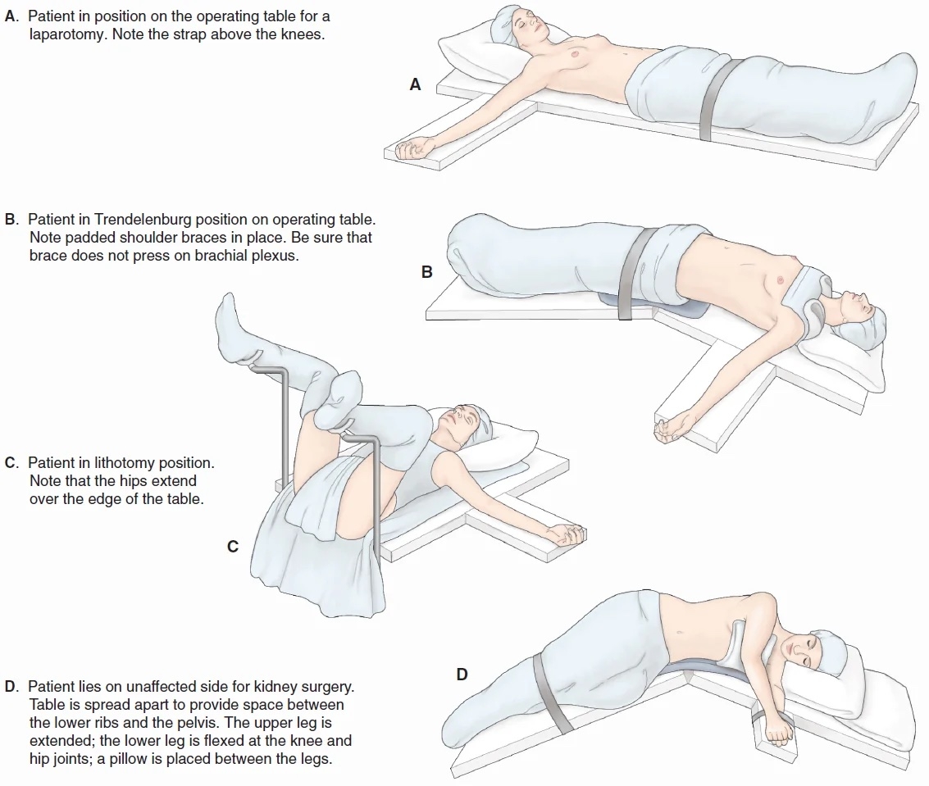
Potential Intraoperative Complications

Slide 107
Assessment: most data comes from patient’s medical record
Diagnosis:
- Anxiety r/t surgical or environmental concerns
- Risk of allergic response
- Risk for perioperative positioning injury
- Risk for injury r/t anesthesia and/or surgical procedure
- Risk for compromised human dignity r/t anesthesia or sedation
Nursing Process – The Patient During Surgery
Planning / Goals: prevent injury and reduce anxiety
Interventions:
- Reducing Anxiety
- Reducing Allergen Exposure
- Preventing Positioning Injury
- Serving as Patient Advocate
- Monitoring and Managing Potential
Complications
- Reducing surgical site infection (Abx)
Evaluation:

Slide 108
A nurse administers midazolam IV bolus to a client before a procedure. The client’s blood pressure is 86/40 mmHg, and the heart rate is 134/min. Which of the following IV medication should the nurse administer?
Naloxone
Morphine
Flumazenil
Atropine

Slide 109
A nurse is assisting an anesthesiologist who is delivering nitrous oxide by face mask to a client during the induction of anesthesia. Which of the following is the priority nursing action?
Assess oxygen saturation
Measure blood pressure
Palpate pulse rate
Check temperature

Slide 110
A nurse is caring for a client who develops malignant hyperthermia. Which of the following actions should the nurse take? SATA
Infuse cold IV fluids
Provide 100% oxygen
Placing a cooling blanket to the client
Treat the complication while the surgeon continues surgery
Administer IV dantrolene

Slide 111
A nurse is caring for a client who develops a systemic toxic reaction following a regional block. Which of the following actions should the nurse take?
Monitor blood creatinine levels
Provide airway support
Turn the client to the right side
Administer a diuretic

Slide 112
A nurse is caring for a client who reports a headache following an epidural regional nerve block. Which of the following actions should the nurse take?
Decrease the client’s fluid intake
Apply pressure to the puncture site
Place the head of the bed flat
Instruct the client to lie prone

Slide 113
Chapter 16
Post-Operative Nursing Management

Slide 114
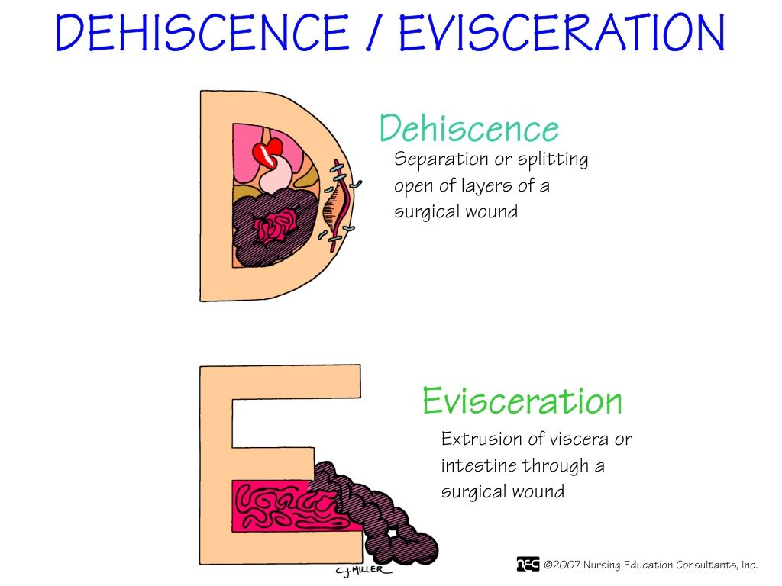
Dehiscence: partial or complete separation of wound edges
Evisceration: protrusion of organs through the surgical incision
Key Definitions

Slide 115
Postoperative phase: begins with the admission of the patient to the PACU and ends with a follow-up evaluation in the clinical setting or home
Postoperative Nursing

Slide 116
Phases of Postanesthesia Care
- Phase 1 PACU: immediate recovery phase, intensive nursing care provided
- Phase 2 PACU: can be located in PACU or inpatient setting; this phase consists of preparing the patient for self-care or extended care setting
- Phase 3 PACU: prepared for discharge
Admitting the Patient to the PACU
- Responsibility of the anesthesiologist or CRNA
- Transportation involves considering the surgical incision
Nursing Management in the PACU
- Provides care until patient recovered from effects of anesthesia
Care of the Patient in the Postanesthesia Care Unit (PACU)

Slide 117
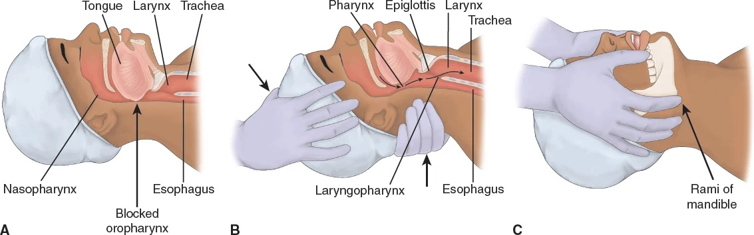
Airway
Respiratory Function
Cardiovascular Function
Skin Color
LOC
Neuro
Vital Signs
Surgical Site – drainage and/or hematoma
*Hemorrhage*
Assessing the Patient

Slide 118
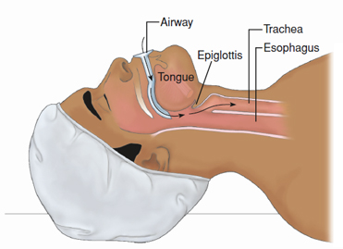
Maintain a Patent Airway
- Primary objective in PACU is to maintain ventilation to prevent hypoxia and hypercapnia
- Patient lying on back can cause hypopharyngeal obstruction
- Artificial Airways can be used
- Oxygen Delivery Devices
Maintaining a Patent Airway

Slide 119
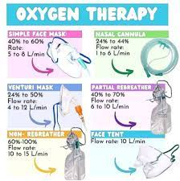
What will you use if the patient is hypocapnic?
What will you use if the patient is hypercapnic?
What will you use if the patient needs pressure?
What if the patient isn’t breathing on their own?
Maintaining a Patent Airway

Slide 120
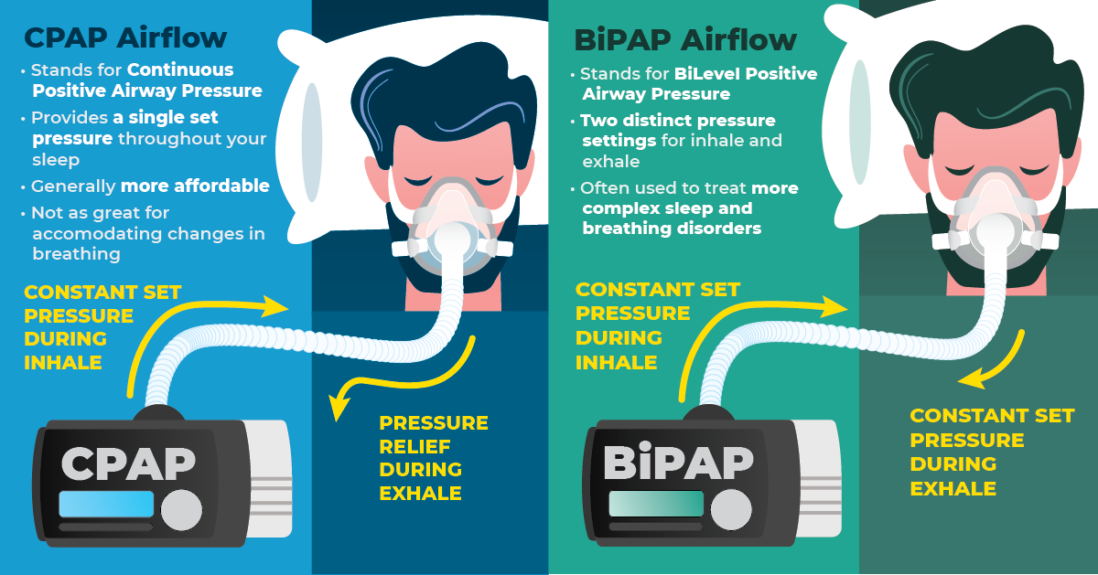
Maintaining a Patent Airway

Slide 121
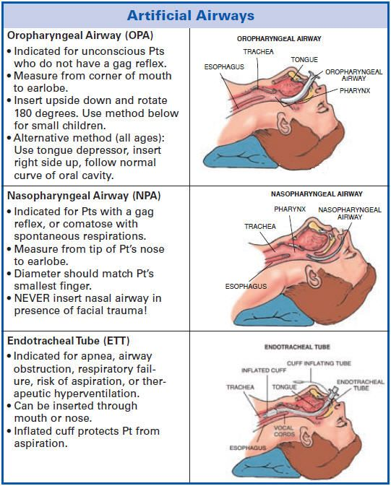
Maintaining a Patent
Airway
- OPA
- NPA
- ETT

Slide 122
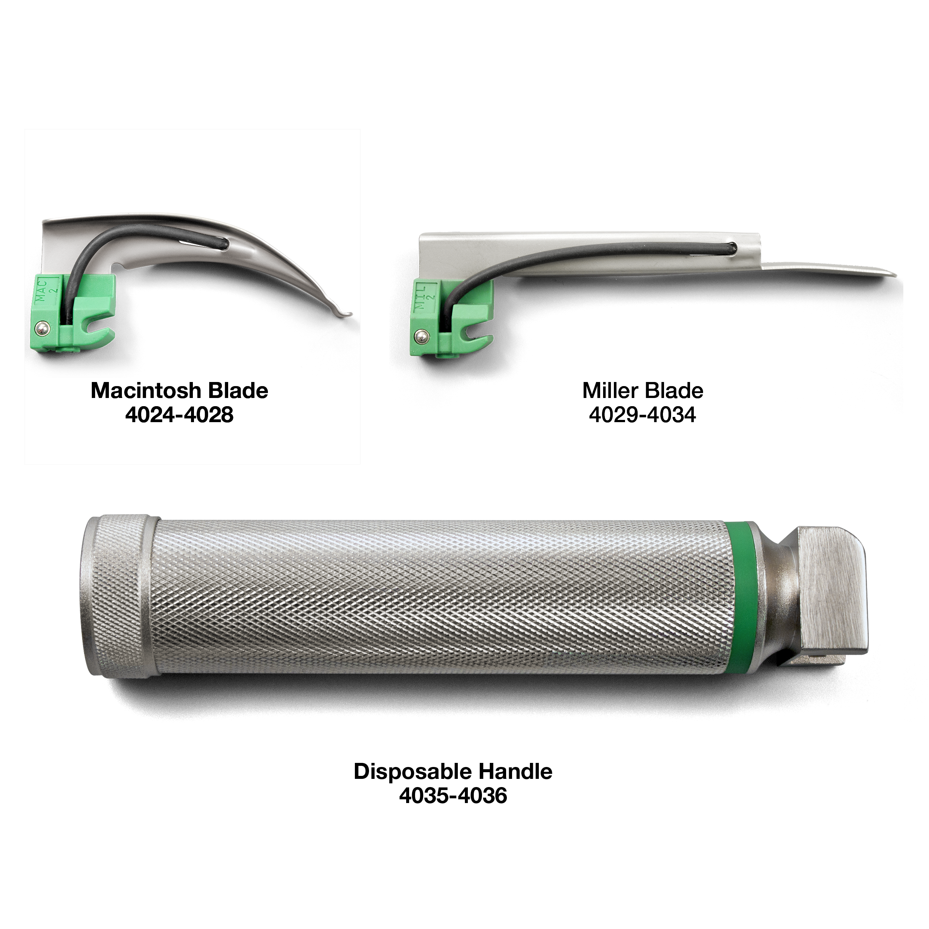
Intubation
- Indications for intubation (NOT BREATHING)
- Poor oxygenation and/or ventilation
- Airway protection
- Prolonged course:
- Worsening respiratory failure
- Sepsis
- ARDS
- Profuse hemoptysis
- Contraindications
- Severe Airway Trauma
- Airway Obstruction
- Severe laryngeal edema
Maintaining a Patent Airway

Slide 123
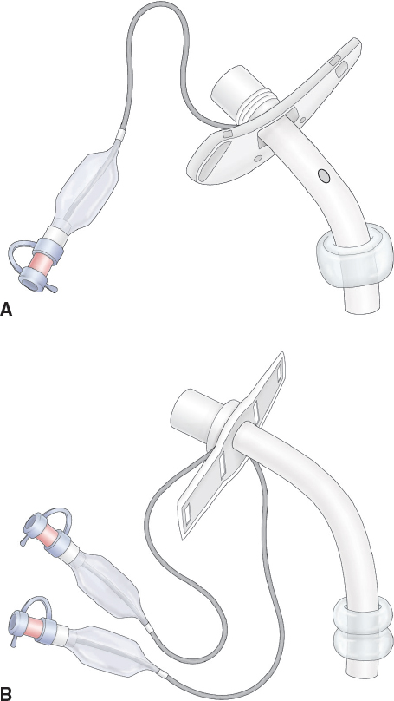
Intubation
-Inserting ET Tube
- Management of ETT
- Assess for bilateral lung sounds
- Sedation and Paralytic
- Ventilator
- ABG’s for further monitoring of respiratory status
Maintaining a Patent Airway

Slide 124
Intubation
- Ventilator Settings:
- Mode of Ventilation: assist control, pressure control, synchronized intermittent mandatory ventilation (SIMV), and pressure support (patient’s breathing on own)
- Tidal Volume: 6 to 8 mL/kg, average person around 500mL
- Rate: breaths per minute
- FiO2: percent oxygen (Room Air is 21%)
- PEEP: positive end-expiratory pressure, normal person is +5 cm in airways
- Pressure Support: when patient takes own breath, vent adds a boost of air to enhance volume
Maintaining a Patent Airway

Slide 125
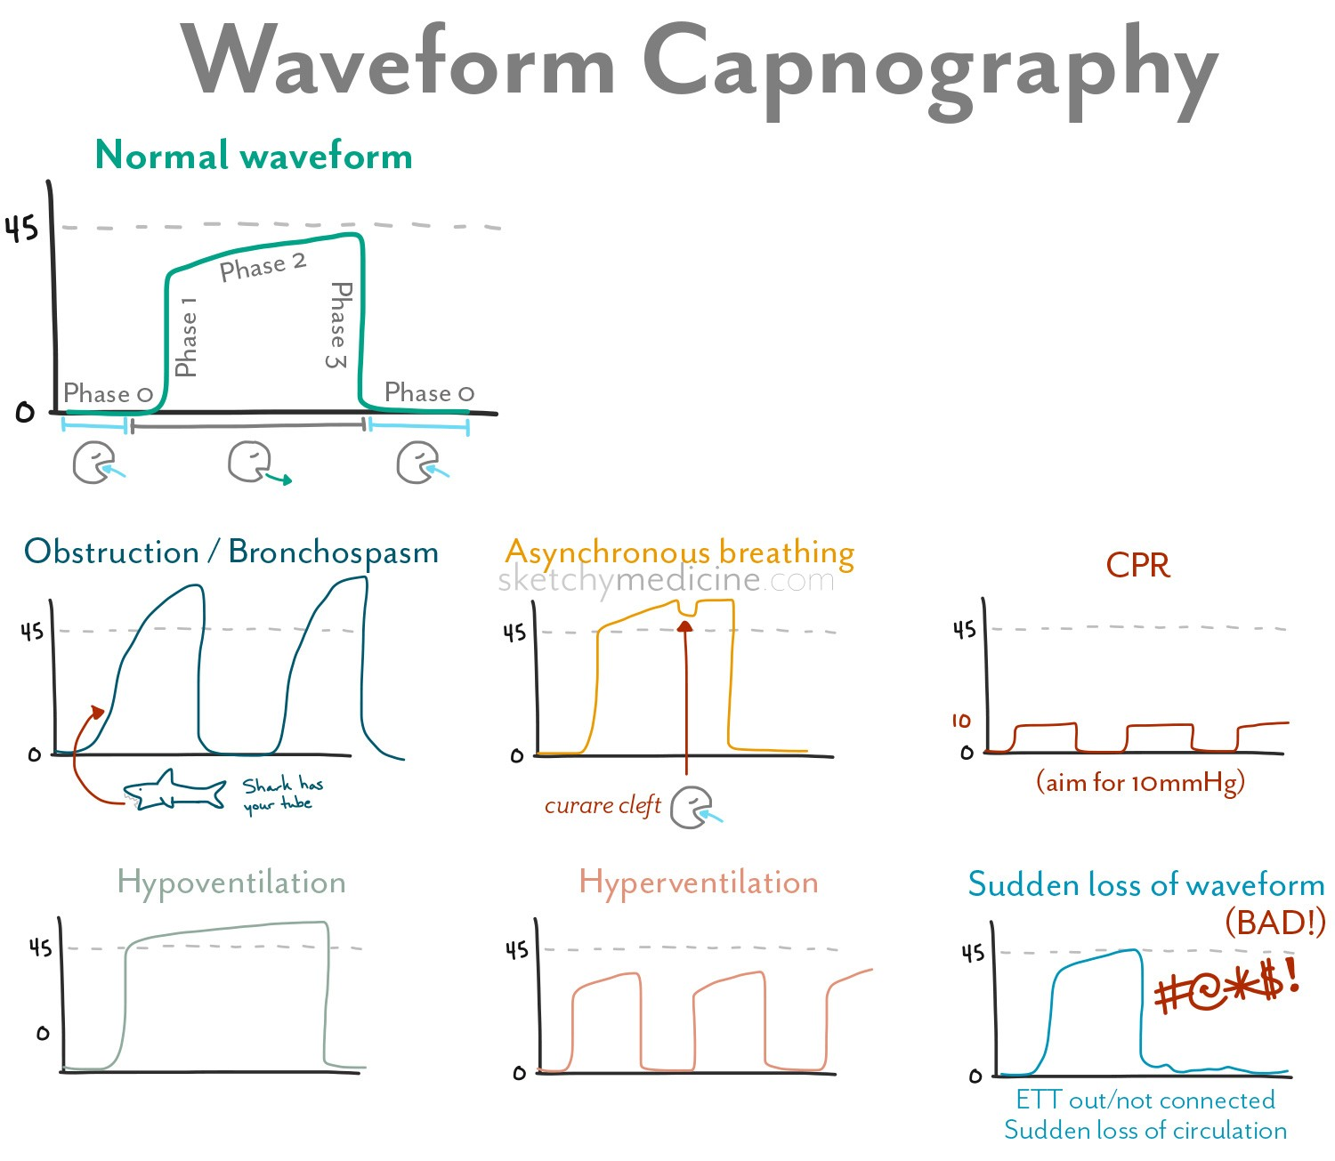
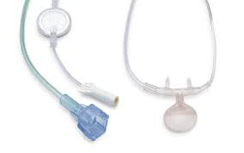
Intubation
- Capnography monitors
CO2 released in exhaled air
- Patient’s becoming acidotic
- CO2 should be 35-45
Maintaining a Patent Airway

Slide 126
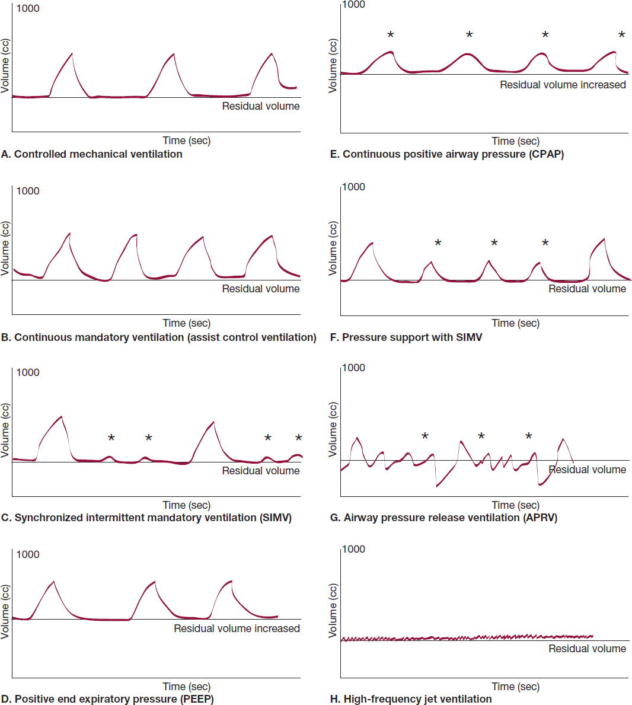

Slide 127
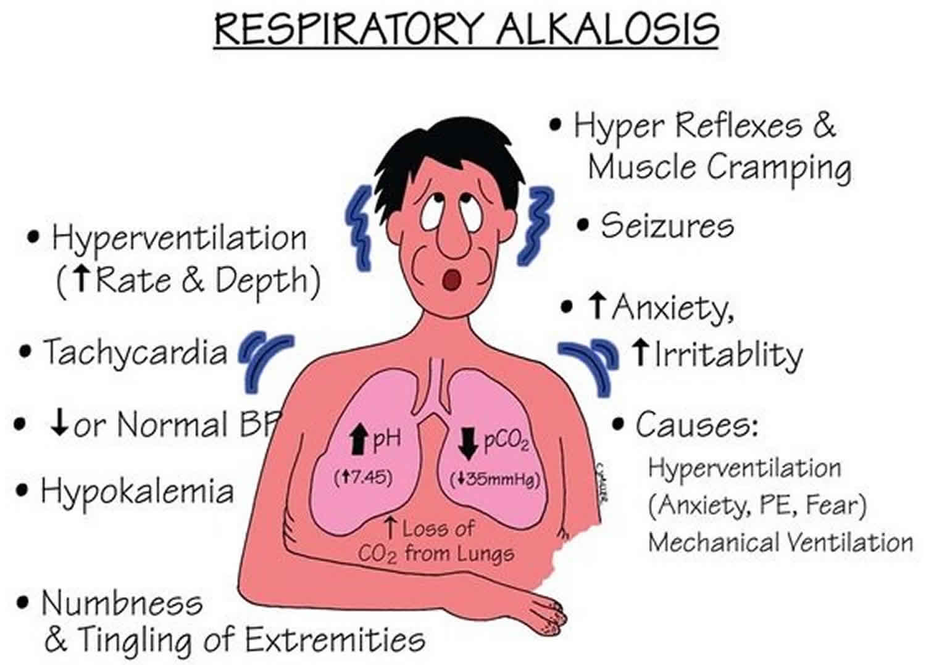
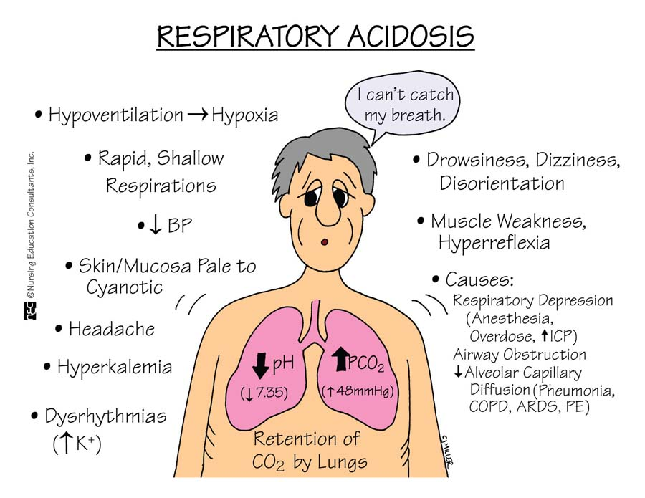

Slide 128
Maintaining Cardiovascular Stability
- Monitor CV Status
- Assess patency of IV lines
- Common Issues: hypotension, shock, hemorrhage, hypertension, dysrhythmias
Relieving Pain and Anxiety
- Assess for comfort
- Controlling the Environment
- Administer Analgesics as indicated
- Family Visitation
Controlling nausea / vomiting
Care of the Patient in the PACU

Slide 129
Outpatient / Direct Discharge
- Discharge planning and discharge assessment
- Provide written and verbal instructions regarding follow-up care, complications, wound care, activity, medications, and diet
- Give prescriptions and phone numbers
- Discuss actions to take if complications occur
- Give instructions to the patient and an adult who will accompany the patient
- Patients are not to drive home or be discharged to home alone
Care of the Patient in the PACU

Slide 130
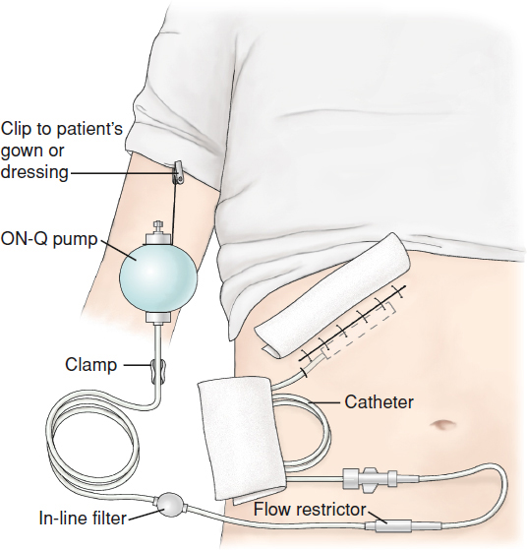
Potential Complications
- DVT
- Hematoma
- Infection
- Wound Dehiscence
- Wound Evisceration
- On-Q Pump: SQ Continuous Administration of Pain Medication
Care of the Hospitalized Postoperative Patient

Slide 131
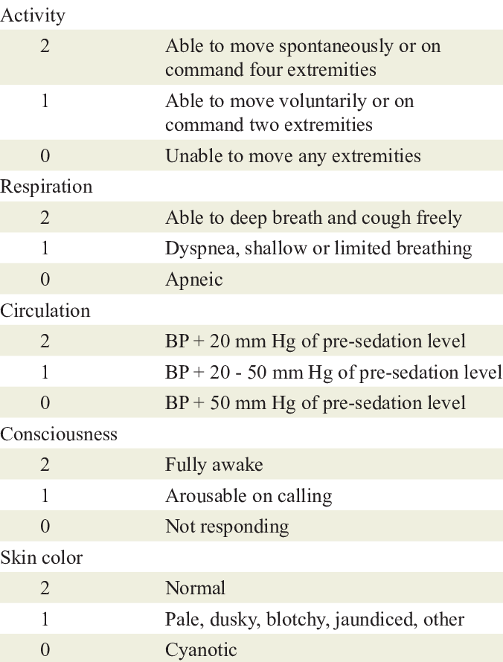
Assessment: Aldrete Score
Goal: 8 or above
Nursing Process:
The Hospitalized Patient Recovering From Surgery

Slide 132
Assessment:
- Vital Signs
- Respiratory Status
- Pain Management
- Neurological Status
- Surgical Site Management
Nursing Process:
The Hospitalized Patient Recovering From Surgery
Diagnosis:
- Risk for Ineffective Airway Clearance
- Acute Pain
- Decreased Cardiac Output
- Risk for Activity Intolerance
- Impaired Skin Integrity
- Risk for Imbalanced Nutrition
- Risk for Constipation
- Risk for Urinary Retention
- Risk for Injury
- Anxiety
- Deficient Knowledge

Slide 133
Planning / Goals:
- Optimal Respiratory Function
- Optimal Cardiovascular Function
- Increase in Activity
- Wound Healing (never change dressing without physician order)
- Normal thermo regulation
- Nutritional Balance
Nursing Process:
The Hospitalized Patient Recovering From Surgery
Interventions:
- Preventing Respiratory Compromise
- Relieving Pain
- Promoting Cardiac Output
- Encouraging Activity
- Maintaining Normal Body Temperature
- Managing GI Function and Resuming
Nutrition
- Promoting Bowel Function
- Managing Voiding
- Maintaining a Safe Environment
Evaluation:

Slide 134
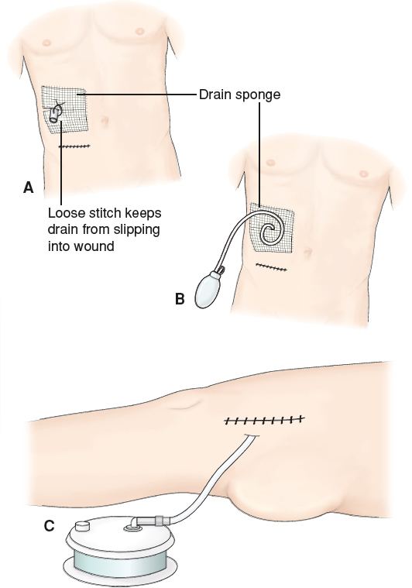
Postoperative Complications
- Respiratory: Atelectasis, PNA, PE,
Aspiration
- Cardiovascular: Shock, Thrombophlebitis
- Neuro: Delirium, Stroke
- Skin: Breakdown, Infection, Dehiscence,
Evisceration, Hemorrhage, Hematoma
- GI: Constipation, Paralytic Ileus,
Obstruction
- Urinary: Retention, Infection
- Functional: Weakness and Decline
Nursing Process:
The Hospitalized Patient Recovering From Surgery

Slide 135
A nurse is reviewing the medical records of several clients in the PACU to identify risk factors that can lead to postoperative complications. Which of the following clients are at risk for complications? SATA
A client who has a WBC of 22,500/uL
A client who uses an insulin pump
A client who takes warfarin daily
A client who has heart failure
A client who has a BMI of 26

Slide 136
A nurse is caring for a client who manifests indications of hypovolemia while in the PACU. Which of the following findings requires action by the nurse? SATA
Urine output less than 25 mL/hr
Hematocrit 53%
BUN 24 mg/dL
Tenting of skin over the sternum
Apical pulse rate of 62/min

Slide 137
A nurse is caring for a client who arrived in the PACU following a total hip arthroplasty. The client is not responding to verbal stimuli. Which of the following interventions should the nurse perform first?
Compare and contrast the peripheral pulses
Apply a warm blanket
Assess dressings
Place the client in lateral position

Slide 138
A nurse is planning care for a client to prevent postoperative atelectasis. Which of the following interventions should the nurse include in the plan of care? SATA
Encourage use of the incentive spirometer every two hours
Instruct the client to splint the incision when coughing and deep breathing
Reposition the client every two hours
Administer antibiotic therapy
Assist with early ambulation

Slide 139
A nurse is caring for a client who reports nausea and vomiting two days postoperative following a hysterectomy. Which of the following actions should the nurse perform first?
Assess bowel sounds
Administer antiemetic medication
Restart prescribed IV fluids
Insert a prescribed nasogastric tube

