Slide 1
Topics in Nursing
NUR 332

Slide 2
Course Outline
Week | Date/ Time | Material/Assigned Readings | Assignments
1 | 10/15 0900-1200 | Ch 1: Wellness Nutrition Ch 2: Personal and Community Nutrition Ch 3 (Hinkle): Health Education and Health Promotion
2 | 10/22 * | Ch 3: Digestion, Absorption, Metabolism Ch 4: Carbohydrates Ch 5: Fats
3 | 10/29 | Ch 6: Protein Ch 7: Vitamins | Exam 1 (Ch 1-5) Therapeutic Food Plan Presentation
4 | 11/5 | Ch 8: Water and Minerals Ch 9: Energy, Weight and Fitness
5 | 11/12 | Ch 10: Nutrition across the Lifespan Ch 11: Nutritional Assessment and Patient Care Ch 12: Food-Related Issues | Therapeutic Food Plan Presentations
6 | 11/19 | Ch 13: Nutrition for Disorders of the GI Tract | Exam 2 (Ch 6-12) Practice ATI opens Therapeutic Food Plan Presentations
7 | 11/26 | Ch 14: Nutrition for Disorders of the Liver, Gallbladder, and Pancreas Ch 15: Nutrition for Diabetes Mellitus | Genetic Diet Teaching Plan due by 11/19, 11:59 PM
8 | 12/3 | Ch 16: Nutrition in Metabolic Stress: Burns, Trauma, and Surgery Ch 17: Nutrition for Cardiopulmonary | Practice ATI sitting
9 | 12/10 | Ch 18: Nutrition for Diseases of the Kidneys | Exam 3 (Ch 13-17)
10 | 12/17 | Ch 19: Nutrition for Neuro-Psychiatric Disorders Ch 20: Nutrition in Cancer and HIV/AIDS | Proctored ATI (Practice ATI remediation due) Therapeutic Food Plan Presentations
11 | 12/24 |  | Proctored ATI remediation due
12 | 1/7/2027 |  | Cumulative Final Exam Therapeutic Food Plan Presentations

Slide 3
Grade Evaluation
Residential Grading Scale Category | Percentage
Exams (3)* | 48%
Comprehensive Final Exam* | 20%
Proctored ATI Exam & Remediation | 10%
Genetic Dietary Teaching Plan | 12%
Therapeutic Food Plan Presentation | 10%
Total | 100%

Slide 4
Genetics Teaching Plan
Design a teaching plan (from the nurse perspective for a client), which includes dietary alterations required for a specific genetically transmitted disease.
Part 1: Narrative discussion:
  APA style, double spaced, appropriate title page and reference list. No abstract.
  Causes, signs and symptoms, and treatment of the genetic disorder, with a heavy emphasis on dietary
  Target audience, discussing their unique characteristics, based on developmental level, any sensory deficits, cognitive level (The target audience can be parents of the child or an adult caregiver.)
  Teaching strategies discussion on how they were chosen based on resources available, content. Also discuss target audience characteristics, that is, discuss how teaching strategies are developmentally appropriate and matched to the learner’s sensory deficits as applicable, cognitive level, and preferred learning style. See rubric for details.
  Identify the standard (overall outcome)
  Identify at least two public information resources for client related to this genetic disorder, and provide a description and complete information to access these resources within the body of the teaching plan

Slide 5
Genetics Teaching Plan
Part 2: Teaching Plan Tool- (See form.) The plan should include:
  Target Clients
  Topic
  Standard- (overall outcome)
  One column for each of the following:
    Goal 1: Client will learn how the disease was genetically transmitted
    Goal 2: The client will learn dietary measures appropriate for the condition
    Goal 3: The client will learn what resources are available locally
  Two learning objectives for each goal (6 objectives all together) content to be covered for each objective- includes the narrative used to teach the client
  Materials needed and time allotment to meet objectives
  Teaching-learning strategies
  Evaluation
  Teaching tool table is single spaced.

Slide 6
Genetics Teaching Plan Topic Ideas
Down Syndrome
Cystic Fibrosis
Sickle Cell Anemia
Huntington’s Disease
Phenylketonuria
Fragile X Syndrome
Tay Sachs Disease
Galactosemia
Maple syrup urine disease
Glycogen storage disease
Familial hypercholesterolemia
Prader-Willi syndrome
Congenital lactose intolerance
Hemochromatosis
Glucose-6-Phosphate Dehydrogenase (G6PD) Deficiency

Slide 7
FORMAT FOR TEACHING TOOL
Goals-3 | Objectives 2 for each goal | Content to be taught for each objective -worded the way it should be discussed with the client | Materials and Time allotment | Teaching/Learning Strategies | Method of Evaluation
The client will:
1 | 1a 1b
2 | 2a 2b
3 | 3a 3b
Target Clients:
Topic:
Standard (Overall Outcome)

Slide 8
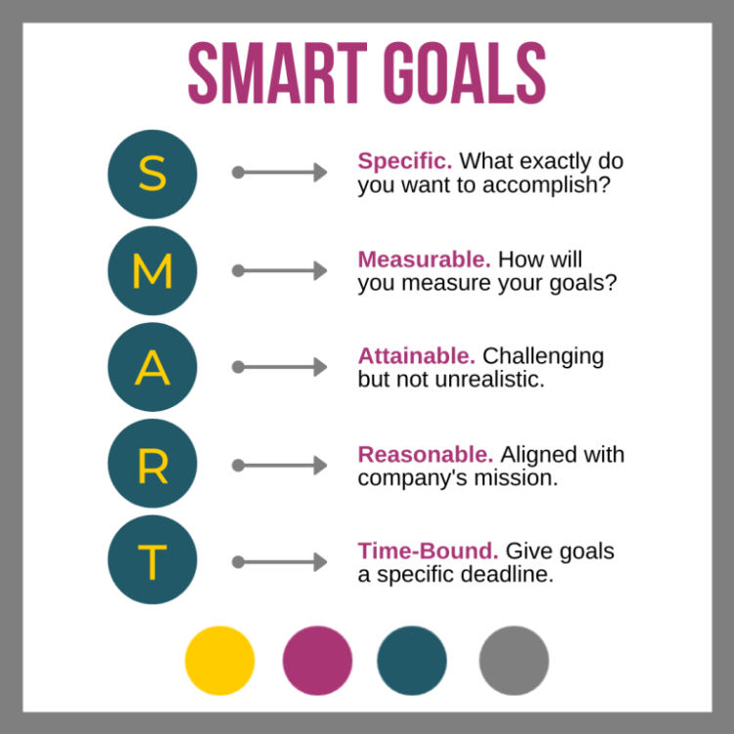
SMART Goals

Slide 9
Teaching Tool Example
Goal 1: By the end of the month, the client will demonstrate effective dietary management of PKU by accurately identifying and incorporating safe food choices into their daily meals. | 1a: Within the next two weeks, the client will create a categorized list of at least 15 safe and unsafe protein sources for PKU, using a visual chart, and will review it with the dietitian to ensure understanding. 1b: By the end of the month, the client will plan and prepare a week's worth of meals that incorporate at least five safe protein sources, demonstrating the ability to make informed dietary choices that align with their PKU management plan. | 1a. "Let’s start by identifying safe and unsafe protein sources for PKU. We’ll review the guidelines and look at common foods, including both animal and plant-based options. We’ll also discuss why certain foods are considered safe or unsafe, focusing on their phenylalanine content.“ 1b: "Now, let’s focus on meal planning. We’ll go over how to incorporate the safe protein sources you identified into balanced meals. We’ll also discuss portion sizes and how to read labels to check for hidden sources of phenylalanine." | 1a: PKU dietary guidelines Lists of safe and unsafe protein sources. Chart/worksheet templates Writing materials (pens, markers) Time Allotment: Discussion: 20 minutes Research & Compilation: 30 minutes Chart Creation: 20 minutes 1b Meal planning templates Recipes featuring safe protein sources PKU-friendly cookbooks or resources Digital tools (optional) for meal planning Meal Planning Discussion: 20 minutes Recipe Review & Selection: 30 minutes Meal Prep Demonstration (if applicable): 30 minutes | 1a: Interactive discussion to engage the client Collaborative brainstorming using sticky notes Visual organization of information through charts 1b Step-by-step guidance through meal planning Hands-on practice with meal prep Encourage questions and sharing personal preferences | 1a: Review the completed chart/list together Assess understanding through questions and discussion 1b Review the planned meals together Ask the client to explain their choices and how they align with PKU management Follow-up on meal preparation in the next session

Slide 10
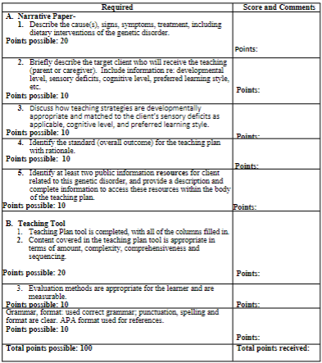
Genetics Teaching Plan Rubric

Slide 11
Therapeutic Food Plan Presentation
Objective:
In this group presentation, students will collaboratively explore a specific disease process related to nutrition, focusing on its underlying pathology, associated symptoms, therapeutic dietary interventions, potential barriers to adherence, and public resources for support. Each group will be evaluated based on the comprehensive coverage of the required content outlined in the grading rubric.
Presentation Outline
Disease Process Overview (20 Points)
  Each group will select a disease, such as Celiac Disease, and provide a brief overview of its underlying pathology. This will include an explanation of how the disease affects nutritional absorption and overall health.
Signs and Symptoms of Untreated Pathology (20 Points)
  The group will detail the signs and symptoms that clients may experience if the condition is left untreated. This section will help highlight the importance of early intervention and dietary management.
Key Elements of the Therapeutic Diet (20 Points)
  Students will identify at least three critical components of the therapeutic diet related to the chosen disease. They will provide examples of foods that are allowed and those that should be avoided, using visuals to enhance understanding.
Barriers to Adherence (10 Points)
  The group will discuss at least two potential barriers clients might face in adhering to the therapeutic diet. This could include social, economic, or educational challenges that impact dietary choices.
Public Information Resources (5 Points)
  Each group will identify at least two reliable public information resources that provide additional support for clients managing their condition. Complete information, including descriptions and URLs, will be provided for easy access.
Presentation Technique and Cohesiveness (15 Points)
  Presentations will be given in Week 12 following the Final Exam. The presentation will be evaluated on its overall cohesiveness and professionalism. Group members should dress in business casual attire and engage the audience using at least one additional teaching technique, such as a game or handouts, alongside their PowerPoint presentation.

Slide 12
Therapeutic Food Plan Presentations
**No more than 5 students per topic**
GERD
Celiac disease
Crohn’s disease
Pancreatitis
Major burns
Hyperlipidemia
Hypertension
Cystic fibrosis
Lactose intolerance
Chronic kidney disease
Epilepsy (ketogenic diet)
Diabetes
Dumping Syndrome s/p gastric bypass
Peptic Ulcer
Irritable Bowel Syndrome (low FODMAP diet)
Phenylketonuria
Iron deficiency Anemia

Slide 13
Reminders
You must obtain a 77% Class Grade for successful completion
You must also obtain a 77% Exam Average (Exam 1, Exam 2, Exam 3, and Final Exam)
Late Submission will receive a 10% penalty per day
Not taking exam at scheduled date/time will also result in grade reduction. Please see your student handbook.
Practice ATI remediation due prior to the Proctored Final ATI. At this time, this is scheduled to open in Week 4. Practice ATI may be completed from home or on campus. This decision will be dictated by school administration.
Practice ATI remediation binders will be due in week 10. Please no late binders. Binders will be collected before the start of the proctored ATI.
Proctored ATI remediation binders due before final exams.

Slide 14



Wellness nutrition
Grover Chapter 1

Slide 15
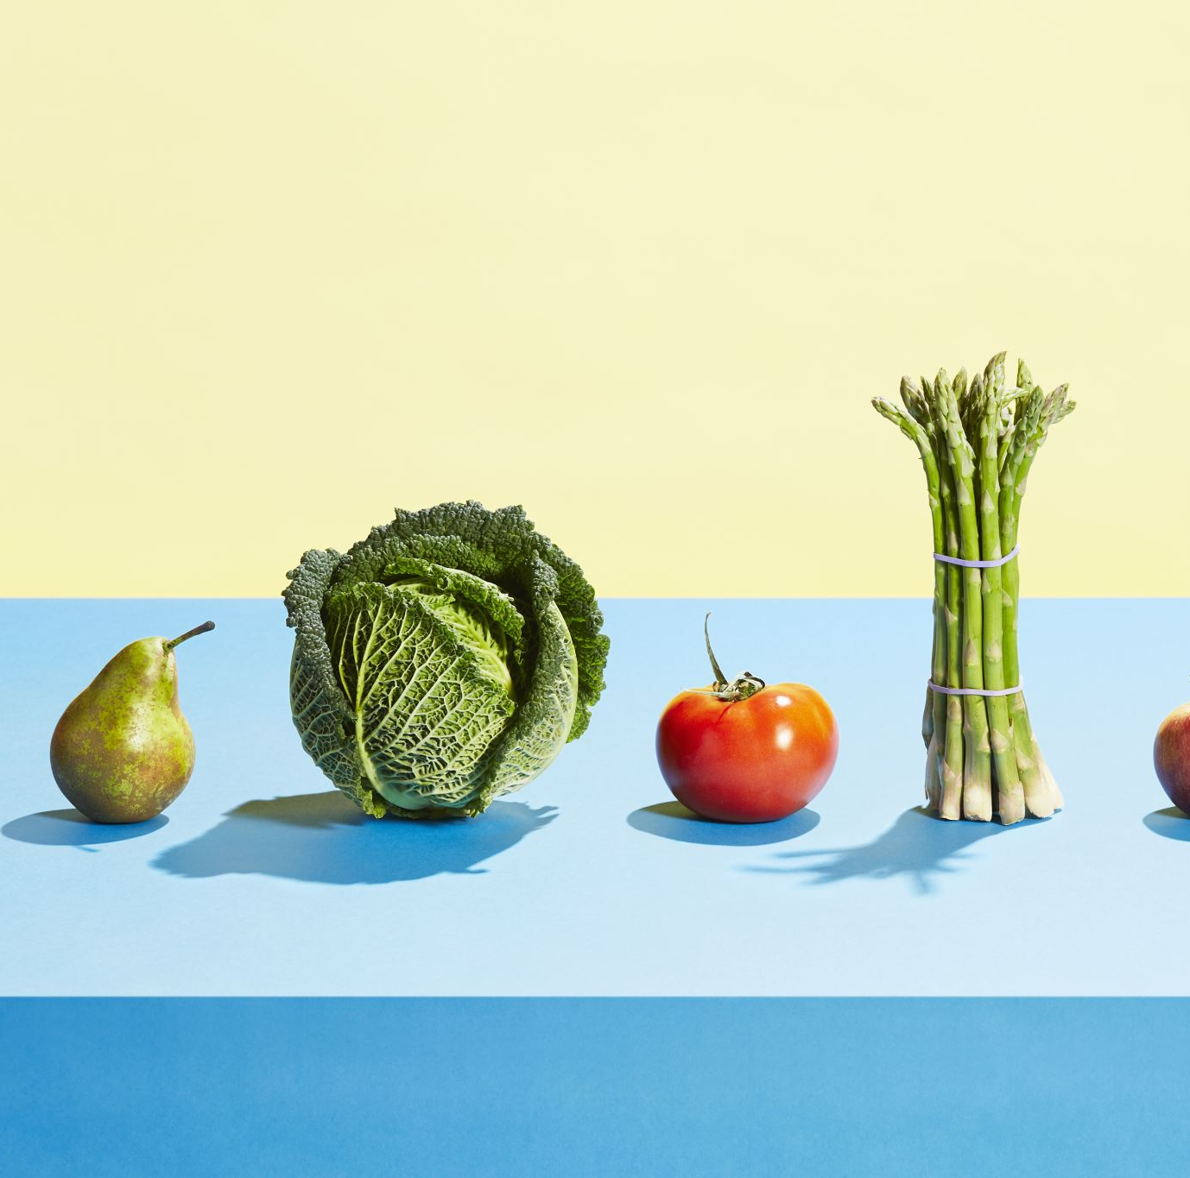
Objectives
Define health and wellness.
Describe health promotion.
State the purpose of Healthy People 2020 (HP2020).
Describe health literacy.
Identify the six nutrient categories.
List the functions of essential nutrients.

Slide 16

Defining health and wellness
Traditional health definitions focused on the absence of disease, but modern perspectives include broader aspects of well-being.
“Health is a state of complete physical, mental, and social well-being and not merely the absence of disease and infirmity.” (WHO, 1946)
“Health is a quality of life involving social, emotional, mental, spiritual, and biologic fitness on the part of the individual, which results from adaptations to the environment.” (Dubos, 1968)

Slide 17
The Multiple Dimensions of “Health”
Physical Health: The body’s ability to function and meet energy needs.
Intellectual Health: Ability to learn and adapt.
Emotional Health: Appropriate expression of emotions.
Social Health: Maintaining relationships.
Spiritual Health: Beliefs that give purpose to life.
Environmental Health: The influence of external factors like living conditions and natural resources.

Slide 18
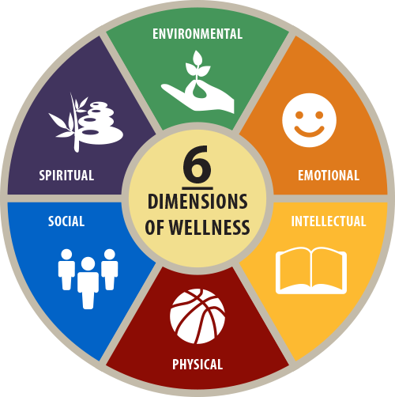
“Wellness” is a lifestyle (pattern of behaviors) that enhances our level of health.
How might nutrition affect or be affected by each of these dimensions of health?

Slide 19
wellness
Wellness is a lifestyle (pattern of behaviors) that enhances one’s level of health
A holistic approach to health, balancing physical, mental, emotional, social, and spiritual well-being.
Individuals engaged in wellness lifestyles feel a sense of competency and achievement in their ability to modify their behaviors to increase or maintain positive levels of health.
Focuses on achieving overall health and quality of life.
Wellness nutrition approaches food consumption as a positive way to nourish the body
Emphasizes balanced nutrition to support optimal health and bodily functions.
Aims to enhance energy, well-being, and prevent chronic diseases.
Health promotion consists of strategies used to raise the level of the health of individuals, families, groups, and communities
Involves efforts to empower individuals and communities to improve health.
Focuses on education, behavior change, policy advocacy, and creating healthy environments.

Slide 20

Healthy people 2030
Vision: A society in which all people can achieve their full potential for health and well-being across the lifespan.
Mission: To promote, strengthen, and evaluate the nation’s efforts to improve the health and well-being of all people.
Overarching Goals
  Attain healthy lives free of preventable diseases, injuries, and premature deaths.
  Eliminate health disparities and achieve health equity.
  Create supportive social, physical, and economic environments.
  Promote healthy behaviors across all life stages.
  Engage leadership and the public to take action and design policies for improving health.

Slide 21
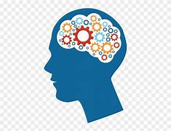
Knowledge Check
Which of the following best describes wellness?
  A. The absence of disease
  B. A lifestyle that enhances one's level of health
  C. Maintaining social health only
  D. Meeting nutrient requirements through supplements

Slide 22
Disease prevention through nutrition
Primary Prevention: Aims to prevent disease before it occurs by adopting healthy lifestyle habits, such as a balanced, low-fat, high-fiber diet to avoid nutrient deficiencies and prevent diet-related diseases.
Secondary Prevention: Focuses on early detection and control of existing diseases. For example, reducing sodium intake to manage hypertension can prevent complications like coronary artery disease or stroke.
Tertiary Prevention: Aims to minimize further health complications in patients with existing conditions. Dietary modifications are common in managing chronic diseases like coronary artery disease, ulcers, and cancer.

Slide 23

Health literacy and disease prevention
Health literacy is the ability to acquire, comprehend, communicate, and apply basic health information and services, such as nutrition, and apply them to one’s own health decisions
Health literacy develops through education on topics related to health promotion and illness.
Patients with low health literacy are more likely to:
Visit and emergency room
Have more hospital stays
Have less compliance with treatment plans
Have higher mortality rates
Challenges in Health Literacy:
Limited health literacy affects patients’ ability to understand medical information, fill out forms, and follow dietary or medication instructions.
Nurses should communicate clearly, taking into account literacy levels, cultural backgrounds, and numeracy/reading skills to ensure patients can follow health recommendations effectively.

Slide 24
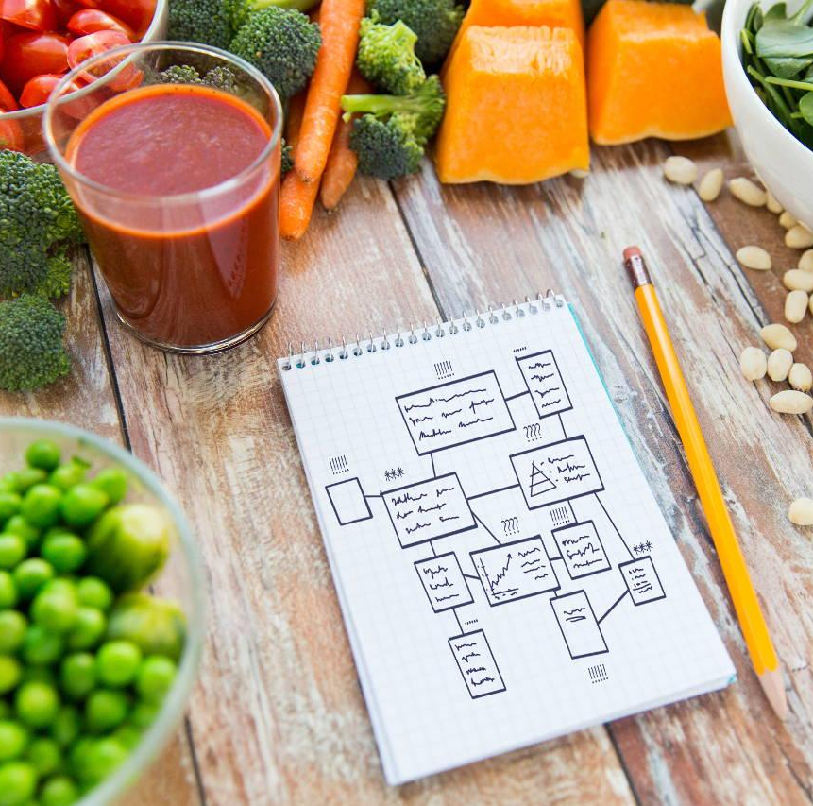
Modifying Nutrition Lifestyles
Patterns of behavior surrounding food choices create our nutrition lifestyles.
Nutrition lifestyles vary widely due to:
  Hectic work, school, or athletic schedules, where finding time to eat is challenging.
  Family influences that may not align with modern dietary recommendations
  Adjusting to new social settings, such as college, with limited food choices
Health professionals must be mindful of both their own nutrition and their clients' dietary habits.
  Nurses need good personal health to handle the demanding nature of their profession.
  A well-balanced diet supports physical stamina and overall well-being.
Promoting health involves educating individuals (clients) about nutrition to maintain or improve health.
  Nurses can influence positive behavior changes in clients by providing tailored, evidence-based dietary recommendations.
  Teaching clients self-management skills for nutrition can lead to long-term health benefits and disease prevention.

Slide 25

Knowledge check
A nurse is educating a client on disease prevention. Which of the following is an example of primary prevention?
  A. Reducing sodium intake to control hypertension
  B. Managing cholesterol levels after a heart attack
  C. Adopting a balanced diet to prevent nutrient deficiencies
  D. Using insulin to manage diabetes

Slide 26

Knowledge check
A patient with hypertension is advised to reduce sodium intake to prevent complications. Which type of disease prevention is this?
  A. Primary prevention
  B. Secondary prevention
  C. Tertiary prevention
  D. Health literacy

Slide 27
Nutrients
Nutrients can be divided into the following six categories:
  1. Carbohydrates
  2. Proteins
  3. Lipids (fats)
  4. Vitamins
  5. Minerals
  6. Water
Essential nutrients
  When the body requires a nutrient for growth or maintenance but lacks the ability to manufacture amounts sufficient to meet the body’s needs (carbs, vitamins, proteins, minerals, water)
Nonessential nutrients
  Nutrients the body can manufacture (vitamin D with sunlight exposure, some amino acids and cholesterol)

Slide 28
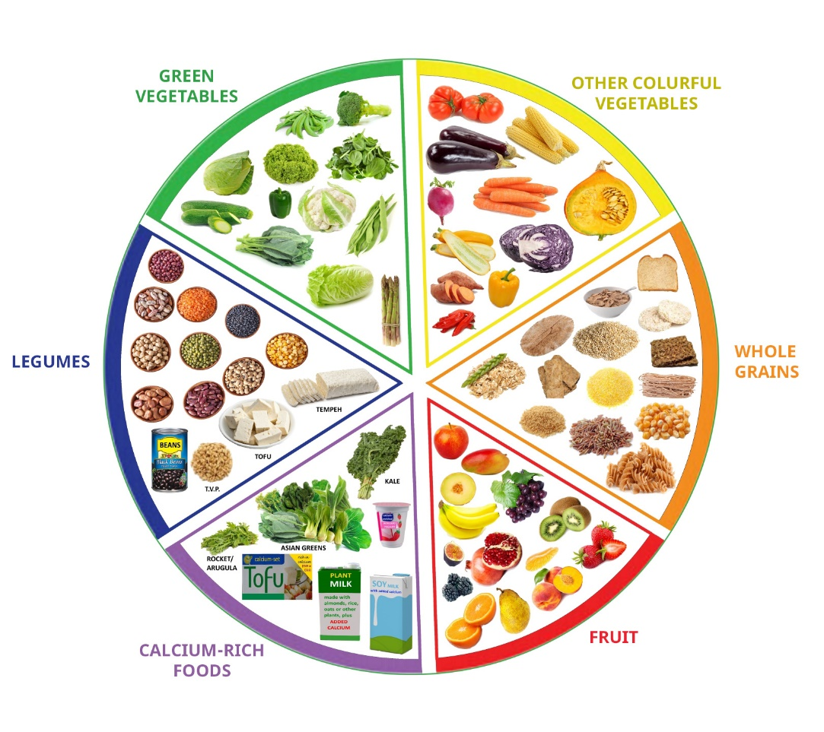
Functions of essential nutrients
Providing Energy:
  Carbohydrates, proteins, and lipids supply energy.
  Vitamins and minerals act as catalysts to help the body utilize these energy sources.
Regulating Body Processes:
  Proteins, lipids, vitamins, minerals, and water are necessary for regulating body functions.
  Each vitamin has a specific role in the regulation process.
Aiding Growth and Tissue Repair:
  Proteins, lipids, minerals, and water are essential for the growth and repair of body tissues.

Slide 29
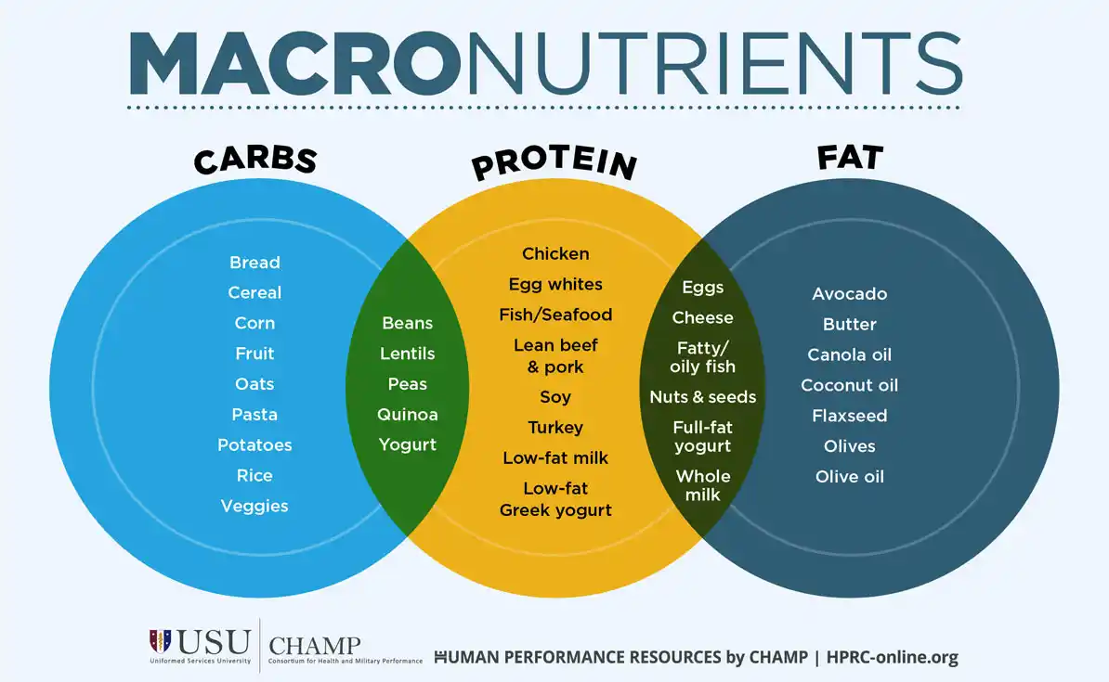
Energy yielding nutrients (Macronutrients)
Carbohydrates, proteins, and lipids (fats) are the main sources of energy. They are organic compounds, meaning they contain carbon and are produced by living things.
When these nutrients are oxidized (metabolized), they release energy, measured in kilocalories (kcal).
Carbohydrates:
  Function: Primary source of energy for the body, especially for the brain and muscles during exercise.
  4 kcal/gram
  Sources: Grains, fruits, vegetables, legumes, and sugars.
Proteins:
  Function: Essential for building and repairing tissues, making enzymes and hormones, and supporting immune function.
  4 kcal/gram
  Sources: Meat, poultry, fish, dairy products, legumes, nuts, and seeds.
Lipids (Fats):
  Function: Provide a concentrated source of energy, support cell structure, cushion organs, aid in the absorption of fat-soluble vitamins, and are involved in hormone production.
  9 kcal/gram
  Sources: Oils, butter, avocados, nuts, seeds, and fatty fish.

Slide 30

alcohol
Alcohol provides 7 kcal per gram but is not considered a nutrient because the body does not need it.
Excessive alcohol consumption is treated as a toxin, stressing the body and depleting essential nutrients.
Moderate alcohol consumption may have protective effects against heart disease due to beneficial phytochemicals, particularly in red wine.
Moderate intake is defined as:
  Up to 2 servings per day for men
  Up to 1 serving per day for women
One serving of alcohol equals:
  12 ounces of beer
  5 ounces of wine
  1.5 ounces of 80-proof spirits

Slide 31
Knowledge check
Match the following nutrients with the amount of energy they provide per gram:
Carbohydrate | 4 kcal/gram
Protein | 9 kcal/gram
Lipids | 4 kcal/gram
Alcohol | 7 kcal/gram

Slide 32
Knowledge check
Match the following functions with their primary nutrient: protein, lipids, or carbohydrates.
Play a crucial role in regulating blood sugar levels
Aid in the absorption of vitamins A, D, e, and K
Provide fiber which helps maintain gut health
Building blocks for muscle, enzymes, and hormones
Quickly converted into glucose, which is easily accessible for immediate energy needs
Aid in building and repairing tissues
Contributes to long-term energy reserves
Aid in immune function

Slide 33
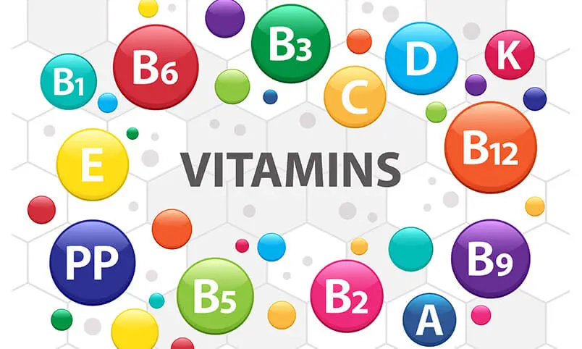
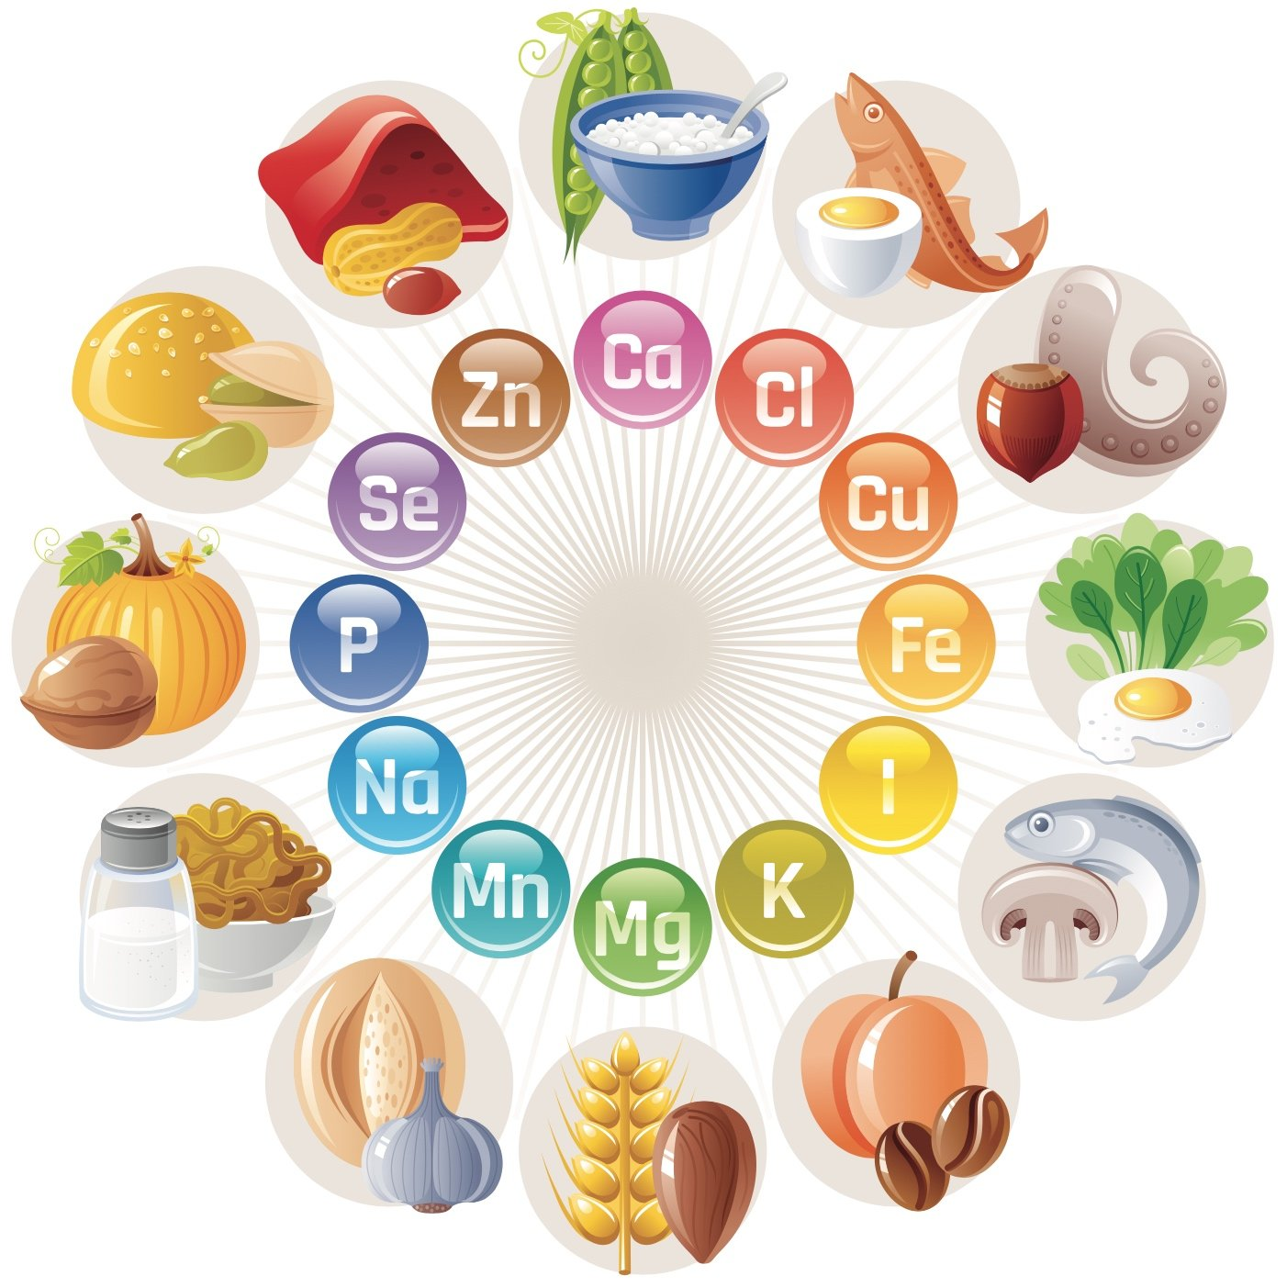
Micronutrients
Micronutrients are nutrients that are required in smaller amounts but are essential for various physiological functions and overall health.
Vitamins:
  Function: Organic compounds that support metabolism, immune function, and overall health. Each vitamin has specific roles in the body.
  Sources: Fruits, vegetables, dairy, meat, and grains.
Minerals:
  Function: Inorganic elements that contribute to bone health, fluid balance, nerve function, and muscle contraction.
  Sources: Fruits, vegetables, dairy, meats, and grains.

Slide 34
Overview of nutrients
Carbo-hydrates:
Main energy source, broken down into glucose for muscles & brain
Simple Carbs: Sugars in fruit, milk, honey
Complex Carbs: Found in grains, pasta, veggies
Aids digestion & prevents constipation
May lower risk of heart disease & colon cancer
Two types:
Fiber (non-digestible):
Proteins:
Provide energy & build key body structures (muscles, enzymes, hormones, immune cells)
Animal: Meat, fish, poultry, dairy
Plant: Grains, legumes, seeds, nuts, veggies
Excess protein is broken down for energy, stored as fat, or excreted
Made of 20 amino acids; 9 are essential (must get from food)
Sources:

Slide 35
Overview of nutrients
Lipids (Fats):
Most energy-dense nutrient in food and the body
Health Considerations
Functions:
Build cell structures
Aid hormone production
Cushion organs
Transport fat-soluble vitamins (A, D, E, K)
Excess saturated/trans fats and cholesterol raise blood lipid levels
Linked to heart disease and some cancers
Focus on healthy fats and limiting cholesterol for public health
Vitamins:
Help with digestion, absorption, metabolism, and waste removal
13 essential vitamins – don’t provide energy but help release it from food
Two types:
Water-Soluble: B vitamins + vitamin C
Fat-Soluble: A, D, E, K
Found in a variety of foods—especially fruits & vegetables
A diverse diet helps meet vitamin needs

Slide 36
Overview of nutrients
Minerals:
Support bones, teeth, fluids, muscles, and the nervous system
16 essential minerals, classified as:
Major and Trace – both vital
Found in fruits, veggies, dairy, meats, legumes
Note: Some minerals are lost in food processing (e.g., refining grains)
Water:
Vital for all body tissues; survival depends on it
Supports biochemical processes & nutrient transport
Daily need: ~9–13 cups from food & drinks
Plain water is healthiest and most cost-effective—better than bottled or fortified alternatives

Slide 37
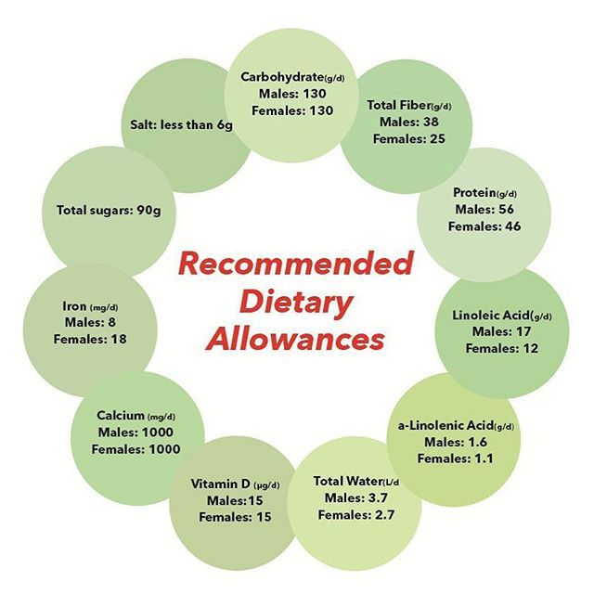
Dietary Reference intakes (DRI)
Modern Nutrient Standards
  Aim to prevent deficiency and reduce chronic disease risk
  Based on scientific data from U.S. & Canada
Key Guidelines
  EAR: Meets needs of 50% of population
  RDA: Meets needs of ~97–98% of healthy individuals
  AMDRs (macronutrient intake ranges):
    Carbs: 45–65% of daily kcal
    Fats: 20–35%
    Proteins: 10–35%

Slide 38
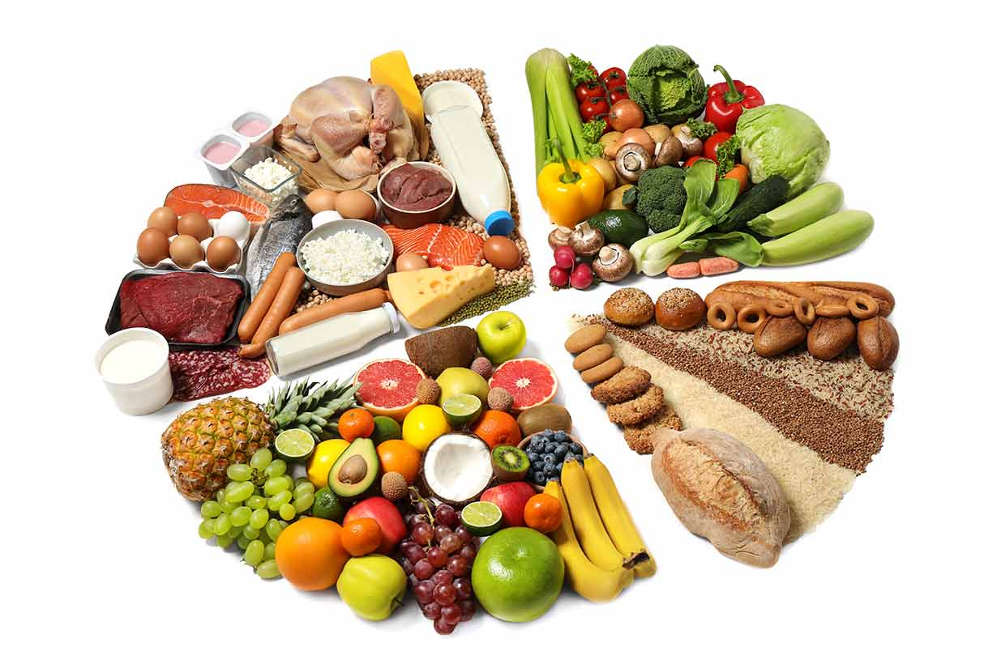
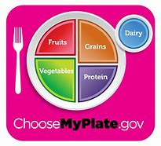
Adequate eating patterns- key components
Assortment:
  Eat a variety of foods from all groups
  Limited diets can lead to nutrient gaps or imbalances
Balance:
  Proportional intake from each food group supports nutrient harmony
  Tools like USDA’s MyPlate guide proper portions
  Ensures both energy and nutrient needs are met for overall health

Slide 39
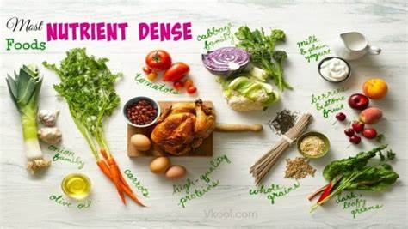
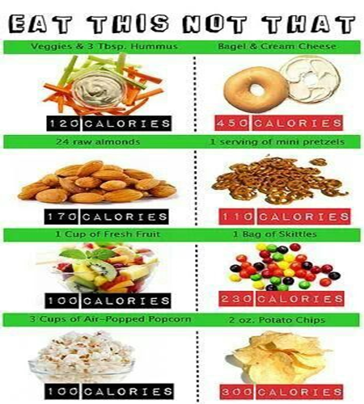
Adequate Eating patterns
Compares a food’s nutrient content to its calorie content
Nutrient-dense foods provide more vitamins, minerals, and beneficial compounds for fewer calories
Example: Orange juice has more nutrients than soda with similar calories
Choosing nutrient-dense foods supports better health without excess calories
Nutrient density

Slide 40
Imbalances in dietary intake
Undernutrition
Not enough energy or nutrients to meet DRI levels
May occur even with enough calories if nutrients are lacking
Example: Inadequate folate intake in women during childbearing years
Overnutrition
Excess energy/nutrients beyond DRI needs
Common in diets high in saturated fats
Linked to: Heart disease risk
Malnutrition
Imbalance of nutrient or calorie intake
Includes both undernutrition and overnutrition
Examples:
Obesity with poor nutrient quality
Restrictive diets with insufficient intake

Slide 41
Performing a Nutritional Analysis utilizing DRIs
Access the DRI calculator found at DRI Calculator for Healthcare Professionals | National Agricultural Library (usda.gov)
Fill in your information to calculate your personal DRI.
List your personal DRI recommendations for:
  Calories
  Carbohydrates and fiber
  Protein
  Fat
  Vitamins A, C, D
  Calcium, Iron, and sodium
Complete the table with a dietary recall of what you ate yesterday using the Nutrition Calculator at https://www.myfooddiary.com/
Add your totals, then fill in the third table comparing your intake to your DRI recommendations.
  Were there any areas that could use improvement?
  How might you adjust tomorrow’s diet to meet any deficiencies or overages identified in this activity?

Slide 42
Health education and health promotion
Hinkle Chapter 3

Slide 43
Introduction to Health Education
Health education is essential for individual and community wellness.
Helps prevent diseases
Helps prevent disease complications
Improves patient self-care
Nurses use teaching to help patients adopt healthy behaviors and lifestyles.
All patient interactions are opportunities for education.
Health education is directly linked to positive health outcomes.
Part of nursing scope of practice
Supports informed decision making and self-care
Promotes adherence to therapeutic regimens

Slide 44
Promoting Adherence
What factors might influence a patient’s adherence to their treatment plan?
Age, race, gender, SES, level of education
Religious or cultural beliefs
Illness variables
Complexity of regimen
Cost of care
Access to care
Support systems
Side effects
Perceived effect of treatment (or lack thereof)
Health literacy

Slide 45
Health Literacy
Health literacy: ability to obtain, understand, and use health information to make informed decisions about one’s health care
  Reading and comprehending medical instructions
  Navigating healthcare systems
  Understanding risks and benefits of treatment options
  Following care plans.
Patients with low health literacy may struggle with complex instructions, medical terminology, or managing their conditions, which can lead to poor health outcomes.

Slide 46
Nursing Methods to Improve Health Literacy
Using Plain Language
Simplify medical jargon, using common words and phrases that are easier to understand.
Teach-Back Method
Ask the patient to repeat the information in their own words to confirm understanding.
Use Visual Aids and Demonstrations
Use images, videos, or hands-on demonstrations to explain concepts like medication administration or wound care.
Consider Culturally Sensitive Communication
Consider the patient’s language, culture, and background to ensure the information is relevant and understandable.
Chunk Information
Provide information in smaller, manageable chunks instead of overwhelming the patient with too many details at once.
Provide Resources
Offer easy-to-read pamphlets or online resources that patients can refer to at home.

Slide 47
Motivation and Learning Readiness
Learning readiness influenced by:
Culture, emotions, physical and emotional status.
Create a positive, accepting environment for optimal learning.
Motivation is key to improving adherence.
Learning contract: collaborative agreement between an educator and a learner that outlines the learner's goals, strategies for achieving them, and criteria for success
Sets clear, achievable, personalized goals
Celebrates progress and enables reflection
Breaks learning into manageable steps
Encourages ownership and accountability
Boosts intrinsic motivation

Slide 48

Gerontologic Considerations in Adherence
Many hospital and nursing home admissions are associated with nonadherence.
Older adults often manage multiple chronic illnesses and numerous medications, with periodic acute episodes complicating their disease course.
Factors affecting adherence include:
  Increased sensitivity to medications and their side effects
  Difficulty adjusting to change and stress
  Financial constraints
  Forgetfulness
  Inadequate support systems
  Lifetime habits of self-treatment with over-the-counter medications
  Visual and hearing impairments
  Mobility limitations
  Cognitive impairment

Slide 49
Knowledge Check
A 67-year-old male with a history of hypertension is newly diagnosed with diabetes mellitus. He expresses concern about managing his medications and adhering to his diet. Which factor is most likely to influence his adherence to the treatment plan?
    A. Age
    B. Cultural beliefs
    C. Health literacy
    D. Support system

Slide 50
Knowledge Check
A nurse notices that an older adult patient with a history of nonadherence to medication schedules seems confused about their medication list. Which intervention would best address this issue?
    A. Simplify the medication regimen
    B. Ask the patient’s family to manage the medications
    C. Provide written instructions
    D. Recommend the patient use a pillbox organize

Slide 51
The Teaching- Learning Process
An active process requiring teacher-learner collaboration to drive behavior change.
Influenced by multiple factors:
Learning Readiness
Teachable Moment
Cultural & Personal Values
Physical & Emotional Readiness
Stress & Environment
Experiential Readiness

Slide 52

The Learning Environment
Optimization of Learning:
  Minimize factors that interfere with the learning process (e.g., room temperature, lighting, noise).
  Appropriate environmental conditions and functional assistive devices (glasses, hearing aids) are essential.
  Schedule teaching sessions according to the individual’s needs (avoid times of fatigue, discomfort, or anxiety).
Family Involvement:
  Schedule sessions when family members can participate in learning necessary skills or techniques.

Slide 53
Teaching Techniques
Lectures
Group teaching
Demonstration and practice
Motivational interviewing
Electronic resources
Printed teaching aids
Reinforcement and followup

Slide 54
Knowledge Check
A nurse is educating a patient about wound care. The patient seems confused but nods in agreement. What is the nurse’s next best action?
    A. Continue with the teaching plan
    B. Ask the patient to demonstrate the procedure
    C. Provide a pamphlet on wound care
    D. Re-explain using simpler language

Slide 55
Health Literacy Round Robin
Each group will have 5 minutes to discuss their assigned patient case study.
During this time, your goals are to:
Identify the barriers to health literacy specific to their patient.
Propose nursing interventions to address these barriers.
Jot down your identified barriers for each specific patient and appropriate nursing interventions. After 5 minutes, case studies will rotate to the next group.

Slide 56

Health Promotion
Healthy People 2030
  Sets national goals for health promotion, protection, and prevention
  Key Goals:
  Increase quality and length of healthy life
  Eliminate health disparities
Health Promotion
  Involves actions that support well-being, prevent illness, and improve quality of life
  Can occur independently or within health systems—no healthcare required
Purpose of Health Promotion
  Maximize individual wellness potential
  Promote healthy habits and lifestyle changes
  Recognize health as dynamic and self-directed
  Requires active personal commitment—not something prescribed

Slide 57
Key Components of Health Promotion
Self-responsibility
Nutritional awareness
Stress reduction and management
Physical fitness

Slide 58

Self-Responsibility
Personal accountability for one’s actions and lifestyle choices.
Individuals control their health by avoiding high-risk behaviors (e.g., smoking, substance misuse) and adopting healthy habits (e.g., exercise, healthy eating).
Techniques to Encourage Self-Responsibility:
  Public service announcements
  Educational programs
  Reward systems
Individualized Approach: Success depends on personal desires and motivations.

Slide 59
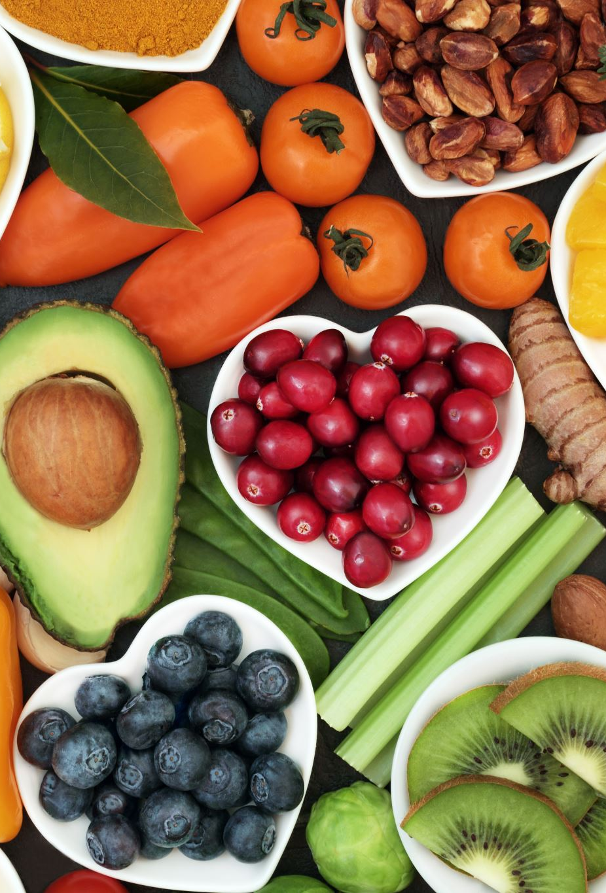
Nutritional Awareness
Understanding the significance of a balanced diet in maintaining health.
Research suggests that good nutrition is the single most significant factor in determining health status, longevity, and weight control
Increased attention due to obesity epidemic.
Key Aspects:
  Importance of essential nutrients.
  Relationship between diet and disease.
  Preference for natural foods over processed ones.
Encompasses assessment of nutritional status, dietary guidelines (e.g., MyPlate), body mass index calculations.

Slide 60

Stress Reduction and Management
Techniques and behaviors to strengthen resources against stress.
Recognizes the negative impact of stress on health and chronic illness.
Management Techniques:
  Relaxation training
  Exercise
  Yoga
  Modifying stressful situations

Slide 61
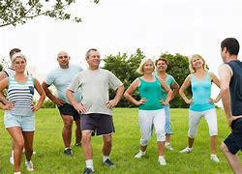
Physical Fitness
Benefits of Regular Exercise:
  Improves circulatory and lung function
  Lowers cholesterol and LDL levels
  Aids weight control by increasing calorie expenditure
  Delays degenerative changes (e.g., osteoporosis)
  Enhances flexibility, muscle strength, and endurance
Personalized Exercise Programs: Should consider age, physical condition, and health risks to avoid injury.

Slide 62
Health Promotion Strategies Throughout the Lifespan
Prenatal Period
Maternal Health: Promote healthy lifestyle choices for expectant mothers, including nutrition, exercise, and avoiding harmful substances (e.g., smoking, alcohol).
Prenatal Care: Encourage regular check-ups, screenings, and prenatal vitamins to ensure fetal health.
Childhood
Immunizations: Ensure adherence to vaccination schedules to prevent communicable diseases.
Nutrition Education: Teach healthy eating habits and the importance of balanced diets.
Physical Activity: Promote regular exercise and active play to support physical development.
Adolescents
Health Screening: Conduct routine health screenings (e.g., vision, hearing, BMI) to detect and address health issues early.
Risk Behavior Education: Address smoking, substance abuse, and risky sexual behaviors through comprehensive health education programs.
Self-Esteem and Values Training: Foster positive self-image and decision-making skills.

Slide 63
Health Promotion Strategies Throughout the Lifespan
Young Adults
Wellness Programs: Encourage participation in programs focused on nutrition, exercise, smoking cessation, and stress management.
Reproductive Health: Provide education on family planning, prenatal care, and health issues specific to men and women.
Mental Health Awareness: Promote resources for mental health support and stress management.
Middle-Aged Adults
Chronic Disease Prevention: Emphasize the importance of screenings for hypertension, diabetes, and cholesterol levels.
Lifestyle Modifications: Encourage weight management, physical activity, and healthy eating to prevent chronic illnesses.
Work-Life Balance: Offer stress reduction techniques and resources for managing work-related stress.
Older Adults
Health Screenings: Conduct regular screenings for age-related conditions such as osteoporosis, cancer, and cardiovascular disease.
Social Support: Facilitate social engagement and support networks to combat isolation and promote mental health.
Exercise Programs: Encourage participation in low-impact exercise programs to maintain mobility and reduce fall risk.

Slide 64

Knowledge Check
Which of the following is a primary goal of health promotion?
  A. Prescribe medications to treat illness
  B. Prevent the onset of chronic disease
  C. Diagnose existing conditions early
  D. Monitor disease progression

Slide 65
Knowledge Check
A nurse is developing a plan to improve adherence with a therapeutic regimen for a middle-aged patient with hypertension. Which strategy should the nurse prioritize?
    A. Implementing a learning contract
    B. Recommending electronic resources
    C. Suggesting group teaching sessions
    D. Discussing alternative medicine options

Slide 66
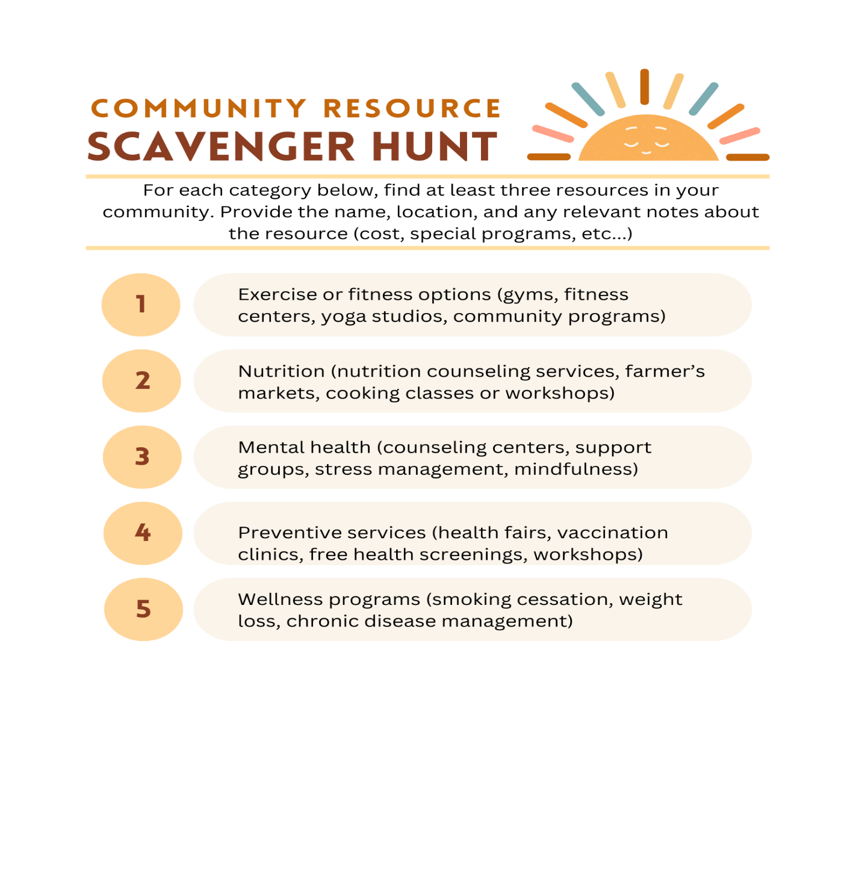
Community Resource Scavenger Hunt
Use your local community in your search
Consider associated costs of each program

