Slide 1

Personal and Community Nutrition
Chapter 2

Slide 2

Overview
Individual health is linked to community and societal well-being.
Community health is shaped by the shared attitudes and actions of its members.
Promoting health involves taking responsibility for both personal and community wellness.
Focus: Improving health through personal nutrition and addressing community nutrition challenges.

Slide 3
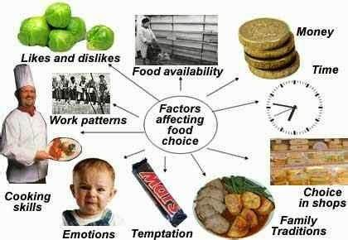
Personal Nutrition
Food Preferences are influenced by
    Genetic factors (inborn preferences for sweet or salty foods)
    Environmental effects (culture, family, media)
Food Choice: Refers to what we select based on availability and convenience at the time of eating. Influenced by:
    Convenience: Busy lifestyles lead to quick, easy food choices.
    Cost: Weighing the benefits of time vs. money.
Food Liking: Foods we enjoy eating, even if they aren't the healthiest.
Food preferences, choices, and liking all influence one’s overall nutrition.

Slide 4
Community Nutrition
Strong link between community nutrition and economic factors
    WIC
    SNAP
  1970s, started recognizing link between nutrient deficiencies or excesses and chronic conditions
  Dietary Guidelines for Americans targets this concern and is updated every 5 years
Current guidelines
  Healthy Diet for All Stages of Life: Start eating healthfully from infancy to older adulthood.
  Customize and enjoy nutrient-dense food and beverages to reflect personal preferences, culture, and budgetary restrictions.
  Focus on consuming nutrient-dense food and beverages from all food groups while staying within calorie limits.
  Limit foods high in added sugars, saturated fats, sodium to meet nutritional goals. Limit alcohol.

Slide 5
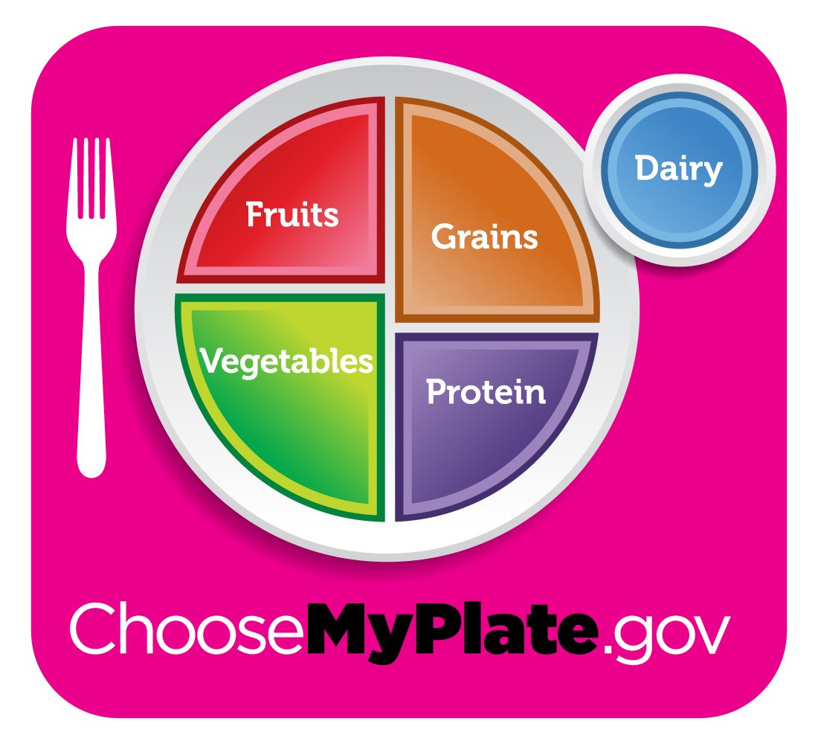
Nutrition Guides: MyPlate
Designed to help individuals implement the Dietary Guidelines and DRIs by making healthier food choices
Provides guidance based on age, sex, and activity levels, offering personalized nutrition recommendations
Key themes: Variety, proportionality, moderation, and activity

Slide 6
Nutrition Guides- MyPlate Exploration
MyPlate Plan | MyPlate
    Click on blue start button
    Enter your information
    Click on the personalized calorie recommendation it provides, and it will take you to your MyPlate Plan
    Click on the Download your MyPlate Plan
  At top of MyPlate Plan webpage, click on link to “My Plate Kitchen”
    Look back at your DRI homework from last week. Were there any areas you needed to improve? Use the filters to refine your search (Get more calcium, Reduce sodium, Tight budget)
    Find 2 new recipes you want to try

Slide 7
Alternative Nutrition Guides
Healthy Eating Plate (Harvard):This alternative guide emphasizes whole grains, plant-based proteins (like nuts and legumes), and recommends limiting red meat and refined grains. It promotes water over dairy and includes guidance on exercise and weight control.
Power Plate (PCRM):A vegan food guide centered on plant-based foods such as whole grains, legumes, fruits, and vegetables. It eliminates animal products, reducing saturated fats and cholesterol.
Ethnic Food Guides: Mediterranean, Asian, Latino, and African Heritage Diet Pyramids offer culturally diverse alternatives to MyPlate, adjusting the servings of animal foods, legumes, fruits, and vegetables.

Slide 8

“Have a Plant” Campaign Exploration
Know you need more veggies in your diet but bored with carrots and celery sticks? Let’s explore Home - Have A Plant (fruitsandveggies.org) for the next 5 minutes.
Did anything catch your attention?
Boo-tiful Boards caught mine!
So did the Blackberry Shrub beverage (no judgment please… I’m allowed my one serving of “spirited” refreshments )

Slide 9

Application to Nursing
Comparison with Guidelines: Assess patients' food choices against national guidelines like MyPlate to evaluate nutritional habits.
Focus on Wellness: Encourage a shift from "looking good" to "feeling good" to motivate dietary changes.
Awareness of Attitudes: Understand patients’ perspectives on nutrition and dietary changes.
Health Benefits Education: Emphasize the positive impacts of snacks and dietary changes for disease prevention.
Strategies for Improvement: Provide simple techniques for improving food selection and integrating more fruits, vegetables, and whole grains into diets.

Slide 10

Food Consumption Trends:
Increased Spending on Food Away from Home: More Americans are spending on eating out, leading to poorer nutritional choices.
Nutritional Imbalance: Under-consumption of healthy foods and over-consumption of processed, high-fat, and high-sugar items.
Influencing Factors: Income, availability, cost, and time constraints significantly affect food consumption trends.
    Time Constraints: Busy lifestyles lead to reliance on pre-prepared or processed foods, reducing home cooking.
    Food Deserts: Areas lacking access to affordable, nutritious food, affecting vulnerable populations.
    Community Initiatives: Local programs (e.g., Georgia Food Oasis) can address food access issues through community engagement and support.

Slide 11
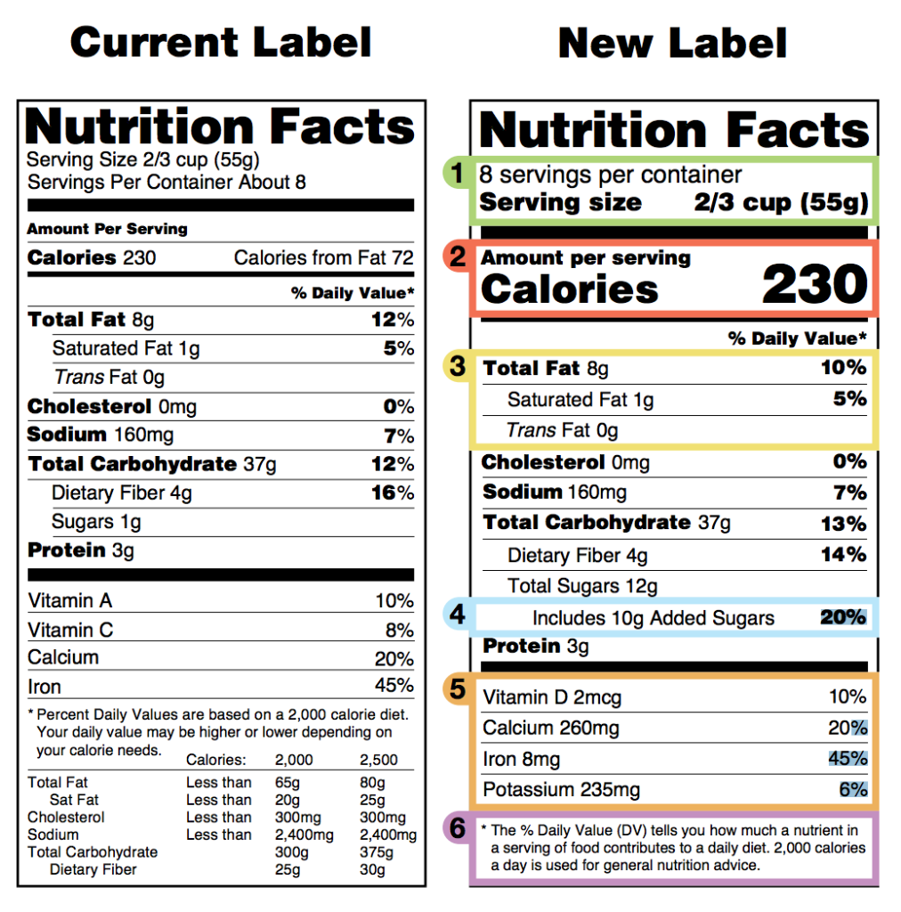
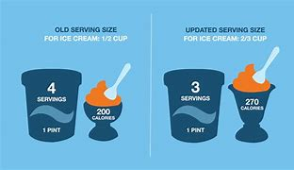
Consumer Information
Informed Choices: More information leads to better food choices that support wellness.
Nutrition Education: Essential for consumers to effectively utilize food information.
Food labeling in the U.S. follows the 1990 Nutrition Labeling and Education Act; mandatory for most processed foods but voluntary for fresh items (e.g., meat, dairy).
Purpose of Food Labels:
  Help consumers select nutritious foods.
  Encourage food companies to improve nutritional quality.
Revised Nutrition Facts Label (2024):
  Reflects current scientific data and dietary guidelines. Adjustments were made on inclusion of essential nutrients (potassium, vitamin D)
  Better readability
  New features include serving size adjustments (what people really do eat vs what people should eat) and the addition of "added sugars" listing.

Slide 12
Nutrition Facts Panel
Nutrients Listed: Total energy, fat, cholesterol, sodium, carbohydrates, dietary fiber, sugars, added sugars, protein, vitamin D, calcium, iron, potassium.
Daily Values (%DV): Indicates the proportion of daily recommended intake for specific nutrients based on a 2000-calorie diet.
Compare products and assess nutrient content.
Balance nutrient intake by selecting foods with varying %DVs.

Slide 13
Standardized Definitions for Food Descriptors
  Free: Minimal or insignificant amounts of fat, cholesterol, sodium, etc.
  Low: Allows frequent consumption without exceeding dietary guidelines (e.g., low-fat = ≤3 g fat/serving).
  Lean (meat and poultry): Less than 10g fat, 4g saturated fat, 95mg cholesterol.
  Extra Lean (meat and poultry): Less than 5g fat, 2g saturated fat, 95mg cholesterol.
  Reduced, Less, Fewer: 25% less of a nutrient or calories (when compared to the standard product).
  Light/Lite: 1/3rd fewer calories or half the fat of the original or half the sodium
  More: At least 10% more of the daily value of a nutrient (vitamin, mineral, or fiber) than standard product.
  Good Source of: Contains 10%-19% of the daily value for a nutrient.
  100% Whole Grain Stamp: All grain ingredients are whole grains with a minimum of 16 g/serving.
  Basic Whole Grain Stamp: At least 8 g of whole grains per serving.

Slide 14
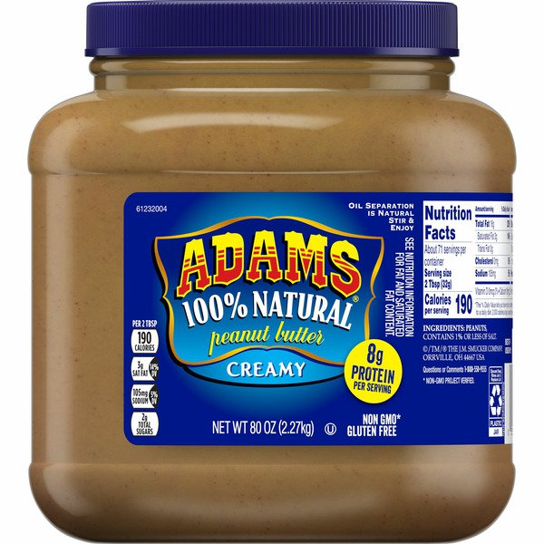

Organic Food Standards
USDA Organic Standards: National standards set by the USDA for organic labeling, applicable to both domestically and internationally grown or processed foods.
Organic Farming Practices: Focus on renewable resources and conservation of soil and water. Organic foods are produced without conventional pesticides, synthetic fertilizers, bioengineering, or irradiation.
Animal-Derived Organic Foods: Must be free of antibiotics and growth hormones.
Certification: Farms and companies must be certified by USDA-approved inspectors to use the organic label.
    “100% Organic”
    “Organic”: 95% or more organic ingredients
    “Made with Organic Ingredients”: 70% or more organic ingredients
    “Natural” means less processed and more wholesome but has nothing to do with how the ingredients were farmed or how the animals were raised

Slide 15
Health Claims on Labels (FDA approved)
• Potassium and reduced risk of high blood pressure (hypertension)
• Plant sterol and plant stanol esters and heart disease (Plant sterols and stanols are substances found naturally in certain plant foods that provide health benefits.)
• Whole grains and reduced risk of heart disease and certain cancers
• Soy protein and reduced risk of heart disease
• A diet with enough calcium and a lower risk of osteoporosis
• A diet low in total fat and a reduced risk of some cancers
• A diet low in saturated fat, cholesterol, and trans-fat and a reduced risk of coronary heart disease
• A diet rich in fiber-containing grain products, fruits, and vegetables and a reduced risk of some cancers
• A diet rich in fiber-containing grain products, fruits, and vegetables and a reduced risk of coronary heart disease
• A diet low in sodium and a reduced risk of high blood pressure
• A diet rich in fruits and vegetables and a reduced risk of some cancers
• Folic acid and a decreased risk of neural tube defect–affected pregnancy
• Dietary sugar alcohols and a reduced risk of dental caries (decay)
• Fluoridated water and reduced risk of dental caries (decay)
• Soluble fiber from certain foods, such as whole oats and psyllium seed husk, as part of a diet low in saturated fat and cholesterol and a reduced risk of heart disease

Slide 16
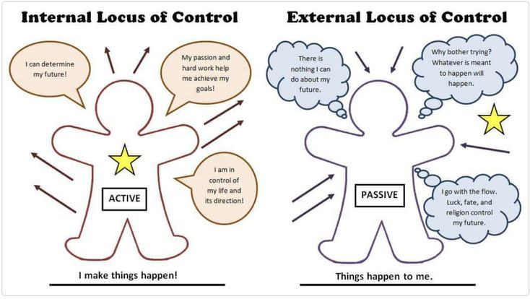
Locus of Control
Locus of control refers to the belief system individuals have regarding how much influence they hold over life events. This concept is crucial for understanding personal behavior, particularly in nutrition and food choices. There are two primary types of locus of control:
Internal Locus of Control: Individuals believe they have personal power over life outcomes. In the context of nutrition, they tend to take proactive steps, such as creating detailed shopping lists based on nutritional value and feel empowered to stick to their plans with minimal deviation. This sense of control leads to healthier and more intentional food choices.
    Strategies: Use tools like meal planning, goal-setting apps, or nutritional tracking to refine and improve food habits.
External Locus of Control: Individuals feel that their choices are driven by external factors, such as societal pressures or environmental cues. In a grocery shopping scenario, these people might start with a plan but are easily influenced by promotions, packaging, or the environment, leading to impulsive purchases that may not align with nutritional goals.
    Strategies: Consider joining a structured program like a weight management group or implementing guidelines like only buying what's on a list, to minimize external influences.

Slide 17
Quiz Time
Which of the following is NOT a focus of MyPlate?
a) Moderation
b) Proportionality
c) Elimination of all fats
d) Variety
What does the term "food desert" refer to?
a) Areas with an abundance of fast food
b) Areas with limited access to affordable, nutritious food
c) Places where people don't like vegetables
d) Communities that rely solely on imported food

Slide 18
Digestion, Absorption and Metabolism
Chapter 3

Slide 19
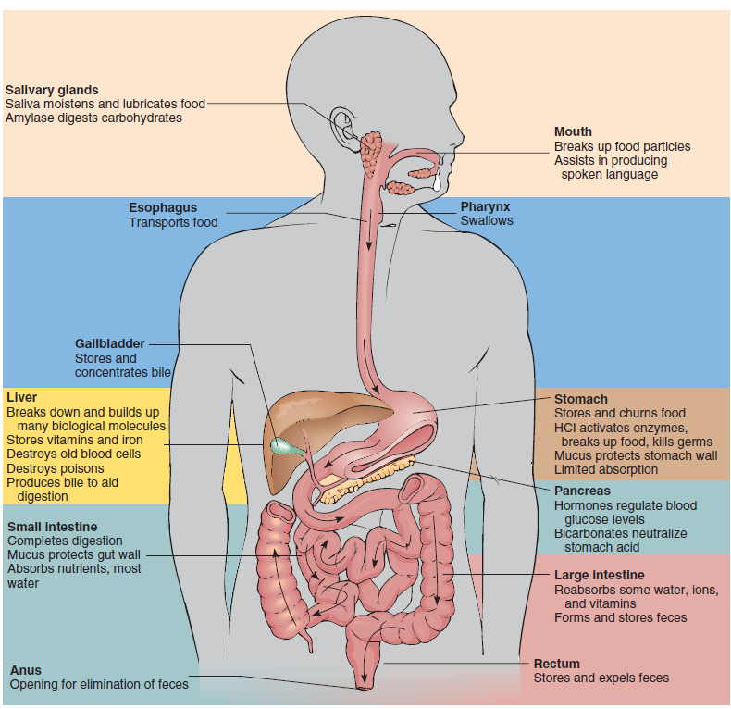
Digestive System Overview

Slide 20
Digestion
Mechanical Digestion:
Chewing in the mouth, churning in the stomach
Chemical Digestion:
Enzymes break down food into absorbable units
Salivary amylase (carbs), Pepsin (proteins), Lipase (fats)

Slide 21
Absorption in the Small Intestine
Absorption
Villi and Microvilli: Increase surface area
Absorbed Nutrients:
Carbohydrates → Glucose
Proteins → Amino Acids
Fats → Fatty Acids & Glycerol
Role of the Liver:
After entering blood, liver has first choice of nutrients passing by it
Key Structures for Absorption:
Process by which substances pass through the intestinal mucosa into blood or lymph
Factors affecting Absorption
Motility
Chronic illness
Ingestion of substances at same time (i.e. Synthroid should not be taken with food)
Nutrient processing and detoxification

Slide 22
Nutrient-Specific Digestion and Absorption
Carbohydrates:
Digestion begins in the mouth (Salivary Amylase)
Absorbed as monosaccharides (glucose, fructose)
Proteins:
Digestion begins in the stomach (Pepsin)
Absorbed as amino acids in the small intestine
Fats:
Emulsified by bile (liver) and digested by pancreatic lipase
Absorbed as fatty acids and glycerol

Slide 23
Metabolism
Metabolism: Set of processes that transform absorbed nutrients into usable energy and form/maintain body structures.
Catabolism: Breakdown of food into smaller particles, releasing energy (heat/chemical).
Anabolism: Synthesis of substances like new bone or muscle tissue.
Creating hormones, enzymes, nerve impulses, muscle contractions, etc.
Two Types of Metabolism that occur simultaneously:
Vitamins and minerals act as catalysts or coenzymes to support metabolism.
Energy used for DNA replication, protein synthesis, and other life-supporting processes.
Metabolic waste products from cellular metabolism removed via lungs, kidneys, large intestine
Metabolic rate decreases as we age requiring less caloric intake, but nutrient requirements stay the same.

Slide 24
Key Hormones in Digestion and Metabolism
Insulin: Lowers blood glucose by promoting uptake into cells
Glucagon: Raises blood glucose by stimulating glycogen breakdown
Thyroxine (T4) & Triiodothyronine (T3): Regulate metabolism and energy use

Slide 25
Quiz Time
Where does chemical digestion of carbohydrates begin?
a) Stomach
b) Small intestine
c) Mouth
d) Liver
What enzyme breaks down proteins in the stomach?
a) Lipase
b) Amylase
c) Pepsin
d) Lactase

Slide 26
Quiz Time
What is the primary role of the villi in the small intestine?
a) Secrete enzymes
b) Absorb nutrients
c) Produce bile
d) Increase stomach acidity
After digestion, which nutrient is absorbed as amino acids?
a) Carbohydrates
b) Proteins
c) Fats
d) Water

Slide 27
Quiz Time
Which structure in the digestive system processes absorbed nutrients before they reach the bloodstream?
a) Liver
b) Stomach
c) Pancreas
d) Gallbladder
What is the function of glucagon?
a) Increases blood glucose by breaking down glycogen
b) Lowers blood glucose by promoting cellular uptake
c) Helps in digestion of fats
d) Regulates metabolism of vitamins

Slide 28
Carbohydrates
Chapter4

Slide 29
Role of Carbohydrates in Wellness
Carbohydrates: Primary source of energy, found mainly in plants.
Composed of carbon, hydrogen, and oxygen.
Types of carbohydrates:
Simple carbs: Glucose, sucrose.
Complex carbs: Starch, dietary fiber.
Serve distinct roles in providing energy, sweetening foods, and supplying dietary fiber.

Slide 30
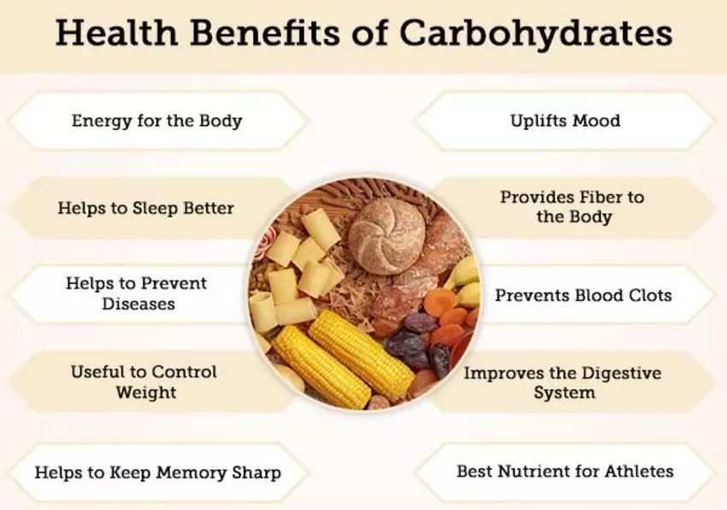
Health Benefits of Carbohydrates
Natural carbohydrate sources (e.g., fruits) include essential nutrients and provide sweetness.
Dietary fiber in complex carbs promotes digestive health.
Increased intake of complex carbohydrates helps reduce risk of chronic diseases:
    Heart disease
    Diabetes
    Some cancers

Slide 31
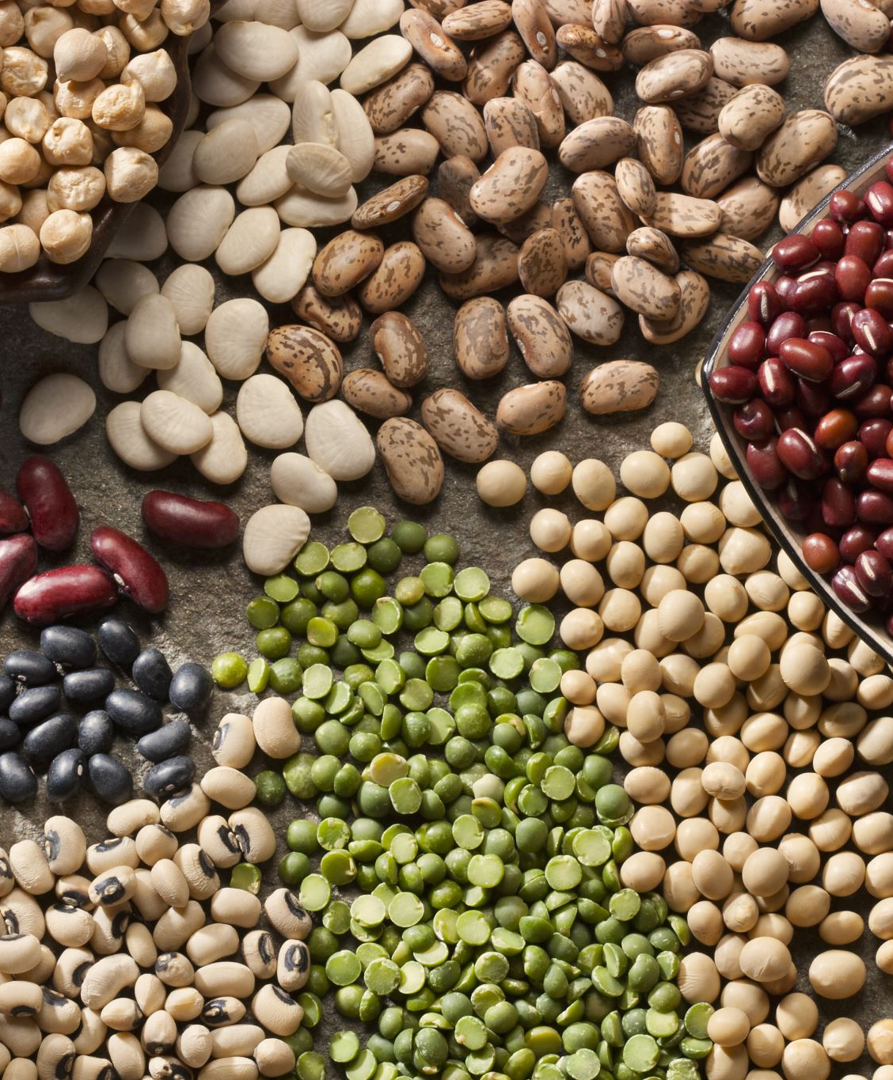
Carbohydrate Intake Recommendations
Dietary Reference Intake (DRI): 130 g/day for adults aged 19–30.
Acceptable Macronutrient Distribution Range (AMDR): 45%-65% of daily kcal from complex carbs.
Emphasis on a plant-based diet:
    Fruits
    Vegetables
    Whole grains
    Cooked dried beans and peas

Slide 32
MyPlate and Carbohydrates
More than 75% of MyPlate includes carbohydrate-rich food groups.
Recommended daily intake:
2 cups of fruits
2½ cups of vegetables
6 oz of grains (with at least half being whole grains)
In general, 1 slice of bread, 1 cup of ready-to-eat cereal, or ½ cup of cooked rice, cooked pasta, or cooked cereal can be considered as 1 ounce-equivalent from the Grains Group.

Slide 33
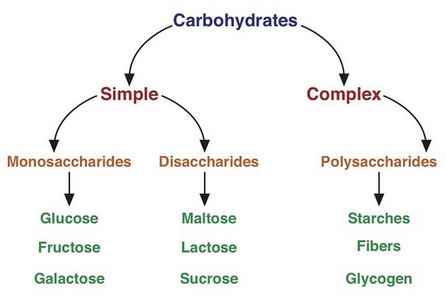
Types of Carbohydrates
Monosaccharides: Single carbohydrate units.
  Examples: Glucose, fructose, galactose.
Disaccharides: Two single carbohydrates bound together.
  Examples: Sucrose, maltose, lactose.
Polysaccharides: Many units of monosaccharides joined together.
  Examples: Starch, fiber (food sources), glycogen (stored in liver/muscles).

Slide 34
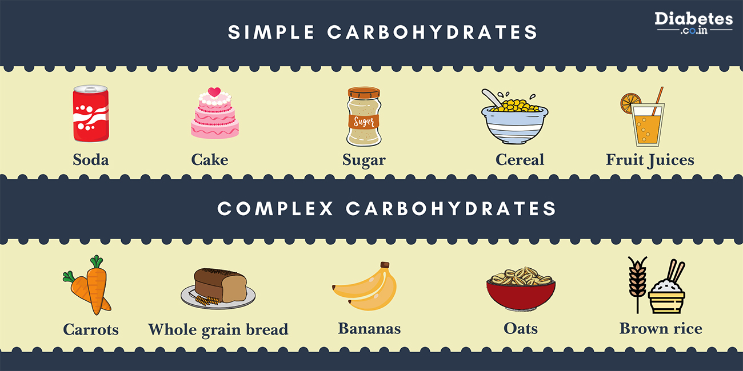
Simple vs Complex Carbohydrates
Simple Carbohydrates:
    Monosaccharides and disaccharides.
    Primarily provide energy (glucose, fructose, galactose).
Complex Carbohydrates:
    Polysaccharides.
    Provide fiber in addition to glucose.

Slide 35
Function of Carbohydrates
Main Functions:
Provide energy.
Supply fiber and natural sweeteners (sucrose, fructose).
Protein-Sparing Effect: Carbohydrates supply energy (in form of glucose), allowing proteins to focus on their specific functions.
Fat Metabolism:
Adequate carbohydrates: Carbs and small amounts of fat are used for energy.
Insufficient carbohydrates: Fat is metabolized, leading to ketone production.
Excess ketones can cause ketoacidosis, which disrupts pH balance and can be life-threatening.

Slide 36
Importance of Glucose
Brain and nerve tissues rely on glucose from carbohydrates for optimal function (quick and efficient use compared to fats and proteins and limited stores in the brain require constant supply of glucose from bloodstream).
Lipids and proteins can provide energy when needed, but they are less efficient than carbohydrates for certain bodily functions (the conversion of both lipids and proteins is a much lengthier and energy-intensive process than the conversion of carbohydrates to energy).

Slide 37
Digestion and Absorption
  Begins in the mouth: Mechanical digestion and ptyalin (salivary amylase) break down starch into dextrin and maltose.
  In the small intestine: Pancreatic amylase and intestinal enzymes further break down starch into monosaccharides for absorption.
  Disaccharide Breakdown (Enzymes secreted by small intestine’s brush-border cells):
    Lactase: Breaks down lactose.
    Sucrase: Breaks down sucrose.
    Maltase: Breaks down maltose.
  Disaccharides are hydrolyzed into monosaccharides (glucose, fructose, galactose).
Monosaccharides are absorbed by small intestine cells through an energy-requiring process.
Once absorbed:
  Glucose, fructose, and galactose enter the portal blood system.
  The liver converts fructose and galactose into glucose.
  Glucose is used for immediate energy or stored as glycogen for later use.

Slide 38
Quiz Time
Which of the following is a complex carbohydrate?
a) Glucose
b) Sucrose
c) Starch
d) Fructose
What is the recommended daily intake of carbohydrates for adults?
a) 100 g/day
b) 130 g/day
c) 150 g/day
d) 200 g/day

Slide 39
Quiz Time
Carbohydrate metabolism begins in the:
a) Stomach
b) Small intestine
c) Mouth
d) Pancreas
What is the function of carbohydrates in the body?
a) Build muscles
b) Provide energy
c) Increase fat metabolism
d) Improve bone strength

Slide 40
Carbohydrate Metabolism and Blood Glucose Regulation
Blood Glucose Homeostasis:
Sources of Blood Glucose:
Dietary Carbohydrates: Carbohydrates from food, such as starches and sugars, are digested and absorbed, increasing blood glucose levels.
Glycogenolysis: Glycogen, stored in the liver and muscles, can be broken down into glucose when blood glucose levels drop. This process ensures a steady supply of glucose when food intake is low or during physical activity.
Noncarbohydrate Sources: Intermediate metabolites like lactic acid and pyruvic acid produced during muscle activity can also contribute to glucose production.
The body maintains blood glucose levels between 70 and 100 mg/dL for proper functioning.
This balance is essential for energy supply, particularly for the brain and muscles.

Slide 41
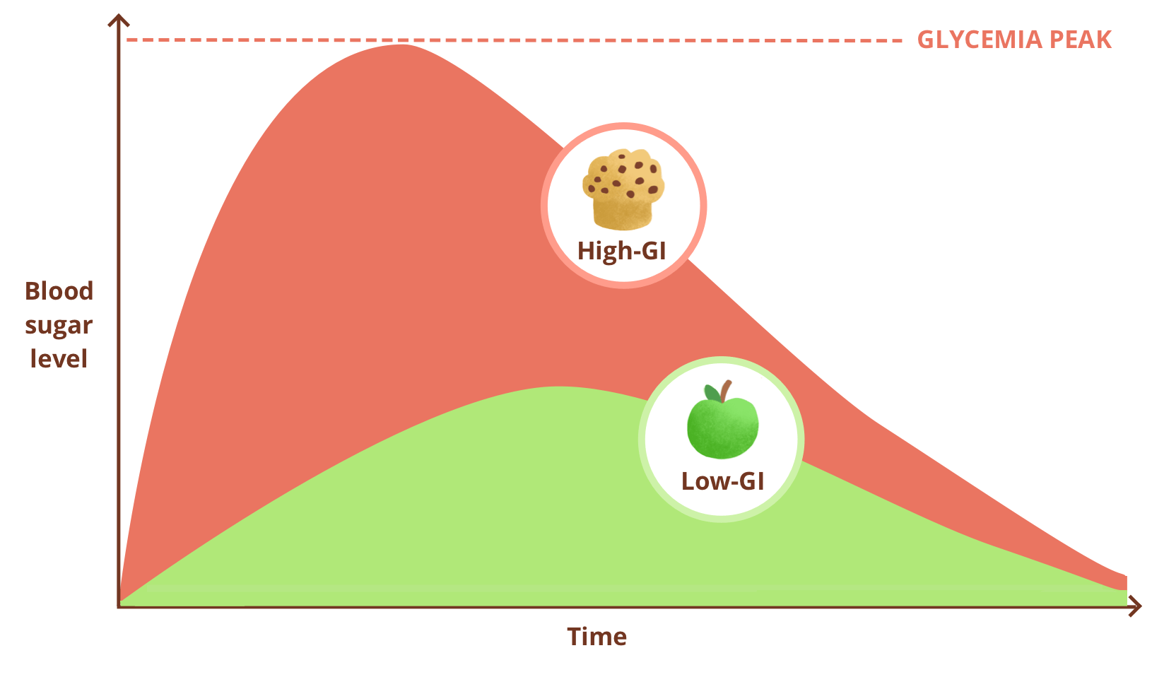
Glycemic Index
Definition:
    The glycemic index is a ranking of foods based on how they affect blood glucose levels after consumption compared to a reference food (such as glucose or white bread).
    It measures the rate at which carbohydrates in a food raise blood glucose levels.
Scale:
    Foods are ranked on a scale from 0 to 100, with 100 being the highest GI.
    A higher GI indicates that a food raises blood glucose levels more rapidly.
Examples of GI Rankings:
    High GI (70 or above): White bread, sugary cereals, and baked potatoes.
    Moderate GI (56-69): Whole wheat bread, brown rice, and sweet potatoes.
    Low GI (55 or below): Lentils, chickpeas, and most fruits.

Slide 42
Factors Affecting Glycemic Index
Physical Form:
Whole vs. Processed: The GI of a food can change based on its preparation. For instance, a baked potato has a higher GI than mashed potatoes. This is because mashing breaks down the starches, making them more readily available for digestion.
Fat and Protein Content:
Nutrient Composition: Foods that contain higher levels of fat and protein can slow down the digestion of carbohydrates. This can lead to a lower GI because the carbohydrates are absorbed more gradually, preventing spikes in blood sugar.
Ripeness:
Sugar Content: The ripeness of fruits and vegetables affects their GI. As fruits ripen, their starches convert to sugars, increasing their GI. For example, ripe bananas have a higher GI than green bananas.
Fiber Content:
Digestive Impact: Foods high in fiber tend to have a lower GI because fiber slows digestion and the absorption of carbohydrates. Whole grains, legumes, and vegetables often have beneficial fiber content.
Botanic Variety:
Different Types: The botanical variety of a food can also influence its GI. Different species of rice, for example, can have significantly different glycemic responses, affecting how they impact blood glucose.

Slide 43
Glycemic Load
Definition: Glycemic load takes into account both the glycemic index of a food and the amount of carbohydrates it contains. It provides a more accurate representation of how a food impacts blood glucose levels in a typical serving.
Calculation: GL is calculated using the formula: GL=(GI×carbohydrate content/100)
Scale:
    Low GL (10 or below): Generally considered beneficial and unlikely to cause rapid blood sugar spikes.
    Moderate GL (11-19): May have a moderate impact on blood glucose.
    High GL (20 or above): Likely to cause significant increases in blood glucose levels.

Slide 44

Glycemic Index vs Glycemic Index

Slide 45
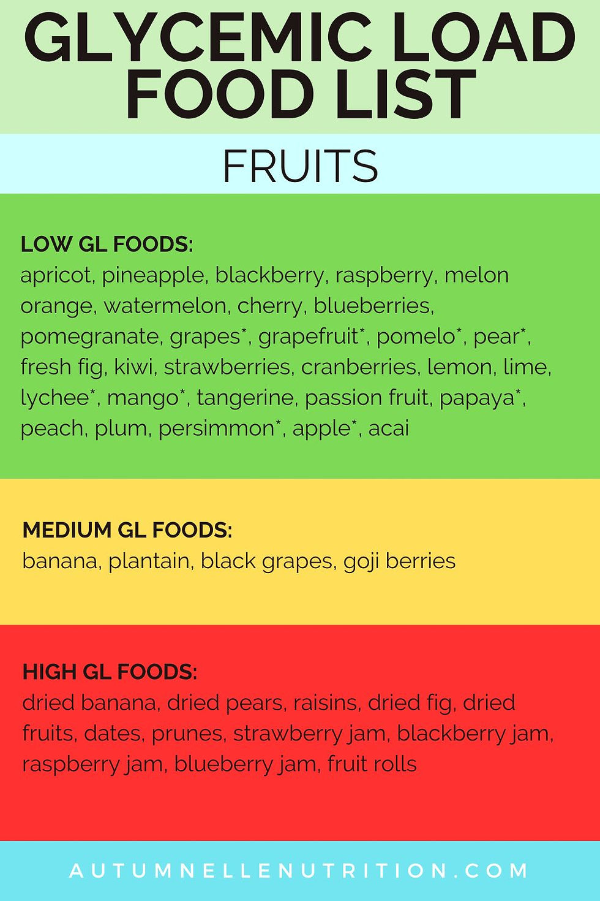
Importance of Glycemic Index and Glycemic Load
Blood Sugar Management: Understanding the GI and GL of foods can help individuals, particularly those with diabetes, manage their blood sugar levels more effectively.
Dietary Choices: Choosing low-GI and low-GL foods can promote sustained energy levels, reduce hunger, and aid in weight management.
Chronic Disease Prevention: Diets emphasizing low-GI foods may reduce the risk of developing chronic diseases like type 2 diabetes and heart disease.

Slide 46
Sugar: A Special Disaccharide
Refers to various carbohydrates, primarily monosaccharides and disaccharides.
Common form is sucrose, known as table sugar when derived from sugarcane or sugar beets.
Types of sweeteners:
    Refined Sugars: White sugar, brown sugar, dextrose, crystalline fructose.
    Other Sweeteners: High-fructose corn syrup (HFCS), glucose, corn sweeteners, lactose, concentrated fruit juice, honey, maple syrup, molasses, agave nectar, sugar alcohols (e.g., sorbitol, mannitol, xylitol).
    All sugar forms provide calories but often lack essential nutrients.
  Consumption Levels
    Added sugars contribute "empty calories" without nutritional benefits.
    Excessive sugary foods can displace more nutrient-dense options, hindering health goals.
  Linked to dental caries; consuming sweets at the end of meals and limiting intake can mitigate risks.
  Obesity is influenced by excess calorie intake from all nutrients, not just sugar.

Slide 47
Recommendations for Sugar Consumption
Moderate sugar intake is acceptable with a low-fat, high-fiber diet.
Dietary Guidelines recommend less than 10% of total caloric intake from added sugars.
The Nutrition Facts label now includes added sugar information for consumer awareness.
HFCS consumption has increased since the 1970s, replacing refined sugar in many products.

Slide 48
Other Sweeteners: Sugar Alcohols
Also known as sugar replacers; provide 2-3 kcal/g, fewer than carbohydrates (4 kcal/g).
Naturally found in fruits and berries; common examples include sorbitol, mannitol, and xylitol.
Advantages:
Less cariogenic than sucrose; do not encourage bacteria growth that leads to tooth decay.
Slower absorption leads to a reduced glycemic response, beneficial for individuals with diabetes.
Disadvantages:
Large quantities may cause fermentation in the intestine, leading to gas and diarrhea.
Lower caloric value per gram results in less available energy.

Slide 49
Alternative Sweeteners (Nonnutritive Sweeteners)
Manufactured to replace naturally sweet substances without providing significant nutrients or calories.
Commonly used types:
Aspartame: 160-220 times sweeter than sucrose; approved in 1981; safe for general consumption, but should be avoided by individuals with phenylketonuria (PKU). Daily intake limit for adults: 50 mg/kg body weight.
Sucralose: 600 times sweeter than sucrose; approved in 1998; stable for cooking and baking; sold as Splenda.
Saccharin: Over 300 times sweeter than sucrose; history of controversy regarding bladder cancer risk; now considered safe; often used with other sweeteners to mask bitter aftertaste; trade names include Sweet’N Low and Sugar Twin.
Stevia: Derived from South American shrub leaves; GRAS (Generally Recognized As Safe) by the FDA; contains no calories; used in products like Truvia and Stevia in the Raw.
Labeling and Consumer Awareness
Products labeled as “sugar-free” may still contain calories; important to check for trans and saturated fats.
Removal of sugar may lead to added fats to enhance taste and texture, which is crucial for those monitoring carbohydrate and fat intake (especially individuals with diabetes).

Slide 50
Sweet Decisions: Real Sugar vs. Artificial Sweeteners
Benefits of Artificial Sweeteners
Caloric Reduction: Artificial sweeteners allow for a sweet taste with significantly fewer calories than sucrose, which can be beneficial for weight management.
Lower Cariogenic Effect: These sweeteners are less likely to contribute to tooth decay compared to traditional sugars.
Weight Management: Many individuals use artificial sweeteners as part of a weight-loss strategy. However, it’s important to note that the calories saved may often be offset by additional calorie intake from other foods.
Risks of Artificial Sweeteners
Physiological Responses: Recent studies suggest that consuming nonnutritive sweeteners may trigger physiological responses similar to those caused by caloric sweeteners. This could potentially lead to increased appetite and weight gain, although findings are mixed and further research is necessary.
Safety Concerns: The safety of alternative sweeteners is less established compared to natural sugars, which have been consumed for thousands of years. Research on artificial sweeteners often involves animal testing at high doses, which may not accurately reflect human consumption levels. The long-term effects and potential risks of these sweeteners remain uncertain.

Slide 51
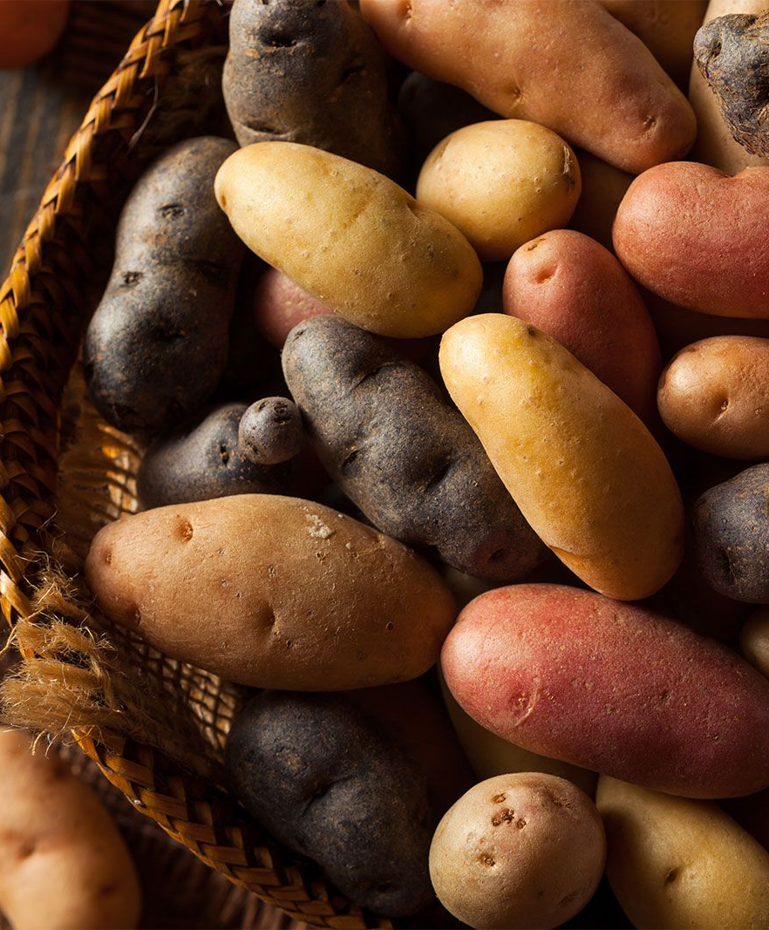
Polysaccharides: Starch
Starch is the primary storage form of carbohydrates in plants. It consists of long chains of glucose molecules that the digestive system breaks down into glucose for energy.
Food Sources of Starch:
Grains: The most significant source of starch. Common grains include: Wheat, Oats, Barley, Rice, Corn, Rye
Legumes: Beans and peas are excellent sources of complex carbohydrates, providing low fat and high fiber, iron, and protein content. They can be found in various forms: Dried, Canned, Frozen
Vegetables: Potatoes are the leading starchy vegetable, rich in complex carbohydrates, fiber, vitamins, and some protein. Other starchy vegetables include: Sweet potatoes, Yams, Parsnips, Carrots, Certain squash varieties (e.g., acorn and butternut)
Health Considerations:
Whole grain products are generally more nutritious than processed ones, as they often contain higher fiber and lower added sugars and fats.
Processed potato products, like chips and fries, often contain high levels of fat and sodium. Opting for baked or boiled potatoes retains more nutrients.

Slide 52
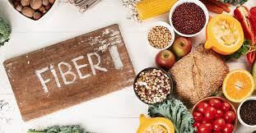
Polysaccharides: Fiber
Fiber is another type of polysaccharide that cannot be digested by human enzymes.
It consists of various plant substances, including carbohydrates and lignin, that generally pass through the digestive system without providing calories or nutrients.
Functions of Fiber:
    Increases bulk in the digestive tract, facilitating smoother digestion and regular bowel movements.
    Supports the growth of beneficial gut bacteria, which can synthesize certain vitamins and short-chain fatty acids (SCFAs), contributing to colon health.

Slide 53
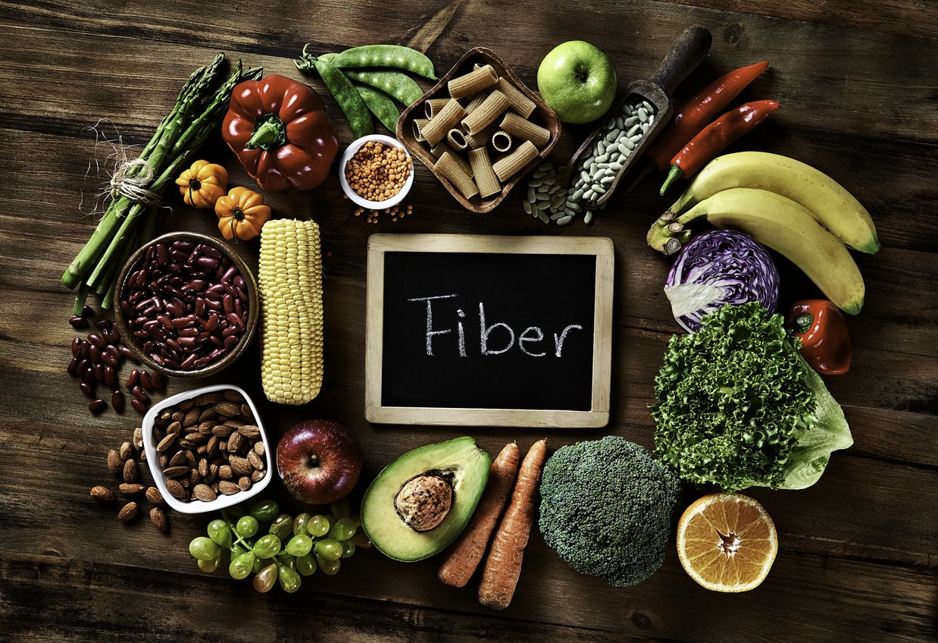
Polysaccharides: Fiber
Types of Dietary Fiber:
Soluble Fiber: Dissolves in water and can be fermented by gut bacteria. It helps to thicken substances and includes:
  Pectin
  Guar gum
  Psyllium
Insoluble Fiber: Does not dissolve in water and helps provide structure and protection to plants. It includes:
  Cellulose
  Hemicellulose
  Lignin (though composed of alcohol rather than carbohydrates)
Food Sources of Fiber:
    Soluble Fiber Sources: Oatmeal (especially oat bran), apples (pectin), and beans.
    Insoluble Fiber Sources: Whole grains, popcorn, and many vegetables.

Slide 54
Health Disorders associated with Low Fiber Intake
Obesity:
Relationship to Fiber: Diets high in fiber can promote satiety, leading to reduced overall calorie intake. Fiber-rich foods often require more chewing and digestion, contributing to a feeling of fullness.
Preventive Role: Regular consumption of fiber can help maintain a healthy weight and prevent obesity.
Constipation:
Relationship to Fiber: Fiber adds bulk to the stool and helps retain water, making bowel movements easier. It aids in regular digestive processes.
Preventive Role: Adequate fiber intake is essential for promoting regularity and preventing constipation.
Hemorrhoids:
Relationship to Fiber: Straining during bowel movements due to constipation can lead to the development of hemorrhoids. A diet low in fiber can exacerbate this condition.
Preventive Role: Sufficient fiber intake can reduce the strain and pressure during bowel movements, lowering the risk of hemorrhoids.
Diverticular Disease:
Relationship to Fiber: Diverticula are small pouches that can form in the walls of the colon. A low-fiber diet may contribute to the formation of these pouches due to increased pressure in the colon.
Preventive Role: Regular fiber consumption can help maintain healthy bowel movements and reduce the risk of developing diverticular disease.
Colon Cancer:
Relationship to Fiber: Some studies suggest that a high-fiber diet may be associated with a lower risk of colon cancer. Fiber may help reduce the time that potential carcinogens are in contact with the intestinal lining.
Preventive Role: Consuming adequate fiber can be part of a dietary strategy to lower the risk of colon cancer.

Slide 55
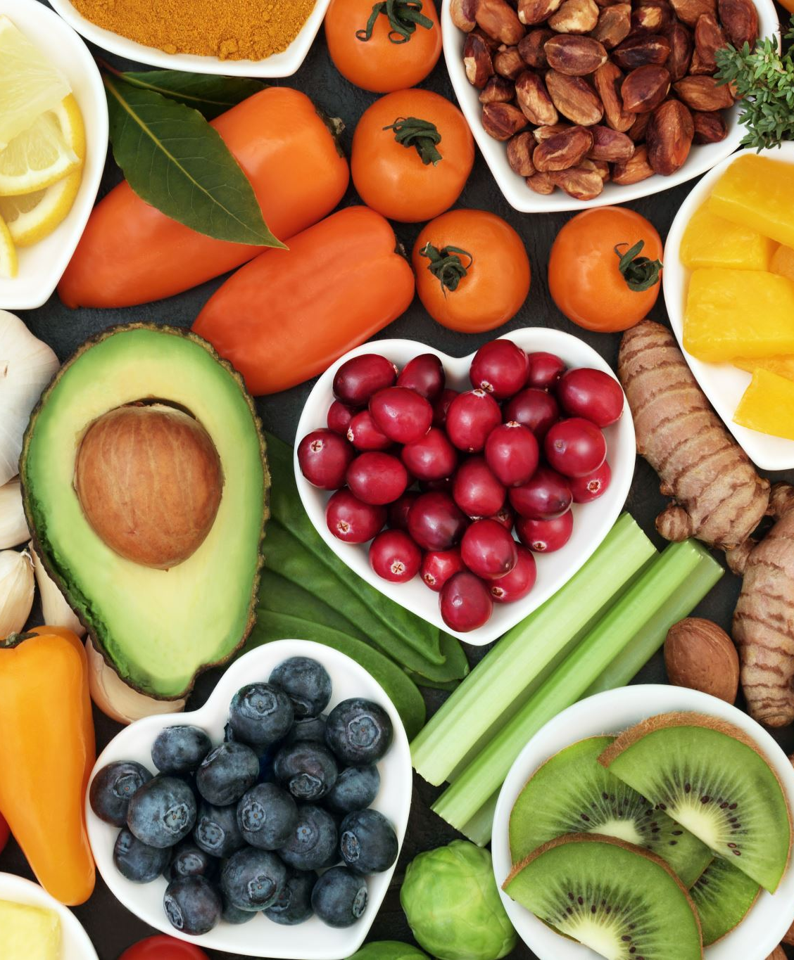
Effects of Fiber on Diabetes and Heart Disease Prevention
1. Heart Disease Prevention
    Lowering Cholesterol Levels: High-fiber foods can replace higher fat foods in the diet, leading to reduced intake of dietary cholesterol and saturated fats. This replacement helps lower blood cholesterol levels, a significant risk factor for heart disease.
    Binding Lipids and Cholesterol: Soluble fiber, found in foods like oats, legumes, and fruits, binds to lipids and cholesterol during digestion. This binding process facilitates the excretion of these substances from the body, contributing to lower blood cholesterol and improved heart health.
2. Diabetes Control
    Stabilizing Blood Glucose Levels: Dietary fiber, particularly soluble fiber, slows the absorption of glucose into the bloodstream. This slower absorption rate helps prevent rapid spikes in blood sugar levels, which is crucial for individuals with diabetes.
    Improving Glucose Regulation: Regular consumption of fiber supports better blood glucose regulation, allowing individuals with diabetes to maintain their blood sugar levels within acceptable ranges, thus reducing the risk of complications associated with the condition.

Slide 56
Potential Health Risks of Dietary Fiber
1. Gastrointestinal Blockages
Overconsumption of Fiber Supplements: Consuming large quantities of fiber supplements or processed fiber, such as oat or wheat bran, can overwhelm the gastrointestinal (GI) tract, leading to blockages in the small intestine and colon. This condition, although rare, can be serious and requires medical attention.
2. Mineral Absorption Issues
Bioavailability of Minerals: The presence of certain fibers and substances found in whole grains, such as phytates and oxalates, can bind minerals in the digestive tract, reducing their bioavailability and absorption. However, higher fiber diets are typically associated with higher mineral content, which helps ensure adequate mineral absorption.
3. Nutrient Composition of Fiber Foods
Nutritional Benefits of Whole Foods: Foods high in fiber often contain a variety of essential nutrients. For this reason, it is advisable to obtain fiber primarily from whole foods rather than supplements, ensuring a balanced intake of nutrients.
Recommendations for Safe Fiber Intake
Gradual Increase: To avoid gastrointestinal discomfort, it is recommended to increase total dietary fiber gradually. This can be achieved by substituting whole-grain foods, fresh fruits, and vegetables for lower-fiber foods. A gradual increase allows the body to adjust to the additional fiber, minimizing the potential for intestinal gas and other digestive issues.

Slide 57
Recommended Fiber Intake
Adequate Intake (AI):The recommended intake for dietary fiber is approximately 25 to 38 grams per day, depending on age and gender
Most Americans fall significantly short of this recommendation, with adults averaging less than 16 grams per day and children and young adults averaging about 12 grams per day
Factors contributing to low fiber intake
Insufficient fruit and vegetable consumption
Refined grains (dietary fiber removed during processing)

Slide 58
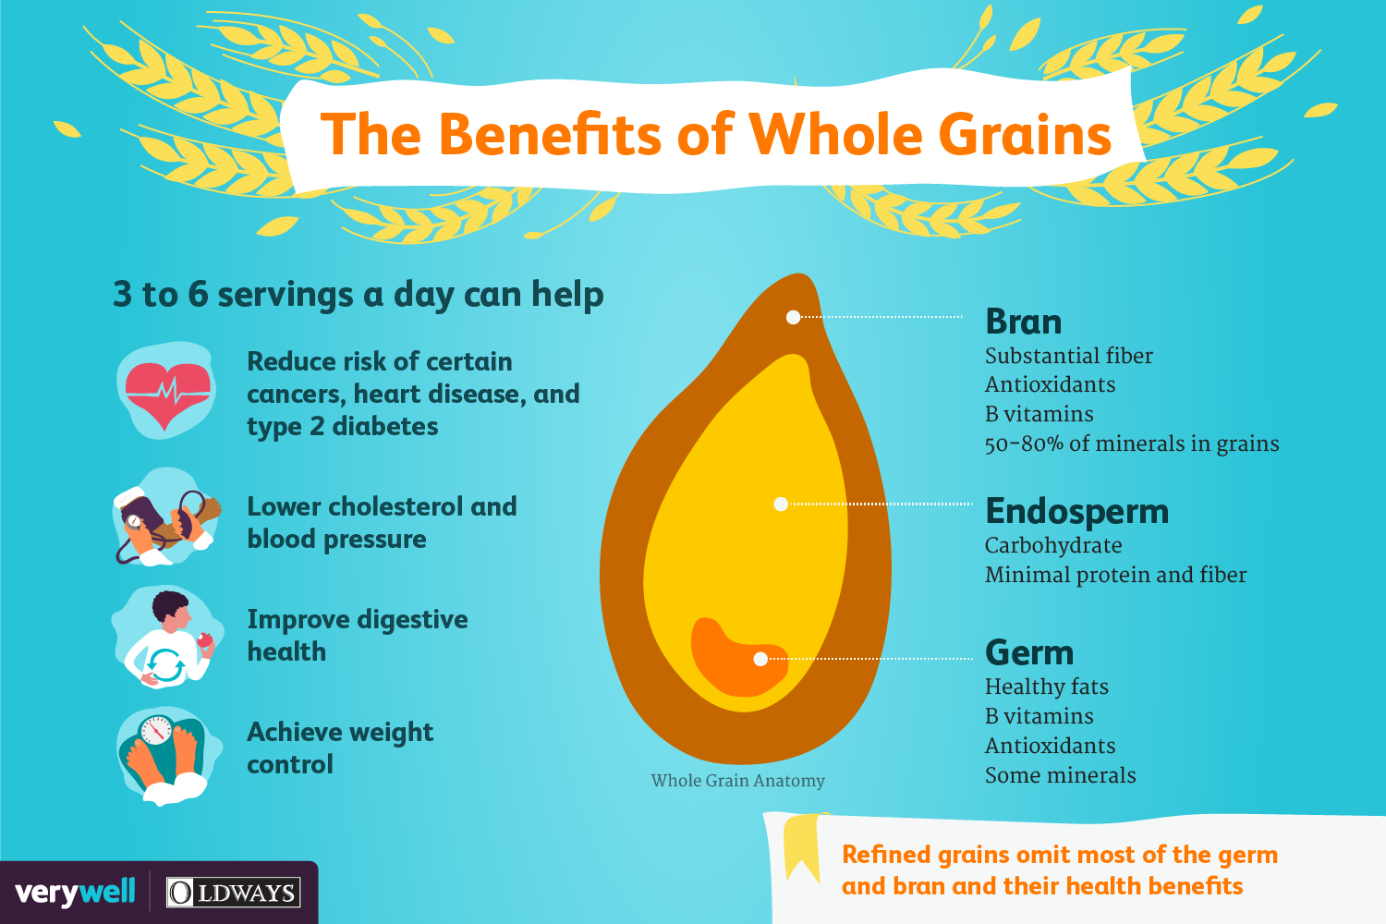
Unrefined (Whole) Grains

Slide 59
Be a Whole Grain Detective
Is the first ingredient listed a whole grain (e.g., whole wheat, brown rice, oats)?
Does the product contain added sugars or unhealthy fats?
What is the fiber content per serving?

Slide 60
Be a Whole Grain Detective
Group 1: Cereals
    Cheerios (General Mills)
    Frosted Flakes (Kellogg’s)
    Quaker Oats Fruit Flavored Instant Oatmeal
Group 2: Breads
    Nature's Own Whole Wheat Bread
    Wonder Bread Classic White
    Pepperidge Farm 12 Grain Bread
Group 3: Rice
    Uncle Ben's Whole Grain Brown Rice
    Jasmine Rice
    Basmati Rice

Slide 61
Be a Whole Grain Detective
Group 4: Crackers
    Triscuit Roasted Garlic Crackers
    Wheat Thins Tomato and Basil Crackers
    Ritz Roasted Vegetable Crackers
Group 5: Pasta
    Barilla Whole Grain Spaghetti
    Barilla Protein Plus Penne Pasta
    Banza Rotini Pasta
Group 6: Granola Bars
    KIND Healthy Grains Granola Bars
    Clif Chocolate Chip Bars
    Quaker Chewy Granola Bars

Slide 62
Be a Whole Grain Detective
Group 7: Tortillas
    Mission Whole Wheat Flour Tortillas
    Mission Carb Balance Flour Tortillas
    La Banderita Flour Tortillas
Group 8: Popcorn
    Orville Redenbacher's Gourmet Popping Corn
    Pop Secret Popcorn
    SkinnyPop Popcorn (Original)

Slide 63
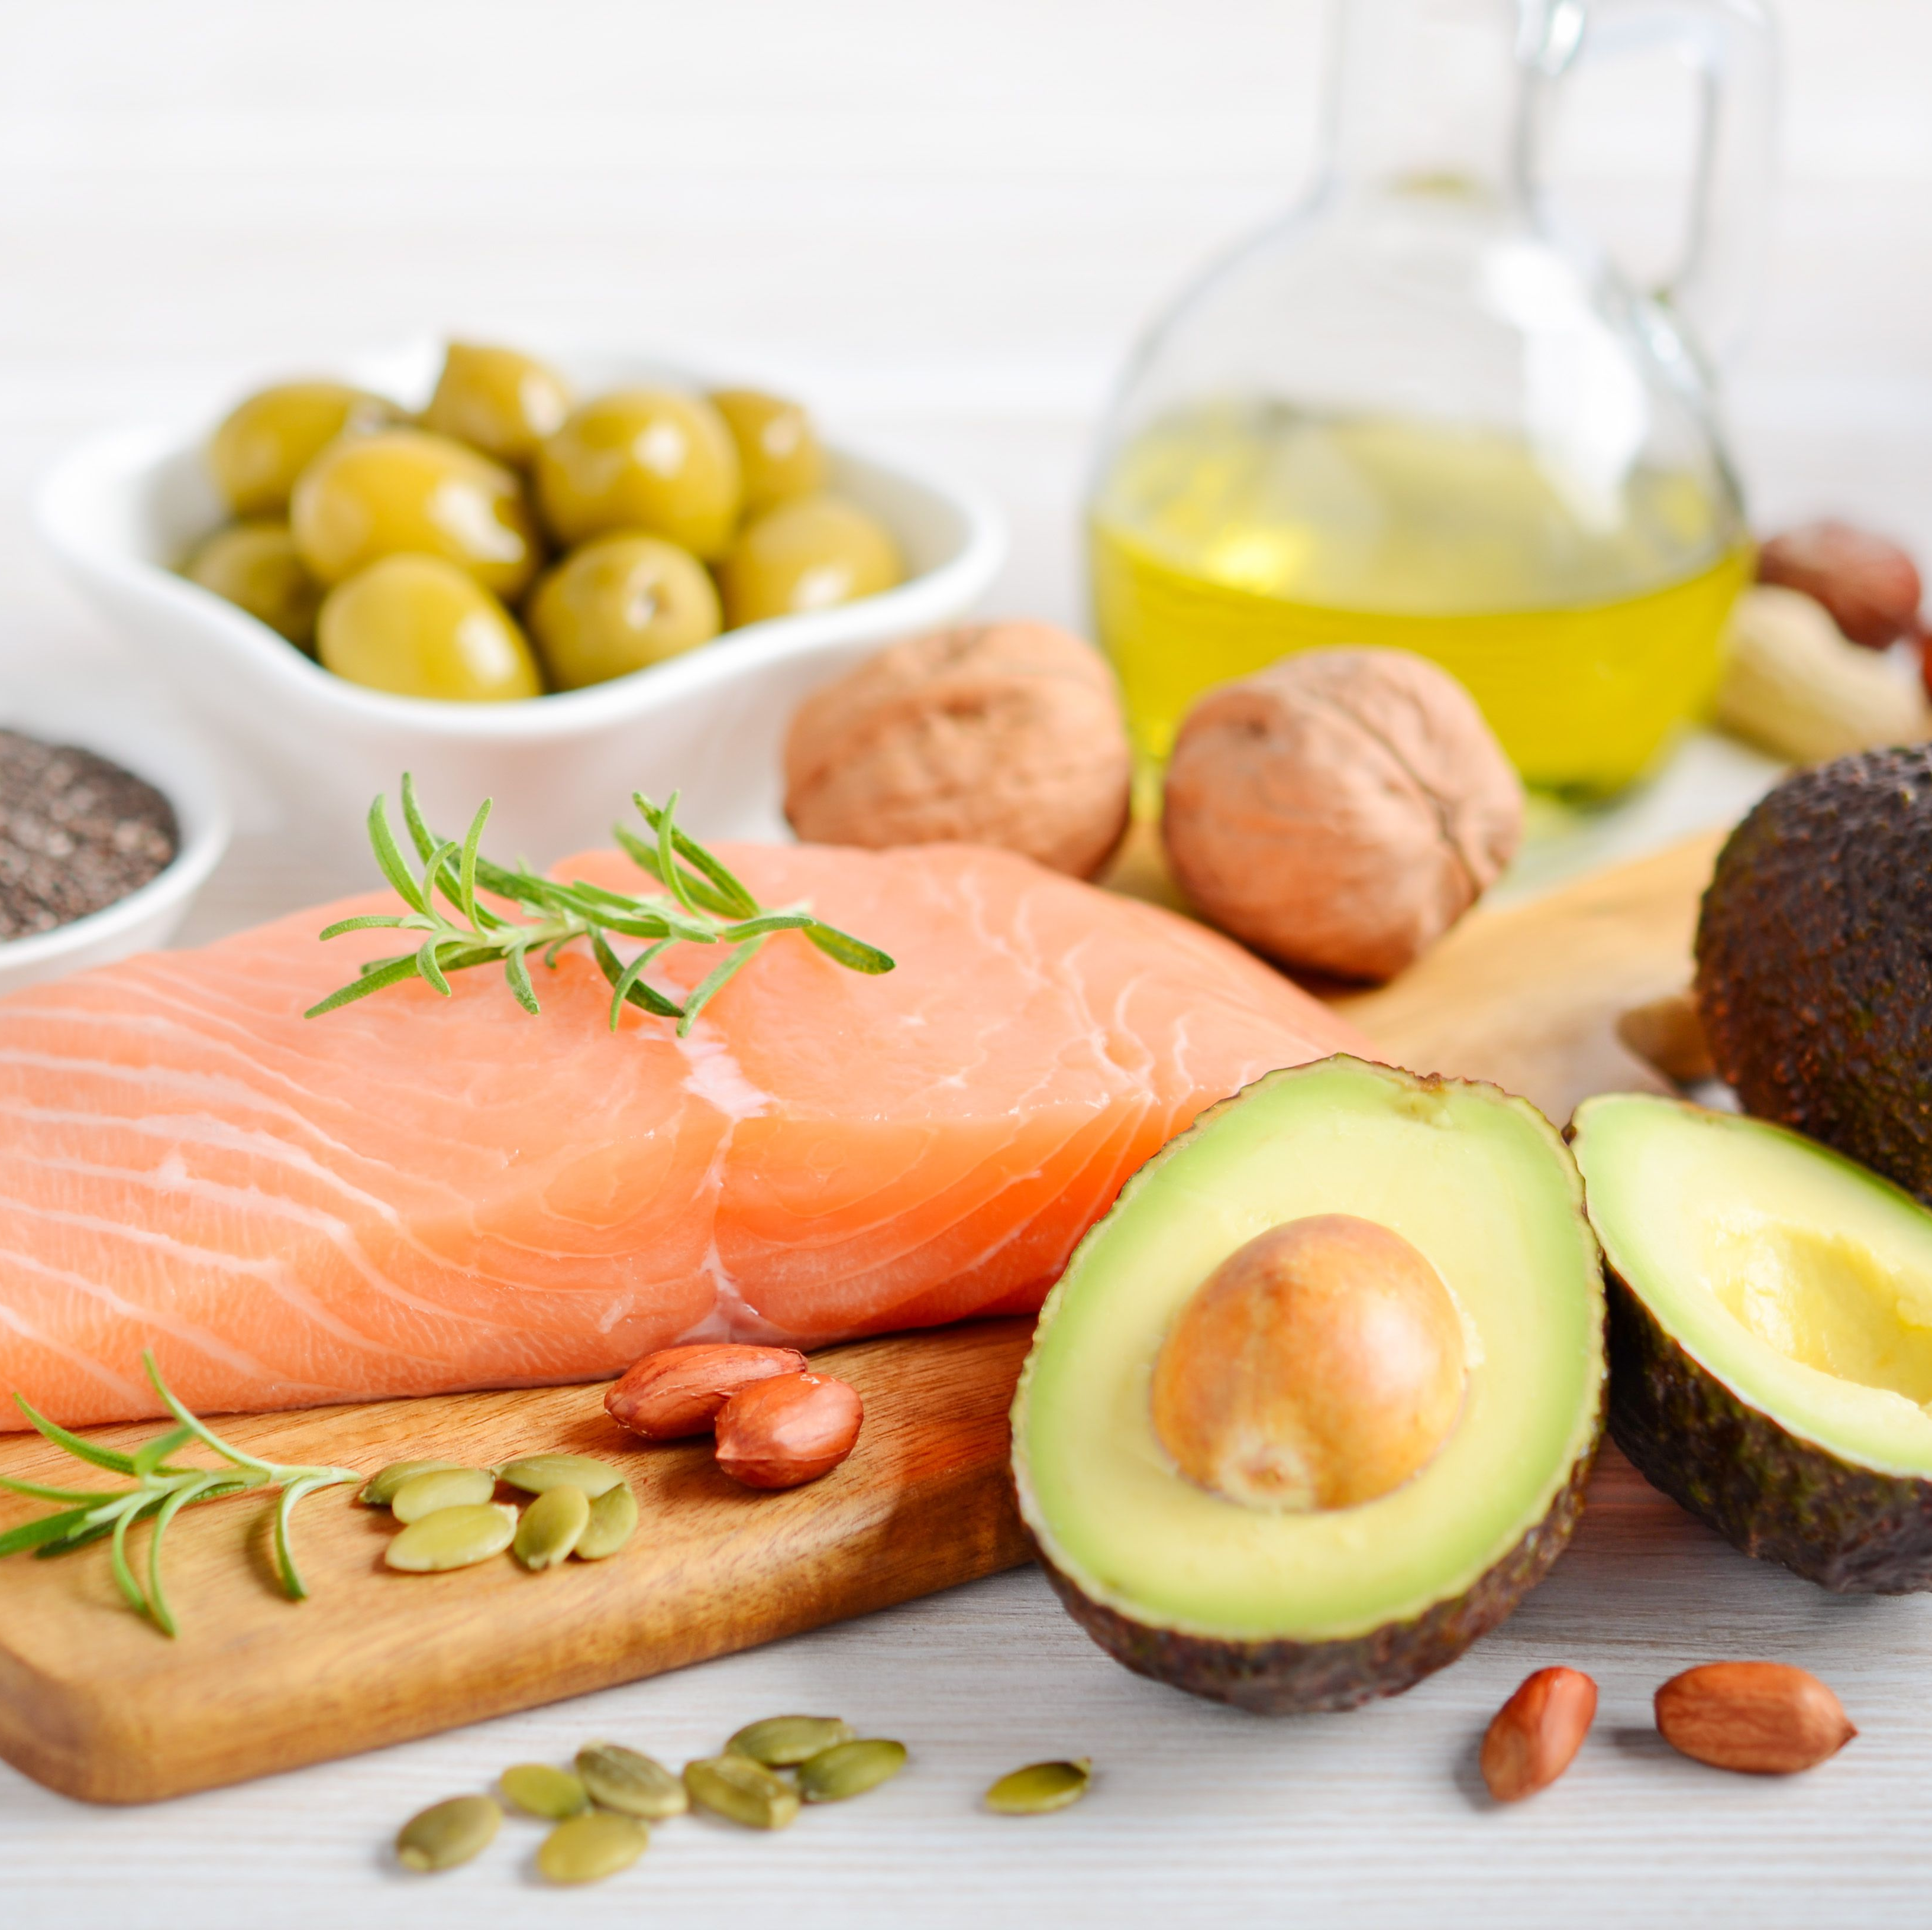
Fats
Chapter 5

Slide 64
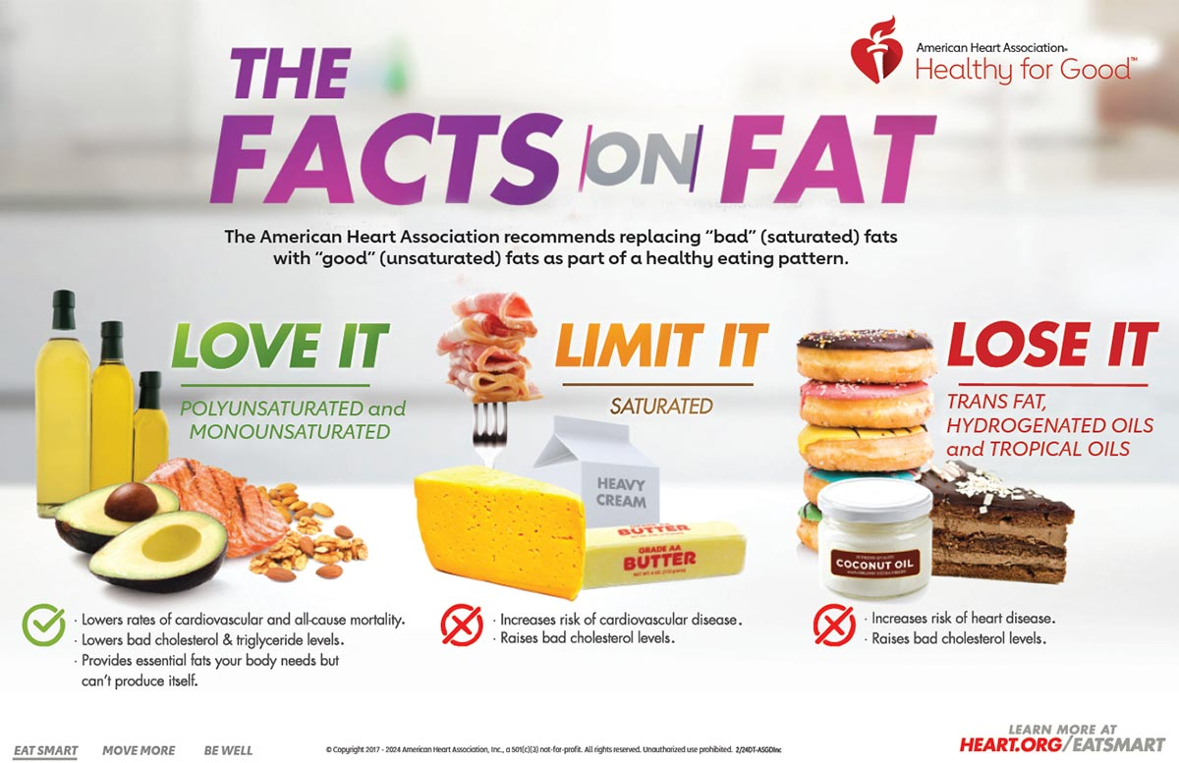
Role in Wellness
Some dietary fats are essential for health, while others may increase disease risk when consumed in large amounts.
Fat is necessary for essential fatty acids (EFAs), energy, and fat-soluble vitamins.
Excessive fat intake may contribute to obesity and diet-related diseases.

Slide 65
Food Functions
Source of Energy
Fat is the densest form of energy, providing 9 kcal per gram, more than twice that of carbohydrates or proteins (4 kcal per gram).
Triglycerides in fat provide stored energy for the body.
Palatability
Fat enhances the taste and smell of food, making it more appealing (e.g., fried foods, butter, cream).
Adding small amounts of fat can improve nutrient intake for patients with anorexia.
Satiety and Satiation
Satiety: Fat slows digestion, helping to prevent hunger between meals by making us feel full.
Satiation: Fat increases the desire to eat more during a meal, potentially leading to overeating.
Food Processing
Lipids are valuable in food processing, such as preventing rancidity and acting as emulsifiers (e.g., lecithin).
Processed fats contribute to higher overall lipid intake.

Slide 66
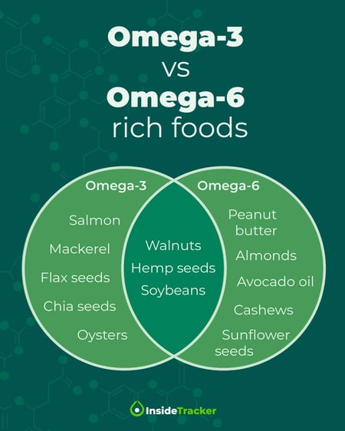
Food Functions
Nutrient Source
Fats transport fat-soluble vitamins (A, D, E, K) and essential fatty acids (EFAs) like linoleic and linolenic acids (cannot be made by the body; omega-3 and omega-6).
EFAs are crucial for regulating blood pressure, blood clotting, and maintaining healthy cell membranes.
EFA deficiency can lead to skin lesions, eczema, inflammation, and increased infection susceptibility
Potential causes of EFA deficiency includes patients with malabsorption disorders, patients on TPN without adequate lipids, patients on low-fat high protein diets, patients recovering from serious burns or injuries, and individuals who opt for extremely low dietary fat intake

Slide 67
Physiological Functions of Fat
Stored Energy: Fat stores in the body, mainly as triglycerides, provide fuel during illness, food restriction, and muscle work.
Organ Protection: Fat cushions organs and protects them from impact during physical activity.
Temperature Regulation: Subcutaneous fat insulates the body, helping to maintain temperature by reducing heat loss.
Insulation: Myelin, a fatty tissue, insulates nerve cells and allows for efficient transmission of nerve impulses.

Slide 68
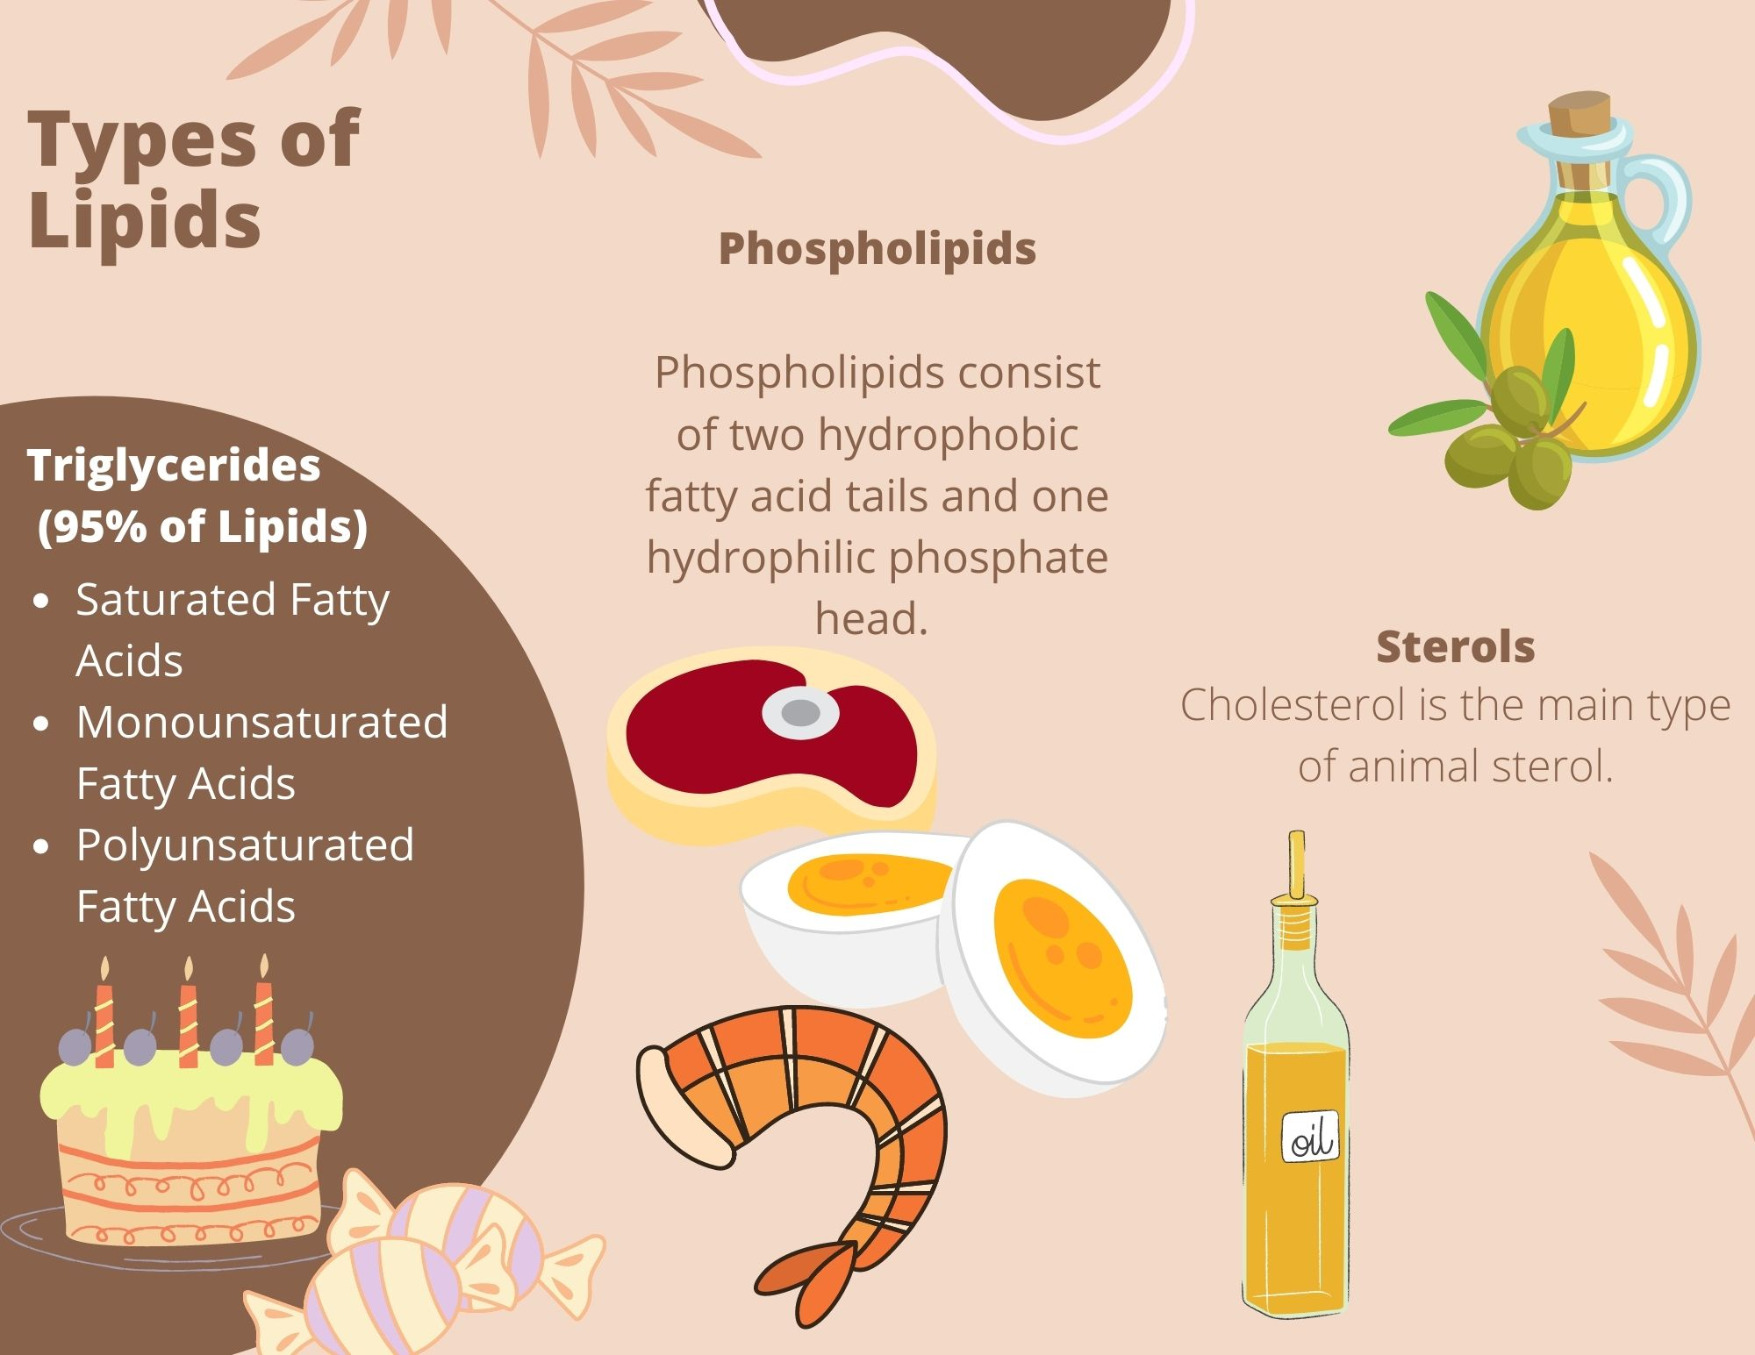
Types of Lipids
Component | Triglycerides | Phospholipids | Sterols
Structure | Glycerol + 3 fatty acids | Glycerol + 2 fatty acids + phosphate | Complex ring structure (e.g., cholesterol)
Function | Energy storage, insulation, protection | Cell membranes, emulsification | Cell membrane structure, hormone production
Solubility | Insoluble in water | Amphipathic (water & fat soluble) | Insoluble in water
Food Sources | Most fats and oils (e.g., butter, oils) | Egg yolks, soy, lecithin | Animal products (cholesterol), plant sterols
Body Role | Energy source, vitamin transport | Cell membrane structure, fat transport | Hormones, Vitamin D, bile production, cell membranes, nerve tissue

Slide 69
Triglycerides
Type of Fat | Structure | Food Sources | Health Impact
Saturated Fats | No double bonds | Animal products, butter, cheese, dairy, coconut oil | Immune function, brain health, cell structure Excess raises LDL cholesterol, increasing risk of CAD
Monounsaturated Fats | One double bond | Olive oil, avocados, nuts | Lowers LDL, heart-protective
Polyunsaturated Fats | Two or more double bonds | Fatty fish, flaxseeds, vegetable oils Fatty fish, chia, flax, walnuts Vegetable oils, sees, nuts | Supports cholesterol balance, heart health Omega-3 Omega-6
Trans Fats | Artificial trans double bonds (to be more solid at room temp) | Processed foods, baked goods, margarine | Raises LDL, lowers HDL, increases heart disease risk, promotes inflammation Linked to diabetes, stroke, etc…

Slide 70
Triglycerides- Omega-3 and Omega-6: Balance
Omega-3 Fatty Acids:
Structure: First double bond is at the third carbon atom from the end of the fatty acid chain.
Food Sources: Fatty fish (salmon, mackerel, tuna, halibut, sardines, rainbow trout- recommendation to eat 2x per week), flaxseeds, chia seeds, walnuts, wheat/oat germ, and green leafy vegetables.
Health Impact: Anti-inflammatory properties, supports brain health, reduces the risk of heart disease (reduce blood clotting process), and improves cholesterol balance.
Role in Body: Produces anti-inflammatory prostaglandins and promotes healthy cell membranes.
Omega-6 Fatty Acids:
Structure: First double bond is at the sixth carbon atom from the end of the fatty acid chain.
Food Sources: Vegetable oils (corn oil, sunflower oil), nuts, seeds.
Health Impact: Necessary for normal growth and development, but excessive omega-6 intake (in comparison to omega-3) may promote inflammation and contribute to chronic conditions like heart disease and arthritis.
Role in Body: Produces pro-inflammatory compounds, which are important for immune response and clotting.

Slide 71
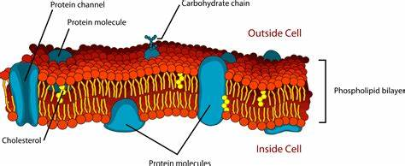
Phospholipids
Composed of two fatty acids, a phosphate group, and a glycerol backbone. Commonly known phospholipid is lecithin.
The body synthesizes phospholipids, so they are not essential nutrients.
Function:
    Emulsification: Lecithin acts as an emulsifier, allowing it to mix with both water and fat, crucial for food products.
    Cell Structure: Essential component of cell membranes, contributing to structural integrity and fluidity.
Sources:
    Natural Sources: Found in egg yolks, soybeans, and certain organ meats.
    Food Processing: Lecithin used in making products like mayonnaise, chocolate, and baked goods to prevent separation and enhance freshness.

Slide 72
Sterols
A class of lipids characterized by complex structures with carbon rings, including cholesterol.
More complex than triglycerides, consisting of interlinked carbon rings with side chains of carbon, hydrogen, and oxygen.
Sterols are synthesized by the liver, particularly cholesterol, which is not an essential nutrient.
Function:
Cholesterol: Plays a critical role in cell membrane structure, hormone synthesis, and vitamin D production.
Liver Regulation: The liver produces cholesterol based on the body’s needs; dietary intake influences but does not solely dictate levels.
Sources:
Dietary Cholesterol: Found only in animal-derived foods, including:
Meats (beef, pork, chicken)
Fish and seafood
Dairy products (milk, cheese, butter)
Eggs
Plant Foods: Do not contain cholesterol.

Slide 73
Fat Content of Foods
High-fat foods = high-calorie foods.
DRIs based on AMDRs recommend 20% to 30% of kcal intake from fats, with 10% or less of kcals from saturated fats (7% or less in patients with CAD)
Total fat intake for average daily kcal intake of 2000 to 2500:
Total fat: ≤40-97 g (400 to 875 kcal) per day
Saturated fat: ≤20-25 g (180-225 kcal) per day
For children younger than 5 years of age: at least 20% of kcals as fat

Slide 74
Misconceptions about Fat Intake
Most Americans consume 35-40% of total kcal intake as fat despite common belief they are limiting high-fat foods in their diets
    Sensory Qualities: High-fat foods are appealing due to their strong sensory qualities (taste and texture) and high energy density, leading to passive overeating.
    Decline in Home Cooking: The decrease in home cooking makes it harder for individuals to track fat content in their diets, as many are unsure about the ingredients in restaurant dishes.
    Portion Sizes: Restaurant portion sizes often exceed recommended serving sizes, contributing to increased fat and calorie consumption.
    Misinterpretation of Dietary Messages: The message of “less fat, more carbs” has been misinterpreted, resulting in diets rich in low-fiber, high-calorie processed carbohydrates rather than healthier alternatives.
    Confusion with Labels: Consumers may be misled by “reduced fat” labels, leading to increased overall intake of these products, which can contribute to higher caloric consumption.

Slide 75
Blood Cholesterol
Chylomicrons: Transport dietary fats from the intestines to the liver.
01
Very Low-Density Lipoproteins (VLDL): Transport newly made triglycerides from the liver to cells.
02
Low-Density Lipoproteins (LDL): Carry cholesterol from the liver to body tissues.
03
High-Density Lipoproteins (HDL): Remove cholesterol from cells and transport it back to the liver for disposal.
04

Slide 76
Blood Cholesterol
Risk Classification | Total Cholesterol | LDL Cholesterol | HDL Cholesterol
Desirable | <200 | <130 | >50
Borderline- high | 200-239 | 130-159 | 40-49
High | >240 | >160 | <40
Health guidelines for dietary cholesterol intake
- <300 mg of dietary cholesterol per day
<200 mg of dietary cholesterol per day if LDL level is elevated
However, blood cholesterol levels are more related to triglyceride intake (esp. saturated fats); food cholesterol intake does not greatly affect blood cholesterol levels

Slide 77
Health Concerns about Dietary Fat Intake
Appropriate energy intake: Fat is more efficient being stored in body than
carbohydrate and protein.
Reduced intake of other nutrients because of excessive dietary fat consumption (i.e. fiber)
Relationship between dietary fat intake and diet-related disorders
      CVD
      Some cancers
      T2DM
      Hypertension

Slide 78
Nursing Implications
Education:
Nurses can educate patients about the importance of understanding fat content in foods and the implications of misleading food labels.
Promoting Healthy Choices:
Encourage patients to choose whole foods and prepare meals at home to have better control over fat and calorie intake.
Awareness of Portion Sizes:
Highlight the significance of appropriate portion sizes when dining out to help manage fat and caloric intake.
Teach patients how to classify foods according to their fat content using tools like the Exchange List and MyPlate.
Emphasize the importance of recognizing healthier fat sources, such as plant-based oils and fatty fish, compared to saturated and trans fats.
Encourage patients to share meals or request smaller portions to manage their fat intake better and avoid excess calories.
Provide simple recipes or cooking classes that emphasize the use of healthy oils and fats.
Encourage patients to use measuring tools for oils and fats to understand appropriate serving sizes.
Promote the consumption of oils rich in omega-3 and omega-6 fatty acids, like olive oil, canola oil, and nut oils. Discuss the benefits of these fats in reducing inflammation and supporting heart health.
Correct any misconceptions patients may have about fats and oils, especially regarding the belief that all fats are harmful. Discuss the role of healthy fats in nutrient absorption and overall health.
While many foods lack labels, educate patients about interpreting nutritional information for packaged foods. Teach them to recognize the difference between “reduced fat” and actual fat content, emphasizing that low-fat does not always mean lower calories.

Slide 79
Quiz Time
Which fatty acid has anti-inflammatory properties and supports brain health?
a) Omega-6
b) Omega-3
c) Trans fat
d) Saturated fat
What type of fat is artificially created and found in processed foods like margarine and baked goods?
a) Monounsaturated fat
b) Trans fat
c) Saturated fat
d) Polyunsaturated fat

Slide 80
Quiz Time
3. What is the main function of fat in the body?
a) Protein synthesis
b) Provide insulation and energy storage
c) Support carbohydrate metabolism
d) Aid in muscle contraction
4. Omega-3 fatty acids can be found in:
a) Olive oil
b) Salmon
c) Butter
d) Red meat

Slide 81
Quiz Time
5. What percentage of daily caloric intake should come from fats, according to dietary recommendations?
a) 10%-15%
b) 20%-30%
c) 35%-45%
d) 50%-60%
6. Which of the following fats should be limited to less than 10% of daily intake?
a) Saturated fat
b) Polyunsaturated fat
c) Omega-3 fat
d) Monounsaturated fat

