Slide 1
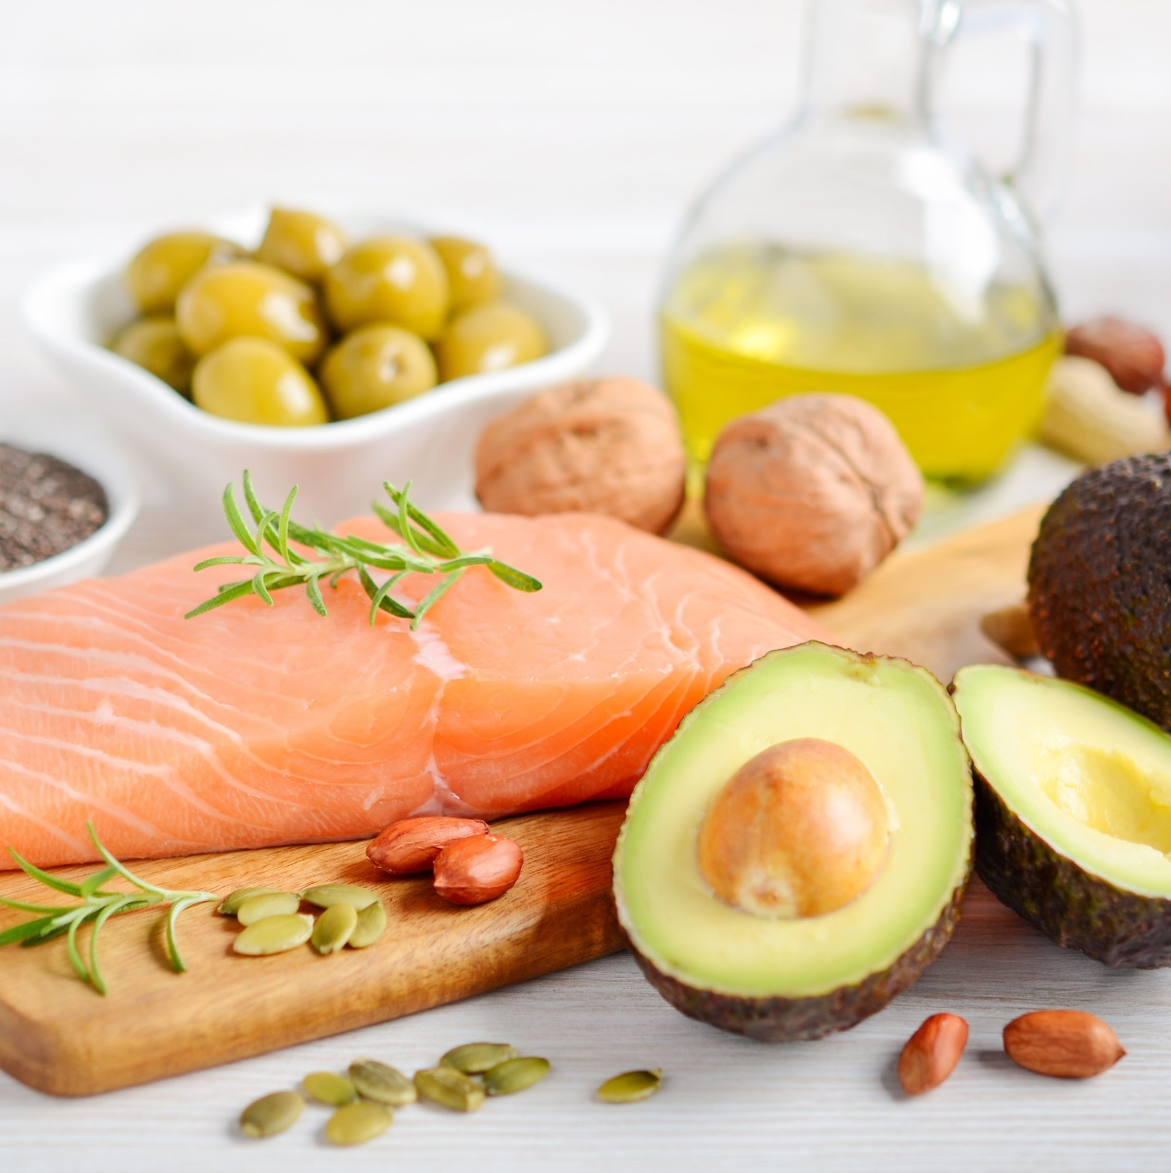
Fats
Chapter 5

Slide 2
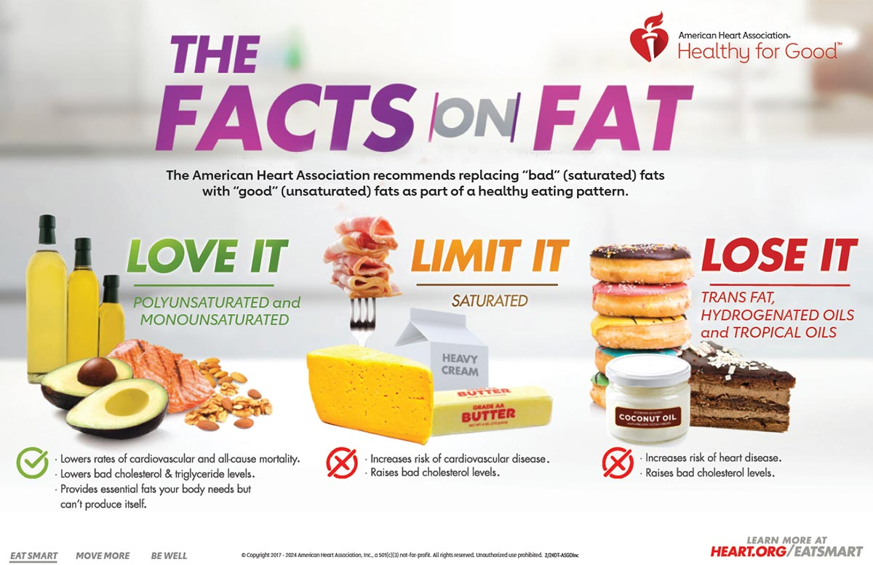
Role in Wellness
Some dietary fats are essential for health, while others may increase disease risk when consumed in large amounts.
Fat is necessary for essential fatty acids (EFAs), energy, and fat-soluble vitamins.
Excessive fat intake may contribute to obesity and diet-related diseases.

Slide 3
Food Functions
Source of Energy
Fat is the densest form of energy, providing 9 kcal per gram, more than twice that of carbohydrates or proteins (4 kcal per gram).
Triglycerides in fat provide stored energy for the body.
Palatability
Fat enhances the taste and smell of food, making it more appealing (e.g., fried foods, butter, cream).
Adding small amounts of fat can improve nutrient intake for patients with anorexia.
Satiety and Satiation
Satiety: Fat slows digestion, helping to prevent hunger between meals by making us feel full.
Satiation: Fat increases the desire to eat more during a meal, potentially leading to overeating.
Food Processing
Lipids are valuable in food processing, such as preventing rancidity and acting as emulsifiers (e.g., lecithin).
Processed fats contribute to higher overall lipid intake.

Slide 4
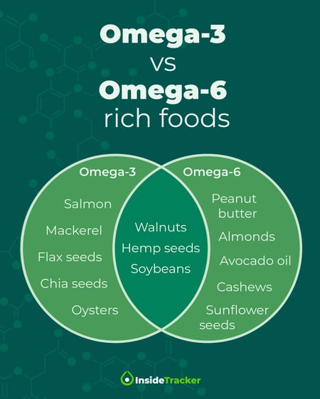
Food Functions
Nutrient Source
Fats transport fat-soluble vitamins (A, D, E, K) and essential fatty acids (EFAs) like linoleic and linolenic acids (cannot be made by the body; omega-3 and omega-6).
EFAs are crucial for regulating blood pressure, blood clotting, and maintaining healthy cell membranes.
EFA deficiency can lead to skin lesions, eczema, inflammation, and increased infection susceptibility
Potential causes of EFA deficiency includes patients with malabsorption disorders, patients on TPN without adequate lipids, patients on low-fat high protein diets, patients recovering from serious burns or injuries, and individuals who opt for extremely low dietary fat intake

Slide 5
Physiological Functions of Fat
Stored Energy: Fat stores in the body, mainly as triglycerides, provide fuel during illness, food restriction, and muscle work.
Organ Protection: Fat cushions organs and protects them from impact during physical activity.
Temperature Regulation: Subcutaneous fat insulates the body, helping to maintain temperature by reducing heat loss.
Insulation: Myelin, a fatty tissue, insulates nerve cells and allows for efficient transmission of nerve impulses.

Slide 6
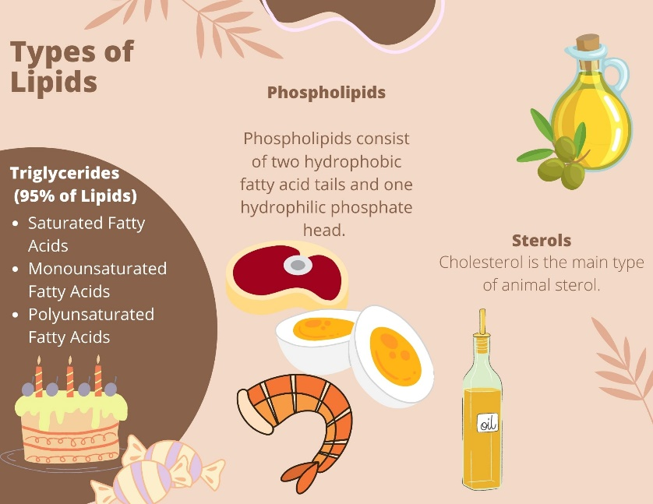
Types of Lipids
Component | Triglycerides | Phospholipids | Sterols
Structure | Glycerol + 3 fatty acids | Glycerol + 2 fatty acids + phosphate | Complex ring structure (e.g., cholesterol)
Function | Energy storage, insulation, protection | Cell membranes, emulsification | Cell membrane structure, hormone production
Solubility | Insoluble in water | Amphipathic (water & fat soluble) | Insoluble in water
Food Sources | Most fats and oils (e.g., butter, oils) | Egg yolks, soy, lecithin | Animal products (cholesterol), plant sterols
Body Role | Energy source, vitamin transport | Cell membrane structure, fat transport | Hormones, Vitamin D, bile production, cell membranes, nerve tissue

Slide 7
Triglycerides
Type of Fat | Structure | Food Sources | Health Impact
Saturated Fats | No double bonds | Animal products, butter, cheese, dairy, coconut oil (fats that are solid at room temperature) | Immune function, brain health, cell structure Excess raises LDL cholesterol, increasing risk of CAD
Monounsaturated Fats | One double bond | Olive oil, avocados, nuts | Lowers LDL, heart-protective
Polyunsaturated Fats | Two or more double bonds | Fatty fish, flaxseeds, vegetable oils Fatty fish, chia, flax, walnuts Vegetable oils, sees, nuts | Supports cholesterol balance, heart health Omega-3 Omega-6
Trans Fats | Artificial trans double bonds (to be more solid at room temp) | Processed foods, baked goods, margarine | Raises LDL, lowers HDL, increases heart disease risk, promotes inflammation Linked to diabetes, stroke, etc…

Slide 8
Triglycerides- Omega-3 and Omega-6: Balance
Omega-3 Fatty Acids:
Structure: First double bond is at the third carbon atom from the end of the fatty acid chain.
Food Sources: Fatty fish (salmon, mackerel, tuna, halibut, sardines, rainbow trout- recommendation to eat 2x per week), flaxseeds, chia seeds, walnuts, wheat/oat germ, and green leafy vegetables.
Health Impact: Anti-inflammatory properties, supports brain health, reduces the risk of heart disease (reduce blood clotting process), and improves cholesterol balance.
Role in Body: Produces anti-inflammatory prostaglandins and promotes healthy cell membranes.
Omega-6 Fatty Acids:
Structure: First double bond is at the sixth carbon atom from the end of the fatty acid chain.
Food Sources: Vegetable oils (corn oil, sunflower oil), nuts, seeds.
Health Impact: Necessary for normal growth and development, but excessive omega-6 intake (in comparison to omega-3) may promote inflammation and contribute to chronic conditions like heart disease and arthritis.
Role in Body: Produces pro-inflammatory compounds, which are important for immune response and clotting.

Slide 9
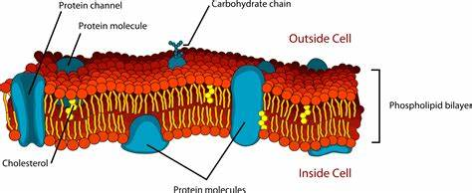
Phospholipids
Composed of two fatty acids, a phosphate group, and a glycerol backbone. Commonly known phospholipid is lecithin.
The body synthesizes phospholipids, so they are not essential nutrients.
Function:
    Emulsification: Lecithin acts as an emulsifier, allowing it to mix with both water and fat, crucial for food products.
    Cell Structure: Essential component of cell membranes, contributing to structural integrity and fluidity.
Sources:
    Natural Sources: Found in egg yolks, soybeans, and certain organ meats.
    Food Processing: Lecithin used in making products like mayonnaise, chocolate, and baked goods to prevent separation and enhance freshness.

Slide 10
Sterols
A class of lipids characterized by complex structures with carbon rings, including cholesterol.
More complex than triglycerides, consisting of interlinked carbon rings with side chains of carbon, hydrogen, and oxygen.
Sterols are synthesized by the liver, particularly cholesterol, which is not an essential nutrient.
Function:
Cholesterol: Plays a critical role in cell membrane structure, hormone synthesis, and vitamin D production.
Liver Regulation: The liver produces cholesterol based on the body’s needs; dietary intake influences but does not solely dictate levels.
Sources:
Dietary Cholesterol: Found only in animal-derived foods, including:
Meats (beef, pork, chicken)
Fish and seafood
Dairy products (milk, cheese, butter)
Eggs
Plant Foods: Do not contain cholesterol.

Slide 11
Fat Content of Foods
High-fat foods = high-calorie foods.
DRIs based on AMDRs recommend 20% to 30% of kcal intake from fats, with 10% or less of kcals from saturated fats (7% or less in patients with CAD)
Total fat intake for average daily kcal intake of 2000 to 2500:
Total fat: ≤40-97 g (400 to 875 kcal) per day
Saturated fat: ≤20-25 g (180-225 kcal) per day
For children younger than 5 years of age: at least 20% of kcals as fat

Slide 12
Misconceptions about Fat Intake
Most Americans consume 35-40% of total kcal intake as fat despite common belief they are limiting high-fat foods in their diets
    Sensory Qualities: High-fat foods are appealing due to their strong sensory qualities (taste and texture) and high energy density, leading to passive overeating.
    Decline in Home Cooking: The decrease in home cooking makes it harder for individuals to track fat content in their diets, as many are unsure about the ingredients in restaurant dishes.
    Portion Sizes: Restaurant portion sizes often exceed recommended serving sizes, contributing to increased fat and calorie consumption.
    Misinterpretation of Dietary Messages: The message of “less fat, more carbs” has been misinterpreted, resulting in diets rich in low-fiber, high-calorie processed carbohydrates rather than healthier alternatives.
    Confusion with Labels: Consumers may be misled by “reduced fat” labels, leading to increased overall intake of these products, which can contribute to higher caloric consumption.

Slide 13
Blood Cholesterol
Chylomicrons: Transport dietary fats from the intestines to the liver.
01
Very Low-Density Lipoproteins (VLDL): Transport newly made triglycerides from the liver to cells.
02
Low-Density Lipoproteins (LDL): Carry cholesterol from the liver to body tissues.
03
High-Density Lipoproteins (HDL): Remove cholesterol from cells and transport it back to the liver for disposal.
04

Slide 14
Blood Cholesterol
Risk Classification | Total Cholesterol | LDL Cholesterol | HDL Cholesterol
Desirable | <200 | <130 | >50
Borderline- high | 200-239 | 130-159 | 40-49
High | >240 | >160 | <40
Health guidelines for dietary cholesterol intake
- <300 mg of dietary cholesterol per day
<200 mg of dietary cholesterol per day if LDL level is elevated
However, blood cholesterol levels are more related to triglyceride intake (esp. saturated fats); food cholesterol intake does not greatly affect blood cholesterol levels

Slide 15
Health Concerns about Dietary Fat Intake
Appropriate energy intake: Fat is more efficient being stored in body than
carbohydrate and protein.
Reduced intake of other nutrients because of excessive dietary fat consumption (i.e. fiber)
Relationship between dietary fat intake and diet-related disorders
      CVD
      Some cancers
      T2DM
      Hypertension

Slide 16
Nursing Implications
Education:
Nurses can educate patients about the importance of understanding fat content in foods and the implications of misleading food labels.
Promoting Healthy Choices:
Encourage patients to choose whole foods and prepare meals at home to have better control over fat and calorie intake.
Awareness of Portion Sizes:
Highlight the significance of appropriate portion sizes when dining out to help manage fat and caloric intake.
Emphasize the importance of recognizing healthier fat sources, such as plant-based oils and fatty fish, compared to saturated and trans fats.
Encourage patients to share meals or request smaller portions to manage their fat intake better and avoid excess calories.
Provide simple recipes or cooking classes that emphasize the use of healthy oils and fats.
Encourage patients to use measuring tools for oils and fats to understand appropriate serving sizes.
Promote the consumption of oils rich in omega-3 and omega-6 fatty acids, like olive oil, canola oil, and nut oils. Discuss the benefits of these fats in reducing inflammation and supporting heart health.
Correct any misconceptions patients may have about fats and oils, especially regarding the belief that all fats are harmful. Discuss the role of healthy fats in nutrient absorption and overall health.
While many foods lack labels, educate patients about interpreting nutritional information for packaged foods. Teach them to recognize the difference between “reduced fat” and actual fat content, emphasizing that low-fat does not always mean lower calories.
Teach patients how to classify foods according to their fat content using tools like the Exchange List and MyPlate.

Slide 17

Chapter 6
Protein

Slide 18
Role in Wellness
Food protein is the only source of amino acids.
Amino acids are required to make body proteins
Americans often consume more protein than necessary
Most people need approximately 5-6 oz of protein per day
  1 small steak = 3½ to 4 ounce-equivalents
  1 small lean hamburger = 2 to 3 ounce-equivalents
  1 small chicken breast half = 3 ounce-equivalents
  1 can of tuna, drained = 3 to 4 ounce-equivalents
  1 salmon steak = 4 to 6 ounce-equivalents
  1 ounce of nuts or seeds = 2 ounce-equivalents

Slide 19
Protein
Protein: organic compounds made from linking amino acids
9 of the 20 required amino acids are essential and cannot be made by the liver
Amino acids contain carbon, hydrogen, oxygen, and nitrogen

Slide 20
Digestion of Protein
Mouth – mechanical digestion only
Stomach- pepsin breaks down into smaller amino acid chains
Absorption of AA through intestinal wall by active transport requires vitamin B₆
Small intestine
Pancreatic enzymes including trypsin break down further into absorbable amino acids

Slide 21
Metabolism of Protein
Amino acids can be synthesized to build new proteins (anabolism)
Amino acids can also be catabolized by liver cells through deamination which results in production of ammonia and keto acids
Ammonia is converted to urea which is excreted in urine.
Ketoacids may be converted to energy or may be converted to glucose and fat
Protein excess leads to increased deamination which can result in high levels of ketoacids and increased workload on liver and kidneys to excrete urea
No definitive benefits of excess protein intake
Animal protein sources often have saturated fat and cholesterol as well which can increase risk of CVD and some cancers
Stimulated by growth hormone and testosterone
Notes:
.

Slide 22
Nitrogen Balance
Nitrogen Balance: Measures the balance between nitrogen intake (from protein) and nitrogen loss (via urine, sweat, etc.).
Positive Nitrogen Balance: Occurs when intake exceeds loss, supporting growth, pregnancy, muscle building, and tissue repair.
Negative Nitrogen Balance: Occurs when loss exceeds intake, often during illness, injury, or malnutrition, leading to muscle and tissue breakdown.
Equilibrium: A healthy adult typically maintains nitrogen balance, where intake and loss are equal, supporting maintenance of body tissues.
Notes:
Nitrogen balance: crucial indicator of overall protein metabolism and health status, as nitrogen is a fundamental component of amino acids, which are the building blocks of proteins
In situations of illness, stress, or inadequate protein intake, the body enters a negative nitrogen balance (where nitrogen loss exceeds intake), leading to muscle breakdown to supply amino acids for critical bodily functions. This can weaken the body, impair healing, and increase the risk of complications in malnutrition.

Slide 23
Functions of Protein in the Body
Growth and maintenance
Builds and repairs cells, tissues, muscles, bones, hair, nails, and skin
Collagen forms connective tissues including ligaments and tendons
Creation of communicators and catalysts
Communicators: Hormones (e.g., insulin) regulate body functions.
Catalysts: Enzymes speed up chemical reactions
Immune system response
Fluid and electrolyte regulation & Acid–base balance
Transportation
Protein pumps nutrients in and out of cells.
Lipoproteins carry nutrients including lipids, minerals, vitamins, and electrolytes in blood.
Protein carriers include hemoglobin and myoglobin which allows for oxygen transport as well as storage in muscle.
Maintain water balance across body compartments
Proteins buffer pH levels to maintain safe acidity in body fluids, protecting protein functions (keeps proteins from denaturing)
Form antibodies, defending against infections and supporting disease resistance
Blood clotting factors (e.g., fibrinogen)
Wound healing
Framework for bone and tooth formation
This osmotic pressure ensures appropriate balance between intracellular, intravascular, and interstitial fluids

Slide 24
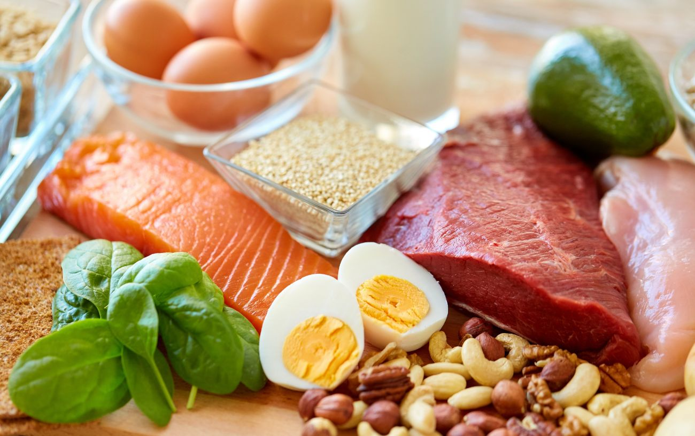
Protein Food Sources
Complete proteins contain all 9 EAAs in sufficient quantities (Animal derived foods, most dairy products, eggs and soybeans)
Incomplete protein lacks one or more of the 9 EAAs (Plant based protein sources including grins, legumes, and some vegetables); therefore, cannot meet the body’s AA requirements independently
“High-quality proteins” contains best balance and assortment of EAAs and NEAAs and are easily digestible (Eggs and human breast milk)
Those with a limited diet (vegetarian or vegan) must ensure wide variety of foods to meet their EAA needs
If there is very little protein intake, the body will break down muscle tissue to get the AA it needs to function

Slide 25
Protein Recommended Dietary Allowance (RDA)
Protein RDA: 0.8 g/kg for adults - (male: 56-63 g; female: 46-50 g)
AMDR Range: 10% to 35% of kcal intake as protein
Serious physical illness, wound healing, fevers (increased metabolic rate), unusual stress, pregnancy and lactation increase protein requirements

Slide 26
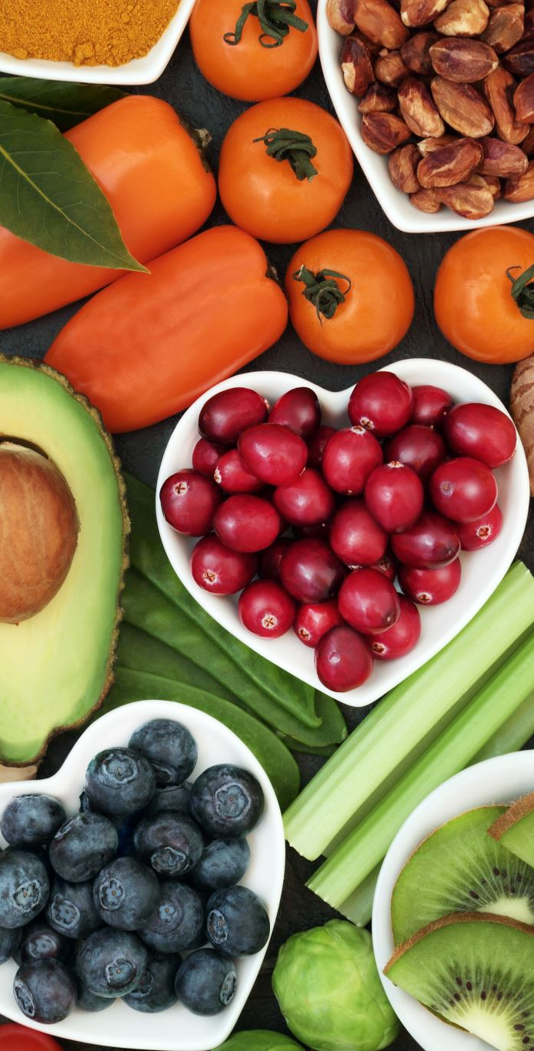
Vegetarianism
Dietary patterns:
  Vegan- No animal-derived foods
  Lactovegetarian- vegan + dairy
  Ovo-lacto-vegetarian- Vegan + dairy + eggs
  Flexitarian or pescatarian- primarily vegetarian with occasional animal-based protein
Benefits: reduced risk diet-related disorders, ethical treatment of animals and environmental conservation
Drawbacks: potential deficiencies of Vit D, B12, calcium, omega-3 fatty acids, iron, zinc; replacement of meat with high fat foods like cheese

Slide 27
Protein and Malnutrition
Protein energy malnutrition
Marasmus – total lack of kcal intake; overall thin, low muscle mass
Kwashiorkor – adequate kcal, not enough protein; swollen belly and round cheeks due to fluid shifts
Malnutrition factors
Populations at risk in North America
Homeless individuals
Older adults
Working poor: income barely covers basic expenses of housing, utilities, and health care and leave little money for food
Growth failure, reduced immunity, permanent brain or liver damage
Biologic- maternal nutrition, conditions affecting nutrient consumption or absorption
Socioeconomic- abuse and neglect, eating disorders, drug abuse, social isolation, alcoholism
Economic- low SES, unemployment, low education, polluted or contaminated food supplies
Children with chronic infections/illnesses

Slide 28
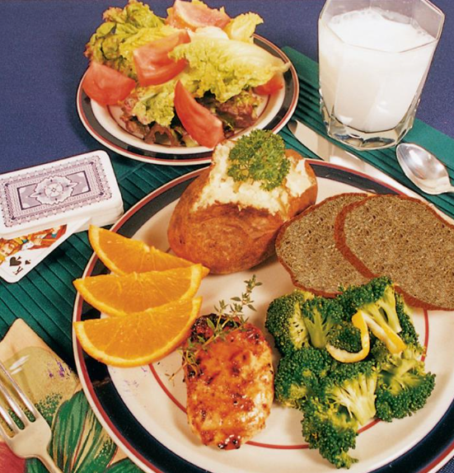

Restructuring the Dinner Plate
Deemphasizing protein foods
Deck of cards or palm of your hand: appropriate size of animal protein portion
Notes:
One on the left is correct amount of protein per my plate – deck of cards, 3 oz
Spreading protein intake throughout the food groups allows the objectives of MyPlate to be met. The first plate (see Fig. 6.5) provides the following:
• 1 oz (whole) grains
• 3 cups vegetables
• 0 cups fruit
• 1 cup milk (low-fat or fat-free)
• 6 oz meat and beans
• The second plate (see Fig. 6.6) provides the following:
• 2 oz (whole) grains
• 4 cups vegetables
• ½ cup fruit
• 1 cup milk (low-fat or fat-free)
• 3 oz meat and beans

Slide 29
Chapter 7
Vitamins

Slide 30
Role in Wellness
Vitamins: organic molecules needed in very small amounts for cellular metabolism
Perform specific metabolic functions
Essential nutrients to be provided by diet
Deficiencies – Primary and Secondary
Risk for toxicities with inappropriate supplement use

Slide 31
Vitamin Categories
Divided into two categories based on solubility
Water-soluble:
B-complex vitamins (thiamin, riboflavin, niacin, pyridoxine, folate, cobalamin, biotin, and pantothenic acid), choline, and vitamin C
Minimal storage by body
Deficiencies quick to develop
Usually low risk of toxicity
Fat-soluble vitamins: vitamins A, D, E, and K
Excess stored in body
Deficiencies slower to develop
Greater risk of toxicity

Slide 32
Food Sources
Vitamins are present in almost all foods, especially fresh fruit and vegetables
Vitamins are best consumed from food sources.
Synthetic vitamins will perform vitamin function but may lack the other benefits found in foods that are rich vitamin sources.
Notes:
Phytochemicals are nonnutritive substances in plant-based foods that appear to have disease-fighting properties. I.e… Flavonoids have anti-inflammatory effects and reduce risk for CVD and cancer

Slide 33
Water Soluble B Vitamins
Vitamin | Functions | Sources | Deficiency | Toxicity
B1 (Thiamin) | - Energy production through carbohydrate metabolism - Nerve, muscle, and heart function | - Whole grains, legumes, nuts - Pork, seeds - Fortified cereals | - Beriberi: ataxia, tachycardia (wet: affects cardiovascular system; dry: affects nervous system) - Wernicke-Korsakoff syndrome (especially in alcoholics): memory loss, extreme confusion, | - Rare, but excessive doses may cause irritability, headache, and rapid pulse
B2 (Riboflavin)- very sensitive to light | - Energy production - Cellular function, growth, and development - Antioxidant function | - Milk and dairy products - Eggs, lean meats - Green vegetables, fortified cereals | - Ariboflavinosis (cracked lips, sore throat, redness/swelling of mouth lining, cheilosis, glossitis) - Seborrheic dermatitis | - No known toxicity; water-soluble and generally well-tolerated
B3 (Niacin) | - Energy production - Supports digestive and nervous system health - Skin health | - Meat, fish, poultry - Whole grains, nuts - Fortified cereals, legumes | - Pellagra (three Ds: dermatitis, diarrhea, dementia) - Weakness and fatigue | - High doses can cause flushing, liver damage, and gastrointestinal issues
B6 (Pyridoxine) | - Amino acid metabolism, protein absorption - Red blood cell production - Neurotransmitter synthesis | - Poultry, fish, organ meats - Potatoes, bananas - Fortified cereals, chickpeas | - Microcytic anemia - Peripheral neuropathy, seizures in infants - Depression, confusion | - Nerve damage leading to ataxia and sensory neuropathy, especially with prolonged use
B12 (Cobalamin) | Red blood cell formation Folate metabolism - DNA synthesis - Nerve function and myelin sheath | - Meat, fish, poultry - Dairy products, eggs - Fortified plant-based milk and cereals | - Pernicious anemia - Neurological symptoms (numbness, tingling, cognitive decline) | - No established toxicity, but high doses could interact with certain medications
Notes:
Dry Beriberi: Primarily affects the nervous system, leading to symptoms like muscle weakness, peripheral neuropathy (tingling, numbness in extremities), and difficulty walking. This form of beriberi is most common in people with poor dietary intake of thiamine (vitamin B1) and can lead to chronic pain and coordination issues.
Wet Beriberi: Impacts the cardiovascular system, causing symptoms such as shortness of breath, rapid heart rate, and edema (swelling) in the lower limbs. Severe cases can lead to heart failure. Wet beriberi occurs when thiamine deficiency impacts the heart’s function and fluid regulation.
Wernicke-Korsakoff Syndrome: A neurological disorder caused by severe thiamine deficiency, commonly seen in people with chronic alcohol use disorder. It has two stages:
Wernicke’s Encephalopathy: The acute phase, marked by confusion, ataxia (loss of coordination), and eye movement issues (ophthalmoplegia).
Korsakoff Syndrome: The chronic phase, which causes persistent memory problems and confabulation (filling in memory gaps with fabricated information). It can lead to long-term cognitive impairment if not treated promptly.
Pellagra, the niacin deficiency disorder, is characterized by the three Ds:
• Dermatitis: A symmetric scaly rash occurs only on skin exposed to the sun
• Dementia: As the central nervous system becomes affected in severe deficiencies, confusion, anxiety, insomnia, and paranoia develop.
• Diarrhea: Damage to the GI tract affects digestion, absorption, and excretion of food, leading to glossitis, vomiting, and diarrhea.

Slide 34
Additional Water-Soluble Vitamins
Vitamin | Functions | Sources | Deficiency | Toxicity
Folate (B9) 400 mcg | - DNA and RNA synthesis - Red blood cell production - Supports cell division and neural tube formation | - Leafy green vegetables, beans, peas - Fortified grains and cereals - Oranges, liver | - Megaloblastic anemia - Neural tube defects in pregnancy - Fatigue, mouth sores | - Masks symptoms of vitamin B12 deficiency in high doses
Biotin (B7) | - Fatty acid synthesis - Amino acid metabolism - Supports healthy hair, skin, and nails | - Eggs, nuts, seeds - Liver, salmon - Whole grains, avocado | - Hair thinning - Skin rash, brittle nails - Neurological symptoms (rare) | - No known toxicity; generally well-tolerated as water-soluble
Pantothenic Acid (B5) | - Energy production (part of Coenzyme A) - Synthesis of fatty acids, hormones, and cholesterol | - Meat, poultry, eggs - Whole grains, potatoes - Broccoli, avocados | - Rare; symptoms may include fatigue, headache, irritability | - No known toxicity; high doses may cause mild digestive upset
Choline | - Cell membrane structure - Brain and nerve function; synthesis of acetylcholine - Lipid transport and metabolism | - Meat, poultry, fish - Eggs, milk - Cruciferous vegetables, peanuts | - Liver damage (rare) - Muscle damage, memory loss | - Fishy body odor, sweating, low blood pressure, liver toxicity at very high doses
Vitamin C 75-90 mg | - Antioxidant - Collagen synthesis - Immune function, wound healing, and iron absorption | - Citrus fruits (oranges, lemons), strawberries - Bell peppers, broccoli, spinach | - Scurvy (bleeding gums, joint pain, poor wound healing) - Fatigue | - Diarrhea, nausea, stomach cramps at high doses; potential for kidney stones in susceptible individuals

Slide 35
Fat Soluble Vitamins
Vitamin | Functions | Sources | Deficiency | Toxicity
Vitamin A | - Vision (especially in low light) - Immune function - Skin and cell growth | - Liver, fish oils, dairy products - Carrots, sweet potatoes, spinach - Orange and yellow fruits and vegetables | - Night blindness, xerophthalmia (dry eyes) - Increased infection risk | - Nausea, dizziness, blurred vision, liver damage (from excessive preformed vitamin A)
Vitamin D | - Calcium and phosphorus absorption - Bone health - Immune function | - Sunlight exposure - Fatty fish (salmon, mackerel), egg yolks - Fortified milk and cereals | Rickets in children (soft bones) - Osteomalacia in adults (bone pain, weakness) Renal patients often need vitamin D supplementation | - Hypercalcemia (high blood calcium levels), kidney stones, nausea
Vitamin E | - Antioxidant - Protects cell membranes from damage - Supports immune function | - Nuts and seeds (almonds, sunflower seeds) - Vegetable oils (sunflower, safflower) - Spinach, broccoli | - Nerve and muscle damage (rare) - Vision problems, weakened immune response | - Hemorrhagic effects in very high doses, particularly with blood-thinning medications
Vitamin K | - Blood clotting - Bone metabolism and maintenance of bone density | - Leafy green vegetables (kale, spinach) - Broccoli, Brussels sprouts - Liver, meat, dairy | - Increased bleeding and bruising (due to impaired clotting) | - Can interfere with anticoagulant medications; toxicity is rare

Slide 36
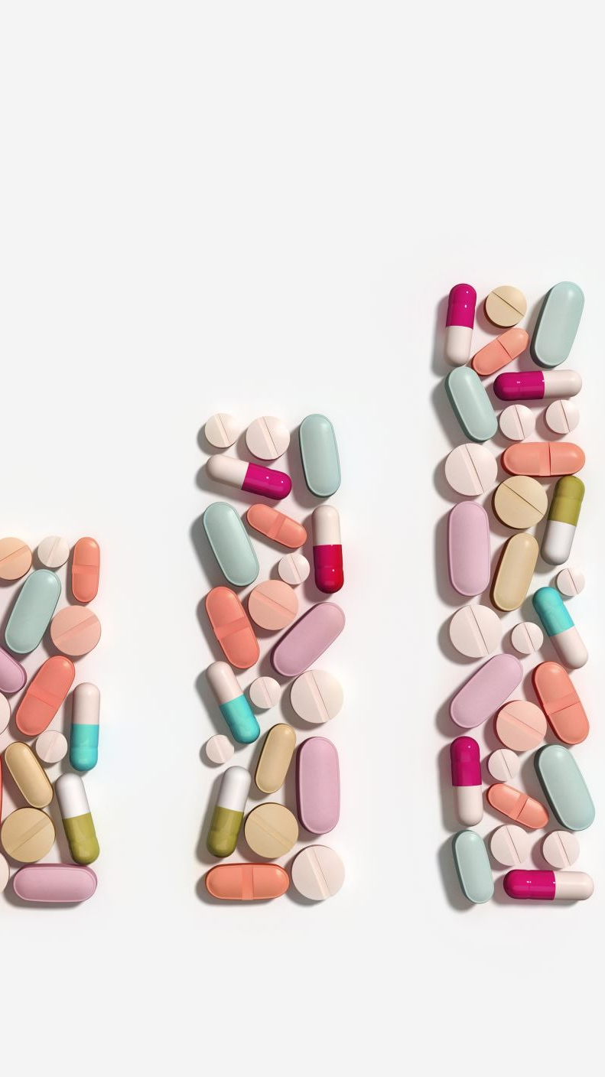
Vitamin Supplementation
Vitamin Supplementation Recommendations
  At-risk Groups: Adolescents, pregnant/lactating women, low-income individuals, older adults, vegetarians/vegans, alcohol-dependent, those with chronic conditions or on medications, and people with food insecurity.
  Identify and address nutrient deficiencies, especially for folate, vitamins A and C, iron, calcium, and zinc.
Approaches to Supplementation
  Education: Promote fortified foods and supplements, raise awareness about nutrient needs (e.g., folic acid during pregnancy).
  Functional Foods: Fortified foods can improve nutrient intake across populations.
  Individualized Supplement Use: Health professionals should guide personalized supplement use.

Slide 37

Chapter 8
Water and Minerals

Slide 38
Water
Food sources - Fluids, fruits, vegetables
Adequate Intake (AI) per day: approximately 13 cups for men; 9 cups for women
Amount in addition to fluids from foods
Water quality
Hard water: contains high level of minerals such as calcium and magnesium
Soft water: filtered with sodium to reduce mineral levels
Contamination: industrial and bacterial pollution, lead
Notes:
Watermelon, grapes, oranges, lettuce, tomatoes, and zucchini have high water content.
Minimum amount: about 4 cups; higher optimal
Hard water refers to water that contains high amounts of minerals such as calcium and magnesium. Drinking this water can provide a significant amount of these nutrients. Non–nutrition-related problems from hard water can develop; mineral deposits may damage appliances and other machinery that interacts with water, and soap suds are reduced. To diminish these problems, a filtration process can be installed to soften water by replacing some minerals with sodium chloride (salt). Soft water containing sodium, however, can be a problem for sodium-sensitive individuals, such as those at risk for hypertension. To prevent health problems, water softeners may be used on only the hot tap in kitchens, leaving the cold tap unsoftened for consumption.
Many older buildings have pipes with lead solder joints that can release lead into the water that sits in or runs through them. If the level of lead in water is more than 15 parts per billion (ppb), pregnant women, infants, and children are advised to drink bottled water because even low levels of lead can seriously impair normal development. The local health department can recommend a competent laboratory that tests household water quality.
To reduce lead exposure: run water for 2 minutes, use only cold water for cooking, drinking, and baby formula (cold water absorbs less lead

Slide 39
Water as a Nutrient in the Body
Structure: intracellular, extracellular, and interstitial fluids
Digestion and absorption
Most absorbed in small intestine
Remainder regulated by colon
Metabolism
Not metabolized, but integral component of metabolic processes

Slide 40
Function of Water
Structural component of cells; water is a major part of every tissue in the body
Regulation of body temperature
Lubricant for joint fluid and secretions
Shock absorber: cushions body tissues
Solvent for transport of nutrients and waste
Source of trace minerals
Involved with chemical processes in the body

Slide 41
Regulation of Fluid/Water in the
Body
Constitutes 50% to 60% of adult weight (75-80% in infants)
Homeostasis: maintained by thirst mechanism and body responses to electrolyte and protein levels
Excretion controlled by kidneys, brain, pituitary gland, and adrenal glands
Must excrete 500 mL daily to clear body of waste products
Hormones: antidiuretic hormone, aldosterone
Renin-angiotensin system triggered in response to sodium levels
Notes:
Percentages even higher for infants (75% to 80%)
Thirst stimulates desire to drink.
Thirst mechanism is controlled by hypothalamus.
As water level in body gets low, sodium and solute levels in blood increase.
This causes water to be drawn from salivary glands to provide more fluid for blood.
Mouth then feels dry because less saliva is produced.
If thirst mechanism is faulty, hormonal mechanisms conserve water by reducing urine output.
This is possible during illness, physical exertion, or aging.
Homeostasis (physiologic equilibrium) is maintained by electrolytes that include minerals and blood proteins. Two of the most important minerals are sodium and potassium. The extracellular distribution of fluid depends on sodium, and potassium influences intracellular water. Water moves within and between the cells in interstitial fluids in response to the levels of these minerals. An imbalance is corrected by mechanisms that cause thirst and regulate the ability of the kidneys to release or retain fluids.
Thirst, a dryness in the mouth, stimulates the desire to drink liquids. We often ignore our thirst until mealtimes. The thirst mechanism is controlled by the hypothalamus and involves several steps. The sodium and solute levels in blood rise as the water level in the body gets low. This causes water to be drawn from the salivary glands to provide more fluid for the blood. The mouth then feels dry because less saliva, which keeps the mouth moist, is produced. This sensation, thirst, stimulates the drinking process. If the thirst mechanism is faulty, as it may be during illness, physical exertion, or aging, hormonal mechanisms also help conserve water by reducing urine output.
The mechanisms of the kidneys regulate the amounts of water excreted. Obligatory water excretion of at least 500 mL (1 pint) must be performed daily, regardless of the amount ingested, to clear the body of waste products. The mechanism relies on the combined actions of the brain, kidneys, pituitary gland, and adrenal gland. When fluid in the body becomes low, the hypothalamus stimulates the pituitary gland to release antidiuretic hormone (ADH). ADH is secreted in response to high sodium levels in the body or too-low blood pressure or blood volume. The target organ of the hormone is the kidney. The kidneys then conserve water by decreasing excretion of water, and the retained fluid is recycled for use throughout the body.
When the sodium concentration in the kidneys gets high (too much fluid excreted), another process kicks in to counteract the lowered blood volume and pressure. The kidneys release renin, an enzyme that activates the blood protein angiotensin. Angiotensin raises blood pressure by narrowing blood vessels; it is a vasoconstrictor. Angiotensin also prompts the adrenal gland to release the hormone aldosterone. The target organ of aldosterone is the kidney. The effect is to decrease excretion of sodium, causing the kidneys to respond by retaining fluid in the body.

Slide 42
Fluid and Electrolytes
To maintain fluid balances; cells control movement of electrolytes
Fluid volume deficit (FVD)
Vascular, cellular, or intracellular dehydration
Causes include diarrhea, vomiting, high fever, diuretics, sweating, polyuria
Most at risk: elderly people and infants
Fluid volume excess and edema
Increased fluid retention and edema associated with compromised regulatory mechanism
Causes: sodium retention, kwashiorkor, water intoxication
Notes:
Kwashiorker- protein malnutrition causing shift of water
Water intoxication- dilutional effect on electrolytes

Slide 43
Minerals
16 essential minerals divided into two categories: major and trace minerals
Major minerals - Required daily: 100 mg or more
Trace minerals - Required daily: 20 mg or less
Food sources
Plants and animals
Inorganic: stable despite cooking
Limited bioavailability from some plant sources
Food processing: may result in mineral loss
Foods fortified with minerals
Notes:
Major
Calcium
Chloride
Magnesium
Phosphorus
Potassium
Sodium
Sulfur
Trace
Chromium
Copper
Fluoride
Iodine
Iron
Manganese
Molybdenum
Selenium
Zinc

Slide 44
Minerals as Nutrients in the
Body
Structure of minerals - Inorganic substances incorporated into body structures (bones), organs, and fluids
Digestion and absorption
During digestion, minerals are separated from foods.
Bioavailability affects levels of minerals absorbed.
Risk exists for deficiencies of iron, calcium, and zinc.
Metabolism
Minerals are not metabolized by the human body.
Some are cofactors of metabolic processes.

Slide 45
Major Minerals: Calcium
Functions: Structure and support, muscle contraction and relaxation, nerve impulses, blood clotting, BP regulation
Regulation
Bones can release calcium (parathormone, calcitriol aka activated vitamin D)
Intestines can absorb more calcium or kidneys prompted to retain more calcium (calcitonin)
Excess can cause calcium rigor (rigidity and stiffness of muscles)
Deficiency can cause calcium tetany (muscle and nerve excitability causing spasms)
Recommended intake and sources
AI: 1000 mg for adults to age 50; increased for children and adults > 50
Sources: dairy products (milk and milk-based products); leafy green vegetables; small fish with small bones; fortified foods (orange juice); legumes; tofu processed with calcium
Notes:
Function
Structure and storage (99% in bones)
Body fluids (1%); central nervous system function; muscle contraction/relaxation; blood clotting; blood pressure regulation
Regulation
Calcium homeostasis: Hormonal actions: parathormone, calcitriol, calcitonin
Hormones that regulate the level of calcium in body fluids control the release of calcium from bones. Hormones affecting blood levels include parathormone (parathyroid hormone), calcitriol (active vitamin D hormone), and calcitonin. Parathormone is secreted by the parathyroid gland in response to low blood calcium levels. It raises blood calcium levels by stimulating all three ways of providing calcium to body fluids. Vitamin D has a hormone-like effect as calcitriol and increases blood calcium levels by acting on all three systems. The third hormone involved, calcitonin, is released by the special C cells of the thyroid gland. Calcitonin reacts in response to high blood levels of calcium by lowering both calcium and phosphate in the blood.
Reactions of very low or extremely high blood levels can occur if regulatory mechanisms are hindered by a lack of vitamin D or hormone malfunction. If calcium blood levels get too high, calcium rigor (with symptoms of hardness or stiffness of muscles) may occur. Conversely, if levels are too low, a person may experience calcium tetany, with spasms caused by muscle and nerve excitability.
Effects of low/high blood calcium levels: calcium rigor (stiff muscles), calcium tetany (muscle spasms)

Slide 46
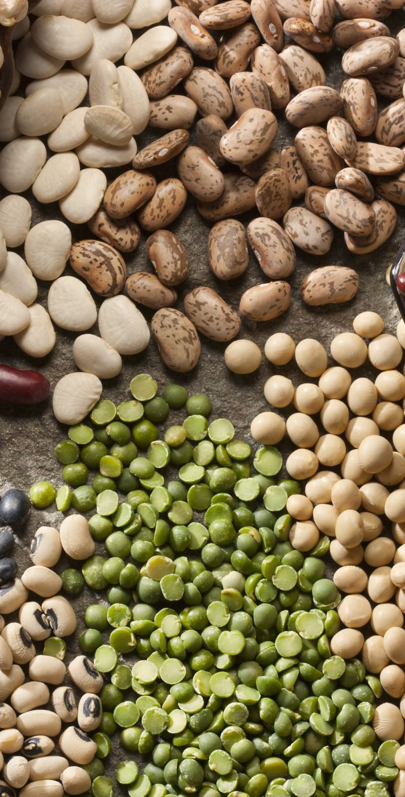
Major Minerals: Calcium
Strategies for lactose intolerance
  Natural non-dairy sources (leafy greens, beans, tofu)
  Calcium-fortified products (OJ, bread)
Absorption factors
  Adequate vitamin D
  Excessive phosphorus intake
  Sedentary lifestyle
Deficiency - Affects bone health; reduces bone density; stunts growth
Toxicity: Upper Limit (UL) of 2500 mg- kidney stones

Slide 47
Osteoporosis
Decreased bone density resulting in weak brittle bones
  Unmodifiable risk factors: race (white, Asian), gender (female), family history
  Modifiable risk factors: nutrition, calcium intake, alcohol, smoking, caffeine, sedentary lifestyle
  Secondary causes: chronic steroid use, alcoholism, multiple myeloma, gastric surgery, anticonvulsant medications
Management targets the risk factors as well as supplementation

Slide 48
Major Minerals:
Phosphorus
Function
85% in bones and teeth
Recommended intake and sources
Recommended Dietary Allowance (RDA): 700 mg
Sources: widely available in foods, especially protein-rich foods
Deficiency: unknown
Toxicity: UL of 4000 mg
Excessive phosphorus, usually from supplements, causes loss of calcium
15% for energy transfer, composition of genetic material, acid–base buffer, phospholipids
Phosphate binders prescribed to renal failure patients
Notes:
Phosphorus is widely available in foods. Particularly good sources are protein-rich foods such as dairy foods, eggs, meat, fish, poultry, and cereal grains. Because of the processing of convenience foods and soft drinks, both are also sources of phosphorus.
Toxicity
Excessive amounts of phosphorus, usually possible only from phosphorus supplements, cause calcium excretion from the body. Very high phosphorus intakes could affect the calcium/phosphorus ratio, possibly reducing the amount of calcium absorbed. This is a problem only if calcium intake is inadequate. Because phosphorus-containing soft drinks and convenience foods have replaced milk beverages and less-processed foods for many American teens and adult women, this may be a dietary concern. A UL of 4000 mg has been determined for phosphorus.

Slide 49
Major Minerals: Magnesium
Function
Structural and storage function in bones
Assists enzymes; regulates nerve and muscle function, including heart
Role in blood-clotting process and immune system
Recommended intake and sources
RDA: 420 mg for men for 31 years and older; 320 mg for women for 31 years and older
Sources: unprocessed foods, whole grains, legumes, leafy green vegetables, broccoli
Deficiency
Secondary causes: excessive vomiting and diarrhea, gastrointestinal disorder, kidney disease, alcoholism, malnutrition
Symptoms: muscle twitching and weakness, convulsion
Notes:
Deficiency
Secondary causes: excessive vomiting and diarrhea, gastrointestinal disorder, kidney disease, alcoholism, malnutrition
Symptoms: muscle twitching and weakness, convulsion
Toxicity: UL of 350 mg (nonfood sources)
Rare but serious
Self-supplementation with calcium tablets containing magnesium while also taking magnesium supplements adds up to an excess that is not seriously toxic but is excessive enough to cause long-term diarrhea and deficient fluid volume (dehydration). This situation is an example of why all medications and dietary supplements should be reported to health care providers before invasive or costly procedures are conducted to determine the cause of symptoms. Simply stopping the magnesium supplementation will most likely restore proper function of the large intestine.

Slide 50
Electrolytes
Electrolytes - Minerals circulating in blood and other body fluids that carry electrical charge
Major electrolytes: sodium, potassium, and chloride
Functions:
Acid–base balance of body fluids depends on regulated distribution of these minerals, proteins, and other electrolytes.
Electrolytes have a role in normal functioning of nerves and muscles.
Each mineral serves other specific functions in body.

Slide 51
Sodium
Function
Maintenance of blood pressure and volume
Transmission of nerve impulses
Fluid balance
Recommended intake and sources
AI:1500-2300 mg, or about ¾- 1 tsp salt (sodium chloride), decreases with age > 50, lower limit should be used for patient with hypertension
Sources: table salt (sodium chloride) and processed foods; occurs naturally in some foods
Deficiency – Hyponatremia
Toxicity: UL of 2300 mg
Sodium-sensitive hypertension and edema
Average intake in American adult: 3300 mg
Dehydration or excessive diarrhea
HA, muscle cramps, weakness, reduced concentration
Increase water intake

Slide 52
Potassium
Function
Primary intercellular cation that maintains fluid levels inside the cells
Normal function of nerves and muscles (heart)
Recommended intake and sources
AI: 4700 mg
Sources: unprocessed foods, potatoes, tomatoes, bananas, oranges, other fruits, vegetables, dairy products, legumes
Deficiency
Causes: dehydration from vomiting or diarrhea, diuretics, and misuse of laxatives
Symptoms: muscle weakness, confusion, appetite loss, and cardiac dysrhythmias
Toxicity
Caused by dehydration, supplement use, renal failure
Symptoms: muscle weakness, vomiting, and, at excessively high levels, cardiac arrest

Slide 53
Trace Minerals: Iron
Function
Distributes oxygen: component of hemoglobin (in red blood cells) and myoglobin (in muscle cells).
Assists enzymes in oxygen use by all cells.
Recommended intake and sources
RDA: 8 mg for men; 18 mg for women (higher D/T loss with menstruation); 27 mg during pregnancy
Animal (heme) and plant (nonheme) sources: meat, fish, poultry, vegetables, legumes, dried fruits, whole and enriched grains
Factors favoring iron absorption: foods with Vitamin C, consuming foods with both heme and non-heme sources, cast iron skillets
Factors inhibiting iron absorption: binders, excessive antacids, tannins in tea and coffee
Iron Deficiency: US public health problem
Common among women of childbearing age, teenage girls, and young children
Causes:
Internal blood loss (i.e., bleeding ulcers, hemorrhoids, menses)
Lack of dietary intake (chronic dieting, poor dietary choices)
Children drinking too much milk, pica
Notes:
Animal (heme) and plant (nonheme) sources:
Heme iron (easier to absorb): meat, fish, poultry
Nonheme iron: vegetables, legumes, dried fruits, whole and enriched grains

Slide 54
Iron- Toxicity
Hemosiderosis is the storage of too much iron in the body >>> iron deposits cause tissue damage, heart and liver damage, diabetes, and weakened immune system
Caused by genetic conditions like hemochromatosis, excessive dietary intake and chronic alcohol consumption
Treated by decreasing dietary intake and/or giving blood regularly
As few as 6-12 iron pills accidentally ingested by a child could be lethal
Notes:
Chronic alcohol consumption damages liver cells, impairing the liver's ability to regulate iron metabolism. This leads to iron accumulation in the liver, as the damaged liver cannot store or process iron properly. Over time, excess iron builds up in the liver, contributing to hemosiderosis.
Alcohol irritates the lining of the gastrointestinal (GI) tract, which can lead to increased absorption of dietary iron. This effect is compounded by alcohol-induced damage to the intestines, which may lead to higher-than-normal iron absorption from food, further increasing iron levels in the body.
Reduced Hepcidin Levels: Hepcidin is a hormone produced by the liver that regulates iron balance by controlling how much iron is absorbed from food and released from body stores. Alcohol can reduce hepcidin production, leading to unchecked iron absorption and accumulation.
Hemochromatosis alters iron metabolism, allowing excess iron to be absorbed from food and supplements

Slide 55
Trace Minerals: Zinc
Function
More than 200 enzymes dependent on zinc
Growth process, taste and smell, healing process, immune system, carbohydrate metabolism
Recommended intake and sources
RDA: 11 mg for men; 8 mg for woman; 11 to 12 mg during pregnancy and lactation
Sources: meat, fish, poultry, whole grains, legumes, eggs
Bioavailability reduced in foods high in phytic acid
Deficiency
Toxicity: UL of 40 mg
Impaired growth, reduced appetite/taste/smell, and immunologic disorders >> dwarfism, delayed sexual development
Impaired wound healing and immune function
GI distress
May decrease iron levels and HDL cholesterol
Notes:
Phytic acid, a natural compound found in plant seeds, grains, and legumes, binds minerals like iron, zinc, calcium, and magnesium, potentially hindering their absorption in the digestive tract.

Slide 56
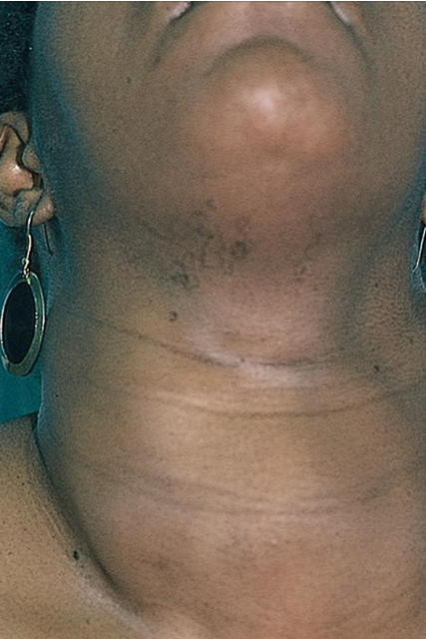
Trace Minerals: Iodine
Function - Part of hormone thyroxin produced by thyroid gland: regulates metabolic rate, growth and development, and body temperature
Recommended intake and sources
  RDA: 150 mcg for adults
  Sources: salt fortified with iodine (check label, not sea salt); seafood
Deficiency
  Reduces thyroxine production (signs of hypothyroidism)
  Goiter can develop as thyroid gland works hard to compensate; goiter may not resolve even when underlying consumption becomes adequate
Toxicity: UL of 1100 µg
  Thyrotoxicosis: iodine-induced goiter

Slide 57
Trace Minerals: Fluoride
Function
  Increases strength of tooth enamel and therefore increases resistance to tooth decay
  Bone mineralization for skeletal health
Recommended intake and sources
  AI: 4 mg for men; 3 mg for women
  Sources: fluoridated water (where available), tea, seafood, seaweed
Deficiency: Increases risk of dental caries and may alter bone health
Toxicity: UL of 10 mg- Fluorosis (mottling of tooth enamel)

Slide 58
Trace Minerals: Copper
Function
Coenzyme, wound healing, nerve fiber protection, iron utilization
Recommended intake and sources
RDA: 900 µg for adults
Sources: organ meats (liver), seafood, leafy green vegetables, legumes, whole grains, dried fruits, water from copper pipes
Deficiency
Anemia
Toxicity: UL of 10,000 µg
From supplementation: vomiting, diarrhea
Wilson’s disease: Inherited disorder characterized by accumulation of copper in brain, liver, and corneas >>> cirrhosis, chronic hepatitis, liver failure, and neurologic disorders
Treat with chelation therapy and dietary restrictions
Bone demineralization

